Slide 1

Asbestos Awareness
[enter division name]

Slide 2
This presentation is an Asbestos Awareness presentation only.
Its purpose is to familiarize staff with asbestos, health effects associated hazards and recognition of asbestos materials in [enter division name] buildings.
This presentation DOES NOT qualify staff/workers to remove or work with asbestos – it is only for general awareness information.
In-depth training as well as worker experience is required for individuals to perform asbestos abatement.

Slide 3
What is asbestos?
The word "asbestos" comes from the Greek meaning "inextinguishable.“
Asbestos is a serious health hazard commonly found in our environment within our buildings today.
Employees who may work in buildings that contain asbestos must know where it is found and how to avoid exposure.

Slide 4
Types of asbestos
Asbestos is composed of six different types of natural minerals:
  Chrysotile (white asbestos)
  Amosite (brown asbestos) Most common types
  Crocidolite (blue asbestos)
  Tremolite
  Actinolite
  Anthophyllite
Of the six, three are used more commonly. Chrysotile is the most common, but it is not unusual to encounter Amosite, or Crocidolite as well. In many instances a single product will have a mixture of different asbestos types.

Slide 5
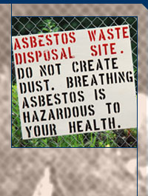
Asbestos facts
All types of asbestos tend to break into very tiny fibers.
These individual fibers are so small they must be identified using a microscope.
Some fibers may be up to 700 times smaller than a human hair.
Because asbestos fibers are so small, once released into the air, they may stay suspended there for hours or even days.
Asbestos fibers are also virtually indestructible.
Resistant to chemicals and heat, and they are very stable in the environment.
Do not evaporate into air or dissolve in water, and they are not broken down over time.
Asbestos is probably the best insulator known to man.
Asbestos fibrous material was regularly used in buildings until later 1990.

Slide 6
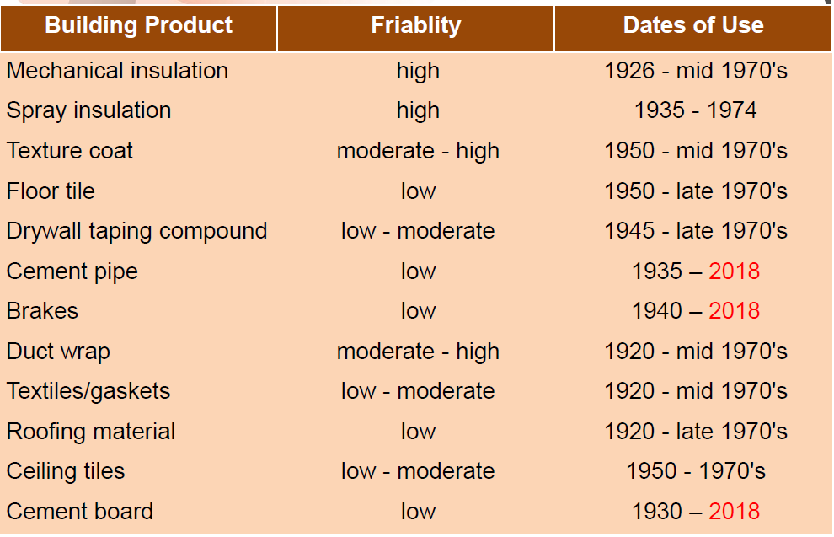
Asbestos containing products
HSE, University of British Columbia: http://www.hse.ubc.ca/safety/asbestosmanagement/typicalusesofasbestos.html
Usually asbestos is mixed with other materials to actually form the products. Floor tiles, for example, may contain only a small percentage of asbestos.
Depending on what the product is, the amount
of asbestos in asbestos containing materials (ACM) may vary from 1%-100%.

Slide 7
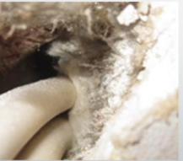
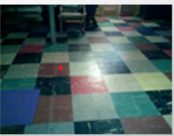
Classification of asbestos
Friable
Can be crushed between the fingers to a powered state when dry.
Easily release asbestos fibers.
Presents the highest hazard as minor disturbance can easily result in exposure.
Non-friable
Can not be damaged by hand pressure.
Asbestos containing material bound in a resin matrix.
Does not easily release asbestos fibers.
Presents a lower hazard as disturbance requires more effort.

Slide 8
Asbestos exposure
Asbestos removal and building renovation & demolition have the greatest exposures.
Disturbing or removing insulation, roofing shingles or siding containing asbestos.
  If asbestos is disturbed, small fibers are released into the air.
Sanding or scraping older surface treatments containing asbestos.
  Vinyl floor tile
  Roofing tar paper
  Spackling
  Sealants, paint, putty , caulking or drywall
Professions that may be exposed to asbestos (including but not limited to):
  Carpenters
  Plumbers
  Roofers
  Construction workers/demolition
  Insulation installers
  Caretakers/custodial/housekeepers
www.healthycanadians.gc.ca

Slide 9
Health effects of asbestos exposure
Could take 20 years for one asbestos fiber to turn into one of these deadly diseases
Always protect yourself if you suspect asbestos
Three common diseases linked to asbestos exposure:
  Mesothelioma
  Lung Cancer
  Asbestosis
Asbestos-related lung diseases are the number one cause of work-related fatalities in the province of Saskatchewan.
  In particular, mesothelioma and other asbestos-related lung diseases were responsible for approximately 26 per cent of the 390 fatalities accepted by the Saskatchewan WCB in the last decade (2010-2019).
  In 2019, 47 per cent of work-related fatalities were a result of occupational diseases.
  The risk of injury to health caused by the inhalation of asbestos is increased by smoking.

Slide 10
Health effects of asbestos exposure
Everyone is exposed to asbestos at some time during their life.
Low levels of asbestos are present in the air, water and soil. Most people do not become ill from their exposure.
People who become ill from asbestos are usually those who are exposed to it on a regular basis, most often in a job where they work directly with the material or through substantial environmental contact.
When asbestos is disturbed, it can travel through the air as very fine dust. As a result, it can enter the body through:
  Inhalation – which is the most common route
  Ingestion – fibers are inhaled , coughed out of the lungs in phlegm and then swallowed. From there, they can travel through the digestive system and become lodged in other organs
  Absorption – through the skin – asbestos fibers can become imbedded in the skin

Slide 11
Definitions
Abatement - Removing all or part of the asbestos.
Asbestos Control Plan - A program used to actively manage asbestos in the workplace. Includes identification, inventories and inspections of asbestos containing materials, labelling systems, emergency response, communication plan and training.
Containment - An isolated system designed to effectively contain fibres within a designated area where asbestos contained materials are handled.
Encapsulation - Sealing the surface of the asbestos with a product that prevents the fibres from being released.
Enclosure - Physical barrier that isolates asbestos containing materials from adjacent occupied areas.

Slide 12
Asbestos Control Plan
A plan shall be developed in consultation with the OHC and includes, but is not limited to:
  Identification of asbestos containing materials
  Written record, including location
    Must be readily available to all staff
  Labelling, placarding and clearing identified on a map or plan
  Inspection, annually be a competent person ensuring to keep a written record to provide to the OHC
  Communication plan
  Training
  Safe work procedures and practices
[Enter division name] recognizes its responsibility to ensure the health and safety of all staff and students.
The Occupational Health and Safety Regulations, 2020 Section 2-1 and Part 23 addresses asbestos.
  “Asbestos can and must be managed in the workplace”
The Occupational Health and Safety Regulations, 2020
  New operations, Section 2-1 and Part 23 requires notification to be given to the Labour Relations Workplace Safety Division 14 days prior to a high risk asbestos process.
All asbestos related work taking place in any [enter division name] facilities must comply to the legislation.
Any questions or concerns please contact the Operations Supervisor. (Division specific)

Slide 13
Resources
The Occupational Health and Safety Regulations, 2020
  Section 2-1
  Part 23
Saskatchewan Asbestos Abatement Manual - Government of Saskatchewan
Safe Work Practices for Handling Asbestos- WorkSafe BC
https://www.ccohs.ca/oshanswers/chemicals/asbestos/effects.html

