Slide 1

Notes:
SASWH acknowledges the Ministry of Social Services for the initial content of this comprehensive PowerPoint.

Slide 2



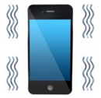

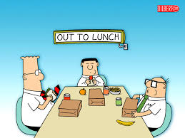

Housekeeping Details

Slide 3
Who is SASWH?
The Saskatchewan Association for Safe Workplaces in Health (SASWH)
is committed to work in partnership with health care industry workers and employers, to reduce the number of workplace injuries and
illnesses in the health sector.

Slide 4

Vision
Mission
To guide the health related industry in the elimination of workplace illness and injury.

Slide 5
SASWH Values
Health and Safety Stewardship
Trust Collaboration
Innovation Respect
Transparency Commitment

Slide 6


How the Power Point lines up with the handbook and exercise book.
Under the topics on the slide there will be a page number; this matches the handbook.
Example:
Under the name of the exercise on the slide is another page number; this matches the exercise book.
Example:

Slide 7
Course Outline
History/Overview
Purpose
Professionalism
Identification
Response
Recording
Dementia Enhancement (if taught)
Breakaway & Evasion (Intermediate, if taught)
Restraint (Advanced, if taught)
Notes:
DO: Consider using the PART video with the message from SASWH’s CEO.
NOTE: At this time the dementia enhancement PowerPoint slides are captured in a section on it’s own…depending on how you facilitate you might want to blend it into the course. Some slides are similar so you may want to review that information and tell participants that it is just a reminder of PART course content covered…

Slide 8
PART History
PART was Authored by Dr. Paul Smith.
  He was working as a psychiatric technician at a state hospital.
  He disliked the way that people who supported others were taught on how to “defend” themselves from assault.
  Other programs at the time may have employ pain or discomfort as a technique.
  Dr. Paul Smith wanted to emphasize verbal interventions.
  He created PART in 1975 in Camarillo, California.
Saskatchewan Association for Safe Workplaces in Health (SASWH) purchased the rights to the PART program in 2007. SASWH holds copyright in Canada.

Slide 9
PART Program
The PART program consists of three levels:
  Basic: communication and response
  Intermediate: breakaway and evasion
  Advanced: manual restraint
PART is NOT self-defense course.
  We do not use measures designed to hurt.
  This course helps employers meet minimum requirements of Saskatchewan’s OH&S legislation.
  This course aids workers in enhancing their communication skills, being aware of their own selves, being aware of the environment and the individual.
As agencies assume responsibility for the treatment of people with assaultive behavior, they face a clear pattern of risks.

Slide 10
Learning Objectives
Basic:
  Understand why individuals are acting out.
  Understand how your attitude may aggravate the situation.
  Know if you are physically and mentally prepared to work with potentially assaultive individuals.
  Know the importance of effective communication to assist with de-escalating an assaultive situation.
  Know how you respond in a crisis situation.
  Know how to identify why an individual may be assaultive.
  Understand the importance of proper communication and documentation.

Slide 11
Learning Objectives
Intermediate (if taught):
  Understand the principles of effective breakaway and evasion techniques.
Advanced (if taught):
  Understand the principles of effective manual restraint techniques.

Slide 12
PART Philosophy
Staff members who have developed a systematic approach to the treatment of assaultive behavior are less likely to injure or be injured during an assaultive incident than those who haven’t.

Slide 13
Legislation
The Saskatchewan Employment Act, Part III:
  3-1(1)(ff) train means to give information and explanation to a worker with respect to a particular subject-matter and require a practical demonstration that the worker has acquired knowledge or skill related to the subject-matter.
3 Rights of Workers
  Right to Know
  Right to Participate
  Right to Refuse
Notes:
DO: Explain that active participation in discussion, role-play, written activities and techniques is required. This will help PART trainers assess each participants’ understanding of the PART program content and meet the definition of train. Consider using the PART video on legislation.
Three Rights of Workers
Saskatchewan’s OH&S legislation has also given every worker, including managers and supervisors, three basic rights:
The right to know.
The right to participate.
The right to refuse work believed to be unusually dangerous.
The Right to Know
Every worker has a right to be informed about the hazards at work, trained to recognize those hazards; and trained to protect him or herself from those hazards.
This right is built into all regulations where information and training could help to protect workers. Workers must use the information and instruction provided.
The Right to Participate
The occupational health committee (OHC) or the OH&S representative is the principal vehicle for worker participation in the workplace. It is the forum for cooperative involvement of every worker, at every level. Workers' participation assists in developing a strong safety culture. Workers participate by:
being knowledgeable regarding their rights and responsibilities under the legislation;
asking for information from the supervisor;
reporting health and safety concerns;
discussing health and safety concerns at meetings;
working safely;
consulting with Saskatchewan Ministry of Labour Relations and Workplace Safety's occupational health officer (OHO);
assisting in inspections and investigations; and,
participating in safety; workers assist in cultivating a culture of safety.
The Right to Refuse
A worker has the right to refuse work that the worker has reasonable grounds to believe is unusually dangerous. The unusual danger may be to the worker or to others. This right is set out in Part III, Division 5 of the Act, section 3-31. An unusual danger could include:
a danger that is not normal for the job
a danger that would normally stop work
an imminent danger and in contravention of the Act and Regulations
a situation for which the worker isn’t properly trained, equipped or experienced.
The right to refuse is the right of an individual and not the right of a group. During a refusal, the refusing worker is protected from discriminatory action through the Act (PART III, Division 5, 3-35)

Slide 14
Worker Responsibilities
With rights come responsibilities.
The Occupational Health and Safety Regulations, 2020, sets out general duties that every worker must be responsible for:
protect his or her health and safety and the health and safety of other workers who may be affected by his or her acts or omissions
refraining from causing or participating in the harassment of another worker
co-operating
complying with the Act and the regulations
using the safeguards, safety appliances and personal protective equipment
following the safe work practices and procedures
Notes:
Worker Responsibilities
With rights come responsibilities.
The Occupational Health and Safety Regulations, 2020, sets out general duties that every worker must be responsible for:
taking reasonable care to protect his or her health and safety and the health and safety of other workers who may be affected by his or her acts or omissions
refraining from causing or participating in the harassment of another worker
co-operating with any other person exercising a duty imposed by the Act or the regulations
complying with the Act and the regulations
using the safeguards, safety appliances and personal protective equipment provided in accordance with the regulations and any other regulations made pursuant to the Act
following the safe work practices and procedures required by or developed pursuant to the regulations and any other regulations made pursuant to the Act.

Slide 15
Accountability
What does accountability mean to you?
The general definition of accountability includes:
being bound to give an explanation of your conduct
being responsible; answerable
Notes:
ASK: What does accountability mean to you?
DO: Give each person the opportunity to give their response(s). You may want to write the responses on a flipchart and refer back to them as you go through this section.
SAY: The general definition of accountability includes:
being bound to give an explanation of your conduct
being responsible; answerable
In day to day work, accountability means:
following the policy
using the skills you have received in training
being responsible for the decisions/actions you make at work and even at home
performing your job duties accurately and appropriately and using your knowledge, skills and abilities received during training - including making appropriate choices
asking for help/assistance or additional training
using equipment safely
reporting anything that is unsafe
Everyone is accountable - you, your manager/supervisor, VPs, right up to the CEO.

Slide 16
PART Advantages
Represents ONE consistent approach.
Problem-solves by asking the right questions rather than providing answers.
Provides an emergency response for when the primary plan does not work.

Slide 17
PART Advantages
Gender neutral - meaning you don’t have to be strong and you don’t have to be male to be safe.
Promotes teamwork because 1:1 (one-to-one) physical techniques can be dangerous.
Focuses on human rights of BOTH the worker and the individual.
Widely accepted as it is research-based.

Slide 18
PART
Organizations are expected to have care/treatment plans in place.
All behaviours have a function and are designed to meet a specific need.
The PART program is designed to address the question: “What happens when the care/treatment plan breaks down?”

Slide 19
PART
Interventions (responses) are used when:
  The primary treatment plan does not work.
  The primary back up plan does not work.
  You are facing an immediate threat of injury.
It is important that you stick to the
primary plan for each individual.

Slide 20
PART Viewpoint
PART is NOT a self-defense course.
Is most useful when its Principles are consistent with the philosophy and values of the organization.
  “Is this behaviour actually dangerous?”

Slide 21
Risks of not having PART
The individual could be successful in injuring themselves or others.
Staff could be seriously injured during the incident.
Avoidable injuries may occur.
Lack of teamwork could contribute to injury.
Public disapproval is possible.
Formal penalties from courts or legislation.

Slide 22
PART Disclaimer
The techniques taught in the PART workshop have proven safe and effective.
Their proper application is the responsibility of all staff involved.
Instruction cannot be a substitute for professional judgment.

Slide 23
Purpose
When staff understand treatment plan outcomes they are better able to provide therapeutic interventions to meet the treatment objectives.
Notes:
DO: Consider showing the PART video on Purpose, Professionalism and Preparedness at some point during training on these Modules.

Slide 24
Purpose
(pg. 1)
When staff do not have a clear understanding of what the individual is expecting to achieve, they are more likely to react to physically injurious behaviour rather than follow a treatment plan.
In the absence of an effective treatment plan, the emergency plan becomes the primary form of treatment and this decreases the likelihood that the individual will benefit from the treatment plan.
Notes:
Alternate wording: when workers understand that beneath difficult or aggressive behaviours there is a message or a reason for the behaviours, workers will be less likely to react negatively to the behaviours and are more likely to respond in ways that assist the individual to express their needs more effectively. This will lead to better outcomes.

Slide 25
Exercise 1
(pg.5)

Slide 26
Exercise 1
(pg.5)

Slide 27
Professionalism
Staff members who understand their motives for working with potentially dangerous individuals are less likely to be cynical and pessimistic about treating assaultive behaviours.
Notes:
Alternate wording: Workers who understand why they have chosen to work with potentially violent people are less likely to become negative about dealing with difficult behaviour.

Slide 28
Professionalism
(pg. 1)
Attitudes that frequently aggravate assaultive behaviour:
  Cynicism – suspicion
  Pessimism – negativity
  Other destructive attitudes

Slide 29
Exercise 2
(pg.6)

Slide 30
Professionalism
(pg. 2)
Self as a tool
  In human services, our skills are our tools.
  We must keep our tools in good working condition.
Professionalism and safety:
  Research has shown that workers with unprofessional attitudes pose a high risk to themselves and others.
  Research has shown that workers rated as having the poorest attitude get injured more often at work.
Features of professionalism that effect performance:
  Mood: refers to a feeling state.
  Attitude: a habit of thought.
  Motivation: why you do what you do.

Slide 31
Professionalism is…
…taking responsibility for the disciplined management of mood, attitude, and motivation when in the service of the individual…

Slide 32
Preparation
Staff members who prepare to respond to assaultive behaviour before they enter the environment are less likely to injure or be injured on the job.
Notes:
Alternate wording: workers who are prepared to respond to challenging behaviour before they get to work are less likely to injure or be injured than workers who are not prepared.

Slide 33
Preparation
(pg. 3)
A fully prepared staff member has:
  Proper attire,
  Adequate mobility,
  Well-practiced observational strategies, and
  An organized plan for self-control.
Ask yourself:
  Am I physically and mentally prepared to work with potentially dangerous people?
  Am I taking care of myself by making healthy choices, getting enough “good” sleep, staying alert and aware of myself, the environment and others?

Slide 34
Preparation
(pg. 3)
Attire: how will it affect my ability to move/respond?
Mobility: am I prepared to move quickly?
Observation: strategy, surroundings, individual?
Self-control: do I have a plan?

Slide 35
Exercise 3A
(pg. 7)
Complete the chart by rating your attire as low-medium-high risk.

Slide 36
Exercise 3B
(pg. 8)
Let get moving!
  Stance
  Deep Breathing
  Neck Mobility
  Shoulder Rolls
  Side Stretches
  Heel Lifts
  Balance

Slide 37
Preparation:
(pg. 4)
Do I have a well-developed observation strategy?
  Determine baseline behaviour.
  Recognize signs of impending danger.
    Changes in frequency, duration, intensity.
    Notice “positive” and “negative” changes in behaviour.
  Position team members so that all individuals can be observed.
  Maintain eye contact with team members.
  Make requests rather than announcements when leaving the area.
  Determine appropriate levels of supervision:
    Routine: where are they and what shape are they in?
    Close: within visual range?
    Constant: within arms reach?

Slide 38
Exercise 3C
(pg .8)
  Everyone close their eyes….
    How many people in the room wear glasses?
    How many people are in the room?
Notes:
DO: another option for this activity is using the PART video on “observation”, then ask participants what they saw in the video.

Slide 39
Self-Control
(pg. 4)
Maintaining self-control in difficult circumstances is one of the hallmarks of professionalism.
When you believe you are being threatened, your body will prepare to reduce or eliminate the threat.
  These processes are involuntary
  Fight or Flight or Freeze
During an assaultive incident you may feel physically strong but you are temporarily incapable of making good judgements.

Slide 40
Self-Control
(pg. 4)
A way to cope with these processes is to have pre-planned techniques.
  Maintaining (or regaining) self-control when in a potentially assaultive situation.
  Restoring emotional balance and reducing stress after a potentially assaultive incident.
These techniques are necessary to be professional.

Slide 41
Self-Control Plans
(pg. 5)
Self-assessment: take a moment to check your own physical state.
Knowing your limits: have a clear picture in your mind of what it looks like when you lose your temper.
Regaining self-control: use your specific steps to counter the fight or flight response.
Restoration and healing: there is an emotional response to being in a potentially assaultive situation.

Slide 42
Exercise 3D
(pg. 9)
Write out what the following terms mean to you:
    Self-assessment
    Knowing your limits
    Practical method for self-control
    Restoration and healing
Think of a time where you were really scared. This will illustrate the “fight or flight” response.
What was the situation and how did you respond? Did you maintain or lose self-control?

Slide 43
Exercise 4
(pg. 10)

Slide 44
Exercise 4
(pg. 10)

Slide 45
Exercise 5
(pg. 11)
Immediately after being threatened or assaulted – I will do these things to restore my sense of well-being:
When I have been threatened or assaulted at work, I will do these things to restore my sense of well-being:
Because I have a job where there is a real possibility of being threatened while performing my duties, I have developed the following patterns/habits to keep myself emotionally balanced:

Slide 46
Plan your work and work your plan!

Slide 47
Identification
Staff members who are able to examine the reasons for the failure of treatment plans from a variety of perspectives are better able to understand and prevent future assaultive incidents.
Notes:
Alternate wording: the better we understand the many contributors to the occurrence and potential for challenging behaviours the more likely we will be to prevent incidents from occurring or deal more effectively with incidents when they occur.

Slide 48
Identification
(pg. 6)
From time to time even the best plans fail…
If there is threat of injury and the treatment plan isn’t working, can I identify why?
  Can I identify why an individual is displaying aggressive behaviours and change MY behaviour accordingly?
The PART Models presented allow us to:
  Take preventative measures in a variety of structures
  Understand and explain assaultive situations
  Increase ability to see the signals
  Enhance the safety of everyone
  Increase our knowledge

Slide 49
Identification
Legal Model
Stress Model
Developmental Model
Communication Model
Interactive Model
Environmental Model
Basic Needs Model
Socio-cultural Model
Common Knowledge Model

Slide 50
Legal Model
(pg. 7)
From a legal standpoint: assaultive behaviour is strictly prohibited and punishable when occurs.
The purpose of analyzing the legal model is to separate it into three levels of dangerousness.
Note: this is not intended as legal advice.
The legal model also gives us parameters on “reasonable force”.

Slide 51
Legal Model
(pg. 7)
Common assault: when a person threatens to injure another and is close enough, has the ability, and shows the intent but the injury being threatened is not serious enough to require immediate medical attention.
Assault causing bodily harm: when a person attempts to injure another and has the ability, shows the intent, and makes physical contact but the injury is not serious enough to require immediate medical attention.
Aggravated assault: when a person tries to injure another and has the ability to seriously injure, shows an intent to seriously injure, and threatens or attempts an injury that would require immediate medical attention.

Slide 52
Exercise 6:
(pg.12)
Assault causing bodily harm
Common assault
Aggravated assault
None, Common, Other?

Slide 53
Disclaimer on Legal Model:
“The previous exercise is of value when discussing levels of assault. There is no clear answer to any of the previous scenarios based on the information provided. The purpose of this exercise it to have participants discuss the possibilities to make them more aware of the levels of assault.”

Slide 54
Stress Model (Assault/Crisis Cycle)
(pg. 8)
Studies show that when people perceive serious threats to their well being, they may prepare themselves to attempt to become assaultive in an attempt to control the environment.
People are willing to use or threaten to use violence to achieve their goals.
This assaultive person will demonstrate physical, psychological, and behavioural reactions which follow a cyclical pattern.
  Each individual has a uniquely patterned cycle of responses.

Slide 55
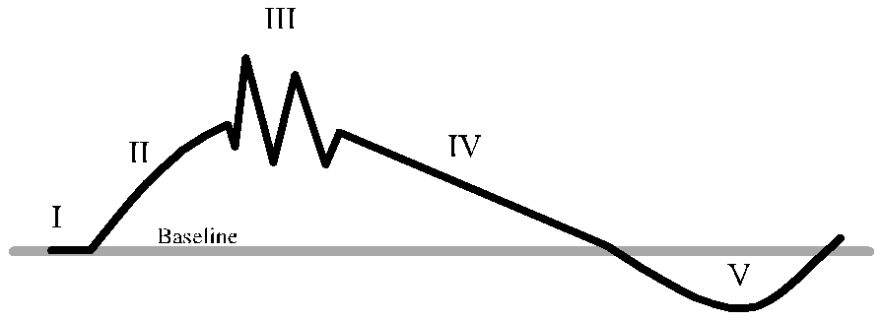
Stress Model (Assault/Crisis Cycle)
(pg. 8)
Phase I: Triggering Event
  Event where an individual perceives a serious threat to their well-being. These may or may not be observable.
Phase II: Escalation
  The persons mind and body prepare to do battle with the cause of the triggering event.

Slide 56
Stress Model (Assault/Crisis Cycle)
(pg. 8)
Phase III: Crisis
  The behavioural pattern explodes into physical assaults on the perceived source of the threat.
  This level of energy cannot be sustained indefinitely.

Slide 57
Stress Model (Assault/Crisis Cycle)
(pg. 8)
Phase IV: Recovery
  With the battle over, the mind and body seek the stability of baseline.
  There is potential to re-escalate!
Phase V: Post-Crisis Depression
  The level of exertion in the crisis phase takes its toll on the body and the mind.

Slide 58
Exercise 7
(pg. 13)

Slide 59
Exercise 7
(pg. 13)

Slide 60
Exercise 7
(pg. 13)
Without saying names to respect privacy, can you tell me what you have learned about this person by documenting their crisis cycle?

Slide 61
Developmental Model
(pg. 9)
From the developmental model, violence can be seen as a function of age.
Younger people are more likely to be “violent” than older people.
  Social norms permit violent expression in children without drastic consequence.
The importance here is in the disparity (difference) between chronological and developmental age. The developmental stage is typically lower than the chronological age.

Slide 62
Developmental Model
(pg. 10)
Preschool age children
  Little ability to control explosive outbursts.
  Can be easily provoked over relatively simple issues.
  Can have outbursts on the basis of environmental features.
Early elementary age children
  Have enough control to avoid hitting and biting however interactions can cause impulsive violent behaviour such as pushing.
  Sometimes violent expression is used to gain the attention of adults.
Late elementary age children
  Can delay their impulses to fight until they can find a time and a place with less adult intervention.
  Fighting is much less frequent.
  There is a notable difference between boys and girls’ ability to control their impulses at this age.

Slide 63
Developmental Model
(pg. 10)
Early adolescents
  Provoke adults or authority figures intentionally.
  Typically, pushing their limits and attempting to thwart authority.
  Inexperience and poor judgement sometimes lead youth to fight with someone who may injure them badly or injure another more than planned.
Late adolescents
  Have the ability to channel most of their violent and destructive impulses into other activities.
Young adults
  Rarely express their violent or aggressive impulses.
  Incidents are more isolated.

Slide 64
Developmental Model II
(pg. 11)
Middle aged adults
  Rarely have physical fights
  Violence is situationally caused (adultery, job loss, alcoholism).
Elderly
  Typically avoid situations that may lead to violence altogether.
  Mental and physical impairments may produce the inability to inhibit impulsive violent expression.

Slide 65
Exercise 8
(pg. 14)

Slide 66
Exercise 8
(pg. 14)

Slide 67
Communication Model
(pg. 11)
Withdrawal:
  Non-verbal communication.
  Examples: stares, “dirty looks”, gestures, isolation, and self-destructive behaviours.
  Some people cause isolation through poor hygiene, grotesque appearance, and muttering in angry tones.
Passivity:
  Verbal communication.
  Examples: whining, “poor me” and blaming “you” messages.
  Turning to others to problem solve for them.
  Being unable to say “no” even when “yes” can hurt.

Slide 68
Communication Model
(pg. 11)
Aggression:
  Verbal communication.
  Examples: hostile “you” messages, yelling, threats, curses.
  These can include threats of future injury.
Assault:
  Non-verbal communication.
  Examples: hitting, kicking, throwing, etc.

Slide 69
Communication Model
(pg. 12)
Assertion: healthy balance between aggressive and passive.
  Using “I” messages.
  Accepting responsibility.
  Making and giving choices.
Assertion is incompatible with any other forms of communication.
Notes:
NOTE: this may be a good place to talk about “frustration” and “manipulation” from the Common Knowledge Model.

Slide 70
Exercise 9
(pg. 15)

Slide 71
Exercise 9
(pg.15)

Slide 72
Exercise 10
(pg.16)
Practice and Return Demonstration of Communication
Withdrawal
Passivity
Assertion
Aggression
Assault
Notes:
DO: it may be of benefit to use the video in PART to help provide a visual of the Communication Model. It may set the stage for participants performing this role-play activity.
Optional learning activity:
Participants are in groups and think of a scenario.
Hand out a piece of paper to each person that indicates which of the 5 forms of communication they are to act out.
Have one person play “the worker” and one play “the supported individual”.
Perform the scene using the form of communication assigned to you.
The group will guess who is engaging in which form.

Slide 73

STOP Strategy
(pg. 12)
Slow down
Think about what is happening
Options
Plan to have some time to yourself

Slide 74
Interactive Model
(pg. 13)
This model is interactive, reciprocal, and systematic.
The individual and his/her mental state influence the staff and environment - the staff and the environment also influence the individual.
The individual’s needs are related to his/her mental state, personal experience, and environment.
These needs are satisfied or frustrated by the staff and the environment, and the individual.

Slide 75
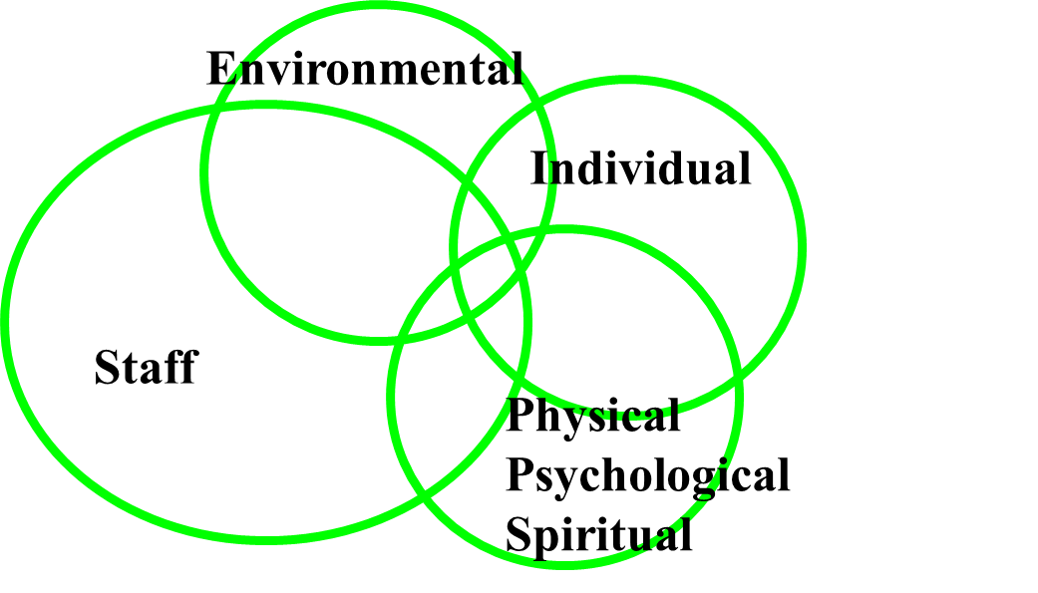
Interactive Model
(pg. 13)
The individual
  What are the unique needs and characteristics of the people you work with?
The environment
  Heat, noise, furnishings, pictures, activities, others, routine, demands…

Slide 76
Interactive Model
(pg. 13)
Mental state (physical, psychological, spiritual)
  Being able to relate to staff and have staff relate to them at their own level (increase orientation and reduce frustration).
The staff
  Enthusiasm, caring, sensitivity, insight...

Slide 77
Interactive Model
Bright
I need my space
Can’t go out
Loud
It’s too much
Staff awareness
I want to get out
Professionalism
Behaviour
I am anxious
Personality
I don’t know what is happening…?

Slide 78
Exercise 11
(pg.17)

Slide 79
Environmental Model
(pg. 14)
From an ecological perspective – behaviour can be seen as a product of circumstances.
Environmental conditions that may increase behaviour include:
  Physical conditions
  Staff performance problems
  Scheduling problems
These are circumstances that we have some control over.

Slide 80
Exercise 12
(pg.18)

Slide 81
Basic Needs Model
(pg. 15)
All behaviour is designed to meet a certain need.
These needs are met in a sequential/hierarchical manner.
All of these needs are “basic” to every human.
Violence may result from a threat to a basic need or an attempt to meet a basic need.
Notes:
NOTE: we cannot work on meeting someone’s needs (e.g. self-esteem) when their basic survival needs are not met.

Slide 82
Hierarchy of Needs
(pg. 15)
Self-Actualization: desire to be one’s best
Self Esteem: respect, recognition, strength, freedom
Love: friendship, intimacy, family, sense of connection
Safety: personal security, employment, resources, health, property
Survival Needs: air, water, food, shelter, sleep, clothing, reproduction
Self-Actualization
Self Esteem
Love
Belonging
Safety
Survival Needs

Slide 83
Exercise 13
(pg.19)

Slide 84
Socio-cultural Model
(pg. 15)
Assault is a result of social training.
  Social training: some cultures encourage aggression as a form of communication while some do not.
  Social settings: traditional sites for “brawls” which cause little concern for the surrounding community while other communities do not tolerate this.

Slide 85
Exercise 14
(pg. 20)

Slide 86
Common Knowledge Model
(pg. 16)
4 basic reasons why people threaten and injure themselves or others:
  Fear
  Frustration
  Manipulation
  Intimidation
Common Knowledge Flowsheet is on page 29/30.

Slide 87
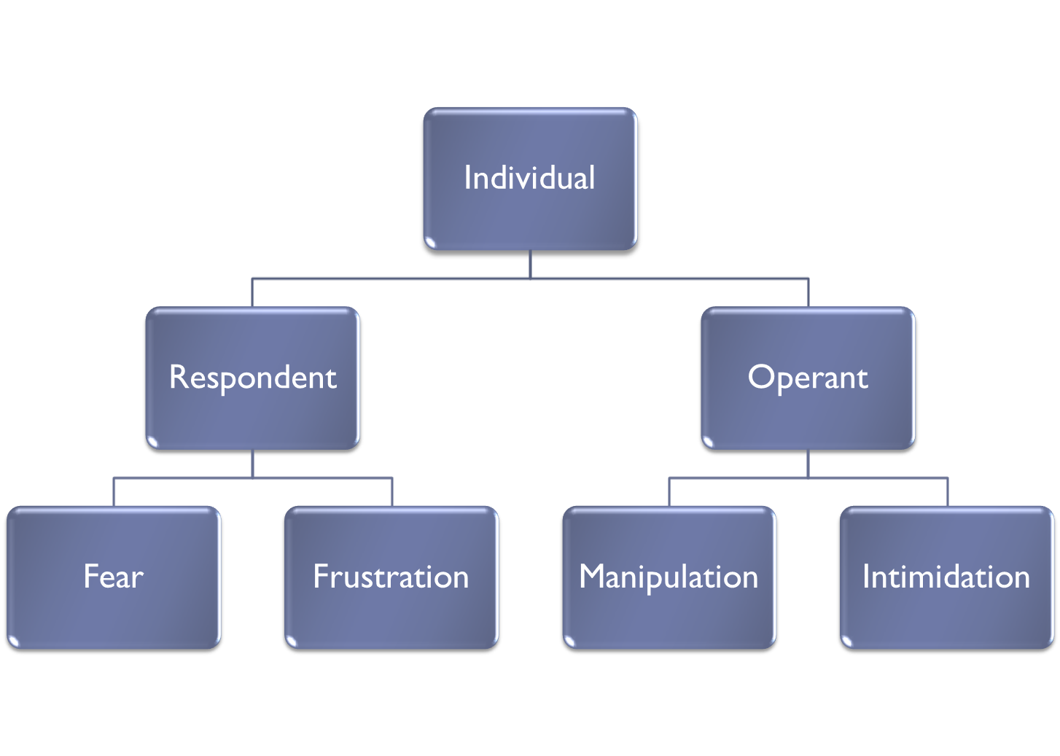
Common Knowledge Model
(pg. 17)
Behaviour
Behaviour

Slide 88
Fear
(pg. 17)
FEAR | Signs of Impending Aggression
Motive | Visual | Auditory | History
Irrational need to escape, defend against or eliminate a perceived threat. | Posture Tense, prepared to defend, hide or run Skin Colour Pale or ashen Facial Expression Wide-eyed or fearful | Voice quality Whining, pleading Nothing Breathing Rapid, shallow, irregular | Withdrawal and victimization Aggressive outbursts
Notes:
DO: Consider showing the PART video on Identification - Fear

Slide 89
Frustration
(pg. 17)
FRUSTRATION | Signs of Impending Aggression
Motive | Visual | Auditory | History
Irrational need to express frustration in a physically destructive manner. | Posture Tense and prepared to assault Skin Colour Tones of purple, red or red blotches Facial Expression Tense, focused and angry | Voice quality Menacing, aggressive, loud Breathing Loud, deep, long and heavy | Low frustration tolerance coupled with impulsive assault and battery.
Notes:
DO: Consider showing the PART video on Identification - Frustration

Slide 90
Manipulation
(pg. 18)
MANIPULATION | Signs of Impending Aggression
Motive | Visual | Auditory | History
Impulsive attempt to obtain something in exchange for not losing emotional control and doing something dangerous. Using impulsive and violently explosive behaviours to make others give in. | Difficult to interpret at any particular moment. | Whiny voice with “gimmie” words of “poor me” (pitiable) victim, accusations, comparisons and trivia in more aggressive tones, threats and actions against property | Losing control and assaulting physically when feeling deprived or oppressed
Notes:
DO: Consider showing the PART video on Identification - Manipulation

Slide 91
Manipulation
(pg. 18)
Tools to identify:
  The temper-tantrum: threatening violence by appearing to lose control (banging, stomping, yelling, etc.)
  Playing the numbers: going in between staff members hoping to find someone who will give in to the demand.
  Promoting confusion: bringing in related but irrelevant matters into the conversation.

Slide 92
Intimidation
(pg. 19)
INTIMIDATION | Signs of Impending Aggression
Motive | Visual | Auditory | History
Calculated attempt to obtain something in exchange for physical safety or freedom from threat of injury. | Basically neutral or unremarkable. Threatening posture. | Menacing voice quality and threatening words Recognizable pattern: Clear, strong demands, believable threat, refusal to comply, followed by attempt to injure through assault. | Bullying Extortion Other criminal assault
Notes:
DO: Consider showing the PART video on Identification - Intimidation

Slide 93
Identification - summary
Assaultive incidents can be categorized logically (and legally).
Incidents progress through a 5-phase cycle.
Aggression may be a function of developmental age.
Assaultive incidents are signaled by and grow from patterns of unbalanced communication.
Environmental irritants often contribute.
A perceived threat to deprive a person of basic needs may lead to assault.
Often related to social or cultural pressures.
Assaultive incidents develop from patterns of behaviour.

Slide 94
Response
Staff members who are able to match their responses to the level of dangerousness presented by the individual’s behaviour are less likely to use too much or too little force.

Slide 95
Response
(pg. 21)
Crisis Intervention: can we talk the individual into stopping the dangerous behaviour?
Evasion: if the individual won’t stop, can we avoid harm by evading?
Restraint:
  If we fail to restrain this person, will someone be seriously injured?
  Do we have enough people to do a restraint safely?
  Are the people properly trained?

Slide 96
Principles of Crisis Intervention
(pg. 22)
Self-control
  It is difficult to convince someone to use self-control when we are not in control of ourselves.
Identification
  Accurately identify visual and auditory signals.
Communication
  Simple, direct, brief.
  “Rule of 5”: sentences are 5 words or less, with 5-letter words or less.

Slide 97
Principles of Crisis Intervention
(pg. 22)
Timing
  Crisis interventions are appropriate shortly before, during, shortly after the crisis phase of the stress cycle.
  If used at other times, interventions lose effectiveness and can provoke assaultive incident.
Patience
  The crisis will pass.
  Panic or using punitive methods can result in avoidable future consequences.
Spontaneity
  Each incident is unique and may require alteration of the basic response guidelines.

Slide 98
STOP Strategy
(pg. 12)
Slow down
Think about what is happening
Options
Plan to have some time to yourself

Slide 99
Legal Model & Reasonable Force
(pg. 23)
Observed Behaviour
Common Assault
Assault Causing Bodily Harm
Aggravated Assault
Reasonable Force
Nil
Crisis intervention
Communication
Evasive techniques
Controlling techniques or manual restraint

Slide 100
Stress Model and Timing
(pg. 24)
Triggering: attempts of self-control, diversion, distraction
Escalation: crisis communication (simple, direct, brief)
Crisis: crisis communication, evasion, restraint
Recovery: crisis communication, no discussing of consequences, voluntary self-isolation
Post-crisis Depression: more verbally engaging techniques, active listening, unconditional positive regard, no discussing of consequences or determining blame, restraint is not necessary at this phase

Slide 101
Stress Model Response
(pg. 24)
Crisis Intervention
Unconditional Positive Regard
Demands for
Self-Control

Slide 102
Crisis Intervention for Fear
(pg. 25)
Goal: THREAT REDUCTION
  Posture: relaxed with open hands in full view
  Gestures: slow with palms up
  Position: off to one side, 8-10 feet away
  Voice quality: firm, reassuring, confident
  Speech content: logical, encouraging, calm, promise to help if possible
  Eye contact: if sought but do not force
  Physical contact: light, if any
Notes:
DO: Consider showing the PART video on Identification & Response - Fear

Slide 103
Crisis Intervention for Frustration
(pg. 26)
Goal: CONTROL OF SITUATION
  Posture: confident and commanding
  Gestures: firm, commanding, palms out or down
  Position: directly in front but out of striking range
  Voice quality: firm, confident, commanding in a low tone
  Speech content: repetitive, confident commands without threat
  Eye contact: direct and expressive
  Physical contact: firm and without excessive movement or pain
Notes:
DO: Consider showing the PART video on Identification & Response - Frustration

Slide 104
Crisis Intervention for Manipulation
(pg. 27)
Goal: DETACHED
  Posture: closed and relaxed
  Gestures: disapproval and mild irritation
  Position: 4-5 feet away, close enough to intervene but far enough to show non-involvement
  Voice quality: detached, mechanical, slightly bored
  Speech content: repetitive, quiet, ‘broken record’
  Eye contact: avoid – look at forehead or chin
  Physical contact: quick and unemotional, contact with clothing, not skin
Notes:
DO: Consider showing the PART video on Identification & Response - Manipulation

Slide 105
Crisis Intervention for Intimidation
(pg. 28)
Goal: CONSEQUATION
  Posture: poised and ready to move
  Gestures: few and far between
  Position: greatest relative defensive advantage
  Voice quality: matter of fact, monotone, emotionless (avoid screaming or shouting or threatening)
  Speech content: clear and direct statements of consequences
  Eye contact: sparingly – use to emphasize a statement
  Physical contact: if necessary – quick and smooth and as matter of fact as possible.
Notes:
Consequation: we are not speaking about “punishment” here. We are talking about using verbal communication to inform the individual of what may happen if they engage in a certain behaviour.
Ex: “If you continue this way it is possible that I won’t be able to help you right now.”
DO: Consider showing the PART video on Identification & Response - Intimidation

Slide 106
Exercise 15
(pg.21)
Role Play – to meet definition of “train”
Use pages 29-30 to help you with this activity
  Each team will get a chance to play one of fear, frustration, manipulation, or intimidation.
  Each team will also get a chance to use the intervention techniques for one of the above.
  Each team will report on what happened.
  Each team will have a chance to observe and comment on (a) which motive is being played and (b) the intervention techniques.
  Trainers will hand out a paper stating which reason from the common knowledge model the team is acting out.
Notes:
DO: As your participants practice, circulate around and offer coaching/mentoring…be present

Slide 107
Exercise 15
(pg.21)
 | Act | Intervene | Report | Observe
Fear | 1 | 2 | 3 | 4
Frustration | 2 | 3 | 4 | 1
Manipulation | 3 | 4 | 1 | 2
Intimidation | 4 | 1 | 2 | 3

Slide 108
Recording
Clearly written reports…complete and accurate, provide the treatment team with needed information to modify the plans when necessary and avoid misrepresentation.

Slide 109
Recording
(pg. 31)
The primary purpose of written reports is to promote communication among team members.
Properly written reports can also protect professionals and their agencies from misrepresentation of staff performance during an assaultive incident.
All documentation could be called into a court of law at some point.
Remember: FACTS only!

Slide 110
Recording
(pg. 31)
A complete report is based on the following 10 points:
  Who: identification of all the people directly involved or in the immediate area.
  Where: an exact description/location.
  When: the time(s) or time frames and date of the incident.

Slide 111
Recording
(pg. 31)
  What: an accurate description (not interpretation) of what happened. This is where staff should list their interventions.
        Tell me what YOU did, not just what the individual did.
  How: a description of how the individual carried out the incident and how the staff intervened.
        Tell me how YOU did what you did and how the individual did what they did.
        I should be able to close my eyes and play the incident out like a script.

Slide 112
Recording
(pg. 31)
  Why: identify the visual, auditory, and historical signs that might explain the motive.
      If you are unsure or the signs were not clear – write that. Do not try to guess.
      Also explain why you chose to intervene as you did and why less restrictive interventions did not work.
  Injuries: state any visible injuries or lack thereof.
  Notification: state who was notified about the incident (social workers, physicians, parents, supervisors, etc.).
  Follow-up: identify of a requirement of further action or a plan to follow up. This is the section to show that you are concerned about the incident.
  Simplicity: a report that is stated in common, ordinary language.

Slide 113
Recording
(pg. 31)
Remember… if you didn’t write it down- it didn’t happen…
&
If you wrote it down incorrectly… it happened the way that you wrote it…

Slide 114
Review:
Notes:
OPTIONAL ACTIVITY: use PART Jeopardy to further assist with understanding, self-testing of knowledge.
DO: Consider using the PART Video on Standards to assist with learning.

Slide 115
Do’s and Don’ts
(pg. 32)
Do
Sharpen your observational skills.
Maintain a positive attitude about behaviour.
Dress comfortably.
Maintain a posture that allows you to move quickly.
Rehearse and use your self-control plan.
Use common sense in determining dangerousness.
Don’t
Become cynical and pessimistic.
Foster inattention.
Wear clothes that don’t allow you to move.
Become unbalanced.
Lose control of your natural responses to danger.
Confuse behaviour that is obnoxious or irritating with dangerous behaviour.

Slide 116
Do’s and Don’ts
(pg. 33)
Do
Follow the rule of 5 during a crisis.
Exaggerate non-verbal communication and minimize verbal.
Encourage assertive responses and promote relaxation.
Maintain honesty.
Remember the 4 basic motives.
Be patient.
Don’t
Talk to much.
Ridicule or condescend.
Use guilt as a method of intervention.
Try to challenge or intimidate.
Promise something you (or another staff) can’t deliver.
Try to use only one crisis intervention.

Slide 117
Therapeutic Approaches
(pg. 35)
Validate the individual as a person:
  Listen to any attempt to communicate.
  Use touch selectively and appropriately.
  Use active listening skills.
Respect privacy:
  Don’t move into an individual’s space too rapidly.
  Respect their boundaries.
Determine historical and present problems:
  Identify who their supports are, their level of coping skills, get as much information about someone you are supporting as possible.

Slide 118
Therapeutic Approaches
(pg. 35)
Complete a mental status evaluation:
  How does the individual make decisions?
  Identify long-term and short-term memory.
Determine an individual’s level of functioning:
  Do not make unreasonable demands on an individual.
  Consider the limitations of the individual.
  Encourage growth and independence with a supportive and accepting environment.

Slide 119
Dementia Enhancement
Notes:
DO: Use the Trainer lesson plan for PART’s dementia enhancement.

Slide 120
Learning Outcomes
Understand dementia
Identification of potentially violent situations
Safe work practices to minimize or eliminate risk
Appropriate response

Slide 121
What is Dementia?
Dementia is an overall term for a set of symptoms that are caused by disorders affecting the brain
Symptoms may include memory loss, difficulties with thinking, problem-solving, or language
May also include changes in mood and behavior

Slide 122
What is Delirium?
An acute mental disturbance characterized by confused thinking and disrupted attention usually accompanied by disordered speech and hallucinations.

Slide 123
Dementia Bill of Rights
To be informed of one’s diagnosis
To have appropriate, ongoing medical care
To be treated as an adult, listened to, and afforded respect for one’s feelings and point of view
To be with individuals who know one’s life story, including cultural and spiritual traditions
To experience meaningful engagement throughout the day
To live in a safe and stimulating environment

Slide 124
Dementia Bill of Rights
To be outdoors on a regular basis
To be free from psychotropic medications whenever possible
To have welcomed physical contact, including hugging, caressing, and hand holding
To be an advocate for oneself and others
To be part of a local, global, or online community
To have care partners well trained in dementia care

Slide 125
Person-centred care
The person-centred philosophy focuses on the individual rather than on the condition, and on the person’s strengths and abilities rather than losses

Slide 126
The Care Plan
Is there a care plan in place for each client?
What is in the care plan?
Do you follow the care plan?
Can/do you recommend changes to the care plan?
Should indicate the needs of the client – likes and dislikes. Knowing this could prevent an incident; not knowing may cause an incident.

Slide 127
Stress Model
Be aware of client’s trigger(s)
Eliminate or manage the triggers
Triggers may be real or imagined (real to them)
When you are faced with a negative or challenging response from a client, it is YOU who will make a change – change your attitude, approach, body language/non-verbal communication

Slide 128
Stress Model
I. Triggering – self control
II. Escalation – crisis intervention
III. Crisis – crisis intervention
IV. De-escalation – self control
V. Post-Crisis Depression – unconditional positive regard

Slide 129

Communication Model
Slow down
Think about what is happening
Options
Plan to have time for you

Slide 130
Common Knowledge Model
Validate their feelings and emotions
Allow a person with dementia to believe what he or she believes is real
Redirect/distract when necessary

Slide 131
Processing Information
Our brain is continuously processing information – consciously or unconsciously
Some behaviours of a person with dementia may be seen as inappropriate to us; while to them it is appropriate because of the way their brain is processing the information

Slide 132
Brain Health

Slide 133
Seven A’s of Dementia
Anosognosia
Agnosia
Aphasia
Apraxia
Altered perception
Amnesia
Apathy

Slide 134
The Train Journey
By Dawson, et al., 1993 xiv-xv
Imagine yourself having dementia and you are on this journey.
Notes:
DO: Read or show the PART video for The Train Journey. This may help with understanding dementia.

Slide 135
Validation Therapy/Redirection
Redirection – diverting individuals’ attention from the stressful event to something that is more pleasant
Validation Therapy – validating feelings and emotions while integrating redirection techniques

Slide 136
Hallucinations and Delusions
Hallucinations can involve any of the five senses – a person with dementia may see, hear, smell, taste, or feel something that isn’t there
People living with dementia can experience delusions that stem from distorted ideas and false beliefs

Slide 137
Ten Tips for Communicating with a Person with Dementia
Set a positive mood for interaction
Get the person’s attention
State your message clearly
Ask simple, answerable questions
Listen with your ears, eyes, and heart

Slide 138
Ten Tips for Communicating with a Person with Dementia
Break down activities into a series of steps
When the going gets tough, distract and redirect
Respond with affection and reassurance
Remember the good old days
Maintain your sense of humor

Slide 139
When working with individuals with dementia remember to be patient, use your self-control plan. Don’t take it personally – be empathetic.
The person with dementia is not doing “things” on purpose – it is not their choice but rather the illness taking over.

Slide 140
Intermediate Program
A Fit for Training declaration must be signed by each participant prior to proceeding

Slide 141

Fit for Training
Please sign the Fit for Training declaration and give it to the trainer.
Inform your facilitator of any injuries or physical limitations.

Slide 142
Principles of Evasion
Keep talking
Stay out of the way
Get out of the way
Cover up
Deflect blows and kicks
Call for HELP!
Be patient
Control yourself
Roll with the punch
Escape holding assaults

Slide 143
Captures
Always move toward the
Point of Capture
Point of Capture

Slide 144
Principles of Practicing
For each of the moves, I will be demonstrating first and then you will be practicing with your partner while I observe each of you.
If there is a question about a similar assault that is not listed – please let the trainer know and we will try to answer it the best that we can.
We do not want to be injured in class:
  If I ask you to stop – stop immediately.
  Inform your partner of what you will be trying to do.
  MOVE SLOWLY.
  This is not a game or a strength contest.
  If you are feeling pain or exhaustion, please stop practicing and let me (trainer/s) know.

Slide 145
Mobility and Warm-up Activities
Stance
Deep Breathing
Neck Mobility
Shoulder Rolls
Heel Lifts
Balance
Crouch
Sidesteps and Backsteps
Pivot
Kneel
Team Steps
Notes:
DO: Consider alternate warm-up activities indicated in your PART Trainer’s Guide in the event any participant has challenges with the standard activities.

Slide 146
Exercises
Warm up
Talk and evade
Talk, crouch, cover and roll
Talk, crouch, cover, roll and close assault
Talk and evade
Escape
Use a shield
Notes:
DO: Refer to your PART Trainer’s Guide, Section 7, for facilitation information.

Slide 147
Sample Assaults
Blows
Kicks
Holding Assaults
Blows With Objects
Notes:
DO: Refer to your PART Trainer’s Guide, Section 7, for facilitation information.

Slide 148
Evasion/Deflection Techniques
Punch to the face/head
Overhead blow
Punch to the upper body
Punch to the midsection
Lunging assault
Kick to thigh
Kick to the stomach
Kick to the head while kneeling
Knee kick to the groin
Notes:
DO: Refer to your PART Trainer’s Guide, Section 7, for facilitation information.

Slide 149
Escape Techniques
Pinch Release
Scratch Response
Bite Release
Hair Pull Release
Choking from Front
Choking from Rear
Forearm Choke From Rear
Bear Hug escape
  Around upper arms
  Underneath arms
Arm grab
  One hand grab
  Both thumbs up
  One up – one down
Notes:
DO: Refer to your PART Trainer’s Guide, Section 7, for facilitation information.

Slide 150
Advanced Program
Restraint: forcible and involuntary deprivation of the liberty to move.
Types of restraint
  Manual (PART has some techniques)
  Seclusion
  Mechanical
  Chemical
PART does not teach about seclusion, mechanical or chemical restraint.
Notes:
DO: Refer to your PART Trainer’s Guide, Section 7, for facilitation information.

Slide 151
Principles of Manual Restraint
Master evasion techniques
Master capture techniques
Get a “grip”
Use weight not strength
Avoid pain
Use only reasonable force
Maintain a proper ratio
Be a team player
Select the least intrusive restraint position
Monitor breathing and circulation very closely
Notes:
DO: Refer to your PART Trainer’s Guide, Section 7, for facilitation information.

Slide 152
Rules of Manual Restraint
Don’t attempt to restrain unless you have double height and double weight.
Use the “captain”: this is the only person who will talk to the individual.
When using restraints always watch for breathing and circulation.
Notes:
DO: Refer to your PART Trainer’s Guide, Section 7, for facilitation information.

Slide 153
Manual Restraint
Balance control
  belt pivot
  belt shirt control
  clothing pivot
  hip pivot
Standing restraint
Escorts
  2 person and 3 person
Wall assisted restraint
  2 and 3 person
Floor assisted restraint
  2, 3, 4, and 5 person
Notes:
DO: Refer to your PART Trainer’s Guide, Section 7, for facilitation information.

Slide 154
Please complete your evaluation!
Thank you – Be Safe!

