Slide 1

Incident Reporting and Investigation
Getting to the Root Cause
SASWH
Rev. Jan 2, 2018
Notes:
Good morning/afternoon…
Welcome to Incident Reporting and Investigation
My name is __________________ and I will be your trainer this morning/afternoon

Slide 2



Housekeeping Details
Notes:
Discuss housekeeping items as appropriate.

Slide 3
Workers and Patients
Worker incidents
Patient/Client/Resident incidents
Both have legislation, rules, forms and paperwork
Same goal
Same investigative steps
Notes:
Incident reporting in health care involves worker incidents as well as patient/client/resident incidents. Each have their own set of legislation, rules, forms and paperwork. The objective of each is to get to the root cause of the incident and take steps to prevent reoccurrence. The session today is primarily is about worker incidents. The processes used parallel each other.

Slide 4
Learning Objectives
By the end of this workshop you will be familiar with:
Regulatory requirements for reporting, investigating and reviewing workplace incidents and dangerous occurrences
Elements of an effective workplace incident reporting and investigation program
Be able to explain and apply the incident investigation process to:
Collect evidence for an investigation
Analyze evidence for an investigation
Determine the contributing factors and root causes(s) of the incident
Develop a report listing recommendations for corrective actions
Ensure follow-up of recommendations
PRE-COURSE ASSESSMENT
Back Page
Notes:
As per the slide
Non SASWH trainers – you can omit the pre-course assessment if you are not using the SASWH evaluation form.

Slide 5


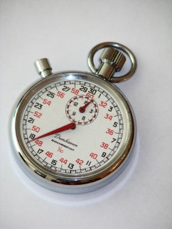
Introduce Yourself…
Your name
Where you work
Why are you here?
  Are you on an OHC?
  Are you a Supervisor?
What involvement have you had or will you have in a workplace investigation?
Notes:
As per the slide

Slide 6

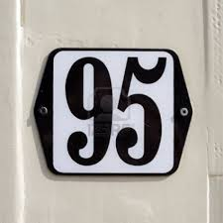


About This Course
Unsafe Behaviour
Hazardous Conditions
Able to Prevent
Uncontrollable Acts
Notes:
(Note to trainers – these stats are from Oregon OSHA and are not meant to be our stats, but are designed to illustrate the point)
According to some statistics:
About 3% of incidents are cause by hazardous conditions
About 95% of incidents are cause by unsafe or inappropriate behaviours – this is NOT blaming the worker, the system reason behind why this is being done should be uncovered in the investigation
About 2% of incidents are caused by uncontrollable acts
Active management is able to control 98%. Safety management system failures account for at least 98% of all workplace incidents. It is that 98% that we will be focusing on today.
System failures refer to inadequate design or performance of safety management systems that provide things such as training, resources, enforcement, and supervision.
Extra info just in case…
Unpreventable incidents
Only about 2% of all workplace incidents are thought to be unpreventable. Heart attacks and other events that could not have been known by the employer are examples of unpreventable acts. Many employers and workers may think of most of their injuries into this category. They sometimes justify these beliefs with such comments as: "He just lifted the box wrong and strained his back. What could we do?" Unfortunately, these beliefs often prevent adequate investigations and the discovery of the root cause.

Slide 7
This workshop is 5 modules
Introduction
Effective incident reporting and investigation programs
Regulatory requirements
Investigation techniques
Reporting, recommendations and follow-up
Please follow along in your workbooks
Notes:
We are in the introduction right now. Most slides have workbook page numbers on them.

Slide 8
Definitions
Accident:
Not defined in legislation
An unwanted, unplanned event that results in a loss (production, property or human) – SASWH SMS Standards 2012
Dangerous Occurrence:
Defined in Regulation 9
Basically, any incident that could have injured, hospitalized or caused the death of a worker, but didn’t
Incident:
Not defined in legislation
An unwanted, unplanned event that results in or could have resulted in a loss (production, property or human) – SASWH SMS Standards 2012
Often also refers to a near miss
Adverse Event
Unintended injuries or complications resulting in death, disability or prolonged hospital stay that arise from health care management. The Canadian Patient Safety Dictionary
Page 1
Notes:
Workbook page 1
In prevention, it’s important to clarify the terms "accident" and "incident." According to many the word accident implies that the event was a chance occurrence, a mishap. It gives the impression that it just happened, and that it was unexpected and unpreventable. This can create a means to escape responsibility, avoid rectifying the situation, dodge scrutinizing current methods, and yield to pressure to change.
In incident prevention, we must start with the principle that almost all incidents are preventable and, hence, they are incidents because they are the result of something else, such as rule violations or inadequate training. Therefore, our recommendation is to eliminate the use of the word "accident," both written and verbally, to reinforce the principle of preventability. It is a mind set that we need to get everyone into so that it becomes a self-fulfilling prophecy of an incident free work place.
In this course the word “accident” will be used only when quoting legislation or some other specific sources. From the book Safety: 24/7, 2006, by Gregory M. Anderson & Robert L. Lorber, Ph.D. Quote: Incident v. Accident: "an accident implies the result is outside a person's control. In 97 percent of the cases, what happens 'the incident' is easily within someone's control. In a previous slide we said 98%

Slide 9

Notes:
This clip is from the Ontario WSIB (Workplace Safety and Insurance Board). (Right now I can’t find it on their website but there are several others in the same theme.)
This clip is shown to get people in the mindset that things don’t “just happen”.
http://www.prevent-it.ca/ . I have asked them for permission to use them.

Slide 10

Reasons for Investigating
Prevention
The law
Due diligence
Demonstrate commitment
Best practice
Hazard identification and control
Page 2
Notes:
Ask the question – Why do we Investigate?
(Right now only the title is there – when you click again the rest of the bullets will appear.)
Prevention - determine the root cause and make recommendations for corrective actions
The law - the Saskatchewan OH&S Regulations require the employer to investigate certain accidents
Due Diligence - take all reasonable precautions, under the particular circumstances, to prevent injuries or incidents
Demonstrate commitment - show management’s commitment to the health and safety of staff
Best practice - SASWH SMS Standards 5.1 & 5.2 requirement
Hazard Identification and control – identify trends and hazards
The goals of a root cause investigation are to find out:
What happened?
Why it happened?
What can be done to reduce the likelihood of recurrence.

Slide 11
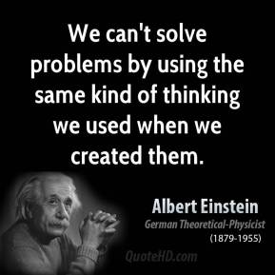
Notes:
Point out that we need a shift in thinking towards the need to find and correct the root cause and move away from “work safer”.
In the past we have not always had the knowledge or ability to find the root cause/causes. Training like this class is designed to change that.

Slide 12
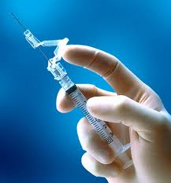
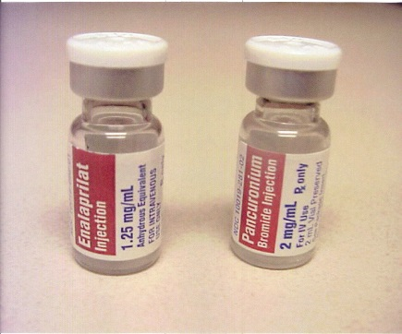
Human Factors
Limitations of Human Performance
Lessons From Human Factors Research
Limited short term memory
Running late / in a hurry
Limited ability to multi-task
Interruptions
Stress
Fatigue (and other physiological factors)
Environmental Factors
Reduce reliance on memory
Reduce reliance on vigilance
Simplify tasks and processes
Reduce handoffs
Reduce need for calculation
Provide for reversibility or automatic correction
Plan for recovery when prevention fails
Provide adequate training
Manage fatigue
Provide adequate informational resources at point of care
Notes:
The longstanding and widespread tradition of the person approach focuses on the unsafe acts—errors and procedural violations—of people at the sharp end: workers. It views these unsafe acts as arising primarily from processes such as forgetfulness, inattention, poor motivation, carelessness, negligence, and recklessness. Naturally enough, the associated countermeasures are directed mainly at reducing unwanted variability in human behaviour. These methods include poster campaigns that appeal to people's sense of fear, writing another procedure (or adding to existing ones), disciplinary measures, and retraining. In a more positive light, human factors seeks to look at the limitations of human performance and prevent them from causing incidents.
Can’t put vehicle in gear unless your foot is on the brake
Bank machine doesn’t give you your money until you remove your card
When using computerized systems to process physician’s orders, an order can’t be processed unless the patient’s current weight and allergy information are also entered.
Any other “fail safes”?

Slide 13

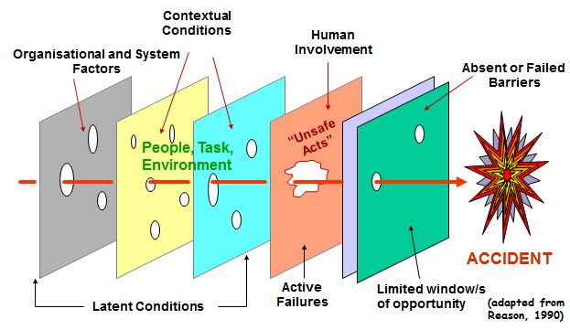
Organizational Error Chain
System Approach
Latent Conditions arise from decisions made by designers, procedure writers, management – understaffing, fatigue, inadequate experience or equipment
Active failures are unsafe acts - slips, lapses, fumbles, mistakes, and procedural violations
Notes:
System Approach
The basic premise in the system approach is that humans are human and errors are to be expected, even in the best organizations. Errors are seen as consequences of systemic factors. The important fact is not who erred, but how and why the system defences failed.
The Swiss Cheese model of system accidents
This approach is about defences, barriers, and safeguards.
In an ideal world each defensive layer would be intact. In reality, however, they are more like slices of Swiss cheese, having many holes—though unlike in the cheese, these holes are continually opening, shutting, and shifting their location. The presence of holes in any one “slice” does not normally cause a bad outcome. Usually, this can happen only when the holes in many layers momentarily line up to permit a trajectory of accident opportunity—bringing hazards into damaging contact with victims (figure). “The perfect storm”
The holes in the defences arise for two reasons: active failures and latent conditions. Nearly all adverse events involve a combination of these two sets of factors.
Active failures are the committed by people who are in direct contact with the system. They take a variety of forms: slips, lapses, fumbles, mistakes, and procedural violations. Active failures have a direct and usually short lived impact on the integrity of the defences.
Latent conditions are the inevitable “resident pathogens” within the system. They arise from decisions made by designers, builders, procedure writers, and top level management. Latent conditions have two kinds of adverse effect:
they can translate into error provoking conditions within the local workplace (for example, time pressure, understaffing, inadequate equipment, fatigue, and inexperience), and
they can create long lasting holes or weaknesses in the defences (untrustworthy alarms and indicators, unworkable procedures, design and construction deficiencies, etc).
Latent conditions—as the term suggests—may lie dormant within the system for many years before they combine with active failures and local triggers to create an accident opportunity.
Unlike active failures, whose specific forms are often hard to foresee, latent conditions can be identified and remedied before an adverse event occurs. Understanding this leads to proactive rather than reactive risk management.
Think of it like this: active failures are like mosquitoes. They can be swatted one by one, but they still keep coming. The best remedies are to create more effective defences and to drain the swamps in which they breed. The swamps, in this case, are the ever present latent conditions.
* Dr. Reason (PhD Psychology) has published multiple important books and papers on human error and organizational processes. Among these are Human Error (1990) and Managing the Risks of Organizational Accidents (1997). In recent years, he and his co-workers have focused upon the development of error management techniques. This work has been carried out in collaboration with a variety of organizations including Shell, British Railways, British Airways, Singapore Airlines, and the Bureau of Air Safety Investigation (Canberra).

Slide 14
“To err is human, to cover up is unforgivable, and to fail to learn is inexcusable.”
Sir Liam Donaldson
Notes:
The goal is to learn from all incidents.

Slide 15
Effective Incident Reporting and Investigation Programs
Notes:
There are best practice as well as regulatory requirements for the reporting and investigation of incidents. Right now we are going to talk briefly about best practice processes. Later we will look at legislation.

Slide 16
Incident Reporting Standards
Provincial SMS Standard 5.1
Reporting processes for:
  Hazards/concerns
  Incidents
  Property/equipment damage
  Near misses
Employees must know how to report
Managers must encourage employees to say something when they see unsafe conditions/behaviours
Managers must stop work if the task is unsafe
Corrective actions to address reported hazards/concerns must be identified
Corrective actions to address reported hazards/concerns must be implemented
There must be defined processes for reporting to regulators
Page 2
Notes:
According to provincial Healthcare Safety Management System (SMS) Standards there must be defined processes for reporting:
Hazards/concerns
Incidents
Property/equipment damage
Near misses
They should be standard across the organization.
ASK: Does everyone know what they are? Those who don’t need to talk to their supervisor after the class.
Note: You might have to explain what a SMS is here if participants don’t know.

Slide 17
Incident Investigation Standards
Employees must be trained
Corrective actions must be prioritized according to risk
Corrective actions must be implemented by the target dates
Results of investigations must be communicated
A standardized incident investigation form must be used
Provincial SMS Standard 5.2
Defined investigation processes that assign responsibilities
Investigations must be conducted for:
  Hazards/concerns
  Incidents
  Property/equipment damage
  Near misses
The OHC must investigate:
  Serious accidents
  Dangerous occurrences
  Work refusals
Page 2
Notes:
SASWH SMS Standard 5.2
According to provincial Healthcare SMS Standards there must be defined investigation processes that assign responsibilities for conducting investigations
Investigations must be conducted to identify and address causes for:
Hazards/concerns
Incidents
Property/equipment damage
Near misses
The OHC/representative must investigate:
Serious accidents
Dangerous occurrences
Work refusals (OHC only)
Employees must be trained for their specific investigation roles and responsibilities
Corrective actions to address causes/root causes of incidents must be prioritized according to risk
Corrective actions for causes/root causes of incidents identified during investigations must be implemented by the target dates
Results of investigations must be communicated to the employees
Investigations must be reviewed by management
A standardized incident investigation form must be used

Slide 18
Incident Reporting and Investigation Program
Policy statement
  Responsibilities
Incident reporting process
  What, when, how, to who, why
  Record keeping and statistics
Root cause investigation process
  What, who, when, how, why
Reporting and follow-up
Training
Page 3
Notes:
REG SECTION 22(1)h – A procedure for the investigation of accidents and dangerous occurrences
Best practice standards also require an incident reporting and investigation program
Preplanning through this program/work standard helps the organization address situations in a timely manner, reducing the chance for evidence to be lost and witnesses to forget. All procedures, forms, notifications, etc. need to be listed out as step-by-step procedures.
Everyone should be familiar with the incident reporting and investigation program.

Slide 19

Employer’s Role
The employer is responsible for:
  Assuring that the incident investigation process is included in the SMS
  The effectiveness of the investigations
  Correcting identified problems
  Providing investigators with appropriate time, training and resources
Management/Executive
Monitor the Incident Reporting and Investigation process for their respective areas of responsibility
Page 4
Notes:
The employer is ultimately responsible for the effectiveness of the investigations and for correcting any problems that are identified. This includes that the incident investigation process is included in the SMS. This also includes training and resources.

Slide 20
The Supervisor’s Role
Promptly initiate the investigation
Involve others as required as per internal procedures and external requirements
Ensure that appropriate control measures are implemented
Monitoring and evaluate the effectiveness of the controls
Notes:
The supervisor is the person most likely to know most about the work and persons involved and the current conditions. Furthermore, the supervisor can usually take immediate remedial action.
The supervisor of the area should be extensively involved in conducting the investigation
The supervisor should be one of the first to be told about the incident
The supervisor knows their workers, their work assignments and their work instructions
The supervisor should know the questions to ask

Slide 21
Worker’s Role
Report all incidents as per policy
Completion of the Incident Report form;
Cooperate during the incident investigation process
Participate in an incident investigation as required
Notes:
As per the slide.
The employer cannot fix/correct problems that are not reported and they are not aware of.
A role of the OHC is to promote the reporting of hazards, concerns and incidents.

Slide 22
OHC Role
Investigate all dangerous occurrences, serious injuries and fatalities as required by OH&S legislation
Participate in other investigations at the request of the supervisor or as defined in the local OHC Terms of Reference
Review the incident reports and investigations for select incidents
Monitor the employer’s health and safety management system
* Worker incidents only
** Implementing corrective action is the employer’s responsibility
Notes:
OHC Members and especially co chairs should be trained and will be a valuable resource in all investigations. OHC Level II training includes investigations.
One of the primary duties of a committee is to participate in investigation of incidents and dangerous occurrences
An effective OHC/representative should have a good working knowledge of the work site, the equipment and hazards present and the people involved
Members will know the questions to ask and the information to consider as well as who to contact for technical advice
Both OHC co-chairpersons, or other members of the committee, or the worker representative should be on the investigation team
Involving the OHC/representative improves the credibility and also keeps lines of communication open
Recommendations contained in the report are likely to be accepted by workers if their representatives on the OHC participate
** Note that the OHC has no role with respect to patient safety, only worker safety.

Slide 23

The Investigation Team
In most cases the Supervisor should investigate the event Other members of the team could include:
Employees with knowledge about the work and process involved
OHC member(s) or representative
Other employee(s) with training in investigations
The internal health and safety advisor
An outside expert (ergonomist)
Notes:
You may need expert advice on technical issues. People with expertise may be called upon to be involved. For example, this may include engineers with specific knowledge about a particular system or process or the electrician or mechanic with particular working knowledge of the department or building. In the case of a fire, outside experts in fire investigation will be utilized.
A determining factor for involving an expert relates to the severity and complexity of the incident. If the investigator is not familiar with machinery (for example) involved in an incident, he or she should consult someone who has experience and skill in a particular situation.

Slide 24
Benefits of Worker Involvement
More effective investigations
Improved credibility
Improved acceptance of recommendations
Conducting investigations is an important function of the OHC/OH&S Rep
Page 4
Notes:
(Right now only the title will show. When you click again the other bullets will appear.)
ASK: What are the benefits of worker participation in investigation?
Also:
Workers see things that others might not
Workers may have a deeper understanding of workplace circumstances

Slide 25
Training
Training ensures the members of the investigating team know what to do and are able to determine the root causes of the event. Training should include how to:
Collect evidence
Interview witnesses
Analyze the facts
Make recommendations
Page 5
Notes:
These are the items that will be learned in training today.

Slide 26
Forms
Provide order, consistency and completeness
Part of a documented program/process
Checklists ensure nothing is forgotten or overlooked
Suggested forms are referenced in the workbook
Separate reporting form for worker incidents and patient incidents
Page 5
Notes:
As per the slide.
Also point our that this class is about worker safety and the forms are those used for reporting and investigating worker incidents, hazards and concerns.
There is also a client Adverse Event form.
** This class is not the time to be teaching how to fill out/use the forms, but the forms can be shown **

Slide 27
Investigation Kit
Appropriate forms and checklists
Floor plans, diagrams or maps of the workplace
Camera
Flashlight
Emergency phone numbers and other useful contacts
Tape measure
Required PPE for investigating
Pencils, pen, paper
* Contact OH&S Department as required
Page 5
Notes:
Some additional items may also be useful for some investigations. Add anything that is deemed appropriate. There is not generally a preassemble “kit” as there is in a spill kit. Kit here refers to the items gathered to complete a particular investigation.
Cell phones are good readily available sources of a camera. BE SURE YOU KNOW THE RULES AROUND THE TAKING OF PHOTOGRAPHS.
If you are at the point where you require this “kit” then you might well also require the assistance of your safety consultant.

Slide 28

Regulatory Requirements
Reporting, Investigating, Reviewing
Notes:
Ask if everyone knows where to find their copy of the OH&S legislation? If not they should make a point after the class to find it.

Slide 29
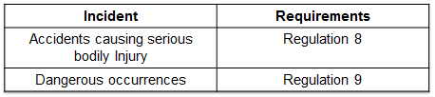
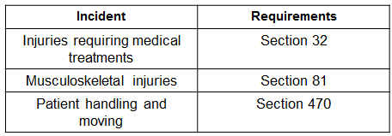
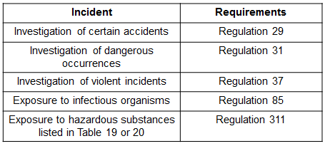
OH&S Summary
LRWS Reportable Incidents
Investigation Required
Review Required
Page 6
Page 20 - 22
LRWS = Labour Relations and Workplace Safety
Notes:
This is a brief summary of the OH&S requirements on reportable incidents and when investigation and review is required. Reporting to the employer is a basic requirement. In some cases reporting to the regulator, LRWS is also required.
Ask them to look up a couple, such as 37, 81 and 470. If they do not have legislation with them these have been included on pages 20 – 22 of the workbook.
Of particular relevance might be: (Point this out but this is not the place to be teaching what is in each part of the legislation)
Regulation 37: Violence
(3) A policy statement required by subsection 14(1) of the Act must be in writing and must include:
(g) the procedure the employer will follow to document and investigate a violent incident reported pursuant to clause (f)
Regulation 81: Musculoskeletal injuries
(2) An employer or contractor, in consultation with the committee, shall regularly review the activities at the place of employment that may cause or aggravate musculoskeletal injuries.
(5) Where a worker has symptoms of musculoskeletal injury, an employer or contractor shall:
(b) promptly review the activities of that worker and of other workers doing similar tasks to identify any cause of the symptoms and to take corrective measures to avoid further injuries
Regulation 470: Patient moving and handling
(4) An employer, in consultation with the committee, shall review all injuries resulting from lifting, holding, turning or transferring patients, residents or clients to determine the causes of the injuries

Slide 30

Incident Scenario
Notes:
In the investigation of this incident working groups will be used. Participants should refer to the incident scenario. At this point the scenario will be reviewed paragraph by paragraph by reading and analyzing (underline, **. Highlight) information that could be useful during the investigation.
Introduce this as an incident where a worker is injured while moving a resident from bed to chair.
Sleeping Inn Care Home Incident Scenario
All names and details, while possibly representative of some real work situations, have been fabricated for the purposes of this training session.
Sleeping Inn Care Home is an 85 bed level 3 and 4 care facility. The single story (plus basement) building was constructed in 1969. There is also a small 6 bed locked down unit. All residents have a private room and their own washroom. Bath facilities are located on each of the 4 wings. A central dining room is used by all the general population of residents. This room is also used as a space for crafts, activities and entertainment. Residents are able to enjoy the outdoor gardens, gazebo and seating areas. Financial constraints have allowed for the purchase of some new equipment but only essential work has been done to the structure of the building.
On any given day there is 3 care staff absent mostly due to illness, vacation or WCB claims. In addition there is a higher than expected rate of staff turnover. Many workers move between health care facilities in the area. Recruitment and hiring efforts are ongoing. Orientation is held the 2nd full week of each month. It consists of 1 day general orientation, followed by 1 day of TLR. New workers then are sent to their respective work units for specific orientation. Current workers are randomly assigned as mentors for new staff. Many staff don’t like to be mentors as they feel it slows them down and the new staff often ask too many questions.
Sleeping Inn Care Home’s injury frequency rate (# of workers /100 who are injured) is above that of the industry in general. Most injured workers are those who are directly involved in resident care and have shoulder, back and hand injuries resulting from “bodily reactions and exertion” or “contact with objects and equipment”, according to the WCB statistics.
The Incident
On a Friday day shift, two Sleeping Inn Care Home workers, Melissa and Sara, were assigned care for 86 year old Mary P as well as several other residents. Breakfast was at 8:00 am and all residents needed to be in the dining room by then. At 7:40 in the morning they were about to move Mary from her bed to the wheelchair. The task required 2 staff members and a total lift which was available in the home.
Melissa had 22 years of experience; Sara only started one week ago and had just completed her 30 week Continuing Care Assistant training program at the local community college. Sara remembered her TLR training and asked Melissa if this was the proper sling to use. Sara impatiently replied that the correct sling was not available, so they always just used whatever sling they had. In this case it was a hygiene sling. Melissa never seemed pleased to answer questions, usually saying that “it’s the way we do it here” or “I always do it this way”. They were in such a hurry to get their work done that Sara hadn’t had time to do her assessments before starting the lift. She didn’t dare mention this to Melissa. As they began getting Mary out of bed Sara was wondering if she should just stop asking questions. While raising Mary the lift the boom gave a sudden jerk when the sling was just a few inches off the bed. Mary slipped through the bottom of the sling. Sara attempted to catch her. Fortunately Mary landed on the bed and was not injured.
While lunging for the resident Sara felt a sharp and painful twinge in her back. During this event, the scatter mat slid along the floor causing Sara to lose her balance and slip right out of the sandals she was wearing. Sara fell to the floor, striking her head on the corner of Mary’s dresser on the way down.
The Resident Care Coordinator (RCC) was immediately summoned to the room. Sara was complaining of being dizzy. She had a nasty goose egg forming on her head where it had connected with the dresser and the shooting pain in her back made it difficult to get up off the floor. The RCC thought it best to send her to the local emergency room. Mary was safely transported (a little bit late) to the dining room for breakfast.
This was the first time that the RCC had needed to do an incident investigation since the announcement of the new investigation requirements at the management meeting last month. She knew that the OHC co-chair had taken OHC Level II training. She was pretty sure that was about investigations so she asked him if he had some time the following week to help her with the investigation and show her what she was supposed to do. He agreed to help but reminded her that it should be started immediately and not left until after the weekend.
Note here is that sharp end and blunt end.

Slide 31
Determine the legislated requirements for the Incident Scenario
In your groups go to page 23 and answer the OH&S Legislated Requirements questions
Notes:
Facilitators note:
Throughout this session there will be material/principles taught and then the participants will flip to the back of the book to apply those principles. At the end of the session they will have pages 23-29 as a completed investigation process.
Participant should turn to page 23. I quickly lead them through this as a large group and point out the legislation.
Yes. This was a failure of a crane or hoist (therefore Dangerous Occurrence 9(1)(b) applies) – workbook page 20
As per Dangerous Occurrence 9(3) – workbook page 21
Yes, it must be investigated, as per 31 – workbook page 21
As per 31(2) – workbook page 21

Slide 32

Investigation Techniques
Notes:
Now we’re going to look at some investigation techniques.

Slide 33

Domino Theory
"The occurrence of an injury invariably results from a completed sequence of factors, the last one of these being the accident itself. The accident in turn is invariably caused or permitted directly by the unsafe act of a person and/or a mechanical or physical hazard.“
(W.H. Heinrich, Industrial Accident Prevention, 1931)
Notes:
Industrial Safety pioneer W.H. Heinrich put forth the Domino Theory. As per the slide.
Again – NOT blaming or accusing the worker for performing an unsafe act!

Slide 34
Degree of Investigation
Depends on:
  Internal workplace policies
  An Occupational Health Officer may also request further investigation
Risk analysis:
  How many workers could be affected by a repeat similar occurrence?
  Is this incident part of a trend?
  Risk to the organization
Page 7
Notes:
What is investigated and to what depth an investigation will go depends on a number of factors:
Internal workplace policies – which must meet or exceed legislated requirements
The employer and the OHC can decide on the investigation parameters. An OHO may also request further investigation of matters.
Risk analysis:
How many workers could be affected by a repeat similar occurrence?
Is this incident part of a trend?
What would the risk be to the organization and the personal impact on worker’s lives of not getting to the root of the issue and preventing further occurrences?

Slide 35
Principles for Investigation Success
Remember:
Incidents don’t just happen, they are caused
Incidents can be prevented if causes are eliminated
Causes can be eliminated if all incidents are investigated properly
Unless the causes are eliminated, the same situation will reoccur
Notes:
To make this work:
Have a procedure
System focused – not individual performance
Fair, thorough, efficient, timely
Focus on problem solving
Include recommendations
Communicate key findings
Follow up

Slide 36
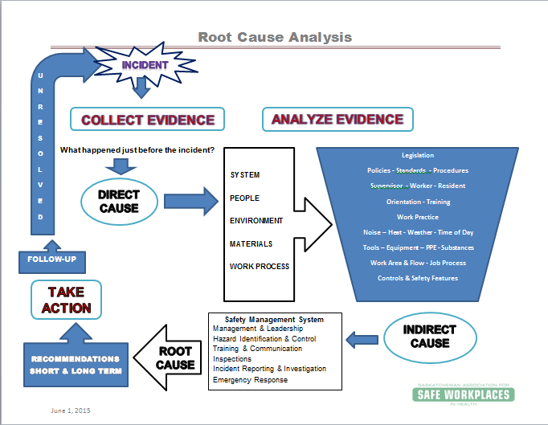
After Page 29
Notes:
We will be following along with this visual summary as we proceed with the investigation today. Right now an incident has happened. You can use this as a reference when you do investigations in your workplace. You can also use the pages at the back of your workbook that you will complete today as a workplace reference.

Slide 37
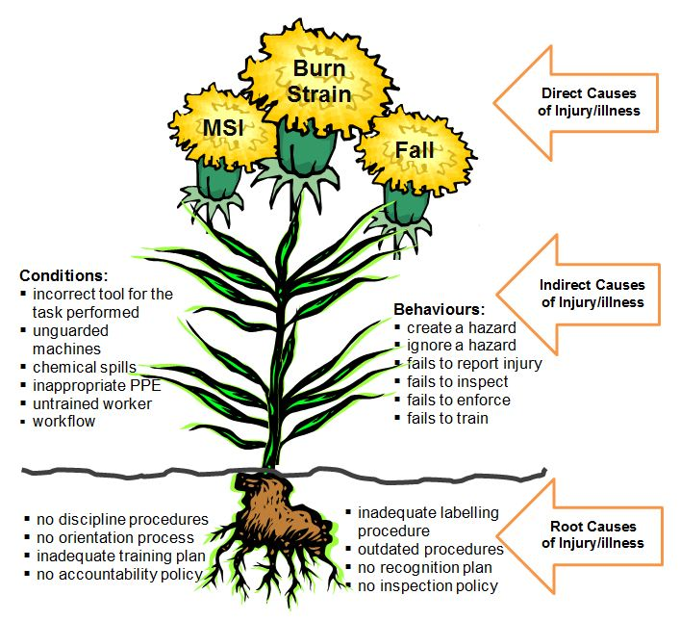
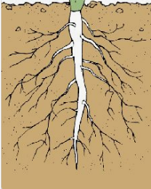
Incident Causes
Page 7
Notes:
WORKBOOK PAGE 37
Question to the group: What happens when you pull a dandelion and you don’t get all of the root?
Answer is of course that it will grow back again. You can pinch off the flowers or leaves but it will come back again. This is the principle of finding and eliminating the root cause of an incident.
If the real cause of the problem is not identified then one is merely addressing the symptoms and the problem will continue to exist. When identifying the root cause ask if this cause was eliminated, would it have either prevented the incident or reduced its severity. If yes – You have identified a root cause.
Review some of the direct, indirect and root cause possibilities from the diagram.

Slide 38
When an Incident Occurs…
Notes:
This is the same process that is used for all incidents, including near misses. There does not have to be an injury to use it. It just so happens that in this situation there has been an injury.
The incident referred to will be the one read for the previous exercise.

Slide 39
First Things First
Notify appropriate individuals according to the procedure
Grab the investigation kit/contact OH&S or patient safety
Approach the scene
First on the scene:
Check for danger – safety first
Provide appropriate assistance in a timely manner
Secure the scene
Assure the evidence is preserved – don’t throw anything away
Page 8
Notes:
When an incident occurs all staff should be trained in response such as:
making the scene safe,
providing aid to the victim,
securing the scene,
notifying the supervisor, and
preserving the scene until the supervisor/investigator(s) arrive
The manner of response will depend on the nature of the incident but must include notification of the supervisor as soon as possible.
Contact the OH&S Department if you require the assistance of your safety consultant.
Assure the evidence is preserved
Don’t throw away or remove anything, no matter how insignificant you might think it is – linen, IV bags and tubing, mechanical lifts, slings, objects related to the incident.

Slide 40
Get the BIG Picture
Investigators should ask broad, general questions such as:
What was taking place at the time of the incident?
Who was involved?
Who might have seen what happened?
What equipment, machinery, tools, chemicals, etc. were involved?
Are there obvious contributing factors such as liquid on the floor, known untrained/inexperienced workers training, broken equipment, damaged materials?
Notes:
Supervisors generally find out about an incident in one of two ways:
After the fact – worker verbal or written/electronic report
A crash and a scream – the event is taking place!
The first is most common.
In the beginning of the investigation process, after arrival on the scene investigators should begin by getting “the Big Picture”. Some of the information about “the Big Picture” may be from talking to someone at the scene. One word of advice, if this person was directly involved in the incident or first on the scene, their account of the incident is just one view and may not be entirely correct. **Without the big picture you may risk rushing into a dangerous situation with realizing that it is dangerous**
You may not totally understand the true “Big Picture” until you are at the scene yourself. Even then it may be hard to find out what exactly happened. These questions we just asked will help you start gathering all the pieces of this puzzle.

Slide 41
Get the Big Picture for the Incident Scenario
In your groups go to page 24 and answer the Big Picture questions
Notes:
Turn to page 24 and answer ONLY the Big Picture question.
This should be very brief and without assumptions or opinions….Sara fell and banged her head…..

Slide 42

The process for success
Remember
C.A.R.T
C - Collect the Evidence
A - Analyze the Evidence
R - Report & Recommend
T - Take Action
Page 8
Notes:
Lets go back to page 8.
To conduct the investigation this is the methodology we will be using.
The same process that is taught in OHC Level II as well as general incident reporting and investigation classes. This is intentional.

Slide 43
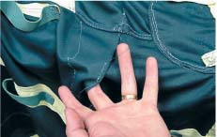


Collect the Evidence
Physical Documentation Witness
Page 8
Diagram
Notes:
Collecting information can be difficult and time consuming. Physical evidence may be damaged, lost, or lacking. Relevant documents may not exist, be out of print, or inaccessible. Witness statements can be contradictory or sketchy. Each piece of information may generate more work. It will be a challenge, but the investigator/investigation team must work hard, be persistent to find out what really happened – and what can be done about it.
First off you are going to attend to the injured worker.
Then - secure the site .
Once this is done :
collect physical evidence from the scene,
find document evidence
interview witness.
Sling picture is from http://www.ltlmagazine.com/article/resident-lift-slings-silent-risk?page=show

Slide 44


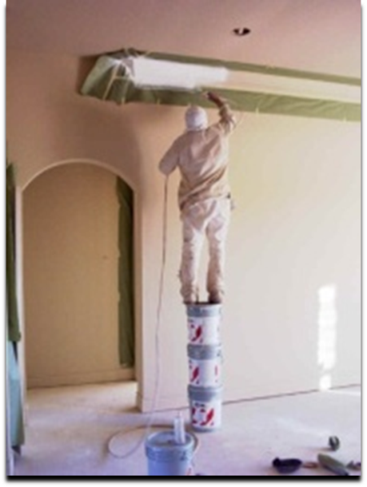
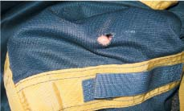
Collect the Evidence – Physical
Information It May Provide
What actually went wrong and why What happened before, during and after the incident Hazards in the work area Effectiveness of engineering controls What caused the injury and how
Page 8
Notes:
Use physical evidence to gather information about what happened before, during and after the incident. Use physical evidence to help develop questions for witness interviews.
Lists start on page 8 of the workbook. When checking the following items you will probably analyze what you see and consider how it might have played a factor in the incident.
Refer to the pictures and ask participants to list the physical evidence:
Example: Top left picture:
Footwear
The victim
Floor – wet, rough, slippery, even. etc,.
Lighting
Wet floor signs
If there is water on the floor, where is it and how much is there
Example: potato bag:
How heavy – how can you determine that?
Material (who wants to hug a rough jute bag?)
Condition of the bag – is it dirty, have holes, are potatoes starting to fall out?
Where is it? – on the floor, back of a delivery truck?
What was being done with the bag?
The guy on the pails is just for comic relief ☺
Bottom right is a sling with a hole in it.

Slide 45


Handling Physical Evidence
Use safe collection and handling procedures
Identify, collect, label, package and store
When possible and if applicable don’t remove any evidence until has been examined by the expert (manufacturer, engineer, trainer, etc.)
Record the locations where the evidence was found
Notes:
Remember to adhere to infection control policies and procedures and safe handling of all substances (WHMIS, etc.)
Assure the evidence is preserved
Don’t throw away or remove anything, no matter how insignificant you might think it is – linen, IV bags and tubing, mechanical lifts, slings, objects related to the incident

Slide 46
Take Photos or Video
Start with a wide view of the area
  Narrow down to specific areas to show detail
Keep a log of all photos and locations
Use a common object for a size reference when appropriate
Check to see if any relevant pictures or videos were taken by others
Call your OH&S support team
Notes:
Use photos and video to record information, especially information that cannot be collected in other ways.
Photos can reduce the number of trips you have to make to the incident site, and will give you an ongoing record of the incident scene once everything has been cleaned up. Be sure to know what rules exist regarding the taking of pictures and the use of pictures.
Ensure that everything of importance is recorded. Move from general to specific shots. Start with shots of the general scene. Shoot each key item from several different directions to provide better information. Move the camera, but not the item that you’re photographing (moving an item may complicate subsequent examinations by specialists).
Select some way of clearly indicating distance, direction, and perspective in your shots, such as rulers to help determine the size of an object in the photo or direction indicators.
Use a written/electronic photo log. Don’t forget to also take notes of what you observe – don’t rely exclusively on photos.

Slide 47
Sketches
Make as soon as possible after the incident
Use a scale if appropriate
  Measure distances and include on the drawing
  Can be for a bird’s eye view
Label landmarks, evidence, directions, etc. if it could possibly be relevant
See sample forms
Notes:
Any appropriately labelled piece of paper will work for this.

Slide 48
Collect Physical Evidence for the Incident Scenario
In your groups go to page 24 and answer the Physical Evidence questions
Notes:
From here on the questions are answered by the working groups.
Have groups complete the questions and then discuss as a large group.

Slide 49

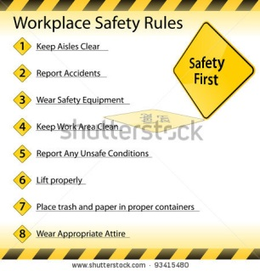



Collect the Evidence – Documentation
Standards and technical information
  Legislation, industry standards
Reports
  Inspection, investigation, incident, hazard
Records
  Training, orientation, maintenance, repair logs
Research
  Technical, best practice, safety alerts
Safety Management Systems documents
Page 9
Notes:
Documentary evidence is just as important as physical evidence. It can tell you what should have happened at the time of the incident. Equipment readouts and so forth may even report what actually happened during some phases of the incident. The reasons for the difference between what should have happened and what actually happened are often the reason why the accident/incident occurred.
Facilitator’s note: Don’t give too may examples from the scenario as they will need to think about this and answer questions in the group exercise.
Find documentation that will support a safe work practice for the incident, such as:
Policies, procedures, programs, and Job Safety/Hazard Analysis
Patient/resident/client chart
Shift schedules/records
OHC inspection reports, and minutes
Orientation and training records
Legislation and other regulatory guidelines e.g. infection control
Best practices
Equipment read outs
Maintenance records
Manufactures guidelines
Previous incident reports on the same type of injury. What was put into place to control the hazard did it work or was a new hazard created. How was assigned to follow up.
Training records become very important. Did the worker receive training? How was it delivered? Who ensured the worker followed the training? How was the worker being supervised? These questions and the answers could tell you a lot about what happened and why.
Analyzing the documentation: lets you see the correlation between what actually happened and what should have happened.
Lacking good documentation shows a gap in the Safety Management System (SMS).

Slide 50
Using Documentary Evidence
Use it to help:
Determine worker training
Determine supervisor training
Understand safe work practices and procedures
Identify witnesses and questions to ask
Check statements given by witnesses
Monitor the SMS
Notes:
Reviewing the documentation:
will help identify witness to be interviewed.
may lead to additional interviews with experts i.e. TLR trainers, doctor, lab specialist, engineer, manufacture.
E.g. you may need specific information from a trainer about what is taught in class.

Slide 51

Conducting Research
Used to learn more about the physical and documentary evidence
Benchmarking
  What are others doing?
  What are the best/industry practices?
  Have others had the same experiences?
  Have others made changes to their practices?
Technical Research
  Internet
  Journals
  Subject matter experts
Page 10
Notes:
Research is a tool to learn more about the physical and documentary evidence
Benchmarking
What are others doing?
Have they had the same experiences?
Have they made changes to their practices?
Technical Research
Internet
Journals
Subject matter experts

Slide 52
Collect Document Evidence for the Incident Scenario
In your groups go to page 25 and answer the Document Evidence questions
Notes:
Document Review
Allow groups the time to determine what documents they will be reviewing and what they hope to find by looking at those documents. Then discuss as a large group.
Review of the Safety Management System (SMS) documents in this facility revealed:
Some training records were present, but training was not always current.
A documented training plan could not be found.
Policies and procedures are in place, but no documentation was found to show that they were being enforced.
The TLR policy included the requirement to use the correct sling for the task being done.
No process was found for creating a safe work environment (e.g., removing a scatter mat prior to completing the task).
Much of The Sleeping Inn Care Home SMS was given to them by a neighbouring facility who assured them that is follows best practice and meets legislative requirements.
Except for a few policies used in orientation there were no records to show that the SMS contents were being reviewed with the staff.
After searching a TLR Resource manual was found in the back of a cupboard
No current copies of the Saskatchewan Employment Act or Regulations were found on the wing.
The preventative maintenance program has not been fully implemented and not many records were available.

Slide 53
Return the scene to normal
Once the required evidence is collected:
Clean and disinfect the area as required
Check equipment and materials to assess functionality
Ensure that the scene is returned to safe use
Ensure that the incident will not be repeated
If in doubt about safety of processes or equipment
Refer too those who are technically qualified
Notes:
Once you have gathered all the evidence and information needed, ensure that the incident scene is returned to normal use. This may involve disinfecting the area if blood was spilled, checking equipment and materials to assess functionality, and ensuring that the incident will not be repeated.
A process may need to be stopped or piece of equipment taken out of service until further examination proves its safety. You may need to notify the management immediately regarding this. If in doubt about the functionality of equipment, materials or process, have it checked by those who are technically qualified.

Slide 54


Collect the Evidence – Witnesses
Page 11
Notes:
Interviews often reveal critical information and are one of the main methods of gathering information in an incident investigation.
Interviews should be conducted with anyone who can give relevant information, even if they were not present. An example would be the supervisor who gave instructions at the start of the shift or a trainer who instructed the worker, even months earlier.
A good practice is to keep those who will be interviewed apart from one another until they are interviewed and make every attempt to conduct the interviews ASAP.

Slide 55
Collect Interview Evidence
Keep an open mind
Be curious
Notes:
As with all parts of an investigation, go into the interview process with an open and curious mind.

Slide 56
Categories of Witnesses
Eyewitnesses
Those who came on the scene immediately after the incident
Those who saw events leading to the incident
Those who have information about the work tasks, processes, safety devices in use, materials, equipment and other conditions involved in the incident
Those with expertise
Notes:
As per the slide.

Slide 57
Planning the Interviews
Identify who to interview and the information that the interview may provide
Use physical and documentary evidence to help prepare questions
Find an appropriate interview location
Minimize interruptions
Notes:
Good planning will give you better results. Have clear objectives about what you want/need to learn.
Determine what questions you need to ask each person to better understand what happened.
Following an interview, take time to gather your thoughts. Did the interview accomplish what you set out to learn? If not, then a follow-up interview may be required?
Identify who needs to be interviewed, and their roles. For example, at the scene was nurse Brown and housekeeper Deb
Identify the injured worker.
Identify if a patient or client was involved or a witness
Identify who was the first person first to come to the aid of the injured worker.
Look for a worker from another department that may have seen or heard something.
Look for others that may have been in the vicinity.

Slide 58
Effective Interviews
Interview within 24 hours if at all possible
  Sooner if the witness won’t be available
Set a schedule
Put the interviewee at ease
  Assure they know the purpose is to collect information NOT to find blame
Listen first, then take notes
Consider the background and credibility of each witness – all good – all bad
Notes:
Effective interviews
Interview within 24 hours if at all possible
Sooner if the witness won’t be available
Interviewing as soon as possible keeps information reliable.
Keep witnesses from talking to each other prior to their interview. This will avoid communication information versus witnessed information
Set an interview schedule – one worker at a time
Have basic knowledge of what happened before starting an interview
Conduct the interview in a neutral, quite place without interruptions
Put the worker at ease
Make it clear this is not disciplinary, but fact finding.
Take detailed notes including date. names,
Number your pages. This will prevent confusion
Record who did the interview, time and date
Following an interview, take time to gather your thoughts. Did the interview accomplish what you set out to learn? If not, then a follow-up interview may be required?

Slide 59
Questioning Techniques
Ask questions to:
  gain knowledge and details
  clarify an observation from the scene
Ask open questions (not yes/no)
Ask clarifying questions (yes/no) only to narrow down a detail
Pause, give the person time to answer, don’t interrupt
Notes:
Questioning Techniques:
Ask questions to gain knowledge and details
Ask questions to clarify an observation from the scene
Ask open questions (not yes/no)
Ask clarifying questions (yes/no) only to narrow down a detail
Pause, give the person time to answer, don’t interrupt
Only use drawings, photos or visits to the site to jog memory
Avoid questions that lead
Review your notes for accuracy
Ask for prevention suggestions
Thank the interviewee
Do not interrupt the witness, just listen and let them tell the story. Interruption may alter information or make the witness forget a valuable piece.
Expect some conflicting information this is normal as the same event may have been seen from a different angle or distance.
You may have to interview more than once.
Always close on a positive note ( thank them for their valuable input)
Do not form conclusion during an interview

Slide 60
Develop Standard Questions
Standard script for all interviewees
Look for trends
What were you doing when the incident occurred?
What did you see? What did you hear?
Who else was around at the time?
What is the standard procedure for the task?
What training do workers receive in the standard procedure?
Who was supervising the work at the time?
Is there anything else you’d like to add?
Notes:
Develop standard questions – standard script for all interviewees:
That are open ended, where they cannot say yes or no. i.e.
Can you tell us what you saw this morning? – NO!
What occurred to place the employee at risk?
Who was involved?
What did they see and hear?
What training did they receive?
What tools and equipment where being used?
What was the environment like noisy busy etc.?
What was happening prior to the incident? The shift before? (find out: Was it a busy time, workers on breaks and reduced coverage?)
What corrective action took place immediately / long term?
What would the worker do differently?
Who else needs to know?
Look for trending. E.g.: several witness answered the same on a particular question
Use physical and documentary evidence to help prepare questions

Slide 61
Interview Order
Interview those who were involved, saw it, or were 1st on the scene
Next, interview those who know what was happening before the incident
Finally, interview others like a trainer, technical expert, other workers
Conduct follow-up interviews as required
Notes:
As per the slide.

Slide 62
Collect Interview Evidence for the Incident Scenario
In your groups go to page 25 and answer the Interview Evidence questions
Notes:
Interview Results
Allow groups the time to determine who they will interview, in what order and what questions they will ask. Then discuss as appropriate the possible interview results below.
What did you learn from Sara (injured worker)?
She thought her orientation was going well but there was a lot to remember.
She had been trained in TLR.
She did not have time to buy appropriate footwear.
She had reviewed policies and procedures for the job during her orientation.
She was rushing to get all her residents to the dining room on time.
When the client started to slip out of the sling, Sara reacted immediately by reaching forward in an attempt to catch the client. The scatter mat that Sara was standing on slid away from the bedside, causing Sara to lose her balance, her footing and sandals.
She felt a sharp twinge in her back.
She realized there was no way to stop her fall, when suddenly her head hit the dresser that was behind her.
What did you learn from Melissa (experienced worker)?
She was rushing to get all her residents to the dining room on time.
She indicated she had received TLR training.
The sling in the resident’s room was the only sling she ever used (except when she couldn’t find it).
The rug beside the bed was one that the resident had made herself and always had been beside her bed in her own home. The resident and the family requested that it be in the same place in her room at the care home.
What was the supervisor’s position?
She had received her work assignment and was responsible to determine the order of tasks as well as the tasks that required supervision. This was normal practice.
She was aware that Sara would not have appropriate footwear for the first few days. She wasn’t aware that she had the authority to direct Sara to get appropriate footwear immediately or to reassign Sara to a safer task.
She was an experienced nurse but had never received any special supervisors training.
She had never seen the job description for a supervisor.
Her understanding of her role and responsibilities, including authority, were unclear.
She was trained in TLR about 4 years ago.
What did you learn from the client?
She indicated she felt herself slipping.
She reached out to hang onto something but nothing was available.
Next thing she knew she was on the bed.

Slide 63

Analyze Incident Factors
People
  Supervision, training, orientation, etc.
Material
  Substances, tools, equipment, etc.
Environment
  Workplace conditions, etc.
Work process
  Work flow, work design, alignment with JSA and procedures
System
  Policies, procedures plans, JSA, etc.
Page 12
Diagram at Back
Notes:
Analyze Incident Factors - Go through each event before, during and immediately after the incident. Ask why each happened. Evaluate the role of every factor. A good question to ask yourself during the analyzing process is - If not – why not?
Refer to the workbook page 12. Review some of the sample questions.
People
Supervision, training, orientation, etc.
Material - Substances, tools, equipment, etc.
When analyzing ask yourself:
Were the materials designed for the task?
Was more than one piece of equipment involved? If so was the equipment compatibility – mechanical lift getting stuck under the beds.
Find out if a substitute product was used?
Should an alternative product been used?
Was PPE required for the task? Correctly selected? Used Correctly
Was equipment of old technology?
Was the equipment in good repair?
Environment - Workplace conditions, etc.
Look at the ventilation system
What did you notice about the house keeping, clean and tidy or congested?
Did you notice loud noise or poor lighting?
Did you smell something?
Work process/task - Work flow design, P&P, JSA, etc.
Look at the task and analyze if the P&P and the JSA align
Analyze and determine if common practices verses safe work practices were being used at the time of the incident
Determine if the worker is trained and competent in doing the task.
System/Management Processes - Policies, procedures plans, etc.
See if the P&Ps are current and reflect the task being done.
Watch and see how the work flow is going? Are a lot of extra steps being taken?
Do you see adequate supervision?
Look to see if the supervisor and the worker are trained for their tasks?
Find out if the hazard has been previously identified? What corrective action was taken?
Did it work or create a new hazard?
You will want to see if the maintenance is done in accordance with the manufactures guidelines.
Is there a process in place to communicate hazards and the corrective action? Follow up to see if the communication was effective.
Look to see if there is a process in place to hold accountability for and compliance to the corrective action.

Slide 64
The Role of Human Error
“The actions of people account for 96% of all injuries” – (DuPont)
“80-90% of accidents are due to human error” (Heinrich et al, 1980)
“50-90% of accidents according to statistics are due to human failings” – Kletz (1990)
Notes:
Trying to do a good job
Employees don’t generally go to work with the intention of causing harm. They are mostly good people trying to do a good job. They operate within the complexity of organizations with sometimes conflicting goals. People do their best to reconcile any inconsistent goals, e.g., operational efficiency versus safety, and to interpret the differing messages provided by the organization (“Safety comes first, but here’s the production/work/output deadline we expect you to achieve.”). They try to achieve success and avoid failure, in an uncertain and confusing work environment.
Humans make errors. Factors in the workplace contribute to the likelihood of these errors. We can change the conditions under which humans work
We know that human error occurs and contributes to incidents. Our task is not to blame those who make the errors, but to look at the SMS and the workplace to determine the root organizational causes behind those errors.

Slide 65
Analyze Incident Factors for the Incident Scenario
In your groups go to page 26 and your handout and answer the Analysis of Incident Factors questions

Slide 66
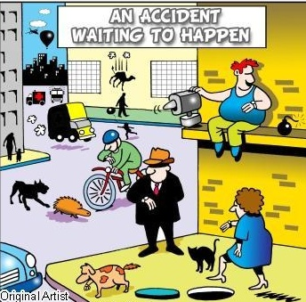

Analyze Evidence - WHY
Start linking together the evidence and incident factors to clarify discrepancies and identify:
direct cause
indirect causes
root causes (system level problems)
What seems like a straight-forward event rarely has a SINGLE cause
Page 15
Diagram at Back
Notes:
At this stage of the investigation most of the facts about what happened and how it happened should be known. This has taken considerable effort to accomplish but it represents only the first half of the objective.
Now comes the key question--why did it happen? To prevent recurrences of similar incidents, the investigators must find all possible answers to this question.
Each conclusion should be checked to see if:
it is supported by evidence vs based on assumption
There is not likely a single cause. Make sure the investigation is focused on finding the root cause
You can do this if you want:
How many incidents do you see in this picture? (13)
What is the common risk factor? (watching the clock rushing?)

Slide 67
Identify the Direct Cause
Usually happens immediately before the incident
The following actions help to describe the Direct Cause
  Struck by
  Fall
  Caught in, on, between
  Contact with, exposure to, etc.
Often involves an unsafe act or substandard conditions
Page 15
Diagram at Back
Notes:
Direct cause :
Is what directly lead to the incident

Slide 68
Analyze the Evidence for the Incident Scenario
In your groups go to page 27 and answer the Analyze the Evidence questions
Notes:
Do just the direct cause now.
Page 27 has direct, indirect and root causes. You will be coming back here 3 times – once for each.

Slide 69
Identify the Indirect Cause(s)
These conditions usually set the stage for the incident
Examples:
  Lack of training
  Departures from safe work practices/standard work
  Not following MSDS/SDS
  Using inadequate or defective equipment or materials
  Inadequate PPE
Page 15
Diagram at Back
Notes:
Indirect Cause:
is the working conditions that set the stage:
Determine what was happening the shift prior,
Determine if there was lack of training to do the task,
Inadequate JSA, policies and procedures/ programs.
Inadequate training for worker and supervisor
Inadequate supervision - who is your worker: know your worker - young with no experience or seasoned and uses best practices
Inadequate tools, equipment or materials available
Inadequate communication of safe P&P, or alerts.
Emergencies procedures unknown to the worker Are all your codes discussed in a safety talk and practiced?
Is there compliance with procedures – or is common or short cut become the norm? eg.
Have you heard?:
This is how we do it around here and nothing happens.
You are in the real world now - so forget what they taught you in school/training, or you will never get done.
10. Does the supervisor stop an incorrect act and use the opportunity to educate.

Slide 70
Analyze the Evidence for the Incident Scenario
In your groups go to page 27 and answer the Analyze the Evidence questions
Notes:
Do just the indirect cause now.
Page 27 has direct, indirect and root causes. You will be coming back here 3 times – once for each.

Slide 71
Identify the Root Cause(s)
Root causes explain why substandard acts and conditions exist
Examples:
  Lack of knowledge could mean inadequate training and/or orientation systems
  Worn, damaged or broken equipment could mean inadequate inspection or preventative maintenance systems
  Trained worker not following safe work procedures could mean inadequate supervision systems
Page 15
Diagram at Back
Notes:
Root Causes:
are flaws in the workplace systems.
As per the slide.

Slide 72
SMS Elements
1 Management and Leadership
1.1 Governance
1.2 Senior Management Involvement
1.3 Health & Safety Policy
1.4 Worker Rights
1.5 Responsibilities
1.6 Accountability
1.7 Safety Rules
1.8 Measurement
2 Hazard Identification and Control
2.1 Risk Assessment
2.2 Safe Work Practices/Procedures
2.3 Personal Protective Equipment (PPE)
2.4 Procurement
3 Training and Communications
3.1 Training
3.2 Orientations
3.3 Occupational Health Committee
3.4 Communication
3.5 Document Development, Review and Communication
3.6 Employee Involvement
4 Inspections
4.1 Inspections
5 Reporting and Investigation
5.1 Reporting
5.2 Investigations
6.1 Emergencies
Diagram at Back
Notes:
A health and safety management system includes the following key elements, as identified in the SMS Standards for Healthcare in Saskatchewan. These are the standards about what should be done.
1.1 Governance
1.2 Senior Management Involvement
1.3 Health & Safety Policy
1.4 Worker Rights
1.5 Responsibilities
1.6 Accountability
1.7 Safety Rules
1.8 Measurement
2.1 Risk Assessment
2.2 Safe Work Practices/Procedures
2.3Personal Protective Equipment (PPE)
2.4 Procurement
3.1 Training
3.2 Orientation
3.3 Occupational Health Committee
3.4 Communication
3.5 Document Development, Review and Communication
3.6 Employee Involvement
4.1 Inspections
5.1 Reporting
5.2 Investigations
6.1 Emergencies

Slide 73
Analyze the Evidence for the Incident Scenario
In your groups go to page 27 and answer the Analyze the Evidence questions
Notes:
Page 27 has direct, indirect and root causes. You can do each individually if you wish.

Slide 74

Reporting, Recommendations and Follow-up
Page 16
Diagram at Back
Notes:
This should be done by answering the questions on the incident investigation form.
Facilitator’s note:
You can show a copy of the form and even hand out copies for people to reference in the class. There is no time in this class to teach people how to use the form. Ideally those tasked with doing investigations should be familiar with the form and its use prior to the class. Anyone with questions about how to use the form should be advised how to contact the appropriate person after the class.

Slide 75
Reporting and Recommendation
The intent of the report is to:
Detail specific recommendations
Effect change
Improve the health and safety at the workplace
Notes:
As per the slide.
The completed investigation form should act as the report and include recommendations. Additional pages can be added as needed.

Slide 76

Hazard Control Methods
At the source | Along the path | At the worker
Elimination Substitution Redesign Isolation Automation | Barriers Absorption Dilution | Training Supervision Policies & procedures Hygiene practices Administrative PPE
Short term - - Long term
Page 16
Notes:
Controls are based on the Hierarchy of Control.
Eliminating the hazard is always the best choice, but is not always possible.
The closer a control is to the source of the hazard, the better.
If this does not work, try to put controls along the path between the source and the worker.
If this is not possible/as effective as desired, hazards must be controlled at the level of the worker. Hazard control at the worker level should be your last resort. This is mainly because the energy from the hazard has already reached the worker.
One type of control may not be completely effective. A combination of several different types of hazard controls often works well.
Remember to also consider selecting short term and long term controls. Short term can fill the gap until longer term controls can be implemented. Long term controls often require money and higher level approval.
For example: For a noisy machine, the best method could be to eliminate the noise by fixing the machine (at the source). Your last option is giving the worker hearing protection . By giving the worker hearing protection you are allowing the noise (energy) to reach the worker. Hearing protection works well but it has limitations . Is it the correct hearing protection for the noise level? Does it reduce the noise levels adequately? Do workers know how to use it? Are they following the rules and using it?
In this case if the machine can’t be adequately fixed the worker may wear hearing protection (short term) until a new machine can be purchased (long term).
Controlling at the Source
Elimination:
Try to eliminate the hazard. Get rid of hazardous job, tool, process, machines or substances
Substitution:
Replace hazardous substances with something less dangerous.
Redesign:
Sometimes engineering can be used to redesign layout of the workplace, workstations, work processes and jobs to prevent ergonomic hazards.
Isolation:
Isolating, containing or enclosing the hazard is often used to control chemical and biological hazards.
Automation:
Dangerous processes can sometimes be automated or mechanized.
Controlling Along the Path to the Worker - Hazards that cannot be isolated, replaced, enclosed or automated can sometimes be removed, blocked, absorbed or diluted before they reach workers
Barriers:
Proper equipment guarding can protect workers from contacting moving parts. Screens and barriers can block welding flash, x-ray radiation.
Absorption:
Baffles can block or absorb noise
Dilution:
Ventilation might dilute the concentration of a hazardous gas with clean air from the outside (e.g., confined space).
Controlling at the Level of the Worker - Control at the level of the worker does not remove the risk posed by a hazard. It only reduces the risk of the hazard injuring the worker and lessens the potential seriousness of an injury.
Administrative Controls
Policies
Safe work practices and procedures
Training
Supervision
PPE

Slide 77
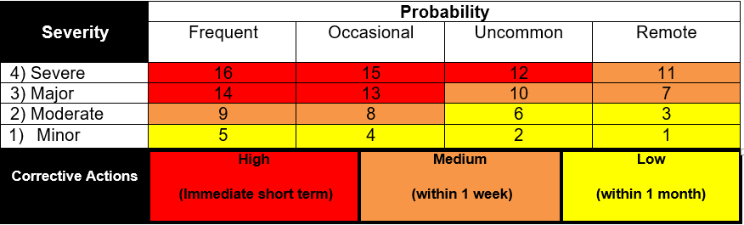
Actual Harm Rating | Description
1 Minor | An incident that has contacted or affected a patient/worker and resulted in no injury or minor injury/haram requiring minimal intervention or first aid.
2 Moderate | Harm/Injury which requires professional or medical treatment beyond first aid.
3 Major | Harm/injury resulting in physical and/or emotional harm and lessening of bodily function. Temporary loss of function. Long term incapacity/disability.
4 Severe | Death or significant harm resulting in irreversible complications including permanent major loss of function.
Frequent | Possibility of repeated occurrence (daily, weekly or monthly)
Occasional | Possibility of occurrence (several times in 1 to 2 years)
Uncommon | Possibility of isolated occurrence (2 to 5 years)
Remote | Not likely to occur (may happen outside of 5 years)
Notes:
Each of the identified causes should be risk assessed, in order to set priorities for action. (this is not done in the class, but the principle is discussed)
Facilitator’s note: Teaching how to do risk assessments is not part of this class. You may tell them how to access the form (if it isn’t with the investigation form) and even hand out copies for people to reference in the class. There is no time in this class to teach people how to risk assess. Ideally those tasked with doing investigations should be familiar with the form and its use prior to the class. Anyone with questions about how to use the form should be advised how to contact the appropriate person after the class.
From the Assessment User’s Guide:
Step 1 Severity Potential
What are the consequences of this incident occurring? Consider what could reasonably have happened as well as what actually happened. Look at the descriptions and choose the one most suitable.
Step 2 Probability
What is the likelihood of the consequence identified in step 1 happening? Consider this without new or interim controls in place. Look at the descriptions and choose the one most suitable.
Step 3 Hazard Risk Rating Scoring Matrix
Take Step 1 rating and select the correct column, take Step 2 rating and select the correct line. Circle the risk score where the two ratings cross on the matrix below to obtain the risk rating.

Slide 78
Develop Recommendations
Recommend short and long term corrective action:
Direct causes
  Such as ensuring all hazards are identified at the workplace
Indirect causes
  Such as ensuring workers are trained in the safe work practices for their job
Root causes
  Such as reviewing the SMS to insure that processes are in place to identify and control hazards, and to ensure adequate training, orientation and supervision processes are in place
Page 17
Diagram at Back
Notes:
The next step is to write a report/complete the investigation form. It may take time to record all the information required, so the people who receive the investigation report can understand what happened, why it happened, and what needs to do be corrected so it doesn’t happen again.

Slide 79
Develop Recommendations for the Incident Scenario
In your groups go to page 28 and answer the Analyze the Evidence questions

Slide 80
Reporting and Recommendation
The investigation report should include:
Description of the incident in detail
Factors that led to the incident as determined by the investigation
Incident direct, indirect and root causes
Risk of inaction
Make recommendations for corrective action
  Short and long term
Ensure a follow-up mechanism
Notes:
A succinct report detailing specific recommendations is critical to the effectiveness of prevention at the workplace. As said this should be able to be accomplished by completing the investigation form.
Recommendations to prevent recurrence must be:
Specific and clear
Practical
Affordable
Achievable
Prioritized
An executive summary may be useful on a longer or more detailed report.

Slide 81
Write the Report for the Incident Scenario
In your groups go to page 29 and answer the Write the Report questions

Slide 82
Take Action
Employer/Management is responsible for:
Acting on the recommendations, and the development of a plan
Implementation of the corrective action
Supervisors are responsible for:
Working with leadership and OHC on implementation and follow up
Communication of corrective action to all employees
Workers are responsible for
Following safe work procedures determined by the corrective action
Identifying to their supervisor if the corrective action does not work
OHC are responsible for
Monitoring the effectiveness of the control
Reporting to management
Page 18
Notes:
Corrective action should not compromise the health & safety of others.
Employers must take immediate action to protect workers! Management is responsible for:
Acting on the recommendations, and the development of a “master plan”.
Putting into place P&P, JSA’s, etc.
Implementation of the corrective action
Assigning who is accountable to see the corrective action is carried out.
Communicating and working with the OHC on the implementation and follow up
Being reported back to on the outcome of the corrective action.
Supervisors are responsible for:
Working with leadership and OHC committee on implementation and follow up
Communication of corrective action to all employees.
Communicate to their leadership team if the corrective action is not working
Ensuring workers know everyone is accountable and responsible to follow the corrective action.
Monitoring to see if the corrective action is working or created a “new” hazard.
Workers are responsible for
Follow safe work procedures determined by the corrective action.
To identify to their supervisor if the corrective action does not work.
OHC are responsible for
Following up - look and check the area ask workers if the corrective measures work.
Reviewing on inspections and or in between inspections
Reporting back to the leadership team and the OHS division as required
Everyone is responsible to monitor and report if the corrective action has improved the work place or created a “ new” hazard.

Slide 83
Take Action
Process to implement recommendations:
Employer reviews the investigation report
Employer reviews the recommendations
Employer decides what action will be taken
OHC/Rep provides input and monitors the effectiveness of the employers corrective actions
* Accountability
Notes:
The employer is responsible for taking steps to make/keep the workplace safe.
Regulation 28(2) - Inspection of place of employment
28(2) On written notice by the committee or the representative of an unsafe condition or a contravention of the Act or any regulations made pursuant to the Act, the employer, contractor or owner shall:
(a) take immediate steps to protect the health and safety of any worker who may be at risk until the unsafe condition is corrected or the contravention is
remedied;
(b) as soon as possible, take suitable actions to correct the unsafe condition or remedy the contravention; and
(c) inform the committee or the representative in writing of:
(i) the actions that the employer, contractor or owner has taken or will take pursuant to clause (b); or
(ii) if the employer, contractor or owner has not taken any actions pursuant to clause (b), the employer’s, contractor’s or owner’s reasons for not taking action.
4 Oct 96 cO-1.1 Reg 1 s28

Slide 84
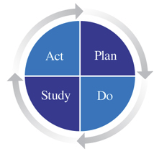
Follow-up
Notes:
Once implemented, corrective actions must be followed up to evaluate their effectiveness and to ensure that other hazards have not been created.
Facilitator information only:
The PDSA Cycle is a systematic series of steps for gaining valuable learning and knowledge for the continual improvement of a product or process.
These four steps are repeated over and over as part of a never-ending cycle of continual improvement.
Plan: Create a process improvement plan.
The cycle begins with the Plan step. This involves identifying a goal or purpose, formulating a theory, defining success metrics and putting a plan into action.
Do: Execute a process improvement plan.
These activities are followed by the Do step, in which the components of the plan are implemented, such as making a product.
Study: Analyse feedback and adjust the plan accordingly.
Next comes the Study step, where outcomes are monitored to test the validity of the plan for signs of progress and success, or problems and areas for improvement.
Act: Integrate a process improvement plan into the system. - See more at: http://www.goleansixsigma.com/pdca-pdsa/#sthash.afTPMsZl.dpuf
The Act step closes the cycle, integrating the learning generated by the entire process, which can be used to adjust the goal, change methods or even reformulate a theory altogether.

Slide 85

Major Reasons Incidents Re-Occur
Investigations are not done
Direct, indirect and root causes not fully considered
Poor communication with employees on cause and corrective actions
Corrective actions; not implemented or followed up
Notes:
As per the slide.

Slide 86

Remember
Incidents don’t just happen. They are caused.
Incidents can be prevented if causes are eliminated
Causes can be eliminated if all incidents are investigated properly
Unless the causes are eliminated, the same situation will reoccur
Notes:
As per the slide.

Slide 87
Thanks for your participation
Please complete and hand in your evaluation on page 30 of your workbook

