Slide 1
Safety Management System a key driver to improve Workplace Health and Safety. A few tips on how to get started….

Slide 2
Safety within the education sector is a priority:
Requires intention and commitment
The approach must be consistent and validated so that the work can be scalable and implemented throughout the entire school division.
Leadership commitment at all levels to improve safety in Saskatchewan schools.

Slide 3
Slide 1
Concept
Leadership
Partners
Current State
Action Plan
Communication
Improve safety in school division with Safety Management System
Senior leadership and support
Build a team of experts
Readiness assessment and identify the top three hazards
Access and utilize resources that are now available
Check in with front line workers and make safety visible.

Slide 4
Communicate Steps in the Process
Identify Schools
Readiness Assessment (pre)
Observation Tours
meet with OHC Co-chairs
Data Collection
Current State
Make Safety Visual
Pre and Post Assessment Against SMS
Confirm Top Three Injuries
Set Targets for Improvement
Action Plan
Strategies
Solid Action Plan with Key Deliverables
Engage Onsite OHC
Job Safety Analysis
Safety Education and Training
SMS Audit
(post)
OHC
Communicate with Onsite Teams and Identify Your Safety Champions
Notes:
Brief overview of navigating the website/ resources

Slide 5
Safety is a must do can’t fail….
Legislative requirements
The Education Act, 1995
The School Bus Operating Regulations, 1987
The Traffic Safety Act
Student Transportation Legislation and Best Practices
The Saskatchewan Employment Act
The Occupational Health and Safety Regulations, 2020
Saskatchewan Workers’ Compensation Board
Ministry of Labour Relations and Workplace Safety

Slide 6
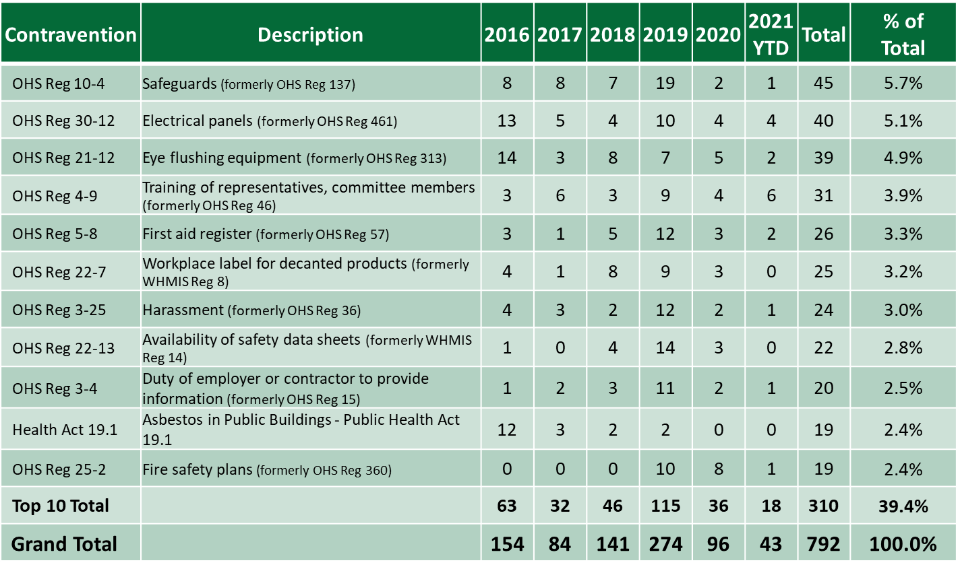
Top Ten OHS Contraventions Issued from 2016 to 2021 (YTD – September 30) Elementary and Secondary Education (G12)

Slide 7
Safety Management System – Six Elements
Management &
Leadership
Hazard
Identification & Control
Training &
Communication
Inspections
Investigation
Emergency Response
Governance
Risk Assessment
Training
Inspections
Reporting
Emergencies
Senior Management
Involvement
Safe Work Practices/ Procedures
Orientation
Investigation
Health & Safety Policy
Business Continuity
OHC
PPE
Worker Rights
Communication
Responsibility
Procurement
Document development, review and communication
Accountability
Safety Rules
Measurement

Slide 8
Top Three Injuries/Hazards
G-12 Education Sector

Slide 9
Be sure to check out the resources and templates that are now available on this website.
Next steps

Slide 10
Desired Future State
Zero Injuries Functioning Safety Management System
Notes:
Read slide

Slide 11
Contact Us:
952 Albert Street
Regina SK S4R 2P7
306.545.5595
info@saswh.ca

