Slide 1
Safe Moving And Repositioning Techniques (SMART®) Program©
General Participant Training
1st Edition

Slide 2
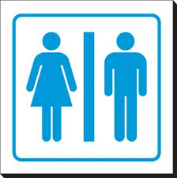
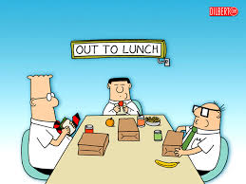
Housekeeping Details

Slide 3
Successful Completion
Participate
Practice – 3 times, each technique
Return demonstration
Ensure you:
understand safe body mechanics, risk assessment process and safe moving techniques
have time for hands-on practice
receive mentoring, coaching and feedback
ask questions

Slide 4
What You Will Learn Today
Laws to follow
Importance of safe posture and safe body mechanics
How to identify risks in a moving task
Safe moving techniques
The importance of evaluation, communication, and documentation

Slide 5
Accountability and Legislation
What does accountability mean to you?
Saskatchewan’s Occupational Health and Safety Legislation
Employers Responsibilities
Three Rights of a Worker
the Right to Know
The Right to Refuse
The Right to Participate
Workers Responsibilities

Slide 6
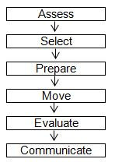
Steps to a Moving Task

Slide 7
Assess
Complete a risk assessment of self, environment, equipment, object/task, not just once, but also In the Moment the task is being performed. SMART utilizes the following steps:
1. identify the risk(s)
2. collect information about the risk factor(s) 3. analyze the information collected

Slide 8
Select
An appropriate moving technique:
is based on the risk assessment of the worker, environment, available and appropriate equipment, the object and task
eliminates or manages the risk of injury to the worker(s)
is considered to be the safest moving task for the worker(s) at the time of the move and in the environment where the moving task is performed

Slide 9
Prepare
The worker(s) has on the appropriate footwear and PPE
The plan for the move is in place:
Appropriate equipment required is available for use.
Assistance is obtained
Roles have been clarified and communicated.
The “1-2-3-command” has been determined.
The route is planned.
The second location has been prepared
The pathway is clear of any obstacles, lighting is adequate, noise is minimized.
The worker(s) ensures clear visibility to start and perform the move (e.g., load height and width).

Slide 10
Move
The worker’s duties include:
providing clear direction
obtaining assistance
The assistant(s) duties include:
managing the equipment
All workers involved in the moving task:
ensure safety of the moving task
stop the moving task when they identify any risks that may jeopardize the safety of the moving task

Slide 11
Evaluate
Did the move compromised safe body mechanics?
Was the load too heavy, awkward or unstable during the move?
Communicate
What went well
What the recommended moving technique should be
How risks were eliminated or managed

Slide 12
Safe Posture and Safe Body Mechanics
Learning outcomes:
use the human body properly by applying principles of safe posture
static and dynamic muscle actions as potential risk factors
safe body mechanics assists with reducing injuries
risk of musculoskeletal injuries (MSIs) must be eliminated or managed

Slide 13
Safe Posture
Neutral Position
Neutral Spine
Standing Posture
Sitting Posture
Lying Posture
Dynamic and Static
Muscle Action
Dynamic (with movement)
Static (without movement)

Slide 14
Ergonomics
Ergonomics is fitting the job to the worker.
Proper set-up of a workstation and use of optimal work techniques can make the difference between comfort and pain.
Adding frequent stretch breaks, task changes, job rotation, etc., and you can minimize your potential for injury.
Ergonomics improves productivity, efficiency, effectiveness and saves time.

Slide 15
Biomechanics
Biomechanics is the study of the body as though it was simply a machine. The main aim of biomechanics is to study the way the body produces force and generates movement.
Body mechanics focuses on the forces which different movements create on the body.
The structure of each part of the human body is directly related to its function.

Slide 16
SMART Principles of Safe Body Mechanics
Think and Plan Ahead
Safe Stance – stride or parallel
Maintain the Three Natural Curves of the Spine
Use the Core, Buttocks and Thigh and Calf Muscles
Use a Safe and Effective Grip
Work Within Your Comfort Zone
Use Weight Transfer When Performing a Moving Task

Slide 17
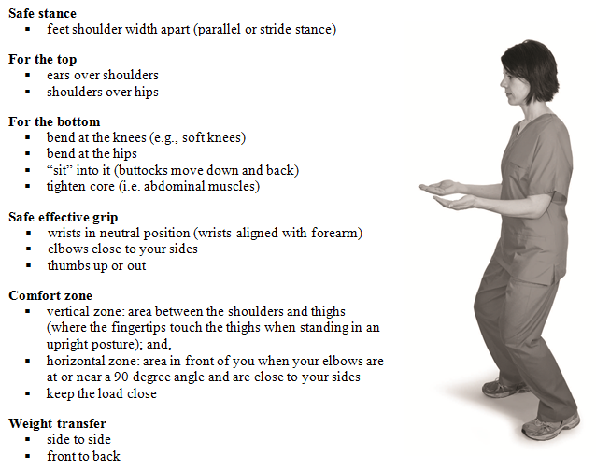
SMART Checkpoints to Safe Body Mechanics

Slide 18
Musculoskeletal Injuries
Work-related MSIs may be defined as:
injuries, illnesses or diseases of muscles
Including tendons, ligaments, bursae, nerves, joints, cartilage (including intervertebral discs), bones and supporting blood vessels
Preventative/Corrective Action:
document and report concerns
consult an appropriate health care provider
supervisor would promptly initiate an investigation to determine the root cause
then take corrective measures to avoid further injuries

Slide 19
Hazard
A hazard is a situation that poses a level of threat to life, health, property, process or environment. Basically, it is anything that can cause an injury or illness.
Hazard identification and control is required at all stages of a work process including:
prior to establishing and using a work place;
when planning and designing work processes;
before selecting, purchasing, installing and using equipment;
before changes are made to the workplace or systems of work; and,
whenever there is new information about work processes.
1
Identify Hazards
2
Assess Risks
3
Eliminate or Control
4
Monitor

Slide 20
Controlling Hazard
Hazard Control Methods
The most effective corrective action or preventative measure will focus on controlling a hazard at the source, without introducing any new or potential risks.
Most Effective Least Effective
At the source | Along the path | At the worker
Elimination Substitution Redesign Isolation Automation | Barriers Absorption Dilution | Training Supervision Policies & procedures Hygiene practices Administrative PPE

Slide 21
Risk Assessment
Learning outcomes:
Identify risks in self, environment, equipment, object/task
Consider ways to eliminate or manage risks
In the Moment Risk Assessment – using the full risk assessment process prior to performing a moving task
A risk is any factor that has the potential to jeopardize the safety of those involved in the moving task.
In SMART, Risk Assessment is the process by which the worker identifies and eliminates or manages risks in order to select the safest moving technique.

Slide 22
SELF Risk Assessment “All About YOU!”

Slide 23
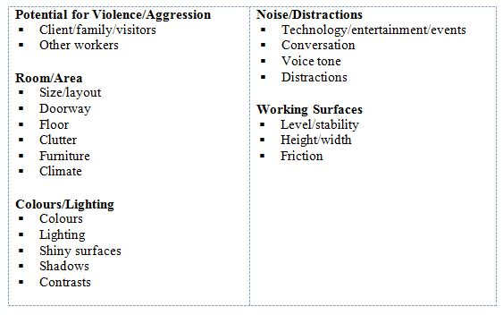
ENVIRONMENT Risk Assessment

Slide 24
EQUIPMENT Risk Assessment

Slide 25
OBJECT Risk Assessment

Slide 26
In the Moment Risk Assessment
Verify
Assess
Select
Prepare
Move
Evaluate
Communicate

Slide 27
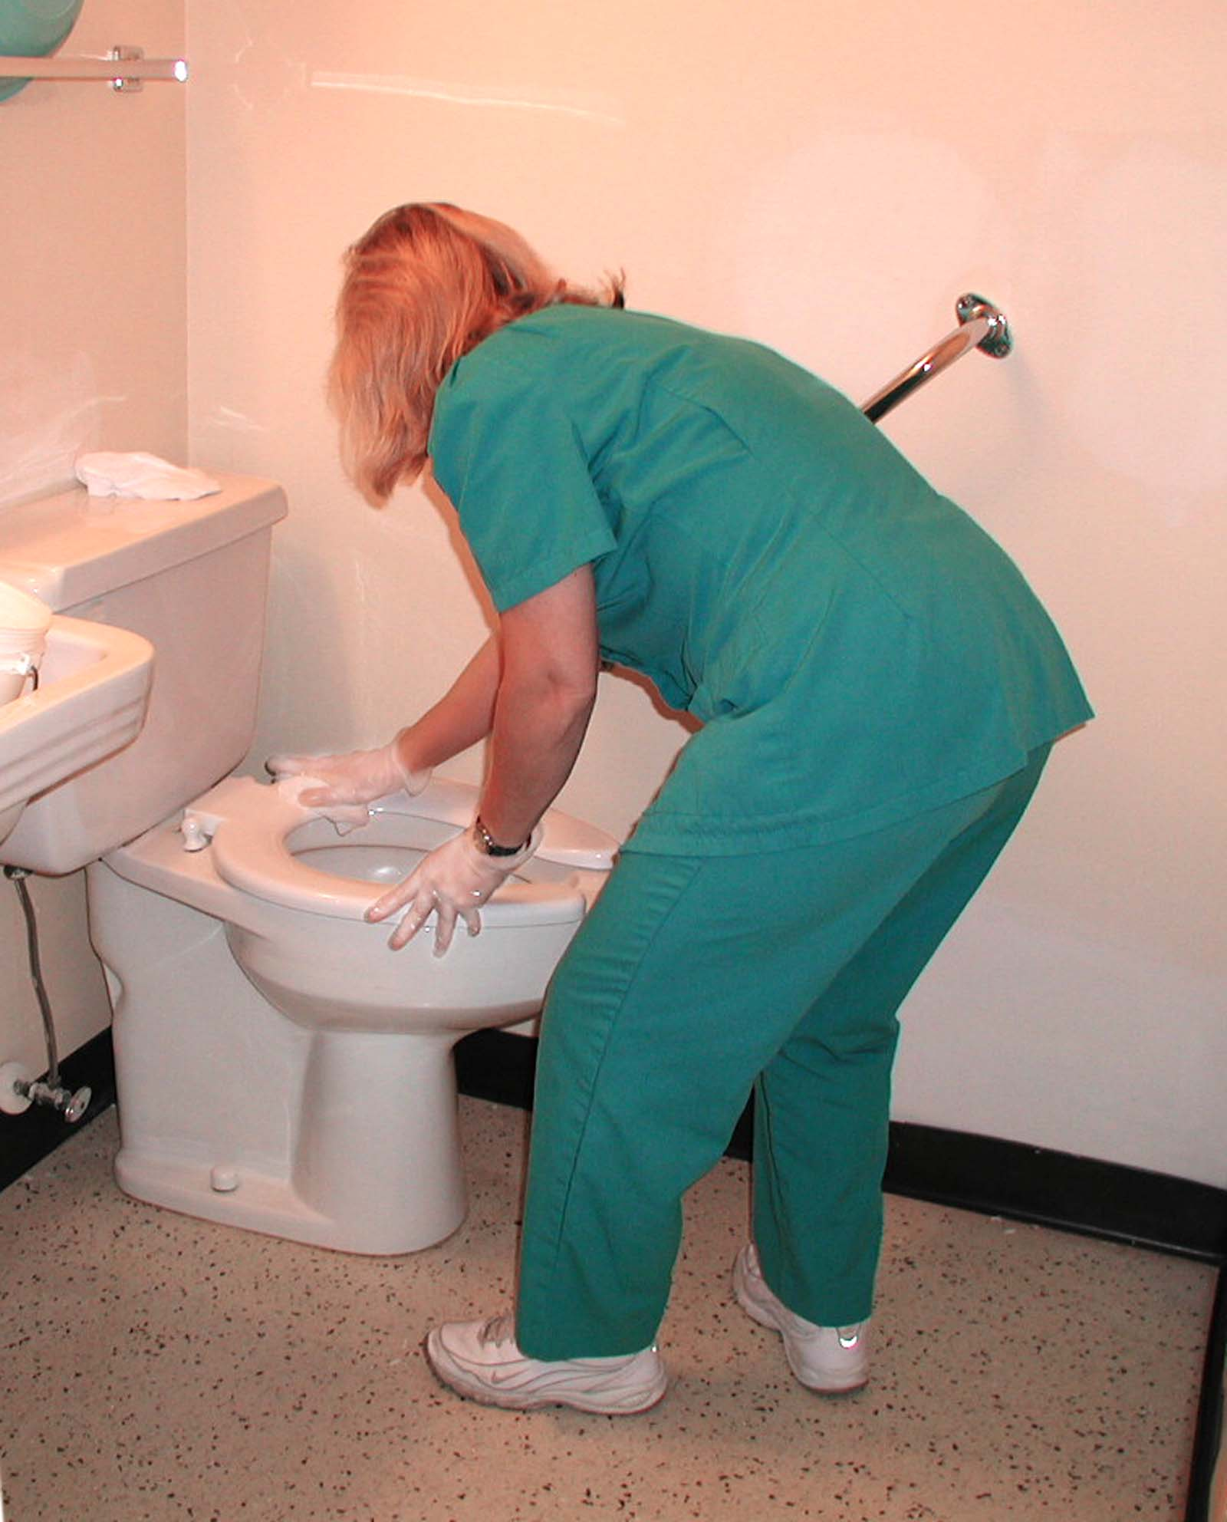
Safe Body Mechanics Review Exercise

Slide 28
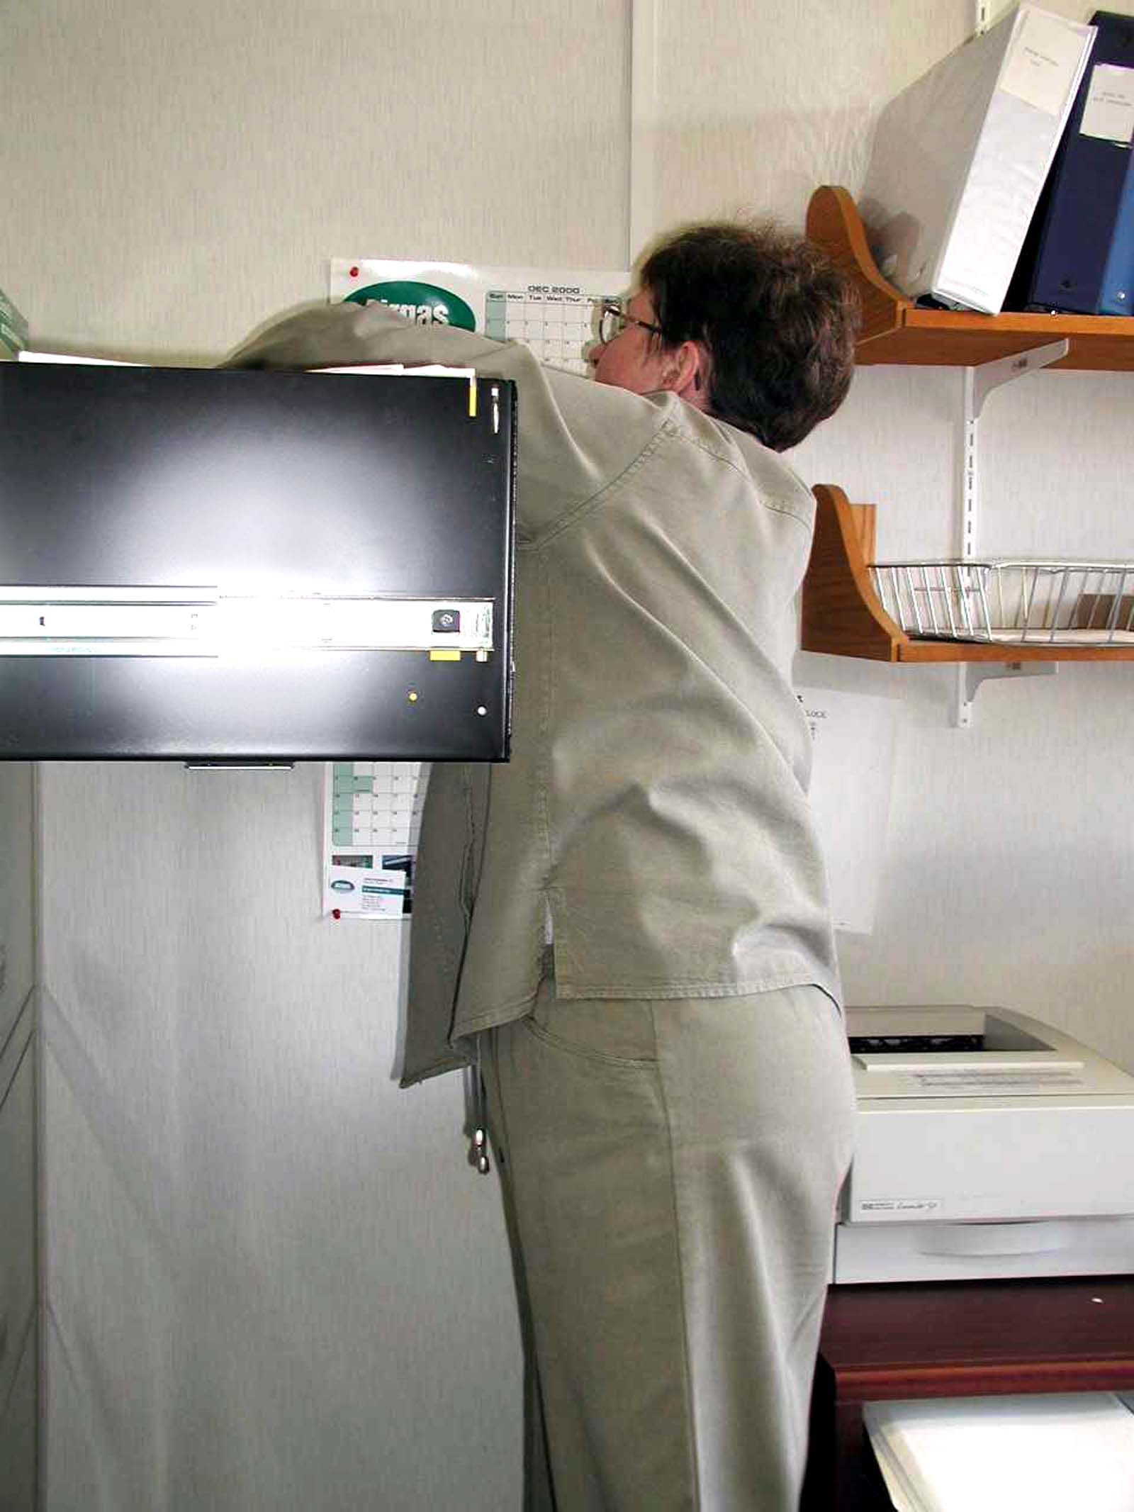
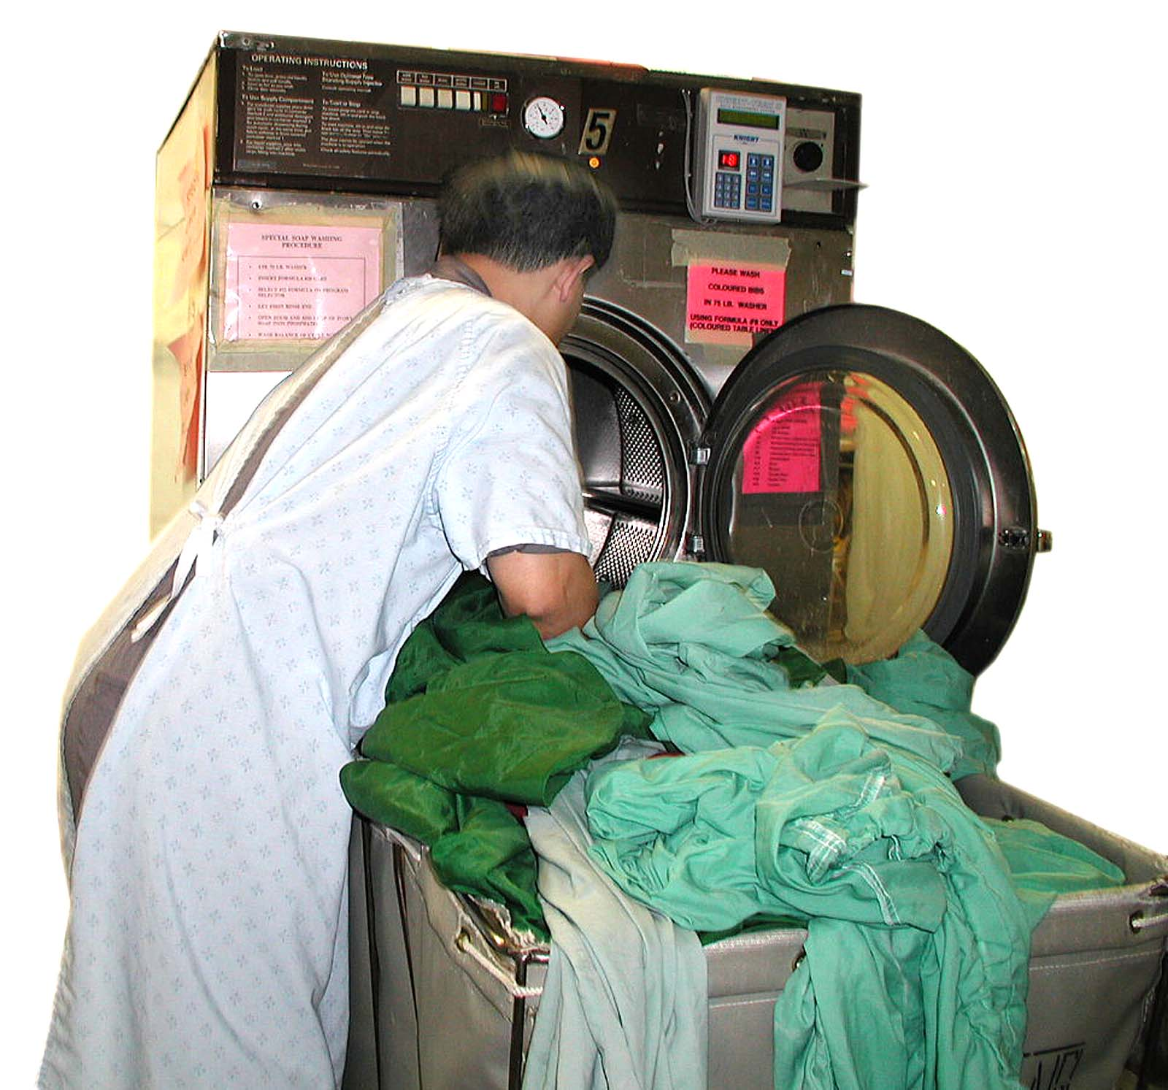
Safe Body Mechanics Review Exercise

Slide 29
SMART Manual Handling Strategies
De-casing/breakdown
Minimal Handling
Task Variation
Micro-breaks
Trip Frequency
Procedure Logo
Storage/Retrieval Strategy
Chunking

Slide 30
SMART General Moving Techniques
Learning Outcomes:
identify the most appropriate situation for use of a technique
the preparatory steps for moving objects including use of 1-2-3-command
SMART standard moving techniques (pushing/pulling, lifting, repositioning)
complete, communicate and evaluate a moving task

Slide 31
SMART General Moving Techniques
Pushing/Pulling Wheeled Equipment

Slide 32
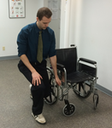
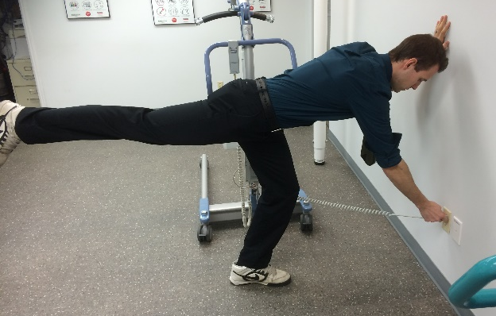
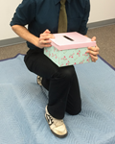
SMART General Moving Techniques
Manually lifting manageable items on or near the floor:
Golfer’s Lift
One Handed Partial Squat Lift
Tripod Lift
Diagonal Lift

Slide 33
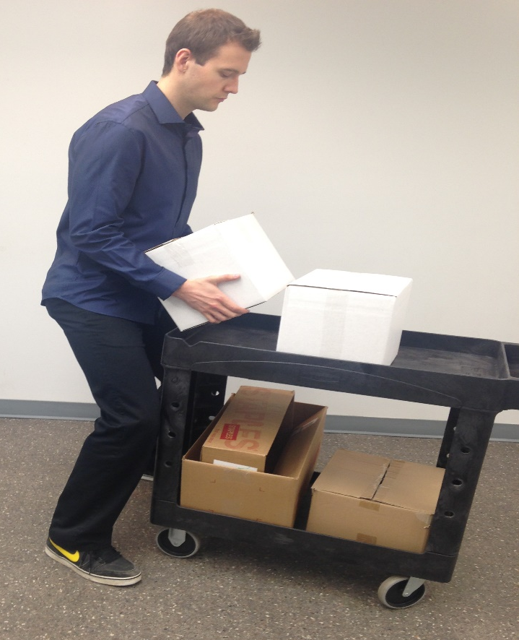
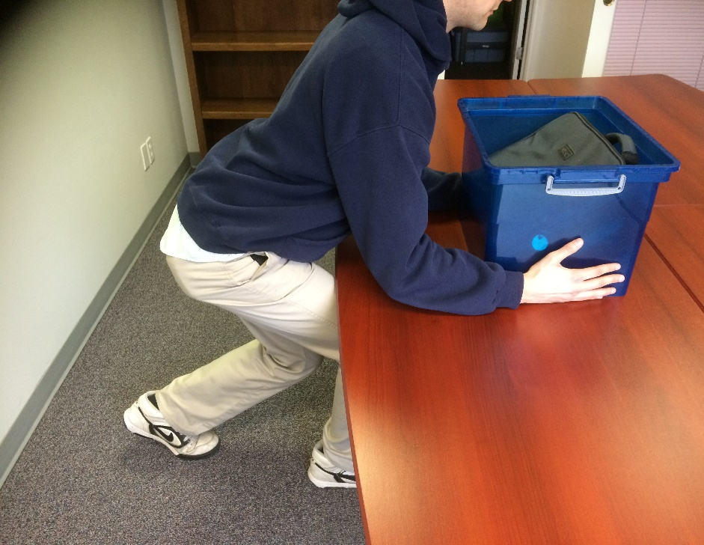
SMART General Moving Techniques
Power Lift Repositioning

Slide 34
SASWH Resources
Programs and resources – visit www.saswh.ca
Safety Talks
SMART material order form
Semi-secure area:
username SMART1
password SMART2

Slide 35
Summary Risk Assessment and General Moving Techniques
You have learned:
Safe Posture and Safe Body Mechanics
Risk Assessment Process - Eliminate or Manage Risks
Selecting and Using an Appropriate Moving Technique
Evaluate, Communicate, Document
In the Moment Risk Assessment
Resources on SASWH’s website
Be Aware…Be Healthy…Be Safe

