Slide 1
Transferring Lifting Repositioning (TLR®) Program©
Specifically for
Emergency Medical Services (EMS)
The TLR EMS program is intended for EMS only and supports classroom training facilitated by SASWH approved TLR EMS Trainers. Use of this information other than in EMS is not authorized.

Slide 2
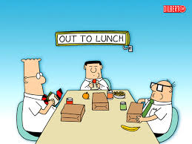
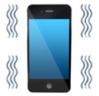
Housekeeping Details

Slide 3
Administrative Details
Sign in sheet - attendance list
Fit for Training Declaration
Evaluation (pre session questions)
Respectful Discussion

Slide 4
TLR EMS Program
New program specifically for EMS, developed in collaboration with EMS
Considers EMS work is primarily performed in an uncontrolled environment (outside, in private homes)
Offers safe moving techniques/guidelines that may be adapted/modified with safety in mind

Slide 5
Successful Completion
Participate – your active involvement
Practice – 3 times, each technique
Return demonstration
Ensure you:
understand safe body mechanics, risk assessment process and safe moving techniques
have time for hands-on practice
receive mentoring, coaching and feedback
ask questions

Slide 6
What You Will Learn Today
There are laws to follow
Importance of good posture and safe body mechanics
How to identify risks in a moving task
Safe moving techniques/guidelines
The importance of evaluation, communication and documentation

Slide 7
Accountability & Legislation
What does accountability mean to you?
Saskatchewan’s Occupational Health and Safety Legislation
Employers Responsibilities
Three Rights of a Worker
The Right to Know
The Right to Participate
The Right to Refuse
Workers Responsibilities

Slide 8
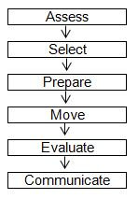
Steps to a Moving Task
Assess the scene
Select a safe move
Prepare for the move
Perform the move
Evaluate
Communicate (verbal and written)

Slide 9
Good Posture and Safe Body Mechanics
Learning outcomes:
use the human body properly by applying principles of good posture
static and dynamic muscle actions as potential risk factors
principles of safe body mechanics to assist with reducing injuries
risk of musculoskeletal injuries (MSIs) must be eliminated or managed

Slide 10
Good Posture
Neutral Position
Neutral Spine
Standing Posture
Sitting Posture
Lying Posture
Muscle Action
Dynamic
Static

Slide 11
TLR EMS Principles of Safe Body Mechanics
Think and Plan Ahead
Safe Stance – stride or parallel
Maintain the Three Natural Curves of the Spine
Use the Core, Buttocks and Thigh and Calf Muscles
Use a Safe and Effective Grip
Work Within Your Comfort Zone
Use Weight Transfer When Performing a Moving Task

Slide 12
TLR Checkpoints incorporates the Principles of Safe Body Mechanics

Slide 13
Musculoskeletal Injuries
Work-related MSIs may be defined as:
injuries, illnesses or diseases of muscles
Including tendons, ligaments, bursae, nerves, joints, cartilage (including intervertebral discs), bones and supporting blood vessels
Preventative/Corrective Action:
document and report concerns
consult an appropriate health care provider
supervisor would promptly initiate an investigation to determine the root cause
then take corrective measures to avoid further injuries

Slide 14
Risk Assessment
Learning outcomes:
Identify risks in self, environment, equipment, object/task, patient
Consider ways to eliminate or manage risks
In the Moment Risk Assessment – using the full risk assessment process prior to performing a moving task
A risk is any factor that has the potential to jeopardize the safety of those involved in the moving task.
In TLR, Risk Assessment is the process by which the worker identifies and eliminates or manages risks in order to select the safest moving technique.

Slide 15
Self-Risk Assessment “All About YOU!”
Physical Status
Previous injury/illness/surgery
Height and weight relative to patient/other workers
Safe body mechanics
Good posture
Physical fatigue
Physical fitness
Nutrition
Stimulant/depressant usage
Clothing
Emotional Status
Stress
Emotional fatigue
Training and Experience
Assessment and decision making
Ability to perform the move
Attitude and approach
Observation, awareness, focus
Policies and OH&S legislation
Communication Skills
With other workers, patient/family
Vision and hearing
Workload
Time to safely perform the move
Availability of assistance
Extended shifts
Additional EMS considerations:
Time being stationary
In a moving ambulance

Slide 16
Environment Risk Assessment
Potential for Violence/Aggression
Patient/family/visitors
Other workers
Room/Area
Size/layout
Doorway
Floor
Clutter
Furniture
Climate
Colors/Lighting
Colours
Lighting
Shiny surfaces
Shadows
Contrasts
Noise/Distraction
Technology/entertainment/events
Conversation
Voice tone
Distractions
Working Surfaces
Level/stability
Height/width
Friction
Additional EMS Considerations
Driving/walking up
to the scene:
Ruts
Hills/slants
Ice
Puddles
Traffic
Other risks:
Other people
Temperature
Bed bugs/lice/scabies
Pets/pet excrement
Doors
Movable beds

Slide 20
Equipment Risk Assessment
Quantity
Accessible
Capacity
Ability
Quality
Function
Maintenance
Design
Ergonomically correct
Adjustable
Manufacturer's intended Use
Limitations
Additional EMS Considerations
Stretcher/cot
Stair chair
Spine board
Scoop stretcher
Bariatric lift sheet
Camel
Short spine board
Transfer belt
Blanket/flannel
KED
Slider board
Rescue seat
Lift belt
Standard lift sheet

Slide 21
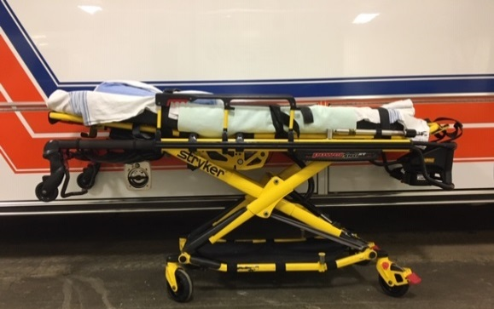
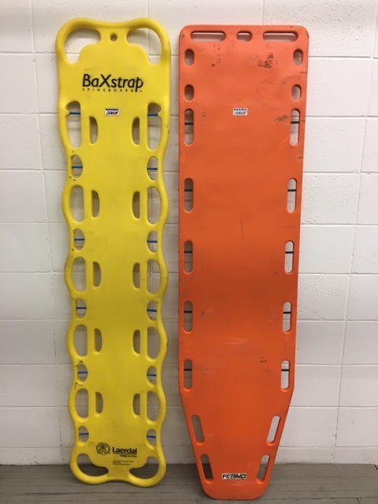
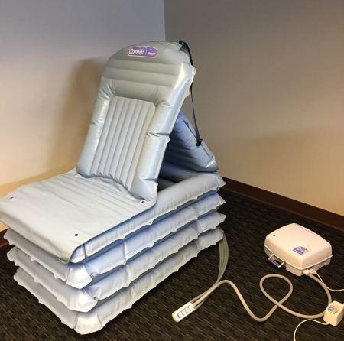
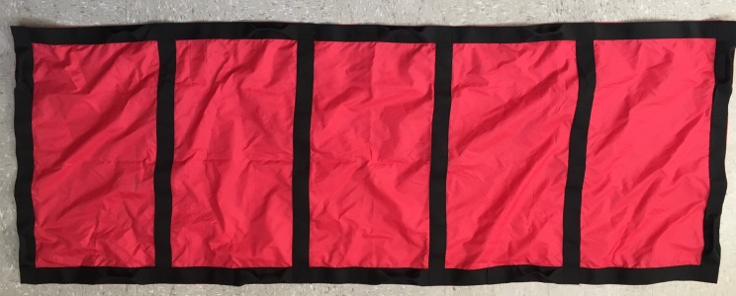
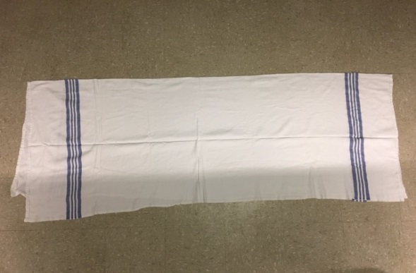
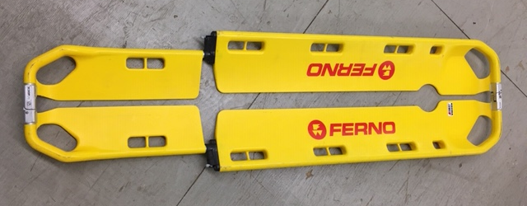
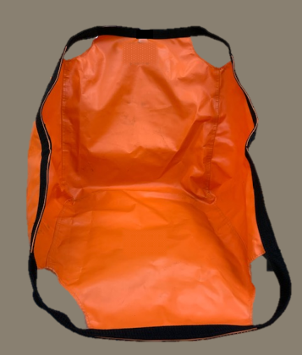
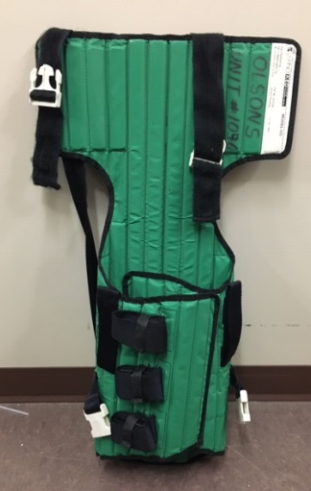
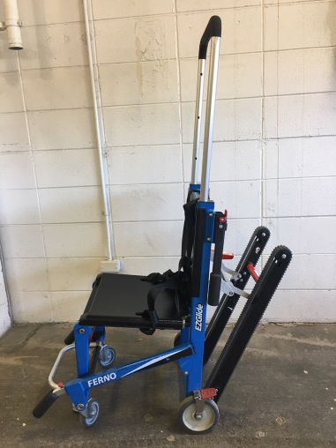
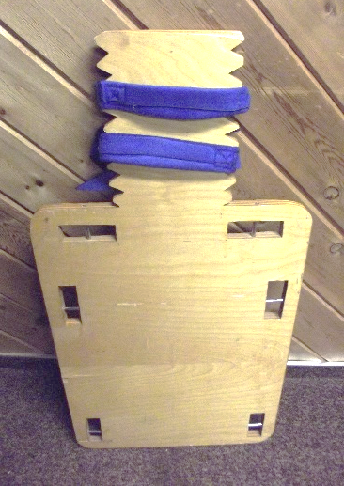
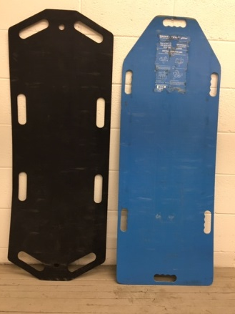
Equipment Risk Assessment
Notes:
Top left to right: stretcher, spine board, Camel
Centre left to right: standard lift sheet (new), flannel, spine board
Bottom left to right: slider board, rescue seat, KED, stair chair, short spine board

Slide 22
Object/task Risk Assessment
The Object
Size/shape
Weight
Texture
Contents
Handles
Balance
Temperature
The Task
Location
Distance to be moved
Force to initiate, maintain or stop movement
Frequency/repetition
Degree of emergency

Slide 23
In the Moment Risk Assessment
Verify
Assess
Select
Prepare
Move
Evaluate
Communicate
At the time of the move
To the best of your ability, eliminate or manage the risks

Slide 24
TLR EMS General Moving Techniques
Learning Outcomes:
identify the most appropriate technique
the preparatory steps for moving objects including use of 1-2-3-command
Safe moving techniques (pushing/pulling, lifting, repositioning)
complete, communicate and evaluate a moving task

Slide 25
TLR EMS General Moving Techniques
Pushing/Pulling Wheeled Equipment
Manually lifting items on or near the floor:
Golfer’s Lift
One Handed Partial Squat Lift
Tripod Lift
Diagonal Lift
Manually lifting items within your comfort zone:
Power Lift (one and two worker techniques)
Changing worker position from Tripod to Power Lift
Repositioning

Slide 26
Summary Risk Assessment and General Moving Techniques
You have learned:
Good Posture and Muscle Action
Safe Body Mechanics – TLR Checkpoints
Risk Assessment Process
Eliminate or Manage Risks
Selecting and Using Safe Moving Technique
Evaluate, Communicate, Document
In the Moment Risk Assessment

Slide 27
Test My Knowledge
What do you remember?

Slide 28
TLR EMS Patient Mobility Risk Assessment and Moving Techniques/Guidelines
Learning outcomes:
awareness of what occurs in a controlled environment (mobility record, logos)
identify risks in the patient’s ability to mobilize
manage (or eliminate if possible) any identified mobility risks
EMS patient moving techniques/guidelines
modify/adapt with safety in mind

Slide 29
Client Mobility Risk Assessment in Controlled Settings
Initial client mobility risk assessment
Re-assessment is the ongoing client mobility risk assessment
Specialized client mobility assessment
You may have seen:
Comprehensive documentation
Logos

Slide 30
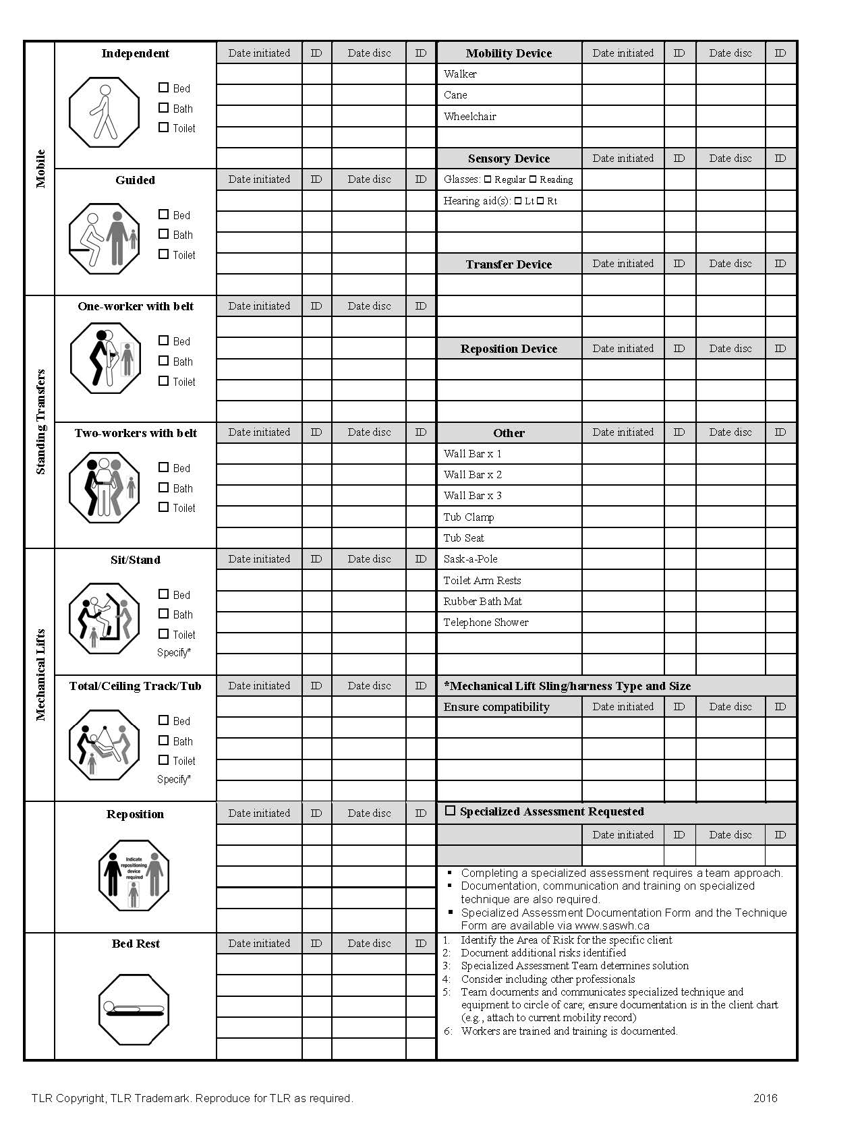
Front
Back

Slide 31
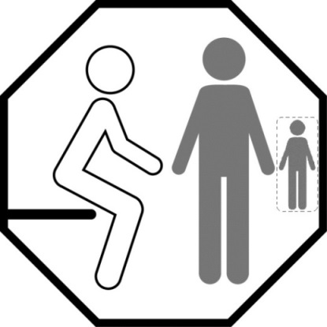
TLR Logos in Controlled Settings
Regulation 470: the client’s level of assistance must be indicated “at or near the location” of the client.
clearly visible logos, decals or other methods that indicate the minimum requirements for assistance
TLR logos provide a visual. The minimum requirements for assistance are indicated on the logo, such as, but not limited to:
equipment needed
number of workers required
other important information for that client

Slide 32
EMS Patient Mobility Risk Assessment and Moving Techniques
Initial patient mobility risk assessment
Re-assessment (ongoing/in the moment)
It is ongoing, during patient mobility, care and transport

Slide 33
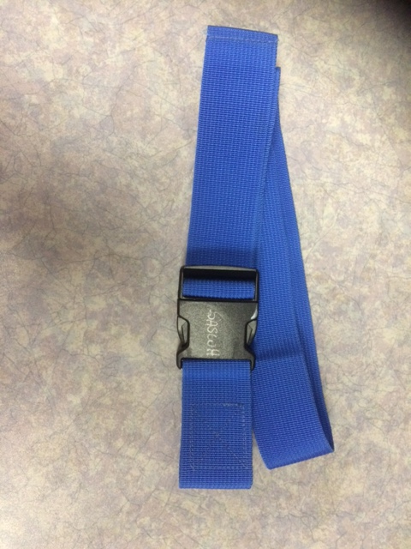
Transfer Belt
Intended for cuing, guiding and stabilizing in a controlled environment
not intended to be used as a lifting device

Slide 34
TLR EMS Patient Moving Techniques
Independent and Guided
Sitting to lying/Lying to sitting
Standing Transfers (one medic; two medic)
use of Transfer Belt
Repositioning (stretcher to bed/bed to stretcher)
EMS techniques/guidelines for use in an uncontrolled environment

Slide 37
Notes:
.

Slide 38
Documentation
PCR needs to include:
How patient was moved to cot
What equipment was used
Any changes in condition due to move
How patient was transferred to hospital bed/chair

Slide 39
Summary
You have learned about:
Good Posture – Safe Body Mechanics
How to Identify, Eliminate or Manage Risks
Patient Mobility Risk Assessments
In the Moment Risk Assessment
Selecting and Using an Appropriate Moving Technique At the Time of the Move
Evaluate, Communicate
Documentation

Slide 40
Administrative Details
Fit for Training Declaration
Evaluation (post session questions)
Questions???
Certificate of Completion
Re-evaluation
Be Aware…Be Healthy…Be Safe

