Slide 1

Transferring Lifting Repositioning (TLR®) Program©
Train the Trainer
4th Edition

Slide 2







Housekeeping Details

Slide 3
Effective Trainers
Participation, Practice, Conversation
Review Effective Facilitation
Return demonstration of your understanding
through teaching back – multiple opportunities
Ensure you:
understand safe body mechanics, risk assessment process and safe moving techniques
have time for hands-on practice
receive mentoring, coaching and feedback
ask questions

Slide 4
Facilitation Practice
Pick a topic (familiar to you)
10 min prep
5 min presentation time
Effective Facilitation
Teaching Adults Effectively
A Guide to Facilitating
Adult Learning Styles
Planning and Organizing

Slide 5
TLR Materials
TLR User Manual
TLR Trainer’s Guide
Participant Workbook

Slide 6
Trainer Responsibilities
Teaching TLR
Lesson Plan Guidelines
Implementing and Sustaining TLR, Step 5- Training
  TLR Instructors
  TLR Trainers
  General Participant Training

Slide 7
What You Will Learn Today
Laws to follow
Importance of good posture and safe body mechanics
How to identify risks in a moving task
Safe moving techniques
The importance of evaluation, communication, and documentation

Slide 8
Accountability and Legislation
What does accountability mean to you?
Saskatchewan’s Occupational Health and Safety Legislation
  Employers Responsibilities
  Three Rights of a Worker
    The Right to Know
    The Right to Refuse
    The Right to Participate
  Workers Responsibilities

Slide 9
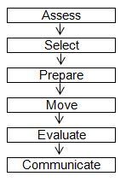
Steps to a Moving Task

Slide 10
Assess
Complete a risk assessment of self, environment, equipment, object, client, not just once, but also In the Moment the task is being performed. TLR utilizes the following steps:
1. identify the risk(s)
2. collect information about the risk factor(s) 3. analyze the information collected

Slide 11
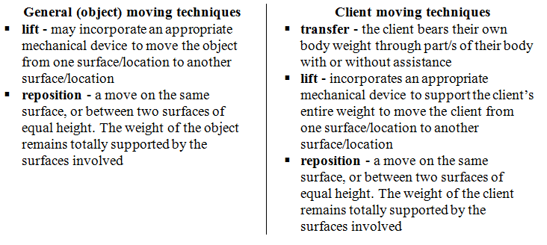
Select

Slide 12
Prepare
The worker(s) has on the appropriate footwear and PPE
The plan for the move is in place:
Appropriate equipment required is available for use.
Assistance is obtained
Roles have been clarified and communicated.
The “1-2-3-command” has been determined.
The route is planned.
The second location has been prepared
The pathway is clear of any obstacles, lighting is adequate, noise is minimized.
The worker(s) ensures clear visibility to start and perform the move (e.g., load height and width).

Slide 13
Move
The worker’s duties include:
providing clear direction
obtaining assistance
The assistant(s) duties include:
managing the equipment
All workers involved in the moving task:
ensure safety of the moving task
stop the moving task when they identify any risks that may jeopardize the safety of the moving task

Slide 14
Evaluate
Did the move compromise safe body mechanics?
For moving objects: was the load too heavy, awkward or unstable during the move?
For moving clients: did the worker feel they were lifting the client or that the client was unstable during the move?
Communicate
What went well
What the recommended moving technique should be
How risks were eliminated or managed

Slide 15
Facilitation Practice
Pick a topic from what we just learned
10 min prep
5 min presentation time

Slide 16
Good Posture and Safe Body Mechanics
Learning outcomes:
use the human body properly by applying principles of good posture
static and dynamic muscle actions as potential risk factors
safe body mechanics assists with reducing injuries
risk of musculoskeletal injuries (MSIs) must be eliminated or managed

Slide 17
Good Posture
Neutral Position
Neutral Spine
Standing Posture
Sitting Posture
Lying Posture
Dynamic and Static
Muscle Action
Dynamic (with movement)
Static (without movement)

Slide 18
TLR Principles of
Safe Body Mechanics
Think and Plan Ahead
Safe Stance – stride or parallel
Maintain the Three Natural Curves of the Spine
Use the Core, Buttocks and Thigh and Calf Muscles
Use a Safe and Effective Grip
Work Within Your Comfort Zone
Use Weight Transfer When Performing a Moving Task

Slide 19
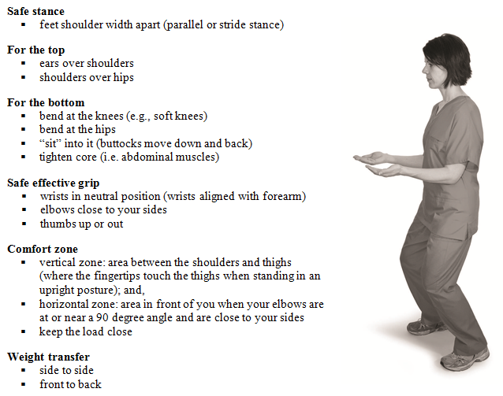
TLR Checkpoints to
Safe Body Mechanics

Slide 20
Musculoskeletal Injuries
Work-related MSIs may be defined as injuries, illnesses or diseases of muscles and their tendons, ligaments, bursae, nerves, joints, cartilage (including intervertebral discs), bones and supporting blood vessels in either the upper or lower extremities or the back.
Preventative/Corrective Action:
Document and report concerns to immediate supervisor, who then advises the worker to consult an appropriate health care provider. The supervisor will also promptly initiate an investigation to determine the root cause and then take corrective measures to void further injuries.

Slide 21
Facilitation Practice
Pick a topic from what we just learned
10 min prep
5 min presentation time

Slide 22
Risk Assessment
Learning outcomes:
Identify risks in self, environment, equipment, object, client
Consider ways to eliminate or manage risks
In the Moment Risk Assessment – using the full risk assessment process prior to performing a moving task
A risk is any factor that has the potential to jeopardize the safety of those involved in the moving task.
In TLR, Risk Assessment is the process by which the worker identifies and eliminates or manages risks in order to select the safest moving technique.

Slide 23
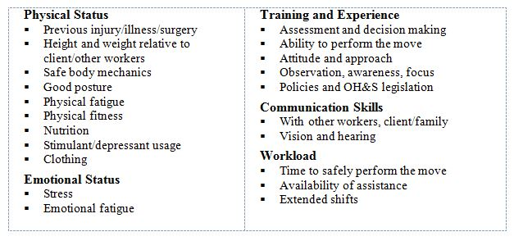
SELF Risk Assessment
“All About YOU!”

Slide 24
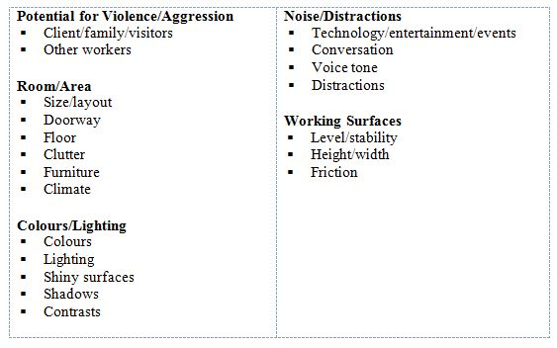
ENVIRONMENT Risk Assessment

Slide 25
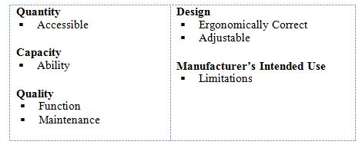
EQUIPMENT Risk Assessment

Slide 26
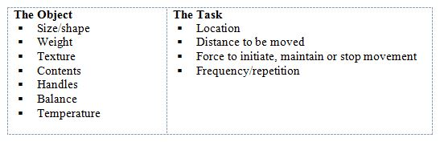
OBJECT Risk Assessment

Slide 27
In the Moment Risk Assessment
Verify
Assess
Select
Prepare
Move
Evaluate
Communicate

Slide 28
Facilitation Practice
Pick a topic from what we just learned
10 min prep
10 min presentation time

Slide 29
TLR General Moving Techniques
Learning Outcomes:
identify the most appropriate situation for use of a technique
the preparatory steps for moving objects including use of 1-2-3-command
TLR standard moving techniques (pushing/pulling, lifting, repositioning)
complete, communicate and evaluate a moving task

Slide 30
TLR General Moving Techniques
Pushing/Pulling Wheeled Equipment
Manually lifting manageable items on or near the floor:
Golfer’s Lift
One Handed Partial Squat Lift
Tripod Lift
Diagonal Lift
Manually lifting manageable items in your comfort zone:
Power Lift (one and two worker techniques)
Changing worker position from Tripod to Power Lift
Repositioning

Slide 31
Facilitation Practice
Pick a topic from what we just learned
10 min prep
6-10 min presentation time

Slide 32
Summary
Risk Assessment and General Moving Techniques
You have learned:
Good Posture and Safe Body Mechanics
Risk Assessment Process - Eliminate or Manage Risks
Selecting and Using an Appropriate Moving Technique
Evaluate, Communicate, Document
In the Moment Risk Assessment
Resources on SASWH’s website
Be Aware…Be Healthy…Be Safe

Slide 33
CLIENT MOBILITY
Risk Assessment
Learning outcomes:
identify risks in the client’s ability to mobilize
Initial client mobility risk assessment (provides baseline)
Re-assessment is the ongoing client mobility risk assessment (completed to change the minimum level of assistance; documents change/s in mobility)
Specialized client mobility assessment (when standard TLR techniques are not suitable)
manage client risks, and if possible, eliminate risks
Documenting the assessment, selecting a moving technique
In the Moment risk assessment

Slide 34
Initial Client Mobility
Risk Assessment
conducted when the client arrives to a facility/agency/service
conducted prior to moving the client (an exception to the TLR formal, documented assessment could be in acute/emergency situations)
documented on a TLR Mobility Record (or an employer’s comparable form) and becomes part of the client’s chart
communicated appropriately

Slide 35
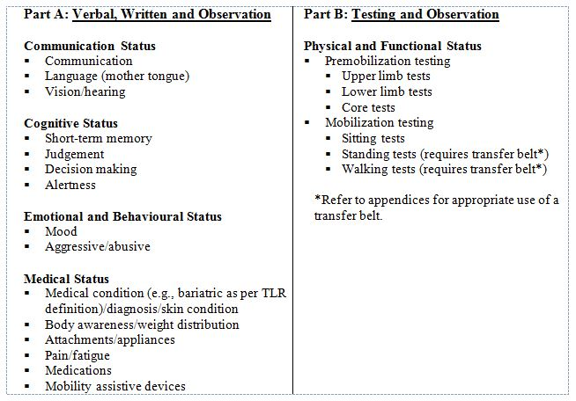
Part A, Part B

Slide 36
Transfer Belt
cuing, guiding and stabilizing
not intended to be used as a lifting device
used during the TLR client mobility risk assessment - PART B, Testing and Observation as well as in Standing Transfers
is removed right after Part B of the assessment is completed

Slide 37
Part B: Testing and Observation
Two levels for testing the physical and functional status:
pre-mobilization testing - requires hands on approach by the worker completing the risk assessment. The client can be assessed either when in a seated or a supine position.
mobilization testing - requires hands on approach by the worker completing the risk assessment and use of a transfer belt. The client requires a degree of mobility. A second worker must be immediately available.

Slide 38
Facilitation Practice
Pick a topic from what we just learned
10 min prep
5 min presentation time

Slide 39
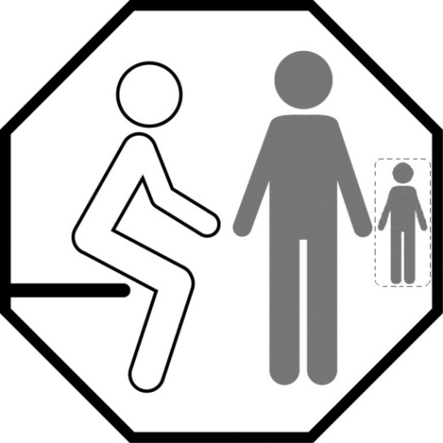
Standard TLR Logos
Regulation 470: the client’s level of assistance must be indicated “at or near the location” of the client.
use of logos, decals or other methods that suit the environment, indicate the minimum requirements for assistance, and must be clearly visible.
TLR logos provide a visual. The minimum requirements for assistance are indicated on the logo, such as, but not limited to:
equipment needed
number of workers required
other important information for that client

Slide 40
Re-assessment of
Client Mobility Risks
replaces the previous assessment
conducted when the client returns to a facility/agency after an absence
conducted after the client adjusts to new surroundings
conducted when there have been at least two consecutive and documented changes in the client’s ability to mobilize
documented on a TLR Mobility Record (or an employer’s comparable form) and becomes part of the client’s chart
communicated appropriately

Slide 41
In the Moment Risk Assessment
Verify
Assess
Select
Prepare
Move
Evaluate
Communicate

Slide 42
Changing a TLR Logo
Changing a logo
More than one logo
In-transition logo

Slide 43
Specialized Client Mobility
Risk Assessment
determining a specialized safe moving technique for a specific client
requested when a standard TLR technique is not safe for a client as identified in the initial or re-assessment. documented on the mobility record and forwarded to a specialized assessment team

Slide 44
Specialized Client Mobility
Techniques
TLR User Manual is utilized
safe body mechanics must be part of the procedures
documentation and communication of the specialized technique and appropriate equipment is required
training on the specialized technique and appropriate equipment is required
support for this specialized assessment process is critical in order to create and sustain a safe work environment
reviewed when there are at least two consecutive and documented changes in the client.

Slide 45
TLR Client Moving Techniques
Learning Outcomes:
identify the most appropriate moving technique
preparatory steps for moving a client
TLR standard moving techniques
apply and remove harnesses, slings and repositioning/sliding sheets
complete, communicate and evaluate a moving task
TLR techniques place emphasis on:
the maximum use of equipment by workers and clients;
the least amount of manual effort from the worker; and,
encouraging the maximum amount of appropriate effort from the client

Slide 46
Assess
Complete a risk assessment of client, not just once, but also In the Moment the task is being performed. TLR utilizes the following steps:
identify the risk(s)
collect information about the risk factor(s)
analyze the information collected

Slide 47
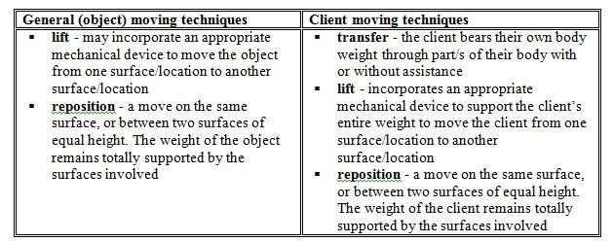
Select

Slide 48
Prepare
The worker(s) has on the appropriate footwear and PPE
The plan for the move is in place:
Appropriate equipment required is available for use.
Assistance is obtained
Roles have been clarified and communicated.
The “1-2-3-command” has been determined.
The route is planned.
The second location has been prepared
The pathway is clear of any obstacles, lighting is adequate, noise is minimized.
The worker(s) ensures clear visibility to start and perform the move (e.g., load height and width).

Slide 49
Move
For techniques with one worker with or without an assistant(s), that worker’s duties include:
providing clear direction to the client
providing clear direction to the assistant(s)
ensuring their hands are the only hands on the client
For techniques with wo workers with or without an assistant(s), TLR uses “primary worker” and “second worker” to define who would be responsible for each of the associated duties.

Slide 50
Move
For the majority of techniques the primary worker would keep their focus and attention on the client during the moving task, and:
operate equipment controls
initiate the “1-2-3-command”
or
assign these tasks appropriately

Slide 51
Move
One or more assistants may be needed.
The assistant(s) duties include managing the equipment and/or attachments, such as:
positioning wheelchair, ensuring brakes are locked
maneuvering intravenous pole
ensuring equipment and/or attachments do not interfere with the safety of the moving task
All workers involved in the moving task:
ensure safety of the moving task
stop the moving task when they identify any risks that may jeopardize the safety of the moving task.

Slide 52
Evaluate
Did the worker feel that the move compromised their own safe body mechanics?
Did the worker feel they were lifting the client?
Was the client somewhat unstable during the move?
Communicate
What went well
What the recommended moving technique should be
How risks were eliminated or managed

Slide 53
Standard TLR
Client Moving Techniques
Lying to Sitting/Sitting to Lying
Standing Transfers (one worker; two workers)
Proper use of TLR Transfer Belt
Mechanical Lifts (sit/stand; total)
Application and removal of slings and harnesses
Repositioning
Application and removal of friction reducing devices
Incorporating a total lift

Slide 54
Standard TLR
Client Moving Techniques
Lying to Sitting/Sitting to Lying
Standing Transfers (one worker; two workers)
Proper use of TLR Transfer Belt
Mechanical Lifts (sit/stand; total)
Application and removal of slings and harnesses
Repositioning
Application and removal of friction reducing devices
Incorporating a total lift

Slide 55
Bariatric Enhancement
Definition of Bariatrics
Bariatrics is derived from the Greek words “baros”, meaning weight, and “iatreia”, meaning medical treatment. It is the branch of medicine that deals with causes, prevention and treatment of obesity.
TLR Definition of a Bariatric Person
The TLR program defines a bariatric person as any individual who possesses a Body Mass Index (BMI) greater than 34 kg/m² and has physical and/or psychological risk factor(s) and/or medical condition(s) that could potentially jeopardize the safety of the worker and/or client in the performance of transferring, lifting or repositioning tasks.

Slide 56
Bariatric Enhancement
SASWH offers a Bariatric Readiness Survey to assist employers in evaluating current transferring, lifting, repositioning practices and procedures for providing health care to bariatric client.
Visit www.saswh.ca for the bariatric enhancement. Contact SASWH for more information and assistance if necessary.

Slide 57
Facilitation Practice
Pick a topic from what we just learned
20 min prep
15 min presentation time

Slide 58
What you Know Now
Teach your original topic again
10 min prep
5 min presentation time

Slide 59
SASWH Resources
Programs and resources – visit www.saswh.ca
Safety Talks
TLR material order form
Semi-secure area:
  username TLR1
  password TLR2

Slide 60
Summary
Client Assessment and Moving Techniques
You have learned:
Initial, Re-assessment and Specialized Client Mobility Risk Assessment
Documentation
Eliminate or Manage Risks
Selecting and Using an Appropriate Moving Technique
Evaluate, Communicate
In the Moment Risk Assessment
Resources on SASWH’s website
Be Aware…Be Healthy…Be Safe

