Slide 2
Welcome and Introductions
Your name and workplace.
Housekeeping:
Length of session
Phones
Washrooms
Emergency exits

Slide 3
What does W.A.V.E. stand for?
W orkplace
A ssessment
V iolence
E ducation

Slide 4
What you will learn
The appropriate approach to an individual (e.g., client).
An awareness of yourself, your environment and an individual.
The basic principles to identify risks and then eliminate or manage the risk(s).
The basics of how to protect yourself in an adverse situation, keeping respect and professionalism foremost.
(in WAVE 303 only) A few techniques to break away from a pinch, hold or choke.

Slide 5
Accountability
We are all accountable, you, your manager/supervisor, VP’s right up to the CEO.
Generally:
To give an explanation for your conduct.
Being responsible and answerable.
Day to Day, for:
Following policy.
Using the skills you received in training.
The decision/action you make.
Performing your duties accurately and appropriately
Asking for help/assistance or additional training

Slide 6
WAVE Approach Zones
Green – it’s okay
Yellow- Caution
Red – Stay away

Slide 7
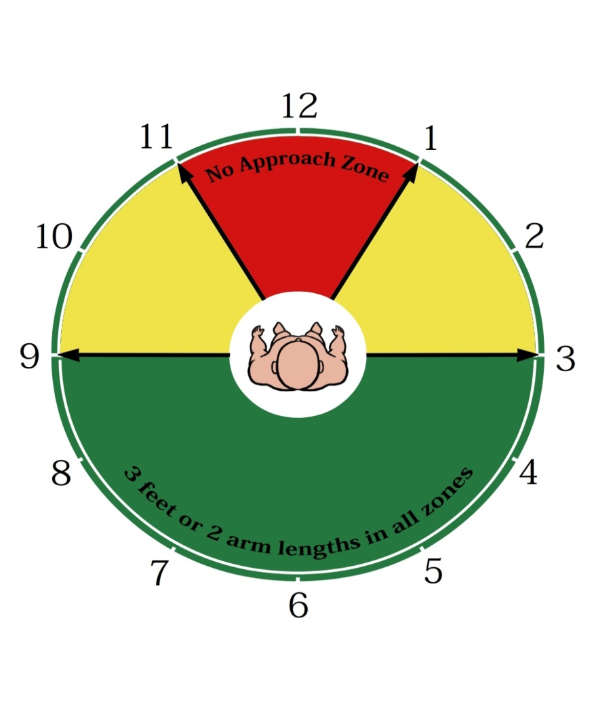
Approach Zones
Green – it’s okay
Yellow- Caution
Red – Stay away

Slide 8
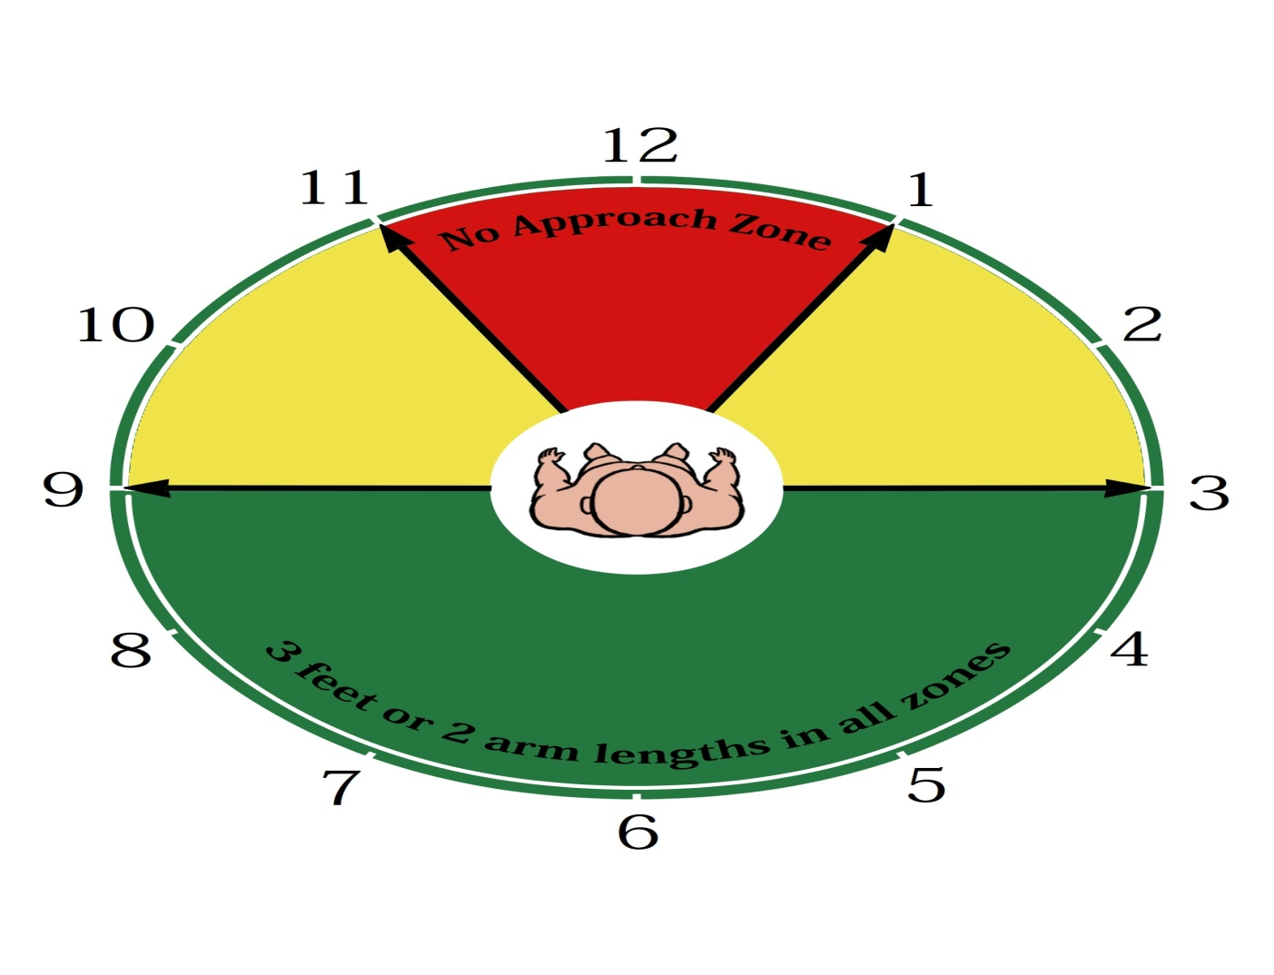
Approach-Standing

Slide 9
Approach-Sitting

Slide 10
Approach-Lying

Slide 11
Activity
Too close for comfort?!?!

Slide 12
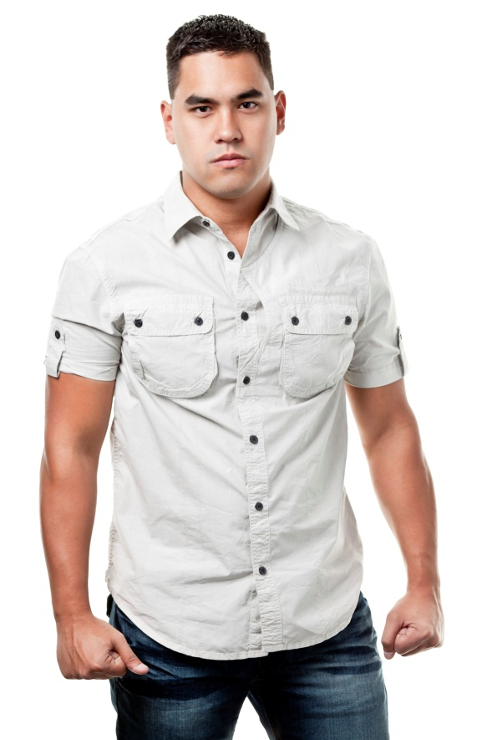
Signs of Aggression

Slide 13
6 Steps to Safety
Make eye contact, if appropriate.
Choose the appropriate yellow zone.
Determine a safe distance and stay there.
Turn your body to minimize target areas.
Talk with your hands – keep them visible.
Assess the individual.

Slide 14
“What’s Your Line”
**Clear communication is very important. State clearly who you are, why you are there and what you will be doing.**

Slide 15
Make eye contact with the individual (if appropriate)
Things to look for:
Mood.
Health.
Possible intentions.
Which “light” are they displaying.

Slide 16
Choose the appropriate yellow zone
Questions to ask yourself:
Which is my dominant side – right or left?
Which appears to be their dominant side – right or left?
Approach with your dominant side to their non-dominant side.

Slide 17
Determine a safe distance
Consider these factors before moving closer:
Individual’s size and level of mobility
Environmental space
Objects that could be used as weapons (e.g., cane, walker, hot beverage, pen)

Slide 18
Turn your body at an angle
Turning slightly sideways reduces target areas and helps to make you less threatening
Puts your dominant side forward so you are more prepared to respond

Slide 19
Talk with or show your hands
Simply approaching with “open” body language can convey a non-threatening attitude.
People may be suspicious of you if they can’t see your hands.
Your hands will be in a position to respond.

Slide 20
Assess the Client
Ask open-ended questions, paying attention to their response. Listening to what they’re saying and how they say it.

Slide 21
Practice 6 Steps to Safety
“What’s my line”
Making eye contact
Choose the appropriate yellow zone
Determine a safe distance
Turn your body at an angle
Talk with or show your hands
Assess the client

Slide 22
Approaching Closer
Lower Approach
Gaining Control
Redirecting Technique
Leaving the Area

Slide 23
Approaching Closer
Standing over someone may be perceived as a domineering stance
Lower Approach
Go lower and into a 3-point stance if you can.
Puts you on both feet and one knee, not just on the balls of your feet.
Caution – this could make you an easier target.

Slide 24
Approaching Closer
Gaining Control
Reaching out to tap someone’s arm, perhaps by the wrist, can help you continue to assess to client.
Are their muscles tensing up?
Is their arm getting ready to move (yellow light moving toward red)?
Are they relaxed and open to you talking to and touching them. (yellow to green)

Slide 25
Approaching Closer
Redirecting Technique
As you are in the lower approach and the client may attempt to strike out, try to use their force to redirect the blow or to give yourself momentum to move away from the client.

Slide 26
Approaching Closer
Leaving the Area
Once you’ve established that the client and others in the area are safe, leave the area. Keep yourself safe, even if it means leaving.

Slide 27
Activity
Approaching
Closer

Slide 28
The 3 Ps of a Right Attitude
Positive
Professional
Productive

Slide 29
5 Safety Scans for Community Workers
While driving to the location
Before exiting your vehicle
Exiting your vehicle and before closing the door
Walking in to meet the client
While meeting and assessing the client

Slide 30
Other Contributors to Violence
Times of distress
Hearing bad news, being in a waiting room, not understanding what’s happening
Medical conditions
Dementia, pain, others
Substance abuse
Drugs and/or alcohol
Environment
Busy, strange place

Slide 31
To Protect Yourself, You Can…
Secure your personal property. Locker, car, purse, wallet, etc.
Always be aware of your surroundings.
Trust your instincts.
Be aware of your own complacency.
Plan for events before they happen.

Slide 32
To Protect Yourself, You Can…
Be aware of suspicious activity.
If working alone, have ways to communicate with others.
Have respect for others and their situation.
Have a proper attitude at work – 3 Ps
Positive
Professional
Productive

Slide 33
Bringing it all together
Approach – be aware of the Green, Yellow and Red Zones
Communication – be clear
Document, report incidents – know the process in your work area

Slide 34
This concludes WAVE 101

Slide 35
WAVE Breakaway Techniques

Slide 36
Safe Practice
DURING PRACTICE, IF AT ANY TIME YOU ARE EXPERIENCING PAIN OR DISCOMFORT, STOP and TELL YOUR TRAINER or PRACTICE BUDDY TO STOP!!
Practice using slow deliberate moves

Slide 37
Warm-up Activity

Slide 38
Key points
Communicate, calmly and assertively.
Maintain your self control.
Only match your level of response to the level of assault.

Slide 39
WAVE Breakaway Techniques
Arm Grab (3 techniques)
Pinch Release (2 techniques)
Hair Pull (front and back)
Choke Release (front and back)
Covering Up technique

Slide 40
Bringing it all Together
Approach – be aware of the Green, Yellow and Red Zones
Communication – clear
Use an appropriate breakaway technique to match the level of assault
Document, report incidents

