Slide 1
WHMIS 2015 Education for Workers (Oct 2017 rev. April 2021)
Notes:
DO: Have this slide displayed as learners enter the room

Slide 2
Welcome
Insert Your Name
WHMIS 2015 Educator
Housekeeping
Emergency exits/muster point
Cell phones/pagers
Washrooms
Introductions
Your name, department
Notes:
DO: Welcome participants and introduce yourself
You may wish to say that as a WHMIS 2015 Educator, your job today is to provide education to help them work safe.
Go over housekeeping (emergency exists/muster point, cell phone/pager to “vibrate” or “off”, washrooms, finish time, etc.)
Mention that the session is about 2 hours long so there are no scheduled breaks.
Participant introductions
If you’re using name tent cards, have participants print their name on the card.

Slide 3
Today’s Education Session
Ask Questions
Respectful Interaction
Successful Completion
Required Exam
Participant Workbook
“My Notes”
Session Evaluation
Notes:
SAY: I encourage you to ask questions. This session will be full of learning with interactive participation.
We will have respectful interaction: everyone is entitled to their opinion, to be heard and listen to others.
Successful completion includes your participation in discussion. Ask questions, contribute to discussion.
There is a required exam at the end of this session; a minimum score of 80% is required in order to pass. So it is important that you listen, refer to your participant workbook and ask questions.
There are “My Notes” areas in your workbook where you can write your notes/highlight or circle important information that may be on the exam.
It is part of my role as a WHMIS 2015 Educator to ensure that you leave here today being educated on WHMIS 2015.
Please turn to the back of your workbook to the evaluation form.
On the first page of the evaluation form, fill out the top section with the date - including your name is optional.
Then complete the first set of questions where you rate yourself.
Only fill in the “prior to the session” column where you rate yourself for each point.
I’ll give you time at the end of the session to complete the evaluation form.

Slide 4
SASWH
The Saskatchewan Association for Safe Workplaces in Health (SASWH) is committed to work in partnership with health care industry workers and employers, to reduce the number of workplace injuries and illnesses in the health sector.
Vision
Mission
To guide the health related industry in the elimination of workplace illness and injury.
Notes:
SAY: SASWH is the provincial safety association for healthcare employers.
SASWH acknowledges the Canadian Centre for Occupational Health and Safety in the development of this education course.

Slide 5
Legal Requirements
Multi-year transition period to change from WHMIS 1988 to WHMIS 2015
The Occupational Health and Safety Regulations, 2020, states employer duties, including the duty to:
educate workers – general information
train workers – worksite and job specific information
Notes:
Page 2 of Participant Workbook
DO: Refer to your Educator Guide (page 6) for the table of transition dates if needed.
Refer to your Educator Guide (page 6) for some information on training if needed.
SAY:
All manufacturers, suppliers and employers must transition over to WHMIS 2015.
Workplaces should have an implementation schedule.
Page 19 of your Participant Workbook has some reference to OH&S legislation that you can refer to after this session.

Slide 6
What You Will Learn
Recognize the pictograms (symbols) and understand the hazards that they represent
Identify the hazards represented by each hazard class
Understand supplier labels
Understand safety data sheets (SDSs) - find additional information about hazards and protective measures
Basic measures to protect yourself
Information in this course is based on the federal Hazardous Products Act and the Hazardous Products Regulations, administered by Health Canada
Notes:
Page 2 Participant Workbook

Slide 7
WHMIS 2015
The Workplace Hazardous Materials Information System (WHMIS) helps you to know about the hazardous products that you use and store in your workplace.
Information is provided by labels and safety data sheets (SDSs), and through education and training programs
WHMIS has aligned with the Globally Harmonized System (GHS) of Classification and Labelling of Chemicals
GHS is worldwide system. Its goal is to have a common set of rules for classifying hazardous products, rules for labels, and a standard format for SDSs around the world
Notes:
Page 2 Participant Workbook

Slide 8
Components of WHMIS 2015
WHMIS involves:
classification of hazardous products into hazard classes and categories according to specific rules
communication of hazard and precautionary information using labels and Safety Data Sheets (SDSs)
education and training for workers
Alignment of WHMIS with GHS – protection of worker; safety; response; compliance; trade
GHS does not replace WHMIS
Notes:
Page 2 Participant Workbook **Exam Question**
DO: ensure participants’ understanding of the components
SAY:
You may want to highlight the components of WHMIS 2015.
Aligning WHMIS with GHS helps to:
enhance the protection of worker health and safety by having improved and consistent hazard information
encourage safe transport, handling and use of hazardous products
promote better emergency response
promote regulatory efficiency and compliance
facilitate international trade
DO: Ensure you are clear that GHS does not replace WHMIS

Slide 9
Exclusions
Both WHMIS 1988 and WHMIS 2015 exclude some types of products from labelling and SDS requirements because these products are regulated by other laws.
Three types of excluded products are:
consumer products (purchased in store; used at home)
explosives
pesticides such as insecticides, herbicides and fungicides, and other pest control products
Notes:
Page 3 Participant Handbook
SAY: We mention these exclusions because you may have some of these products in your workplace
Workers still receive training on consumer products such as safe handling, use, storage
DO: Refer to your Educator Guide (page 6) for supplemental information on exclusions if needed.

Slide 10
Using Consumer Products at Work
Consumer products:
purchased in a store
generally intended to be used in the home (e.g., cleaning products, adhesives [glue], lubricants)
A comprehensive chemical program would include both hazardous products as regulated by WHMIS and any other products a worker may be exposed to (e.g., consumer products)
Notes:
Page 3 Participant Workbook
ASK: What would be an example of a consumer product that you’d use at work?
(An example of consumer products could be Windex)
SAY: If your workplace has a consumer product (such as Windex) that was bought at a store, a comprehensive chemical program would include that item.
In Notes, you may want to write excluded products may still be hazardous; workers still receive training on the safe use of excluded products in their workplace.

Slide 11
What is the Purpose of WHMIS
establishes rules for classifying hazardous products into hazard classes and categories
requires suppliers to attach labels to hazardous products that meet one or more of the classification criteria according to the Hazardous Products Act and regulations
requires suppliers to provide SDSs for these hazardous products to their customers
employers are responsible to obtain an SDS if it is not provided by the supplier
Notes:
Page 3 Participant Workbook
SAY: I will explain hazard classes and categories as we move forward
To obtain an SDS, employer’s may source an SDS through the provincial SDS database [SiteHawk], other facilities, Internet

Slide 12
Pictograms
Changed
Notes:
This graphic is not in the participant workbook
ASK: Do any of these pictograms look familiar?
SAY: Some are new - some have changed – some have stayed the same
Much like WHMIS 1988, pictograms are meant to provide visual aid in identifying the hazard present
Pictograms are now bordered by a red diamond shape on a point
You may see the environment pictogram if a supplier has chosen to use it
The Biohazardous infectious materials pictogram is circled in a black border in order to be more separate from the other pictograms – it is a very serious hazard that requires its own set of PPE, emergency response, and specific training/education.
As we work through this session I will explain when each pictogram would be used.

Slide 13
What Pictograms Mean
Notes:
Page 3 Participant Workbook **Exam Question**
SAY: The pictograms are a visual of the TYPE of hazard that the product presents
The bulleted list is the hazard class
HAZARD CLASS is the description of the Hazards that the product presents
These classes are in the bulleted list for each pictogram
As you can see, some pictograms have one or multiple hazard classes next to it – that is because a product can belong to more than one hazard class – to which ever it meets the criteria
In Notes, you may want to write that one product may belong to more than one hazard class.
ASK: Any questions before we have the first mini-quiz on what we’ve covered so far?

Slide 14
Mini Quiz
Match the Class Name to the Pictogram
Notes:
Page 4 Participant Workbook
DO:
Complete as a group or have participants complete it individually
Allow a few minutes to complete
Encourage participants to refer to their workbook on what was just covered

Slide 15
Mini Quiz - Answers
Match the Class Name to the Pictogram
Notes:
The slide is laid out a little different than the workbook so that it appears on one slide and is large enough to be seen
DO: Review answers with the group

Slide 16
Hazard Groups
Two hazard groups used in WHMIS 2015:
Physical
Health
Hazard Class
The hazard class is a description of the hazard that the product presents.
Each Hazard Group is made up of a number of Classes.
Notes:
Page 4 Participant Workbook
SAY: Now that we’ve touched on pictograms, its important to know that these pictograms identify the hazard group they fall under
Just like the classes that fall under certain pictograms, the same classes will fall under the physical or health hazard group, or both.
The Physical Hazard group represents products with hazards that can burn or cut us, explode, etc. They cause physical damage.
The Health Hazard group represents products with hazards that can cause health effects such as acute or chronic illnesses, poisoning, etc.
In Notes, or circle/highlight the information, it is important to know:
that one product may belong to more than one hazard class
the hazard class is the description of the hazard the product presents

Slide 17
How Hazard Classification Works
Hazard class and category are a guide to the:
type of hazard
degree of hazard, and
precautions to follow
Based on their properties, hazardous products are assigned to hazard classes such as Corrosive to metals or Serious eye damage/eye irritation along with their appropriate category.
Notes:
Page 4 Participant Workbook **Exam Question**
SAY: Remember that a product can have a variety of hazard classes – to which ever it meets the criteria
Circle or highlight that hazard class and category are a guide to the type and degree of the hazard, and precautions to follow.

Slide 18
Category
Hazard classes consist of categories or subcategories.
Category identifies the severity or degree of the hazard.
Category 1 always more hazardous than 2 or 3
Category 1A always more hazardous than 1B or 1C
Notes:
Page 4 Participant Workbook **Exam Question**
SAY: Remember that hazard classes and categories are an indication of the type and degree of hazard a product presents
Circle or highlight that categories identify the severity or degree of hazard.

Slide 19
Summary
Groups
Physical: based on physical/chemical properties
Health: ability to cause adverse health effects
Classes
Describes the type of hazard present
19 classes for Physical Hazard group
12 classes for Health Hazard group
Categories
Indicates severity or degree of hazard
Category 1 or A = highest degree of hazard
Notes:
This graphic is not in the participant workbook
ASK: Any questions before completing the next mini-quiz on what we’ve just covered?

Slide 20
Mini Quiz
Match Key Term with the most appropriate Description
Notes:
Page 5 Participant Workbook
DO:
Complete as a group or have participants complete it individually
Allow a few minutes to complete
Encourage participants to refer to their workbook on what was just covered

Slide 21
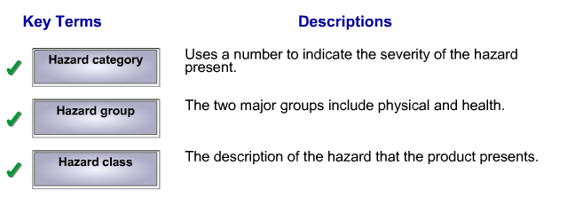
Mini Quiz - Answers
Match Key Term with the most appropriate Description
Notes:
DO:
Review answers with the group

Slide 22
Physical Hazards
CLASSES:
Flammable gases
Flammable aerosols
Oxidizing gases
Gases under pressure
Flammable liquids
Flammable solids
Self-reactive substances and mixtures
Pyrophoric liquids
Pyrophoric solids
Self-heating substances and mixtures
Substances and mixtures which, in contact with water emit flammable gases
Oxidizing liquids
Oxidizing solids
Organic peroxides
Corrosive to metals
Combustible dusts
Simple asphyxiants
Pyrophoric gases
Physical hazards not otherwise classified
Notes:
Page 5 Participant Workbook
SAY: We are now going to look at the Physical Hazard group
There are 19 Classes that fall under Physical Hazards
You do not need to memorize the 19 Classes of Physical Hazards, you need to be aware that this information exists
I’ll go through the pictograms and classes in more depth

Slide 23
Physical Hazards - Flammables
4 main classes commonly encountered at work:
Flammable gases
Flammable aerosols
Flammable liquids
Flammable solids
Notes:
Page 6 Participant Handbook **Exam Question**
ASK: What is an example of a flammable gas? Answer: carbon monoxide, nitrous oxide, medical gas
ASK: What is an example of a flammable aerosol? Answer: WD-40, hairspray, industrial adhesives
ASK: What is an example of a flammable liquid? Answer: gasoline, toluene, kerosene
ASK: What is an example of a flammable solid? Answer: wood, paper, some plastics, zinc, copper, magnesium
In Notes, you might want to write it is important to know:
all of these materials will burn if ignited by a spark, static discharge or hot surface (hot plate, lit cigarette)
we must store and handle according to the safe working procedures
Other classes that are not common in the workplace and use this pictogram have similar safety concerns. They are:
pyrophoric liquids, solids and gases – can readily ignite when exposed to air.
self-heating substances and mixtures – can decompose slowly; become hot when exposed to air.; may catch fire.
substances and mixtures which, in contact with water, emit flammable gases – they react with water to give off a flammable gas

Slide 24
Flammables - examples
propane
butane
acetylene
acetone
paint thinner
kerosene
gasoline
toluene
Notes:
Information not in participant workbook
DO: briefly cover these examples
propane – heating, cooking and car fuels
butane – fuel and aerosol propellant
acetylene - welding (in torches)
acetone – nail polish remover, industrial cleaners, degreasers
paint thinner – cleaner for paints, varnishes
kerosene – home heating fuel, solvent, rocket fuel
gasoline – fuel and solvent
toluene – industrial solvent
Gases – medical gas, nitrous oxide, oxygen, carbon monoxide

Slide 25
Physical Hazards - Oxidizers
3 classes are:
Oxidizing gases
Oxidizing liquids
Oxidizing solids
Notes:
Page 6 Participant Workbook
SAY: Oxygen is necessary for a fire to burn. Oxidizers do not usually burn by themselves, but they will:
increase the intensity of a fire
cause materials that normally do not burn to suddenly catch on fire, sometimes even without an ignition source
ASK: What would be an example of an oxidizing gas? Answer: oxygen, nitrogen (nitrous oxide), chlorine trifluoride
ASK: What would be an example of an oxidizing liquid? Answer: bromine (found in flame-retardant plastics), fluorine (used in toothpaste), chlorine (pool/water cleanser), liquid air (oxygen brought to a very low temperature)
ASK: What would be an example of an oxidizing solid? Answer: wood, plastic, paper, zinc, copper

Slide 26
Oxidizers - examples
Nitric acid – used to manufacture explosives
If spilled on cotton fabric, it can spontaneously ignite and burn when the spilled acid dries
Notes:
Information not in participant workbook
DO: briefly cover these examples
SAY: Precautionary statements on the label would include:
keep away from heat, hot surfaces, sparks, open flames and other ignition sources. No smoking
keep away from clothing and other combustible materials
wear PPE (gloves, clothing, eye/face protection)
wear fire resistant or flame retardant clothing

Slide 27
Physical Hazards – Gases Under Pressure
These gases are stored under pressure in a container, liquefied, chilled or dissolved in a carrier
Notes:
Page 6 Participant Workbook
SAY: The main hazards are:
the cylinder or container may explode if heated
leaking gas can be very cold and may cause frostbite if it touches your skin
a leaking cylinder can rapidly release extremely large amounts of gas into the workplace

Slide 28
Gases Under Pressure - example
When exposed to high temperatures and direct sunlight, cylinders can explode.
Notes:
SAY: Examples of gases under pressure in healthcare are oxygen tanks, CO₂ tanks
Optional information to share as an example:
When exposed to high temperatures and direct sunlight, cylinders can explode.
In St. Louis, Missouri - a propylene cylinder valve vented gas which ignited and caused a domino effect fire.
The small fire from one propylene cylinder spread to others and then to propane and acetylene cylinders. Exploding cylinders flew 800 feet, damaged property and started fires in the community.
Full story at: http://www.csb.gov/assets/1/19/Praxair_Report.pdf

Slide 29
Physical Hazards – Corrosive to Metals
Common corrosives are nitric acid, hydrochloric acid and sodium hydroxide solutions
Notes:
Page 7 Participant Workbook
SAY:
Materials that are corrosive to metals can eat through, damage, and/or destroy metals (steel and aluminum).
When a corrosive material eats through a container, the contents may spill out into the workplace resulting in health effects, reactivity or fire damage, or evaporate into the air making it toxic and hazardous.
Common corrosives are:
Nitric acid (used to make fertilizer)
Hydrochloric acid (used to make batteries and refining metal)
Sodium hydroxide solutions (soaps, drain cleaners, detergents)
Remember to store according to the safety data sheet (we’ll review SDSs shortly) and safe working procedures
For example, if the product eats through metal, do not store it in a metal storage container

Slide 30
Other Physical Hazards
Self-reactive substances and mixtures, and organic peroxides are two classes that may be explosive or flammable, or both.
They are unstable materials.
WHMIS 2015 includes:
combustible dusts
simple asphyxiants
physical hazards not otherwise classified (PHNOC)
Notes:
Page 7 Participant Workbook
SAY: Self-reactive substances and mixtures are unstable materials that can cause or increase the intensity of a fire.
Many organic peroxides are unstable and may be highly reactive or explosive. This material requires specific storage and handling.
WHMIS 2015 also includes these hazards:
combustible dusts – means a mixture or substance that is in the form of finely divided solid particles that, upon ignition, is liable to catch fire or explode when dispersed in air. Example: saw dust
simple asphyxiants – gases that may displace oxygen in air and cause rapid suffocation. Example: over abundance of CO₂ in the air
physical hazards not otherwise classified (PHNOC) – hazards that occur by chemical reaction and result in the serious injury or death of a person at the time the reaction occurs. For example, injury or death from a violent chemical reaction like hazardous polymerization or detonation of nitroglycerin. These hazards do not fall into another physical hazard class.
Combustible dusts and simple asphyxiants do not require a pictogram. PHNOC requires a pictogram that is applicable to the hazard.
ASK: Any questions before completing the next mini-quiz on what we’ve just covered?

Slide 31
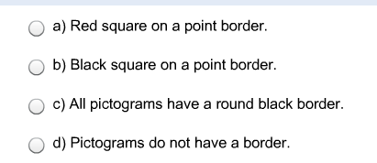
Mini Quiz
Check the answer that best fits in the blank:
Pictograms can be easily identified because they have a _________ (except for the Biohazardous Infectious Materials pictogram which has a round black border).
Notes:
Page 7 Participant Workbook
DO:
Complete as a group or have participants complete it individually
Will only take a moment to complete
Encourage participants to refer to their workbook on what was just covered

Slide 32
Mini Quiz - Answer
Pictograms can be easily identified because they have a _________ (except for the Biohazardous Infectious Materials pictogram which has a round black border).
Notes:
DO: Review with group if there was limited understanding

Slide 33
Health Hazards
CLASSES:
Acute toxicity
Skin corrosion/irritation
Serious eye damage/eye irritation
Respiratory or skin sensitization
Germ cell mutagenicity
Carcinogenicity
Reproductive toxicity
Specific target organ toxicity – single exposure
Specific target organ toxicity – repeated exposure
Aspiration hazard
Biohazardous infectious materials
Health hazards not otherwise classified
Notes:
Page 8 Participant Workbook
SAY: We’ve reviewed Physical Hazards, now we’ll review Health Hazards
There are 12 hazard classes that fall under the health hazard group.
Some pictograms may be coupled or tripled to indicate several different hazard classes of the hazardous product.
You do not need to memorize the 12 Classes of Health Hazards, you need to be aware that this information exists
I’ll go through the pictograms and classes in more depth

Slide 34
Health Hazard Pictogram
Respiratory or skin sensitization
Germ cell mutagenicity
Carcinogenicity
Reproductive toxicity
Specific target organ toxicity – single exposure
Specific target organ toxicity – repeated exposure
Aspiration hazard
Notes:
Page 8 Participant Handbook **Exam question**
DO: For each hazard class provide the supplemental information below.
Refer to the Educator Guide (page 7) for examples if needed.
Respiratory or Skin Sensitization: may cause allergy or asthma symptoms, or breathing difficulties if inhaled.
Germ cell mutagenicity: may cause genetic defects or is suspected of causing genetic defects. Mutations can lead to birth defects or cancer.
Carcinogenicity: may cause cancer or is suspected of causing cancer.
Reproductive toxicity: may damage, or is suspected to damage, fertility or the unborn child. May cause harm to breast-fed children.
Specific target organ toxicity – single exposure: causes a specific, but not fatal, target organ toxicity that occurs from a single exposure. Category 3 of this class uses the exclamation mark pictogram for products that may cause drowsiness/dizziness or that may cause respiratory irritation.
Specific target organ toxicity – repeated exposure: causes or may cause damage to organs through repeated or prolonged exposure.
Aspiration hazard – may be fatal if swallowed and enters the airways.
SAY: Remember that products can belong to one or more classes – to which ever it meets the criteria
In Notes, you might want to write it is important to know that you need to be aware of all the hazards associated with this pictogram

Slide 35
Exclamation Mark Pictogram
Acute toxicity (Category 4)
Skin corrosion/irritation (Category 2)
Serious eye damage/eye irritation (Category 2)
Respiratory or skin sensitization (Category 1)
Specific target organ toxicity – single exposure (Category 3)
Notes:
Page 9 Participant Handbook **Exam Question**
DO: For each hazard class provide the information below.
Refer to the Educator Guide (page 7) for examples if needed.
SAY: Like the health hazard pictogram, the exclamation mark pictogram is used for a number of classes.
Acute toxicity (Cat. 4) – harmful if swallowed. Harmful if in contact with skin. Harmful if inhaled.
Skin corrosion/irritation (Cat. 2) – causes skin irritation
Serious eye damage/eye irritation (Cat. 2) – causes serious eye irritation
Respiratory or skin sensitization (Cat. 1) – a skin sensitizer that may cause an allergic skin reaction. Remember that the Respiratory sensitivity category of this class uses the health hazard pictogram
Specific target organ toxicity – single exposure (Cat. 3) – may cause respiratory irritation. May cause drowsiness or dizziness.
This pictogram indicates products that have health hazards; however, these hazards may not be as severe as other categories in that class.
We will see why and how this Exclamation Mark pictogram is used from examples that we will get to later on in the presentation.
In Notes, highlight, circle or make a note that each of these classes are important to know.

Slide 36
Skin Sensitization
The exclamation mark is also used for products that can cause allergic skin reactions.
Signal word is Warning
Hazard statement is May cause an allergic skin reaction
Notes:
Page 9 Participant Workbook
SAY: We will be talking about Signal Words and Hazard Statements shortly

Slide 37
Specific Target Organ Toxicity – Single Exposure
hazard class for products that may cause significant, non-lethal damage to organs following a single exposure
labelled with health hazard or exclamation mark pictogram
Notes:
Page 9 Participant Workbook
SAY: Depending on the supplier, the label may have both pictograms – depends on the category number of the hazard
An example is “Toluene may cause drowsiness or dizziness”
Although the 2 pictograms may on their own each indicate the same type of hazard - have the same hazard class - they are typically used together.

Slide 38
Skin and Eye
These products can cause effects ranging from severe skin burns and eye damage (corrosion) to skin irritation or eye irritation.
Corrosion and exclamation mark pictograms are used to indicate:
skin corrosion/irritation
serious eye damage/eye irritation
Notes:
Page 9 Participant Workbook
SAY: Recall that the Corrosion pictogram is also used in the Physical Hazard group.

Slide 39
A closer look at some other classes
Can cause severe health effects or even death:
if you breathe them in, or
if they come in contact with your skin, or
if they are swallowed
Acute toxicity uses skull and crossbones or the exclamation mark pictogram to indicate products that can cause adverse effects following brief exposure.
Statements with fatal are more serious than toxic; toxic is more serious than harmful.
Notes:
Page 10 Participant Workbook
SAY: Brief exposure – the exposure could be a single oral or dermal exposure, or multiple doses given within 24 hours, or an inhalation exposure of 4 hours
Examples are: cyanide, high doses of ammonia, carbon monoxide, even high concentrations of oxygen
ASK: Any questions before completing the next mini-quiz on what we’ve just covered?

Slide 40
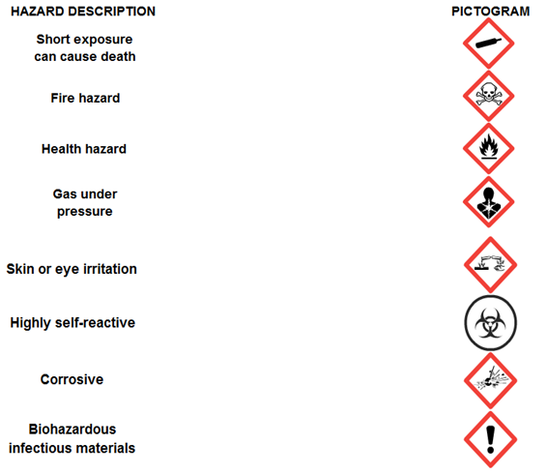
Mini Quiz
Match the Hazard Description with the Pictogram
Notes:
Page 10 Participant Workbook
DO:
Complete as a group or have participants complete it individually
Will only take a moment to complete
Encourage participants to refer to their workbook on what was just covered

Slide 41
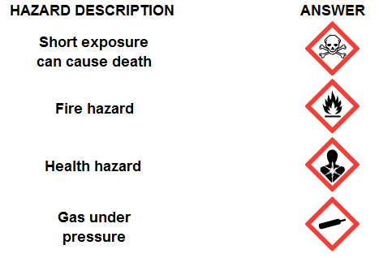
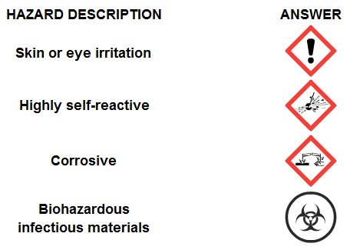
Mini Quiz - Answers
Match the Hazard Description with the Pictogram
Notes:
The slide is laid out a little different than the workbook so that it appears on one slide and is large enough to be seen
DO: Review answers with the group

Slide 42
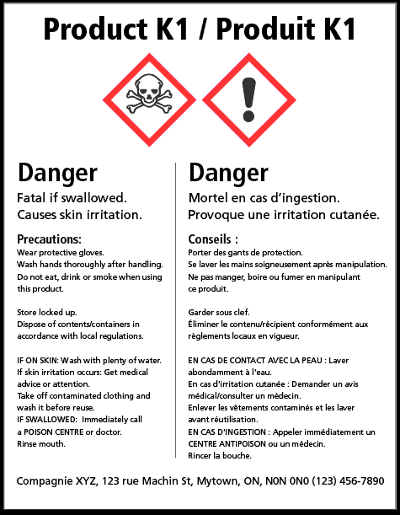
Labels
WHMIS 1988 WHMIS 2015
Notes:
Page 11 Participant Workbook **Exam Question**
SAY: Every product that falls into a hazard class MUST have a label and a SDS.
The WHMIS 1988 label had a thick dash black border with the pictograms and information
The WHMIS 2015 label has a solid black line with the new pictograms and hazard information.
Both labels have the same information in English and in French
In Notes, you might want to write it is important to know both the employer and supplier are responsible for hazardous product labels:
The employer is responsible to make sure that all hazardous products have labels. Workers are to let the employers know if a label is missing or unreadable.
The supplier is responsible to provide a product that is appropriately labelled when it is delivered to the employer’s worksite.
Listing hazardous ingredients on a label is not required by WHMIS. However, some suppliers may choose to list that, which is acceptable under WHMIS.
Labels are important because they alert workers that the product is potentially hazardous. Labels tell you:
the major hazards of the product
basic precautions (safety steps) that you should take

Slide 43
Labels for WHMIS 2015 Two Signal Words
There are only two signal words used: “Danger” and “Warning”
Danger is used for higher hazards
Indicates the degree of hazard
Note: Some of the lower ranking hazard class/categories do not use a signal word.
Notes:
Page 11 Participant Workbook **Exam Question**
The following information is in the workbook but not on the slide
SAY:
Only one signal word will appear on the label
The word DANGER will be used if both Danger and Warning are assigned
Some low hazard categories do not have a signal word assigned
In notes, you may want to write down that it is important to know that a signal word indicates the degree of the hazard.

Slide 44
Hazard Statements
Labels will have hazard statements.
Hazard statements are brief, standardized sentences that describe the hazards of the product.
Examples:
Extremely flammable gas
Contains gas under pressure; may explode if heated
Fatal if inhaled
Causes eye irritation
May cause cancer
The pictogram, signal word and wording of the hazard statements helps to describe the degree of the hazard
Notes:
Page 11 Participant Workbook
SAY: In notes, you might want to write, circle or highlight that the pictogram, signal word and hazard statements tell you about the degree of the hazard.

Slide 45
Precautionary Statements
Provide standardized advice on how to minimize or prevent harmful effects from the product.
Can include instructions on storage, use, first aid, personal protective equipment, emergency measures.
Examples:
Keep container tightly closed
Wear protective gloves, clothing, eye/face protection (PPE)
Protect from sunlight
If exposed, get medical advice/attention
Fight fire remotely due to risk of explosion
Notes:
Page 12 Participant Workbook
SAY: Precautionary statements on labels may not identify all of the control measures that are necessary. The SDS provides more information that you need to know.
In notes, you might want to write that precautionary statements can be found on both the label and the SDS.

Slide 46
Example of the Label Elements
Notes:
This slide is NOT in the participant workbook
It provides a quick visual example of Label Elements
The next slide provides explanation

Slide 47
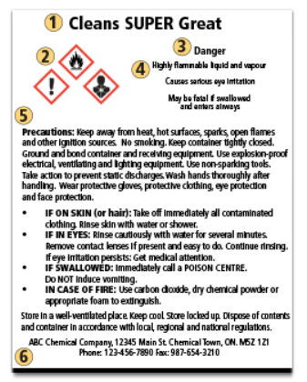
Example of Supplier Label Elements
Product identifier
Hazard Pictograms
Signal Word
Hazard Statements
Precautionary Statements
Supplier Identification
Notes:
Page 12 Participant Workbook
DO: Point to the various elements on the screen as you introduce each one
SAY: Labels may vary somewhat in the way they are laid out.
They will be required on hazardous products intended for use in the workplace.
The WHMIS regulations require that the pictogram, signal word and hazards statements must be grouped together.

Slide 48
What Do I Have to Do?
As a worker, you will have to:
Check to see if there is a label
Read, understand and follow the instructions on the label. Follow your workplace’s safe work and training procedures
Ask your supervisor for a new label when the existing label cannot be seen or read properly
Make sure that a Workplace Label is attached when you transfer a chemical to a new container
Used together, the pictogram, the signal word and the hazard statements indicate the nature and severity degree of the hazard(s) presented by the product.
Notes:
Page 12 Participant Workbook **Exam Question**
SAY: In Notes, you might want to write, highlight or circle the statement as it is important to know:
Ask your supervisor for a new label when the existing label cannot be seen or read properly.
Used together, the pictogram, signal word, and hazard statement(s) indicate the nature and severity of the hazards presented by the product.
DO: Direct participants to the back of their workbook to see the CCOHS poster highlighting the supplier and workplace labels.
SAY: A workplace label is a customized label that must be affixed to a container in which a product has been decanted into
Workplace labels need to have the following information:
a) a product identifier identical to what is on the safety data sheet for that product;
b) all necessary information for the safe handling, use, & storage of the hazardous product - including signal words and hazard statements; and
c) whether a safety data sheet is readily available.
ASK: Any questions before completing the next two mini-quizzes on what we’ve just covered?

Slide 49
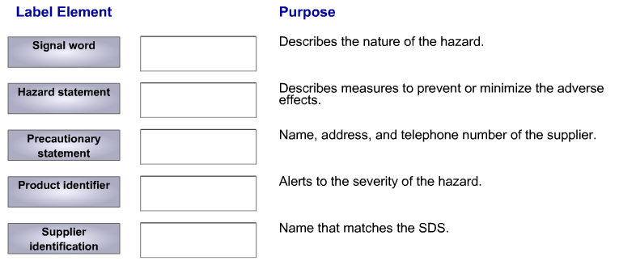
Mini Quiz
Match the Label Element to its Purpose
Notes:
Page 13 Participant Workbook
DO:
Complete the first quiz, review it and then complete the second quiz, then review it
OR
Complete both quizzes then review each
Will only take a moment to complete
Encourage participants to refer to their workbook on what was just covered

Slide 50
Mini Quiz - Answers
Match the Label Element to its Purpose
Notes:
DO: Review answers with the group

Slide 51
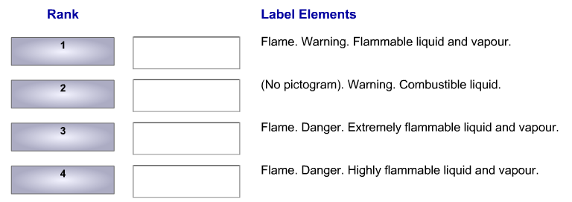
Mini Quiz
Elements on a Label tell you how hazardous a product is.
Match the Rank to its Label Elements
Notes:
Page 13 Participant Workbook
DO:
Complete as a group or have participants complete it individually
Will only take a moment to complete
Encourage participants to refer to their workbook on what was just covered

Slide 52
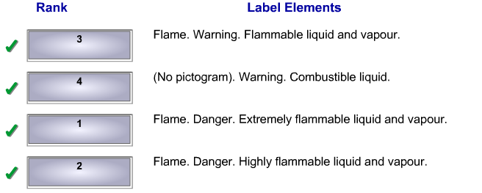
Mini Quiz - Answers
Match the Rank to its Label Elements
Notes:
DO: Review answers with the group

Slide 53
Using the Label
Acute toxicity | Acute toxicity | Acute toxicity
Inhalation (Categories 1 and 2) is labelled with the skull and crossbones pictogram and the signal word Danger. In this case, you see the hazard statement Fatal if inhaled. | Inhalation (Category 3) is labelled with the skull and crossbones pictogram and the signal word Danger and the hazard statement Toxic if inhaled. | Inhalation (Category 4) is labelled with the exclamation mark and the signal word Warning. The hazard statement is Harmful if inhaled.
Notes:
Page 14 Participant Workbook
SAY: This graphic shows the class (Acute Toxicity) at the top, the category, signal word, hazard statement, and the pictogram(s). The information works together to tell you about the type and severity of the hazards for the product.
ASK: How do you know if the product is classified as fatal, toxic or harmful?
Answer: Read the label for more information, including the hazard statements.
You can go back to slide 35 to go over all the classes under the Exclamation Mark Pictogram

Slide 54
Combining the Elements
Class/category | Serious Eye Damage – Category 1 | Eye Irritation – Category 2A | Eye Irritation – Category 2B
Pictogram |  |  | (no pictogram)
Signal word | Danger | Warning | Warning
Hazard statement | Causes serious eye damage. | Causes serious eye irritation. | Causes eye irritation.
Notes:
Page 14 Participant Workbook
SAY: This graphic shows the Class/Category, Pictogram, Signal word, and hazard statement(s).
It shows how they all work together to tell you about the type and severity of the hazards.
ASK: Any questions before completing the next two mini-quizzes on what we’ve just covered?

Slide 55
Mini Quiz
Notes:
Page 15 Participant Workbook
DO:
Complete the first quiz, review it and then complete the second quiz, then review it
OR
Complete both quizzes then review each
Will only take a moment to complete
Encourage participants to refer to their workbook on what was just covered

Slide 56
Mini Quiz - Answers
You think that a product is a health hazard but are not sure how hazardous it is. Using the label, how would you know what level of hazard is present?
Notes:
DO: Review answers with the group

Slide 57
Mini Quiz
There are a lot of classes and categories under the WHMIS 2015 system. While it is important to know the class names, what else can you use to know what the nature and severity of the hazards are?
Notes:
Page 15 Participant Workbook
DO:
Complete as a group or have participants complete it individually
Will only take a moment to complete
Encourage participants to refer to their workbook on what was just covered

Slide 58
Mini Quiz - Answers
There are a lot of classes and categories under the WHMIS 2015 system. While it is important to know the class names, what else can you use to know what the nature and severity of the hazards are?
Notes:
DO: Review answer with the group

Slide 59
Safety Data Sheets (SDSs)
created or obtained by the supplier of the product
provides more detailed information about the hazardous product than the label does
answers 4 basic questions:
1. What are the identities of the product and the supplier?
2. What are the hazards?
3. What precautions should I take to work safely with this material?
4. What do I do in the case of an emergency?
Notes:
Page 16 Participant Workbook **Exam Question**
SAY: The SDS must be provided to the customer at the time of the sale.
SDSs provide more detailed information about the hazardous product than the label does
In notes, you might want to write, circle or highlight the 4 basic questions that the SDS answers:
1. what are the identities of the product and the supplier
2. what are the hazards, such as:
can this material harm my health?
what are the early warning symptoms and signs of overexposure?
is this material a fire hazard?
can this material explode if I mix it with other materials? which ones?
3. what precautions should I take to work safely with this material, such as:
is special ventilation needed?
do I need to wear PPE (gloves, goggles, gown)
4. what do I do in the case of an emergency, such as:
overexposure, a fire, a spill?
SDSs help employers develop comprehensible chemicals programs – they use the information provided by SDSs to aide in training employees working with hazardous chemicals

Slide 60
Safety Data Sheets (SDSs)
16 sections
variable number of pages
available for every hazardous product in your workplace that is covered by WHMIS
readily accessible and up-to-date
standardized format
Notes:
Page 16 Participant Workbook
SAY: Suppliers must provide the SDS at point of sale; your employer must obtain them, inform you of any changes made to them and how to access the SDSs
readily accessible means not just electronically, but also a paper copy that workers have access to. Not locked away in someone’s office.
For WHMIS 2015, the information on the SDS must always be in the same section, regardless of which supplier created the SDS.

Slide 61
SDSs – 16 sections
Notes:
DO:
Hand out an SDS – use one of your own SDSs or the sample provided for Petro Canada Unleaded Gasoline
Have participants follow along as you go through each section – a high level overview rather than a word by word reading may be adequate as the goal is to show them the new format, not to train them on the SDS used for this education session.
For supplemental CCOHS information on SDSs: https://www.ccohs.ca/oshanswers/chemicals/whmis_ghs/sds.html

Slide 62
SDSs
Hazard Control:
SDS used along with your knowledge and workplace training
Look for recommendations about precautions in the SDS
Location of SDSs:
readily available to everyone in the workplace
in a binder, electronically
training on how to understand them and where to find them
SDSs have more information such as the Category. May also state specifics such as hazardous to your skin or eyes.
BEFORE you start using a product, READ and UNDERSTAND the SDS, label and pictogram.
Notes:
Page 16 Participant Workbook **Exam Question**
SAY: The SDS will have all the information you need to know about how to work safely with that chemical.
The label will have some information, but not all of the information you need
If information is on the label, it will also be on the SDS
If it is on the SDS, it isn’t required to be on the label – so it’s important to read the SDS
In notes, write, circle or highlight that SDSs must be readily available to everyone AND that BEFORE you start using a product for the first time, READ and UNDERSTAND the SDS, as well as the label and the pictogram.
Employers are to have MSDSs available until the date they transition to WHMIS 2015. The Ministry of Labour Relations and Workplace Safety has advised:
SDSs can be obtained in preparation for the transition date, but they are not to be available to staff until the date of transition.
SDSs and MSDSs must not be in the same binders.
Training will be provided in addition to this education - if there are phrases or terms on the SDS that workers don’t understand, suggest they ask their supervisor, a member of the occupational health committee/representative, a health and safety professional or a union representative for help.
ASK: Any questions before completing the last mini-quiz on what we’ve just covered?

Slide 63
Mini Quiz
Notes:
Page 17 Participant Workbook
DO:
Complete as a group or have participants complete it individually
Will only take a moment to complete
Encourage participants to refer to their workbook on what was just covered

Slide 64
Mini Quiz - Answers
Notes:
DO: Review answer with the group

Slide 65
Resources
Resources available:
your manager/supervisor
CCOHS (www.ccohs.ca)
www.whmis.org
Saskatchewan Employment Act and The OH&S Regulations, 2020 via Publications Saskatchewan – www.publications.gov.sk.ca
Ministry of Labour Relations and Workplace Safety
SASWH – www.saswh.ca
Notes:
Page 18 Participant Workbook
Two CCOHS posters are located at the back of their workbook that you may want to review with participants. These are available via CCOHS website.

Slide 66
Summary
You have learned how to:
Recognize pictograms
Identify the hazards linked to each class
Understand Supplier Labels
Find information about hazards and protective measures from the SDS
Site-specific (unit/department) training as per your employer’s schedule
Notes:
ASK: Are there any questions?
Answer any questions people may have

Slide 67
Evaluation and Exam
Complete the balance of the participant evaluation of the WHMIS 2015 education session
Complete required exam
Thank you for a good session
Have a safe day
Notes:
SAY: Please take a moment and complete the balance of the participant evaluation of this education session
DO: Gather completed evaluations – either pass the envelope or have someone gather completed evaluations and put in envelope
ASK: Are there any other questions before I pass out the exam?
DO: Respond to questions, use parking lot/parkaide if necessary
Hand out an exam to each participant
SAY:
Print your name on the top of the exam
I will stay in the room and walk around; I can offer you guidance if needed but I won’t answer the questions for you
Use your workbook if you need to
The exam is done individually – no group work
When you’ve completed the exam please leave it on your table and exit the room quietly
I’ll grade the exams after this session and provide the employer with the graded exams and wallet cards; they will distribute this back to you
Thank you for a good session
Have a safe day

