Slide 1
Additional Precautions: Respiratory Illness
SASWH Infection Prevention & Control
Notes:
Welcome, opening remarks

Slide 2
Discussion
Routine Practices
The chain of infection
Review the components of Additional Precautions for respiratory illnesses

Slide 3
What is Routine Practices?
Routine Practices are the minimum standard of practice for preventing transmission of infectious diseases in all health care settings, for all patients, including residents and participants in Group, Residential and Personal Care Homes.

Slide 4
Break the Chain of Infection with Routine Practices!
Hand Hygiene
Point of Care Risk Assessment (PCRA)
Personal Protective Equipment (PPE)
Resident Placement/Accommodation
Respiratory Hygiene/Cough Etiquette
Handling Resident Items & Equipment
Linen & Dishes
Environmental Cleaning
Waste and Sharp Handling
Staff Health and Education

Slide 5
Additional Precautions
Used in addition to Routine Practices
Used when providing care to residents known or suspected to be infected or colonized with germs that spread easily in the environment.
Type of Additional Precautions used are determined by the way germs could spread throughout the home or facility.
Contact
Droplet
Airborne
Combination

Slide 6
Additional Precautions: Contact
Used for residents known or suspected to have infectious germs that can be spread by direct contact with the resident or by indirect contact with environmental surfaces or resident care equipment.

Slide 7
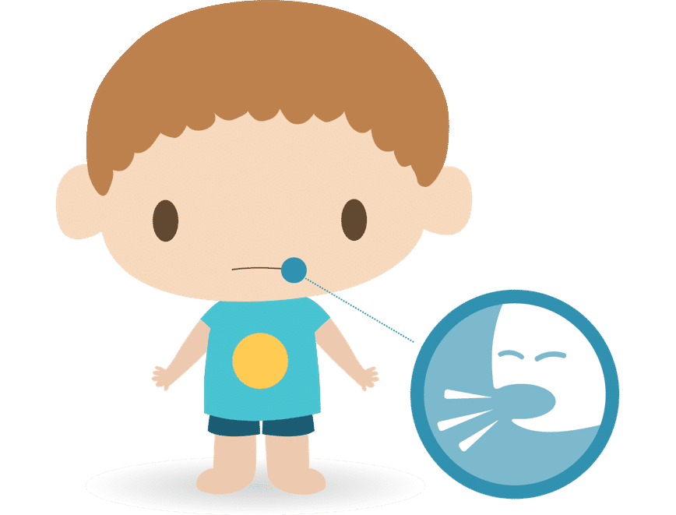
Additional Precautions: Droplet
Used for residents known or suspected to have infectious germs transmitted by large-particle droplets.
Produced during coughing, sneezing or certain procedures.
particles are propelled a short distance, less than two metres, and do not remain suspended in the air.
viruses such as Influenza, COVID-19 & colds.

Slide 8
Respiratory Illness
Most of our respiratory illnesses = Droplet/Contact Precautions
Common causes of respiratory illness are influenza, COVID-19, and common cold or cold-like viruses
This Photo by Unknown Author is licensed under CC BY-NC
Notes:
Infectious respiratory illness is a term used to describe a wide range of respiratory illnesses prior to laboratory confirmation of a particular germ. Symptoms of infectious respiratory illness is defined as:
Some of the organisms (germs) that are more common causes of respiratory outbreaks are influenza, coronavirus, respiratory syncytial virus (RSV) or rhinovirus (the common cold).

Slide 9
Droplet & Contact Precautions

Slide 10
Droplet & Contact Precautions

Slide 11
Notes:
It is important to put on PPE properly, so you are protected, but it is equally important that it is removed properly so you do not infect yourself well removing. This poster was adapted from the SHAs PPE removal poster. Every home should have a training program that educates staff how to put on and take off PPE properly. This poster can be displayed in the home as a reminder to staff how to safely don and doff PPE. See the PPE presentation on this site for a more details in the proper use of PPE.

Slide 12
Accommodation
Single room and bathroom recommended.
Droplet and Contact Precautions sign visible on entry to room.
Room door may remain open.
Close door if an aerosol generating medical procedure is in progress.

Slide 13
Accommodation-Room Sharing
If room-sharing:
ensure separation of at least two metres between residents
dedicate a bathroom or commode for each resident
pull privacy curtains between residents

Slide 14
Hand Hygiene
Perform
Perform hand hygiene using alcohol-based hand rub (ABHR) or soap and water per Routine Practices guidelines
Use
Use plain soap and water when:
hands are visibly soiled
caring for residents with diarrhea and/or vomiting
Perform
Perform hand hygiene:
before accessing and putting on PPE
after taking off each piece of PPE
Teach
Teach residents and visitors too!!

Slide 15
Notes:
These posters developed by the sask health authority outline the steps to take to ensure all areas of your hands are clean. These posters should be displayed in your care environment and every staff member trained in proper hand hygiene.

Slide 16
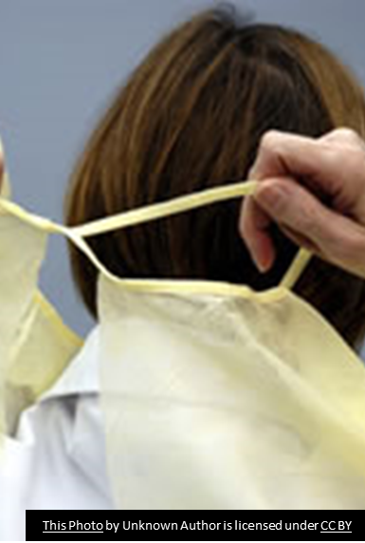
Personal Protective Equipment: Gowns
Wear a new gown to enter resident room or bed space.
Make sure the back ties are tied!
Take off gloves and perform hand hygiene before taking off gown.
After removing gown:
place in waste container if disposable
place in linen bag if reusable
perform hand hygiene

Slide 17
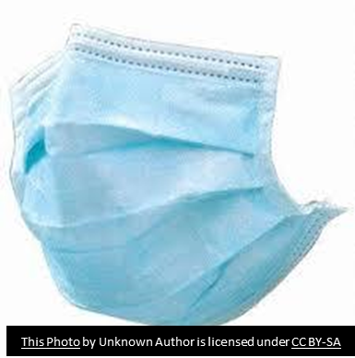
Personal Protective Equipment: Facial (mask and eye) Protection
Wear facial protection within two metres of the ill resident.
Proper wearing of a mask includes:
a snug fit over the nose and under the chin
molding the metal bar over the nose
wearing the mask with the moisture-absorbing side closest to the face
removing mask when leaving resident room or bed space unless continuous masking is in place
change mask when it becomes moist, soiled, damaged or hard to breath
touch only the elastic or ties
Face protection (nose and mouth)

Slide 18
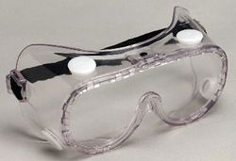
Personal Protective Equipment: Facial (mask and eye) Protection
Eye protection
Prescription glasses do not meet workplace health and safety regulations for eye protection.
Clean and disinfect re-useable eye protection after each use.
Discard single-use facial protection in waste container.

Slide 19
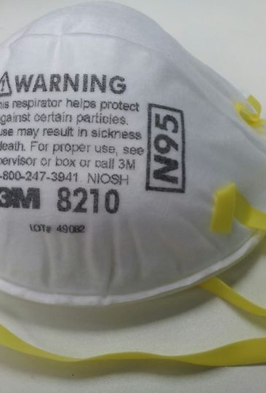
N95 Respirators
All staff entering the room of a resident with confirmed or suspected COVID-19, while aerosol generating medical procedures are being performed, must wear an N95 respirator
Staff must be properly fit-tested and trained to wear N95 respirators in compliance with CSA Standard Z94.18
Perform a seal-check
This Photo by Unknown Author is licensed under CC BY-SA

Slide 20
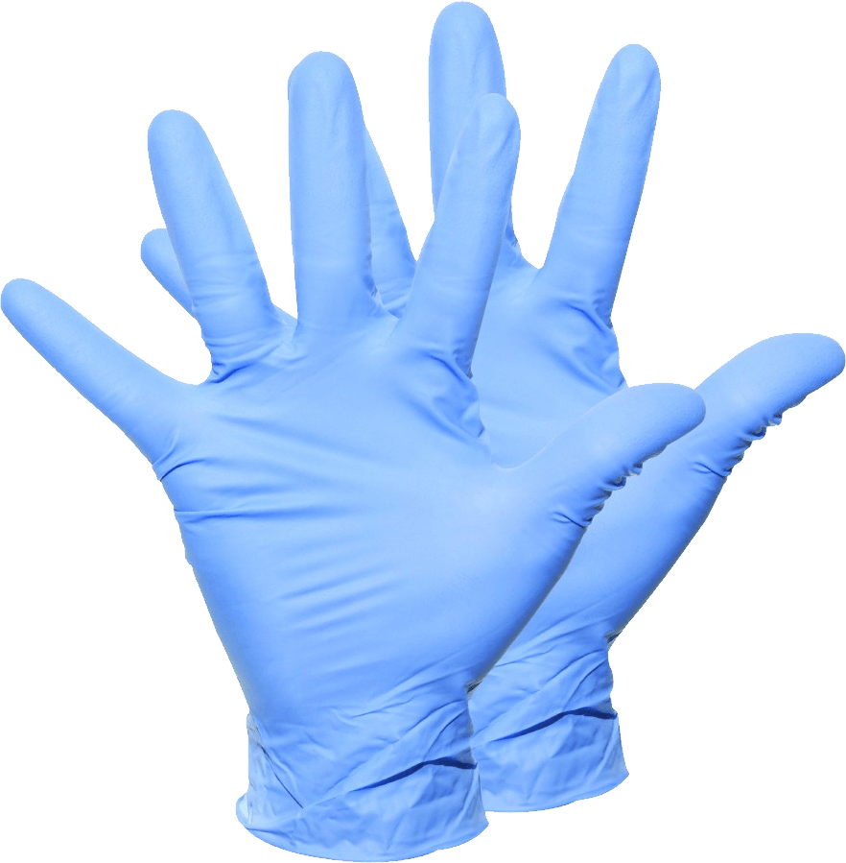
Personal Protective Equipment: Gloves
Gloves are single-use
Do not wear gloves outside resident rooms unless carrying contaminated items or assisting with resident transfer to another area
Never wash disposable gloves or use ABHR on any gloves
Take off gloves and perform hand hygiene before taking off gown and facial protection
Discard used gloves
This Photo by Unknown Author is licensed under CC BY-NC

Slide 21
Environmental Cleaning
Clean all high touch surfaces in resident rooms, including bathrooms and commodes, at least daily.
Clean high touch areas in common spaces twice daily.
Use Health Canada approved products and procedures (properly diluted bleach is acceptable).
When Droplet and Contact Precautions are discontinued:
Notify cleaning staff to request a terminal/discharge cleaning of room
clean high touch surfaces of resident’s ambulation aides
change privacy curtains
This Photo by Unknown Author is licensed under CC BY-SA-NC

Slide 22
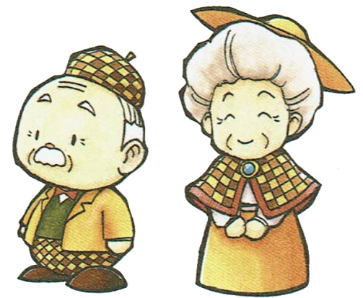
Visitors
Encourage visitors to perform hand hygiene and don PPE
Instruct how to put on and take off PPE properly
Restrict visitations when possible
This Photo by Unknown Author is licensed under CC BY-NC
This Photo by Unknown Author is licensed under CC BY-SA

Slide 23
Ambulation Outside Room, Bed Space or Transfer
Residents should not leave their room.
If residents must leave their room, instruct them on or assist them with:
performing hand hygiene
putting on clean clothing or clean housecoat
ensuring dressings and incontinence products can contain any drainage
putting on a medical procedure mask
Notify transport staff of the need for Droplet & Contact Precautions before departure.

Slide 24
Handling Resident Care Items and Equipment
Use disposable care equipment when possible.
Dedicate reuseable equipment to a single resident.
If not possible, clean and disinfect equipment between residents.
Rooms should contain a dedicated linen bag.
Do not share items (e.g., puzzles, books, electronics) that cannot be cleaned and disinfected.
When precautions are discontinued: discard single-use care equipment, reprocess reusable care items, change bed linens and cubicle curtains. Launder soiled resident clothing and any unused linens in the resident room.

Slide 25
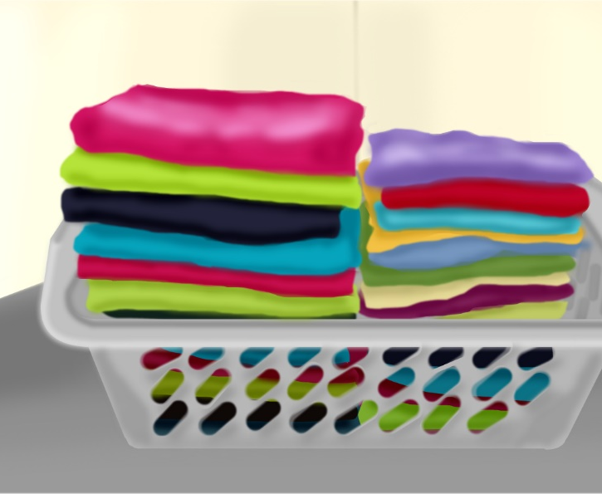
Dishes & Linen/Laundry
Dishes do not require special handling.
Disposable dishes and utensils are not required.
Laundry is always handled as if it is contaminated.
No change if on additional precautions.
This Photo by Unknown Author is licensed under CC BY-NC
This Photo by Unknown Author is licensed under CC BY

Slide 26
Discontinuing the Additional Precautions
The period of communicability is unique for each specific illness.
For most respiratory illnesses, a 7-day isolation period is usually enough, as long as there is 48 hours of significant improvement in symptoms.
Follow Public Health's recommendation.
Notes:
The Medical Health Officer (MHO) is responsible for declaring the outbreak over and will advise the facility when the institutional outbreak measures can be discontinued.
Individual infection control precautions can be discontinued when the individual is no longer considered infectious. The period of communicability is unique for each specific causative organism identified during the outbreak.

Slide 27
References
Saskatchewan Association for Safe Workplaces in Health. (2021). Infection Prevention and Control. https://saswh.ca/index.php/infection-prevention-and-control
Saskatchewan Health Authority. (2021). PPE/Infection Prevention and Control https://www.saskhealthauthority.ca/news/service-alerts-emergency-events/covid-19/PPE-infection-prevention-control/Pages/Home.aspx
https://www.saskhealthauthority.ca/

