Slide 1
Environmental Cleaning & Handling Items & Equipment!
SASWH Infection Prevention & Control
Notes:
Welcome, opening remarks

Slide 2
Today you will learn:
What Routine Practices are
About the chain of infection
The importance of handling and cleaning equipment properly
The importance environmental cleaning
How to properly clean and disinfect in order to break the chain of infection

Slide 3
What is Routine Practices?
Routine Practices are the minimum standard of practice for preventing transmission of infectious diseases in all health care settings for all patients, including residents in Group, Residential and Personal Care Homes.

Slide 4
Break the Chain of Infection with Routine Practices!
Hand hygiene
Point of Care Risk Assessment (PCRA)
Personal Protective Equipment (PPE)
Resident Placement/Accommodation
Respiratory Hygiene/Cough Etiquette
Handling Resident Items & Equipment
Linen & Dishes
Environmental Cleaning
Waste and Sharp Handling
Staff health and education

Slide 5
Handling Resident Care Items and Equipment
Bring minimal supplies into the resident's room
Use disposable equipment
All reusable equipment and supplies should be dedicated
If reusable equipment cannot be dedicated to a single resident, clean and disinfect thoroughly
Some items MUST NOT be shared between residents, unless they are sterilized
Notes:
Any reusable itms must be cleaned and disinfected between residents, including bedpans, commodes, chairs, beds, thermometers, blood pressure cuffs.
Workplace practices should outline how and when to clean items that are shared, such as, whirlpool tubs, showers, blood pressure cuffs , stethoscopes and more

Slide 6
Environmental Cleaning
What is cleaning?
physical removal
What is disinfecting?
inactivation of disease-producing germs
Notes:
Cleaning is the physical removal of foreign material (e.fg. Dust soil and organic materials e.g. blood and body fluids. Cleaning physically removes Rather than kills germs.It is accomplished with water, detergents, and mechanical action.
Disinfection on the other hand is the inactivation of disease-producing germs. Disinfection does not destroy bacterial spores. Equipment/devices must be cleaned thoroughly before effective disinfection can take place

Slide 7
Environmental Cleaning
Site assessment to determine if:
the resident status could pose a challenge to safe cleaning
there is any need for additional PPE or supplies
there are any obstacles (e.g., clutter) or issues that could pose a challenge to safe cleaning?
there is any damaged or broken furniture or surfaces to be reported to supervisor/management

Slide 8
Cleaning Process
A. Proceed from Cleaner to Dirtier
During cleaning, clean low-touch surfaces before high-touch surfaces.
Clean resident living areas (e.g., bed, chair) before toilets.
Clean general resident areas not under additional precautions before those areas under additional precautions.
B. Proceed from High to Low (Top to Bottom)
Cleaning bed rails before bed legs.
Cleaning environmental surfaces before cleaning floors.
Cleaning floors last to allow the collection of dirt and microorganisms that may have fallen.
Notes:
Proceed from cleaner to dirtier areas to avoid spreading dirt and germs. Follow the example given below to know the process
Proceed from high to low to prevent dirt and microorganisms from dripping or falling and contaminating already cleaned areas. Examples include

Slide 9
Cleaning and Disinfection
1. Choose cleaning and disinfecting products that have a Drug Identification Number (DIN) from Health Canada.
This Photo by Unknown Author is licensed under CC BY-SA

Slide 10
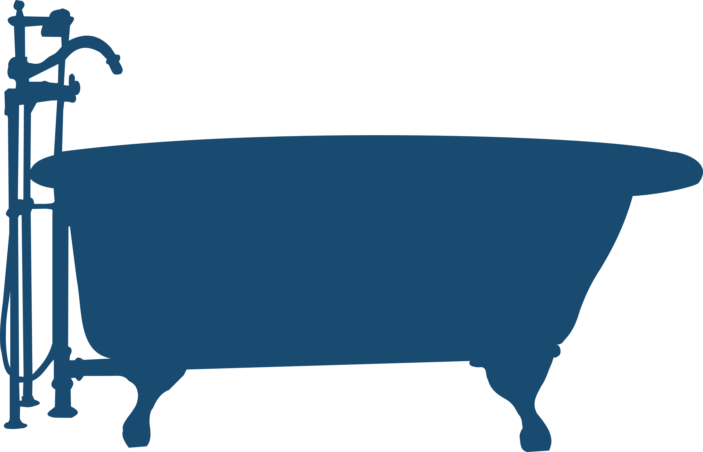
Cleaning and Disinfection
2. Follow manufactures instructions for contact time.

Slide 11
Cleaning and Disinfection
3. Only use a clean cloth to enter the cleaning or disinfectant solution. Do not dip a dirty cloth back into the cleaning solution (no double dipping).
This Photo by Unknown Author is licensed under CC BY-NC-ND
Notes:
Here are three important aspects of the cleaning and disinfection process.

Slide 12
Use the General Surface Cleaning Process
1. Thoroughly wet (soak) a fresh cleaning cloth in the environmental cleaning solution.
2. Fold the cloth in half, then in half again, to create 8 sides.
3. Wipe surfaces from clean to dirty, high to low in a systematic manner.
use mechanical action (for cleaning steps) and a thoroughly wetted surface to allow required contact time (for disinfection steps).
4. Rotate and unfold the cleaning cloth to use all the sides.
5. Dispose of the cleaning cloth when all the sides of the cloth have been used, or when it is no longer saturated with solution. Do not place it back in your cleaning solution.
6. Get a new cloth and repeat process from step 1.

Slide 13
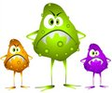
Outbreaks of Gastrointestinal (GI) Illness
The viruses that cause GI illness are ‘tough’ and are resistant to many disinfectants.
Label will state if it is effective against viruses such as norovirus, Norwalk-like virus and other GI illnesses.
Many of the Health Canada approved cleaning products are a cleaner and disinfectant in one.
Bleach is only a disinfectant.
Effective in killing most GI illnesses.
Effective as long as the surface is cleaned first and then a fresh bleach solution of 1,000 parts-per-million (71 ml of 5.25% bleach in 4 litres of water) is applied.

Slide 14
Floors
Change cloths/mop heads when:
Visibly soiled
No longer wet enough to moisten surfaces
Moving from a dirty area to a clean area
This Photo by Unknown Author is licensed under CC BY-NC

Slide 15
Break the chain of infection & Keep yourself and others safe! Clean and disinfect properly!
This Photo by Unknown Author is licensed under CC BY

Slide 16
References
www.Germsmart.ca
Public Health Ontario. (2021). IPAC Best Practices.
https://www.publichealthontario.ca/en/health-topics/infection-prevention-control/best-practices-ipac
Provincial Infection Control Network of British Columbia. (2011). Residential Care Infection Prevention and Control Manual For Non-affiliated Residential Care Facilities.
Provincial Infectious Diseases Advisory Committee. (2018). Best Practices for Environmental Cleaning for Prevention and Control of Infections in All Health Care Settings, 3rd Edition
https://www.publichealthontario.ca/en/health-topics/infection-prevention-control/environmental-cleaning
Saskatchewan Association for Safe Workplaces in Health. (2021). Infection Prevention and Control. https://saswh.ca/index.php/infection-prevention-and-control
Saskatchewan Health Authority. (2021). PPE/Infection Prevention and Control https://www.saskhealthauthority.ca/news/service-alerts-emergency-events/covid-19/PPE-infection-prevention-control/Pages/Home.aspx
https://www.saskhealthauthority.ca/

