Slide 1
Hand Hygiene
SASWH Infection Prevention & Control
Notes:
This presentation is called Routine Practices: Keeping everyone safe

Slide 2
You will learn:
About Routine Practices
About the chain of infection
The importance of hand hygiene in breaking the chain of infection
The difference between sanitizing your hands and washing your hands
How to perform HH properly
How hand hygiene can safe lives!!

Slide 3
What is Routine Practices?
Routine Practices are the minimum standard of practice for preventing transmission of infectious diseases, in all health care settings, for all patients, including residents and participants in Group, Residential and Personal Care Homes.

Slide 4
Break the Chain of Infection with Routine Practices!
Hand hygiene
Point of Care Risk Assessment (PCRA)
Personal Protective Equipment (PPE)
Resident Placement/Accommodation
Respiratory Hygiene/Cough Etiquette
Handling Resident Items & Equipment
Linen & Dishes
Environmental Cleaning
Waste and Sharp Handling
Staff Health and Education
Notes:
You can break the chain of infection by using routine practices. The diagram on the left shows chain of transmission. If you break this chain at any point, germs cannot spread. For example, if I have infectious germs on my hands and I clean them with ABHR and kill the germs, I will not spread the germ to a susceptible host. Another example, is I get vaccinated to avoid being a susceptible host. These are a few examples, but there are many ways to break the chain of infection. The list on the right-hand side are the components of routine practices and can be used, to stop the spread of germs in your care home and keep everyone safe

Slide 5
Notes:
These posters developed by the sask health authority outline the steps to take to ensure all areas of your hands are clean. These posters should be displayed in your care environment and every staff member trained in proper hand hygiene.

Slide 6
Perform Hand Hygiene:
before putting on gloves and other PPE
before contact with a resident or resident’s environment
before a clean or aseptic procedure
after exposure or risk of exposure to blood or body fluids
after contact with a resident or resident’s environment
immediately after removal of gloves (hands are still considered dirty)
Notes:
You should perform hand hygiene

Slide 7
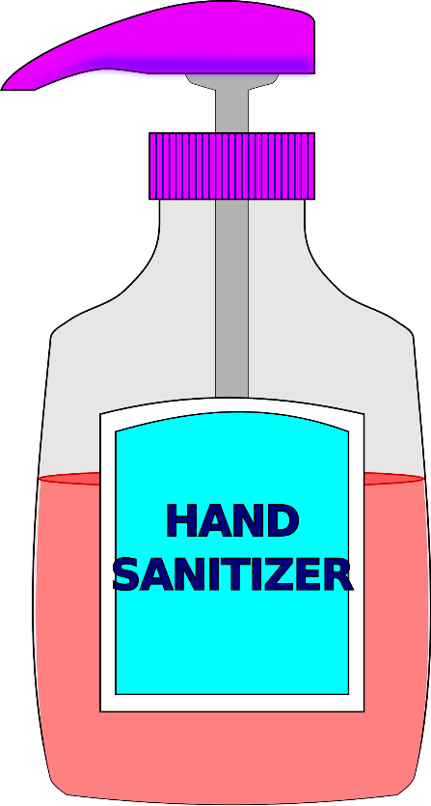
Sanitize Your Hands
Alcohol-based Hand Rub (ABHR) is the preferred method of hand hygiene when hands are not visibly soiled.
Kills most germs
Cover all surfaces of your hands and rub until dry.
Approximately 20-30 seconds for the entire procedure (with at least 15 seconds of rubbing).
This Photo by Unknown Author is licensed under CC BY-SA
Notes:
If your hand are completely dry prior to rubbing for 15 seconds, then you did not put enough product on your hands. It takes 20-30 seconds for the entire procedure, but must rub for at least the 15 seconds for proper hand sanitizing.

Slide 8
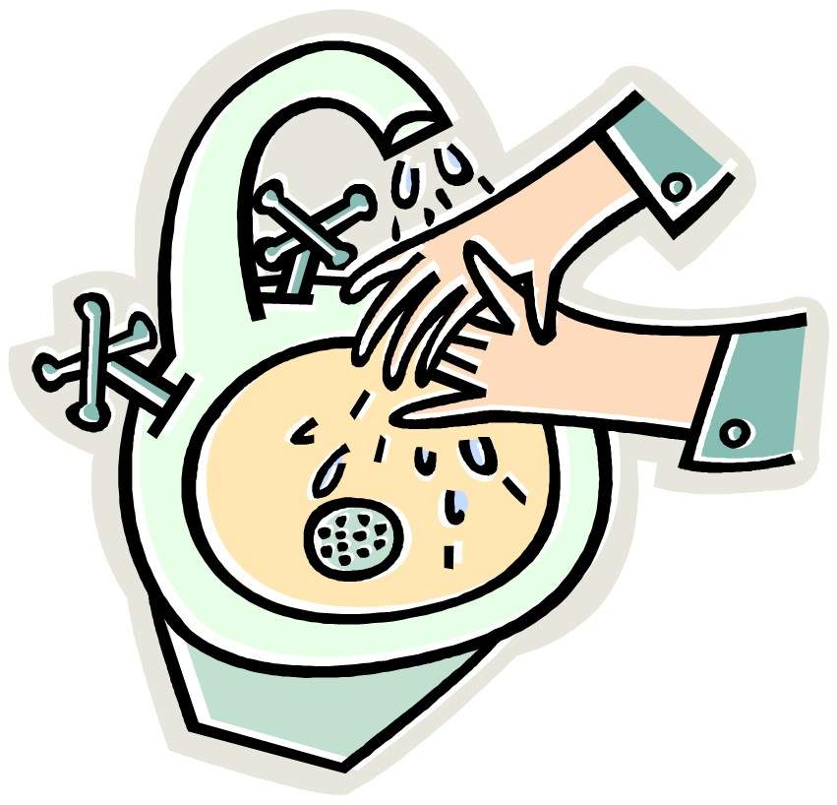
Wash Your Hands
Plain liquid soap and water when hands are visibly soiled.
Handwashing process should take approximately 40-60 seconds.
a minimum of 15 seconds of friction and lathering of soap is required
Plain soap is a surfactant to help loosen germs.
Notes:
Plain soap is a surfactant to help loosen germs but does not kill the germs. Because Antibacterial soaps can lead to antibiotic resistant organisms, they are not recommended in community care settings.

Slide 9
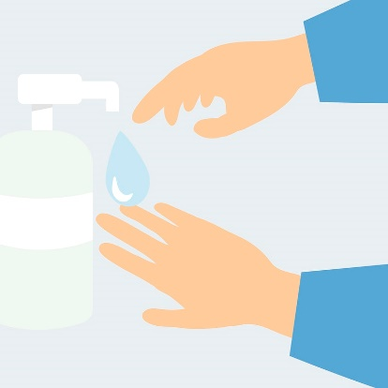
Sanitizing vs Washing Hands
Washing hands removes germs
Sanitizing hands kills most germs
This Photo by Unknown Author is licensed under CC BY-SA-NC

Slide 10
Break the Chain of Infection & Keep Yourself and Others Safe! Clean your Hands!
This Photo by Unknown Author is licensed under CC BY
Notes:
Use routine practice to break the chain of infection and keep yourself and those you care for safe. Every home needs to educate their staff in proper routine practices and other infection control principles and have regular audits to assure everyone is implementing good infection control practices.

Slide 11
References
www.Germsmart.ca
Public Health Ontario. (2021). IPAC Best Practices.
https://www.publichealthontario.ca/en/health-topics/infection-prevention-control/best-practices-ipac
Provincial Infection Control Network of British Columbia. (2011). Residential Care Infection Prevention and Control Manual For Non-affiliated Residential Care Facilities.
Provincial Infectious Diseases Advisory Committee. (2018). Best Practices for Environmental Cleaning for Prevention and Control of Infections in All Health Care Settings, 3rd Edition
https://www.publichealthontario.ca/en/health-topics/infection-prevention-control/environmental-cleaning
Saskatchewan Association for Safe Workplaces in Health. (2021). Infection Prevention and Control. https://saswh.ca/index.php/infection-prevention-and-control
Saskatchewan Health Authority. (2021). PPE/Infection Prevention and Control https://www.saskhealthauthority.ca/news/service-alerts-emergency-events/covid-19/PPE-infection-prevention-control/Pages/Home.aspx
https://www.saskhealthauthority.ca/

