Slide 1
Mask vs. Respirator
Presented by the SASWH Occupational Health and Infection control Specialists
January 21, 2022

Slide 2
Cloth Masks
Advantages:
Easy to obtain
Low/minimal cost
Fashionable? Attractive?
Disadvantages:
No manufacturing standard
Easily contaminated
Need laundering
Not for healthcare use
Uncomfortable?

Slide 3
Surgical Mask
Advantages:
Usually sold as sterile
May have ties rather than ear loops
Offer similar protection to disposable medical masks
Manufactured to specific standard
Disadvantages:
Accessibility
Limited use
Cost

Slide 4
What makes a medical grade mask?
Mask performance assessed in four areas:
Fluid Resistance
Differential Pressure
Filter Efficiency
Flammability
ASTM F2100-11 Levels:
Level 1: low barrier protection General use for short procedures and exams that don’t involve aerosols, spray or fluids
Level 2: moderate barrier protection For low to moderate levels of aerosols, spray and/or fluids
Level 3:maximum barrier protection For heavy levels of aerosols, spray and/or fluids

Slide 5
Mask Manufacturing Standards
Both American standards (ASTM F2100-11) and the European (EN 14683) are approved standards
The Chinese standard is GB19083 – however – check for Health Canada approval - Non-testing COVID-19 medical devices: Authorized medical devices - Canada.ca
Look for terms like “three ply” and medical
Medical and surgical often used interchangeably
“Not for medical use” – can be used in community but may not offer enough protection
MDEL – Medical Device Establishment License
CE – a European approval standard

Slide 6
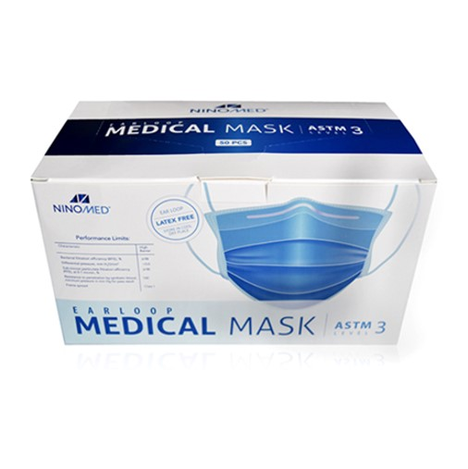
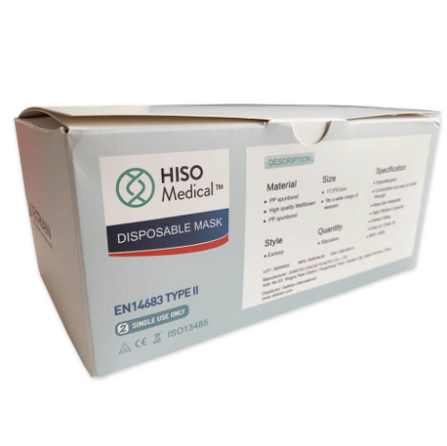
Look for these symbols or stamps:
ASTM
EN 14683
CE
MDEL – indicates Health Canada approved manufacturer

Slide 7
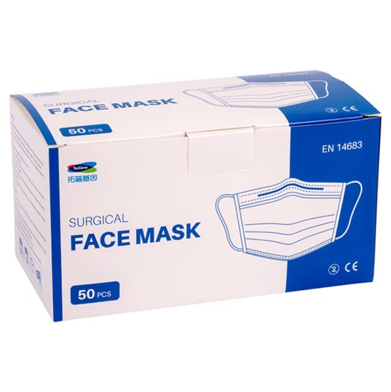
Disposable Masks (Medical & Non-Medical)
Advantages:
Usually easy to access
Disposable
Fit most people/reasonable comfort level
Medical grade have a manufacturing standard
Disadvantages:
Cost of replacement
Short life span e.g., contamination from moisture in our breath

Slide 8
A universal fit respirator is like cholesterol free salad dressing……it’s all in the marketing!

Slide 9
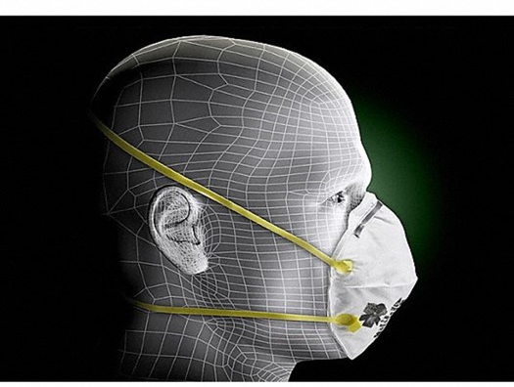
Definitions of mask vs. respirator
Mask
A device that covers the mouth and nose and acts as a barrier to the transmission of infectious agents, especially one intended for the use of medical personnel when interacting with patients
Respirator
A fitted apparatus worn over the mouth and nose or the entire face to prevent the inhalation of particles, dust, smoke, or other noxious substances

Slide 10
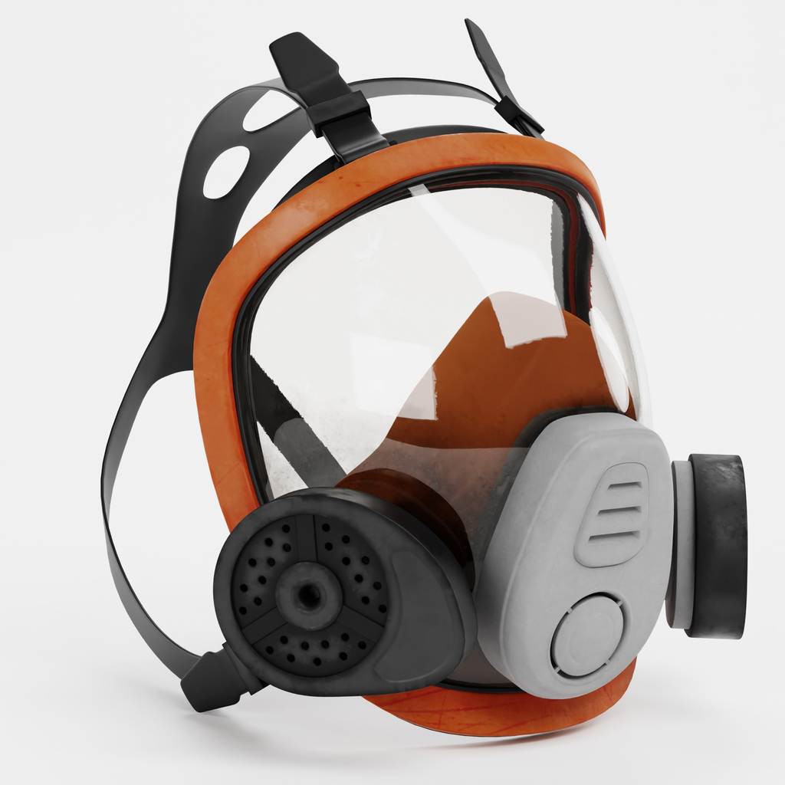
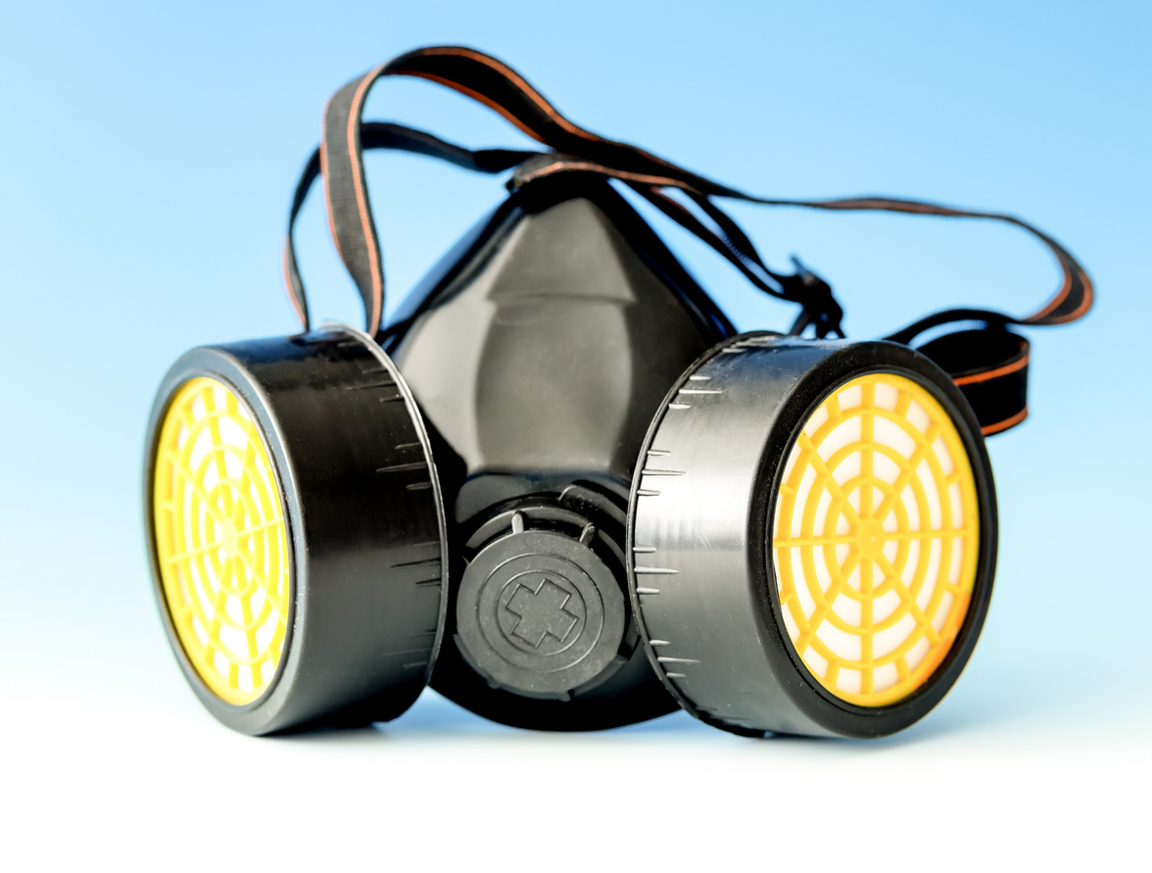
Types of Respirators & NIOSH Ratings
Meaning of the letters:
N – NO oil in the air
R – Oil Resistant
P – Oil proof
Numbers:
95 – filters 95% of particles 0.3 microns or larger
99 – filters 99% of particles….
100 – filters 99.9% of particles…..
Types of respirators:
Disposable e.g., 3M 8210
Must be fluid resistant for healthcare use
Elastomeric – use cartridges and may be full face, or half face

Slide 11
N95 Respirators
Advantages:
Manufactured to a specific standard
Tight seal to face – increases protection (If fit tested)
Disadvantages:
Must be fit tested
May be costly and difficult to access
Not all disposable respirators are fluid resistant e.g., 3M 8210

Slide 12
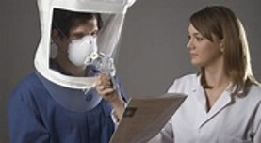
Fit Testing Process
Qualitative
Quantitative
Health screen
Training process
CSA standards
OH&S legislation

Slide 13
KN95s
Health Canada did not approve certain Chinese made KN95s as respirators due to manufacturing standards.
NIOSH found many KN95s did not meet the 95% filtration standard.
Health Canada did state KN95s can be used as a disposable mask if used correctly and in any setting where 95 per cent filtration isn't necessary.

Slide 14
C95s – Approved as a Respirator
A made in Canada respirator
Health Canada approved
Must be fit tested
Available from Benchmark PPE
C95 PFE95 Level Respirator PFE 95 Made in Canada (Headstraps) – Benchmark PPE

Slide 15
Respirators with One Way Valves
Not recommended for use – they allow infectious respiratory particles to escape

Slide 16
When do we use which mask/respirator?
Cloth masks and bandanas not recommended even in the community.
N95s and C95s can be worn if the person is fit tested and trained in their use.
KN95s can be used similarly to disposable masks.
Medical grade disposable masks still considered effective protection.

Slide 17
Resources
IPAC web page at www.saswh.ca
Voice over PowerPoint recording - masks
SASWH Fit testing Program
Email: info@saswh.ca
Government of Saskatchewan COVID-19 site
COVID-19 | Emerging Public Health Issues | Government of Saskatchewan
IPAC consultants:
Mary Anderson (306)750-8310
mary.anderson@saswh.ca
Kim Bourassa (306) 530-4967
kim.bourassa@saswh.ca

