Slide 1
Occupational Health & Safety Paired with Routine Practices
Presented by the
Infection Prevention and Control Consultants
SASWH March 2022

Slide 2
Occupational Health & Safety and Routine Practices
Occupational health and safety is about improving workplace health and safety and reducing injury and illness in the worker population. An OH&S program offers processes for mitigating the risks and hazards workers encounter on the job.
Routine Practices are the minimum standard of practice for preventing transmission of infectious diseases in all health care settings, for all patients, including residents and participants in group, residential and personal care homes.
Using Routine Practices in the workplace is one means for workers to reduce their risk of being exposed to biological hazards such as respiratory or other infections in the workplace.
This presentation will look at the common themes in Infection Control Routine Practices and workplace occupational health and safety.

Slide 3
Roles and Responsibilities – OHS Legislation
employer
supervisor
For most homes/agencies, the employer will refer to the owner/operator or the Executive Director and/or Board of Directors.
Ensure as reasonably practicable, the health and safety of all employees
Provide sufficient and appropriate equipment for workers to do their job safely
Make reasonable attempts to follow up any concerns in a timely manner
Ensures worker are trained and competently supervised in their tasks
The supervisor is the individual present on a day to day basis who assigns resident/participant care or who is in charge of resident care and the home for that shift or day.
Ensure as reasonably practicable, the health and safety of all workers under their direct supervision
Ensure workers are not exposed to harassment as reasonably practicable
Ensure workers are working safely in accordance with the legislation

Slide 4
Workers’ Roles and Responsibilities – OHS Legislation
Workers
Occupational health committee
Take care to reasonably protect their own health and safety
To not participate in harassment
Co-operate with anyone exercising a duty imposed by the OHS legislation
The workers’ voice for health and safety concerns in the workplace
Required where there are 10 or more employees

Slide 5
An Effective Safety Management System
A safety management system is defined as a series of approaches that organizations use to reduce accidents and illnesses in the workplace. A SMS includes a systematic approach to managing safety, including organizational structures, accountabilities, policies, and procedures.
Includes:
Employer commitment
Education and training
PPE/supplies
Emergency plans (including pandemic plans)
Reporting, inspections and investigations

Slide 6
Potential Workplace Hazards
Biological e.g., infectious diseases, molds, vector borne illness
Physical e.g., lighting, noise, electricity, vibration
Chemical e.g., any solid, liquid or gas that has potential for harm such as disinfectants
Ergonomic e.g., manual lifting, equipment design, shift rotations, work space, etc.
Psychosocial e.g., violence, harassment

Slide 7
Hierarchy of Controls
When developing controls for an exposure control plan, the employer needs to start at the top of the hierarchy. Can the hazard be eliminated or substituted?
Engineering controls are changes in the work environment such as a barrier wall or the way a space is designed or equipment used.
Administrative controls include training and procedures.
PPE is the last line of defense between the worker and the hazard.
Most hazards need several controls.

Slide 8
Exposure Control Plan
If workers are required to handle, use or produce an infectious material or organism or are likely to be exposed at a place of employment, an employer, in consultation with the committee, shall develop and implement an exposure control plan to eliminate or minimize worker exposure.
The plan must be specific to the workplace. The employer must also review the plan every two years in consultation with the organization’s Occupational Health Committee.

Slide 9
Elements of an Exposure Control Plan
1. Who could be exposed?
2. What tasks will put workers at risk?
3. How might they be exposed? For example, inhalation, direct contact, poke from needle?
4. What are the potential signs and symptoms of illness that could arise from an exposure?
5. What types of infection control measures are provided or to be used? This would follow the Hierarchy of Controls.
6. What are the procedures to be used for spills, exposures, safe handling and cleaning?
7. What training will workers receive?
8. What is the process for investigating and documenting an exposure?

Slide 10
Blood and Body Fluids Exposure
Every exposure to contaminated sharps, human bites, blood or body fluids on broken skin or exposure to the eyes/mouth/nose must be considered serious.
It is important to receive FIRST AID immediately after any exposure and get medical advice within 2 hours.
Blood or body fluids includes the following: blood, saliva, feces, vomit, mucus, sputum, urine, any drainage from a skin wound, semen, vaginal secretions – basically any body fluid can be infectious.
Treat ALL blood and body fluids as being infectious.

Slide 11
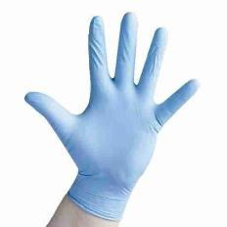
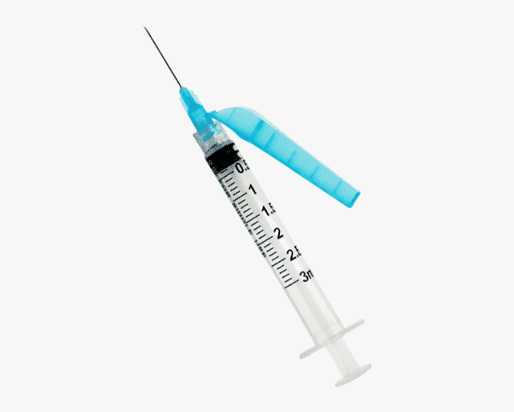
Preventing Blood and Body Fluid Exposures
Follow Routine Practices using a point of care risk assessment then choose appropriate PPE.
Ensure biohazardous waste containers being used.
Workers should be immunized against Hepatitis B.
Procedures should be in place for managing spills and waste; for using safety engineered sharps devices; and appropriate PPE use.

Slide 12
Handling Waste and Sharps
Wear gloves to remove waste from resident rooms, common care rooms (e.g., resident tub rooms).
Garbage should be contained in a plastic bag and secured when ready for removal.
Hold the garbage bag away from the body to prevent contamination of clothing. Take the garbage directly out to the garbage collection area.
Dispose of sharps immediately after use in puncture-proof biohazard container e.g., needles, lancets.
Do not overfill waste or sharps container.

Slide 13
Point of Care Risk Assessment & PPE

Slide 14
Staff Health and Vaccinations
Immune caregivers are preferred for the care of those with vaccine preventable infections e.g., influenza, COVID, measles, chicken pox.
For example, staff having had chickenpox or measles as a child will not get re-infected as adults and can be assigned to the care of a person with such airborne infections. Likewise, staff having been vaccinated against these infections can safely work with people with these illnesses.
All staff who are unaware of their immune status to vaccine preventable diseases should consider having a blood test to confirm whether they have had the disease in the past. (Contact the local Public Health nurse for follow-up).

Slide 15
Fitness to Work
Do not come to work when you are sick with:
A fever
A new cough or a cough that does not go away
Vomiting
Diarrhea
Or a rash
If you have broken skin on your hands from cuts or a rash, you should cover the areas with a bandage and wear disposable gloves.
See your healthcare practitioner for severe or ongoing illness
Your Health Is Your Responsibility!

Slide 16
When can you return to work after an infection?
If you have had gastro-intestinal illness (nausea, vomiting , diarrhea), you should wait 48 to 72 hours AFTER the LAST bout of illness.
If your symptoms are respiratory (cough, sneezing, runny nose, etc.) you should remain at home for AT LEAST 48 hours after you feel significantly improved. IF YOU NEED TO USE AN OVER THE COUNTER MEDICATION TO MANAGE SYMPTOMS, YOU ARE LIKELY NOT WELL ENOUGH TO BE AT WORK.
In all cases, check with your manager.
IF YOUR FACILITY IS ON OUTBREAK, there may be some special circumstances for when you can return to work e.g., self isolation for COVID-19.

Slide 17
Need more information? Email info@saswh.ca

Slide 18
References
Canadian Centre for Occupational Health and Safety. (2021). Hazards.
https://www.ccohs.ca/topics/hazards/
Centers for Disease Prevention and Control (CDC). (2015). Hierarchy of Controls.
https://www.cdc.gov/niosh/topics/hierarchy/default.html
Government of Saskatchewan Ministry of Health. (2021). Communicable Disease Control Manual.
https://www.ehealthsask.ca/services/Manuals/Pages/CDCManual.aspx
Government of Saskatchewan Ministry of Health. (2013). Guidelines for the Management of Exposures to Blood and Body Fluids.
https://www.ehealthsask.ca/services/Manuals/Pages/hiv-guidelines.aspx
Government of Saskatchewan. (2020). Occupational Health and Safety Regulations, 2020, S-15.1 Reg 10
https://publications.saskatchewan.ca/#/products/112399

