Slide 1


Point of Care Risk Assessment (PCRA)
SASWH Infection Prevention & Control
Notes:
This presentation is called Routine Practices: Keeping everyone safe

Slide 2
You will learn:
About Routine Practices
About the chain of infection
The importance of a point of care risk assessment to determine what PPE is needed to protect yourself

Slide 3
What is Routine Practices?
Routine Practices are the minimum standard of practice for preventing transmission of infectious diseases in all health care settings, for all patients, including residents and participants in Group, Residential and Personal Care Homes.

Slide 4
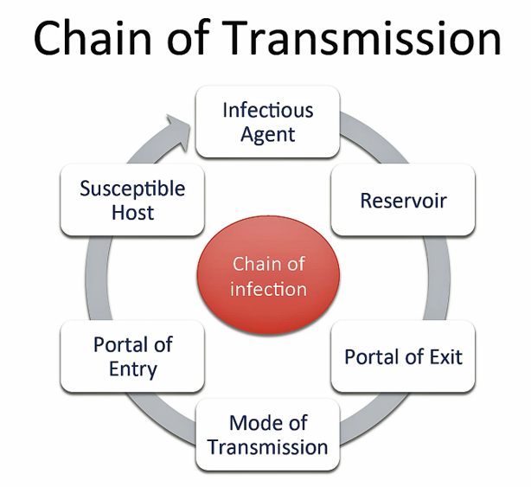
Break the Chain of Infection with Routine Practices!
Hand hygiene
Point of Care Risk Assessment (PCRA)
Personal Protective Equipment (PPE)
Resident Placement/Accommodation
Respiratory Hygiene/Cough Etiquette
Handling Resident Items & Equipment
Linen & Dishes
Environmental Cleaning
Waste and Sharp Handling
Staff Health andEeducation
Notes:
You can break the chain of infection by using routine practices. The diagram on the left shows chain of transmission. If you break this chain at any point, germs cannot spread. For example, if I have infectious germs on my hands and I clean them with ABHR and kill the germs, I will not spread the germ to a susceptible host. Another example, is I get vaccinated to avoid being a susceptible host. These are a few examples, but there are many ways to break the chain of infection. The list on the right-hand side are the components of routine practices and can be used, to stop the spread of germs in your care home and keep everyone safe

Slide 5
Point of Care Risk Assessment (PCRA)
PCRA is the first step in routine practices.
  Used with all residents for all care and all interactions.
ASSESS the TASK, the RESIDENT and the ENVIRONMENT prior to EACH resident INTERACTION.
  Then decide what, if any, PPE needed to protect yourself.
Notes:
You will need to preform a PCRA to determine what PPE is required for each resident or the environment.
Is there a chance you will be in contact with any blood or body fluids ? If yes, you need to don the appropriate PPE to protect yourself.
For example, I am about to provide am care and my resident is incontinent so there is a change I will be exposed to body fluids, I will need to don gloves, on the other hand if I am only assisting the resident to get dressed I would not be at risk of a body fluid exposure and no PPE is necessary. Now let's take this same resident that I am helping to get dressed but they are known to spit at staff—then I may want gloves, but the main PPE I would wear is eye protection.

Slide 6
Point of Care Risk Assessment (PCRA)
Prior to contact with every resident, every time, even if the resident has been placed on Additional Precautions
Ask yourself:
Will my hands be exposed to BBF or contaminated items? If yes, wear gloves.
Will my clothing or skin become soiled from splashes/sprays or contact with items contaminated with BBF? If yes, wear a gown.
Will my eyes or face or mucous membranes be splashed or sprayed with BBFs or will I be within 2 meters of coughing, spitting or vomiting resident? If yes, wear eye protection and a mask.

Slide 7
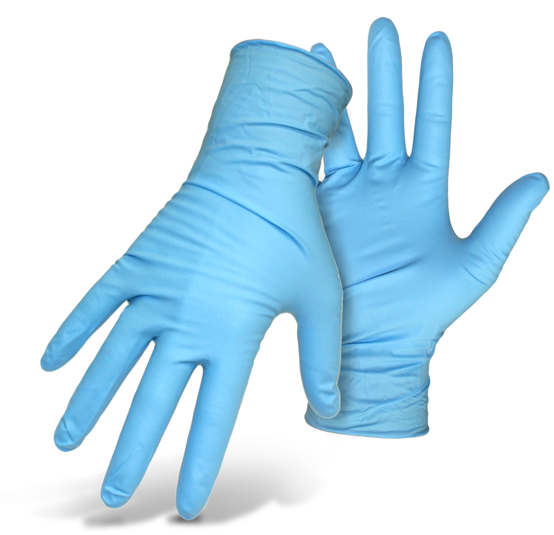
Glove Use!
Needed when a risk of BBF = Blood and Body Fluids (urine, feces, wound drainage, saliva, vomit, CSF, sputum, nasal secretions, semen, vaginal secretions
This Photo by Unknown Author is licensed under CC BY-NC
Notes:
Gloves should be used if there is a risk of blood and body fluid exposure , which includes mucus membranes such as eyes nose and mouth & non-intact skin. You do need to use gloves in most common areas of the home, unless it is mandated to do so, as is the case of mandatory masking in a pandemic. If I am pushing a resident in their wheelchair or walking a them, there is typically no body fluids involved in those tasks so no gloves are needed. When I am finished caring for the resident, I would clean my hands before caring for another resident. On the other hand, if I am cleaning up body fluids or carrying a dirty garbage or laundry to the dirty service room then I would.

Slide 8
Notes:
This poster was adapted from the SHAs PPE removal poster. Every home should have a training program that educates staff how to put on and take off PPE properly. This poster can be displayed in the home as a reminder to staff how to safely remove PPE so they do not contaminate themselves. This sign can be placed at the door of a resident that is on additional precautions.

Slide 9
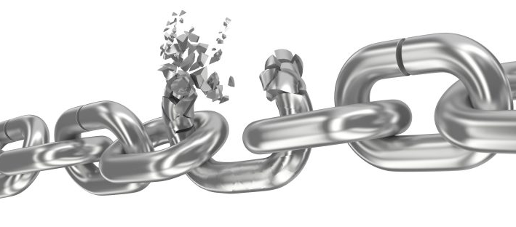
Break the Chain of Infection & Keep Yourself and Others Safe! Perform a Point of Care Risk Assessment prior to each resident interaction!
This Photo by Unknown Author is licensed under CC BY
Notes:
Use routine practice to break the chain of infection and keep yourself and those you care for safe. Every home needs to educate their staff in proper routine practices and other infection control principles and have regular audits to assure everyone is implementing good infection control practices.

Slide 10
References
www.Germsmart.ca
Public Health Ontario. (2021). IPAC Best Practices.
https://www.publichealthontario.ca/en/health-topics/infection-prevention-control/best-practices-ipac
Provincial Infection Control Network of British Columbia. (2011). Residential Care Infection Prevention and Control Manual For Non-affiliated Residential Care Facilities.
Provincial Infectious Diseases Advisory Committee. (2018). Best Practices for Environmental Cleaning for Prevention and Control of Infections in All Health Care Settings, 3rd Edition
https://www.publichealthontario.ca/en/health-topics/infection-prevention-control/environmental-cleaning
Saskatchewan Association for Safe Workplaces in Health. (2021). Infection Prevention and Control.
https://saswh.ca/index.php/infection-prevention-and-control
Saskatchewan Health Authority. (2021). PPE/Infection Prevention and Control https://www.saskhealthauthority.ca/news/service-alerts-emergency-events/covid-19/PPE-infection-prevention-control/Pages/Home.aspx
https://www.saskhealthauthority.ca/

