Slide 1


Proper PPE Use
SASWH Infection Prevention & Control
Notes:
This presentation is called What is routine practices

Slide 2
You will learn:
What is Routine Practices
About the chain of infection
That PPE is an important component of Routine Practices
The importance of proper donning and doffing PPE
Proper PPE & glove use!

Slide 3
What is Routine Practices?
Routine Practices are the minimum standard of practice for preventing transmission of infectious diseases in all health care settings, for all patients, including residents and participants in group, residential and personal care homes

Slide 4

Break the Chain of Infection with Routine Practices!
Hand hygiene
Point of Care Risk Assessment (PCRA)
Personal Protective Equipment (PPE)
Resident Placement/Accommodation
Respiratory Hygiene/Cough Etiquette
Handling Resident Items & Equipment
Linen & Dishes
Environmental Cleaning
Waste and Sharp Handling
Notes:
You can break the chain of infection by using routine practices. The diagram on the left shows chain of transmission. If you break this chain at any point, germs cannot spread. For example, if I have infectious germs on my hands and I clean them with ABHR and kill the germs, I will not spread the germ to a susceptible host. This is one example but there are many ways to break the chain of infection. The list on the right-hand side are the components of routine practices and can be used, to stop the spread of germs in your care home and keep everyone safe, including yourself! We do not always know the infectious state of those we care for. The use of routine practices can help to protect against the spread of blood borne viruses as well, such as HIV and hepatitis.

Slide 5
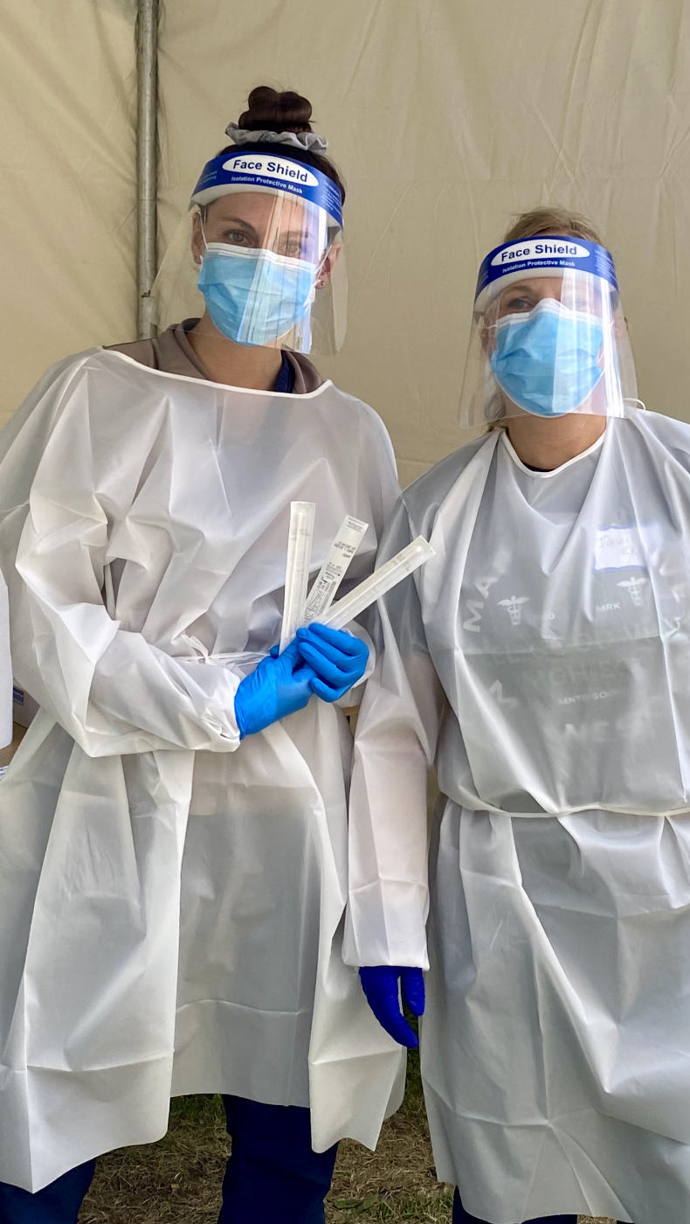
Why is Personal Protective Equipment Worn (PPE)?
Worn to provide a barrier from infectious organisms or hazardous products
When used correctly will help prevent injury or exposure
This Photo by Unknown Author is licensed under CC BY-NC-ND

Slide 6
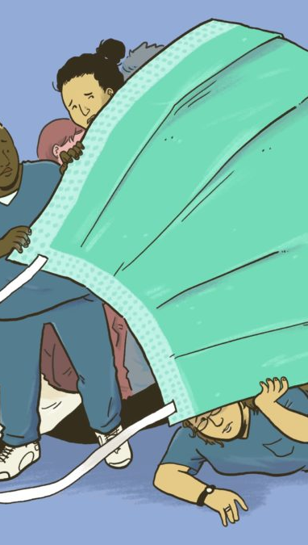
Personal Protective Equipment (PPE)
Based on the job you are about to do (i.e., Point of Care Risk Assessment) and what PPE is needed to protect you and the resident/participant
Additional Precautions
Public Health/Government mandates
This Photo by Unknown Author is licensed under CC BY-NC
Notes:
as just discussed, PPE is based on the task you are about to do and the residents behaviour and the environment . However , if your resident becomes ill with and infectious illness, they will be placed on additional precaution and the PPE worn will be based on how the infectious illness spreads. For example, colds, influenza and COVID spreads through droplets and through contact, therefore the PPE worn will be gloves gown , mask and eye protection,. And of course mandates might be in place such as mandatory mask use.

Slide 7
Notes:
It is important to put on PPE properly, so you are protected, but it is equally important that it is removed properly so you do not infect yourself well removing. This poster was adapted from the SHAs PPE removal poster. Every home should have a training program that educates staff how to put on and take off PPE properly. This poster can be displayed in the home as a reminder to staff how to safely don and doff PPE. See the PPE presentation on this site for a more details in the proper use of PPE.

Slide 8
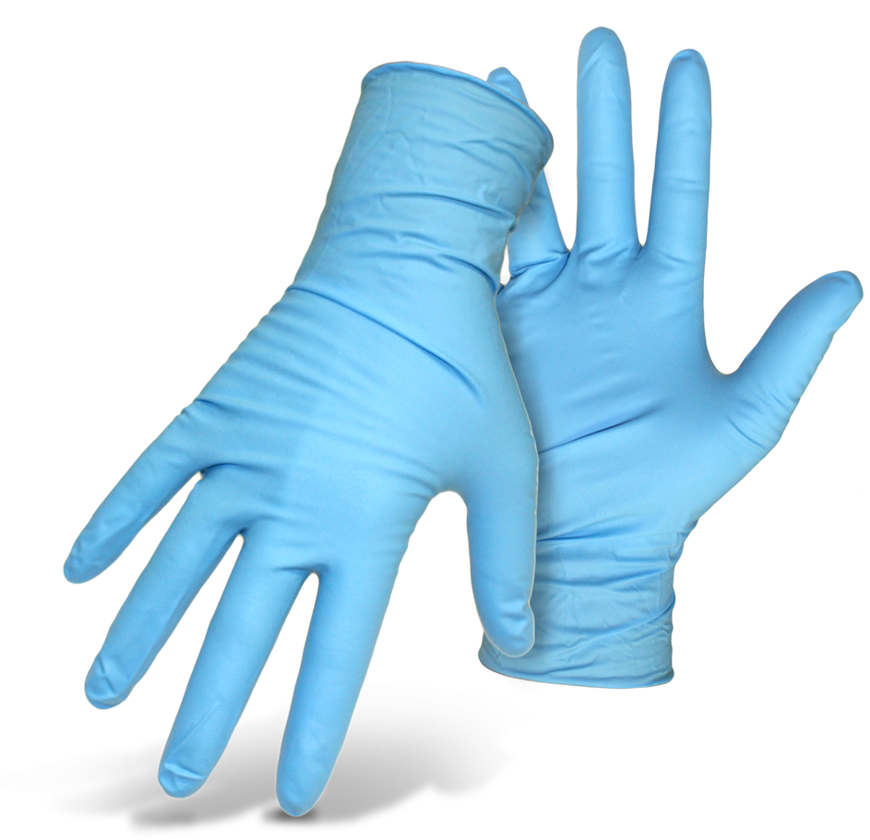
PPE: Gloves
This Photo by Unknown Author is licensed under CC BY-NC
Notes:
Gloves should be used if there is a risk of blood and body fluid exposure , which includes mucus membranes such as eyes nose and mouth & non-intact skin. You do need to use gloves in most common areas of the home, unless it is mandated to do so, as is the case of mandatory masking in a pandemic. If I am pushing a resident in their wheelchair or walking a them, there is typically no body fluids involved in those tasks so no gloves are needed. When I am finished caring for the resident, I would clean my hands before caring for another resident. On the other hand, if I am cleaning up body fluids or carrying a dirty garbage or laundry to the dirty service room then I would.

Slide 9
Proper Glove Use!
This Photo by Unknown Author is licensed under CC BY-NC
Notes:
Gloves should be used if there is a risk of blood and body fluid exposure , which includes mucus membranes such as eyes nose and mouth & non-intact skin. You do need to use gloves in most common areas of the home, unless it is mandated to do so, as is the case of mandatory masking in a pandemic. If I am pushing a resident in their wheelchair or walking a them, there is typically no body fluids involved in those tasks so no gloves are needed. When I am finished caring for the resident, I would clean my hands before caring for another resident. On the other hand, if I am cleaning up body fluids or carrying a dirty garbage or laundry to the dirty service room then I would.

Slide 10
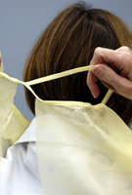
PPE: Gown
Wear a gown to protect exposed skin and clothing during activities likely to cause:
  splashes of fluids
  contact with blood or body fluids (e.g., wound drainage)
Never use gowns as housecoats or warm-up jackets
Do not wear gowns outside resident rooms or bed spaces
Do not reuse gowns
This Photo by Unknown Author is licensed under CC BY

Slide 11
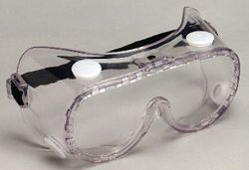
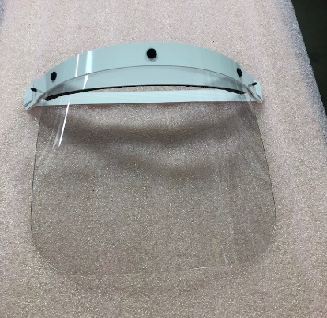
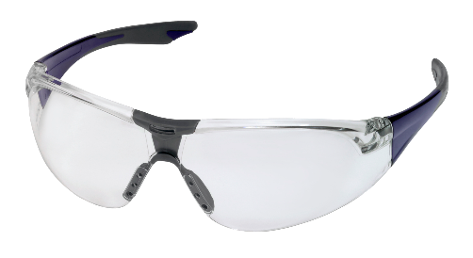
PPE: Face/Eye Protection
To protect your eyes from spray or splashes of blood or body fluids
Perform hand hygiene before putting on and taking off
Prescription glasses do not meet regulations.
Clean and disinfect after each use
Discard single-use in waste container
Most under used PPE, but the most important
This Photo by Unknown Author is licensed under CC BY
This Photo by Unknown Author is licensed under CC BY-NC
This Photo by Unknown Author is licensed under CC BY-SA-NC
Notes:
• If you need a mask, you also need eye protection (e.g., goggles, face shields, visors attached to masks). Wear facial (mask and eye) protection to protect your mouth, nose and eyes during activities likely to spray or splash you with blood or body fluids. • Perform hand hygiene before accessing and putting on, and immediately after taking off facial protection.

Slide 12
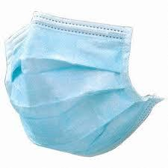
PPE: Mask
Proper wearing of a mask includes:
ensuring a snug fit over the nose and under the chin
molding the metal bar over the nose
wearing the mask with the moisture-absorbing side closest to the face
changing the mask when it is moist, soiled, damaged or hard to breathe
touching only the elastic or ties upon removal
This Photo by Unknown Author is licensed under CC BY-SA

Slide 13
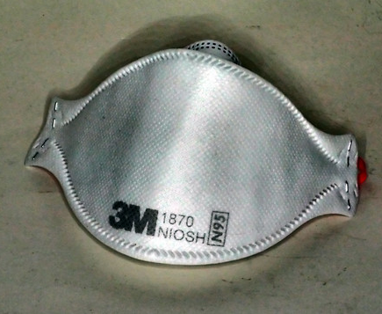
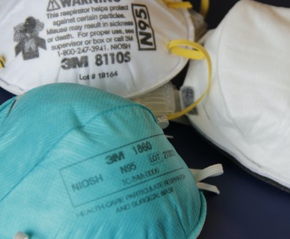
N95 Respirator
For airborne illnesses (aerosolized or airborne tiny particles)
When an aerosol generating medical procedure is occurring with some droplet illnesses (e.g., Covid-19)
These tiny airborne and aerosolized particles can easily travel through the home/facility
N95 respirators require fit-testing, and the worker should only wear the make/model and size that they were fit with
  proper seal check must be performed to assure a tight seal
This Photo by Unknown Author is licensed under CC BY-NC
This Photo by Unknown Author is licensed under CC BY-SA-NC

Slide 14

Break the Chain of Infection & Keep Yourself and Others Safe!
This Photo by Unknown Author is licensed under CC BY
Notes:
Use routine practice to break the chain of infection and keep yourself and those you care for safe. Every home needs to educate their staff in proper routine practices and other infection control principles and have regular audits to assure everyone is implementing good infection control practices.

Slide 15
References
www.Germsmart.ca
Public Health Ontario. (2021). IPAC Best Practices.
https://www.publichealthontario.ca/en/health-topics/infection-prevention-control/best-practices-ipac
Provincial Infection Control Network of British Columbia. (2011). Residential Care Infection Prevention and Control Manual For Non-affiliated Residential Care Facilities.
Provincial Infectious Diseases Advisory Committee. (2018). Best Practices for Environmental Cleaning for Prevention and Control of Infections in All Health Care Settings, 3rd Edition
https://www.publichealthontario.ca/en/health-topics/infection-prevention-control/environmental-cleaning
Saskatchewan Association for Safe Workplaces in Health. (2021). Infection Prevention and Control. https://saswh.ca/index.php/infection-prevention-and-control
Saskatchewan Health Authority. (2021). PPE/Infection Prevention and Control https://www.saskhealthauthority.ca/news/service-alerts-emergency-events/covid-19/PPE-infection-prevention-control/Pages/Home.aspx
https://www.saskhealthauthority.ca/

