Slide 1


Risk Assessment & Masks
SASWH Infection Prevention & Control

Slide 2
Discussion
Routine Practices
The chain of infection
The importance of a risk assessment to determine PPE
When to wear the mask

Slide 3
What is Routine Practices?
Routine Practices are the minimum standard of practice for preventing transmission of infectious diseases in all health care settings, for all patients, including residents and participants in Group, Residential and Personal Care Homes.

Slide 4
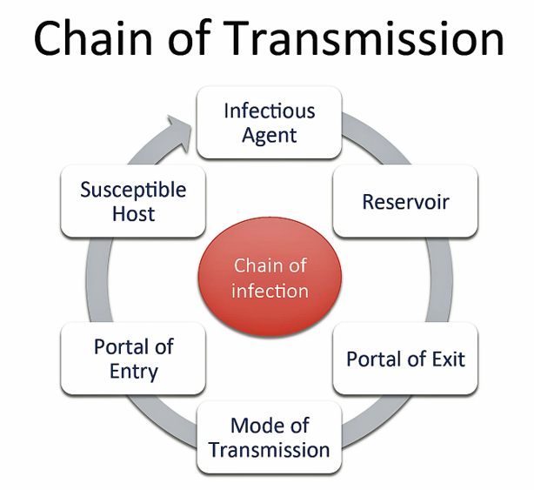
Break the Chain of Infection with Routine Practices!
Hand Hygiene
Point of Care Risk Assessment (PCRA)
Personal Protective Equipment (PPE)
Resident Placement/Accommodation
Respiratory Hygiene/Cough Etiquette
Handling Resident Items & Equipment
Linen & Dishes
Environmental Cleaning
Waste and Sharp Handling
Staff Health and Education

Slide 5
Break the Chain of Infection with Routine Practices!
Hand Hygiene
Point of Care Risk Assessment (PCRA)
Personal Protective Equipment (PPE)
Resident Placement/Accommodation
Respiratory Hygiene/Cough Etiquette
Handling Resident Items & Equipment
Linen & Dishes
Environmental Cleaning
Waste and Sharp Handling
Staff Health and Education

Slide 6
Point of Care Risk Assessment (PCRA)
PCRA is the first step in routine practices.
Used with all residents for all care and all interactions.
ASSESS the TASK, the RESIDENT and the ENVIRONMENT prior to EACH resident INTERACTION.
Then decide what, if any, PPE needed to protect yourself.

Slide 7
Point of Care Risk Assessment (PCRA)
PCRA is the first step in routine practices.
Used with all residents for all care and all interactions.
ASSESS the TASK, the RESIDENT and the ENVIRONMENT prior to EACH resident INTERACTION.
Then decide what, if any, PPE needed to protect yourself.

Slide 8
Let's Talk Masks!!
If you wear a mask, make sure it is medical grade.
No more mask mandates! Now what?
Wait and watch.
Remember you are caring for the vulnerable.
Watch for the SHA recommendations for LTC.

Slide 9
Assess Home/Facility & Community
What is occurring in your community?
What is occurring in your care environment?
What is recommended for LTC?
What are the Public Health/Gov’t/facility recommendations?
Ministries recommendations or mandates?

Slide 10
Assess Home/Facility & Community
What is occurring in your community?
What is occurring in your care environment?
What is recommended for LTC?
What are the Public Health/Gov’t/facility recommendations?
Ministries recommendations or mandates?

Slide 11
Notes:
This poster was adapted from the SHAs PPE removal poster. Every home should have a training program that educates staff how to put on and take off PPE properly. This poster can be displayed in the home as a reminder to staff how to safely remove PPE so they do not contaminate themselves. This sign can be placed at the door of a resident that is on additional precautions.

Slide 12

Break the Chain of Infection & Keep Yourself and Others Safe!! Assessment is key to knowing when to use PPE!
This Photo by Unknown Author is licensed under CC BY

Slide 13
References
Saskatchewan Association for Safe Workplaces in Health. (2021). Infection Prevention and Control. https://saswh.ca/index.php/infection-prevention-and-control
Saskatchewan Health Authority. (2021). PPE/Infection Prevention and Control https://www.saskhealthauthority.ca/news/service-alerts-emergency-events/covid-19/PPE-infection-prevention-control/Pages/Home.aspx
https://www.saskhealthauthority.ca/

