Slide 1


What is Routine Practices?
SASWH Infection Prevention & Control
Notes:
This presentation is called What is routine practices

Slide 2
You will learn:
  What Routine Practices are
  The importance of breaking the chain of infection
  The components of Routine Practices and when to use
  Routine Practices can stop the spread of illness!
  What staff/employer obligations are

Slide 3
What is Routine Practices?
Routine Practices are the minimum standard of practice for preventing transmission of infectious diseases in all health care settings, for all patients, including residents and participants in group, residential and personal care homes.

Slide 4
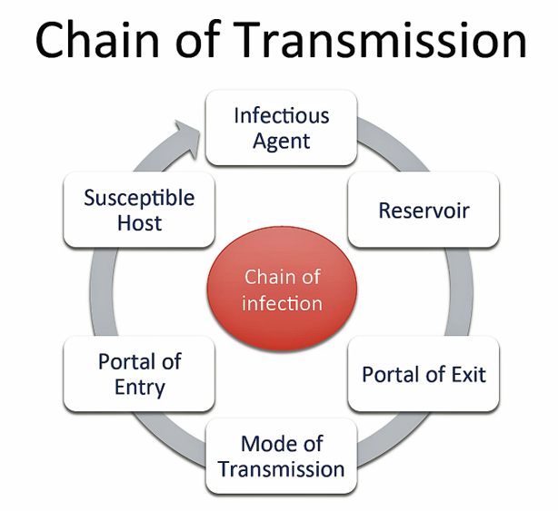
Break the Chain of Infection with Routine Practices!
Hand hygiene
Point of Care Risk Assessment (PCRA)
Personal Protective Equipment (PPE)
Resident Placement/Accommodation
Respiratory Hygiene/Cough Etiquette
Handling Resident Items & Equipment
Linen & Dishes
Environmental Cleaning
Waste and Sharp Handling
Notes:
You can break the chain of infection by using routine practices. The diagram on the left shows chain of transmission. If you break this chain at any point, germs cannot spread. For example, if I have infectious germs on my hands and I clean them with ABHR and kill the germs, I will not spread the germ to a susceptible host. This is one example but there are many ways to break the chain of infection. The list on the right-hand side are the components of routine practices and can be used, to stop the spread of germs in your care home and keep everyone safe, including yourself! We do not always know the infectious state of those we care for. The use of routine practices can help to protect against the spread of blood borne viruses as well, such as HIV and hepatitis.

Slide 5
Notes:
These posters developed by the sask health authority outline the steps to take to ensure all areas of your hands are clean. These posters should be displayed in your care environment and every staff member trained in proper hand hygiene. See the Hand Hygiene presentation on this site and find out how HH safes lives!

Slide 6
Point of Care Risk Assessment (PCRA)
ASSESS the TASK, the RESIDENT and the ENVIRONMENT prior to EACH resident INTERACTION.
This will help you decide what, if any, personal protective equipment (PPE), you will need to wear to protect yourself.
Notes:
You will need to preform a PCRA to determine what PPE is required for each resident or the environment.
Is there a chance you will be in contact with any blood or body fluids ? If yes, you need to don the appropriate PPE to protect yourself.
See the PCRA presentation on this SASWH page for a detailed discussion on how to assess risk, to determine if PPE is needed

Slide 7
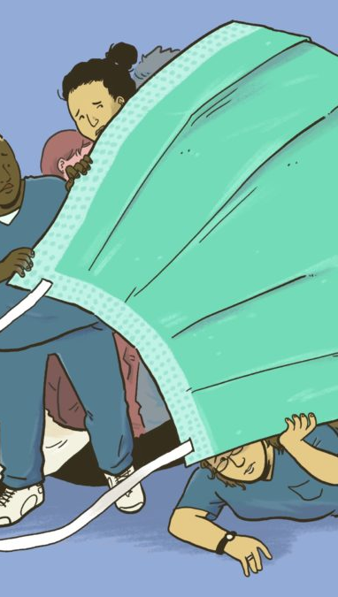
Personal Protective Equipment
Based on the job you are about to do (i.e., Point of Care Risk Assessment) and what PPE is needed to protect you and the resident/participant
Additional Precautions
Public Health/Government mandates
This Photo by Unknown Author is licensed under CC BY-NC
Notes:
as just discussed, PPE is based on the task you are about to do and the residents behaviour and the environment . However , if your resident becomes ill with and infectious illness, they will be placed on additional precaution and the PPE worn will be based on how the infectious illness spreads. For example, colds, influenza and COVID spreads through droplets and through contact, therefore the PPE worn will be gloves gown , mask and eye protection,. And of course mandates might be in place such as mandatory mask use.

Slide 8
Notes:
It is important to put on PPE properly, so you are protected, but it is equally important that it is removed properly so you do not infect yourself well removing. This poster was adapted from the SHAs PPE removal poster. Every home should have a training program that educates staff how to put on and take off PPE properly. This poster can be displayed in the home as a reminder to staff how to safely don and doff PPE. See the PPE presentation on this site for a more details in the proper use of PPE.

Slide 9
Accommodation
When a single room is NOT possible, cohorting of residents should be based on transmission risk factors:
  Compromised immunity
  Infectious state e.g., Antibiotic Resident Organisms such as VRE, MRSA …
  Open wounds or medical devices
  Cognitive status, hygiene
6 feet between beds/privacy curtains

Slide 10
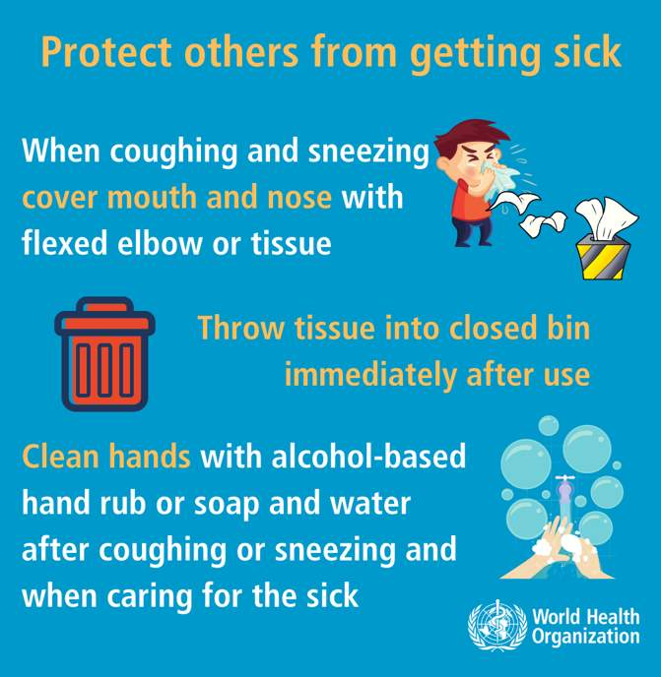
Respiratory Hygiene/Cough Etiquette
Notes:
It is not acceptable to cough or sneeze at people.

Slide 11
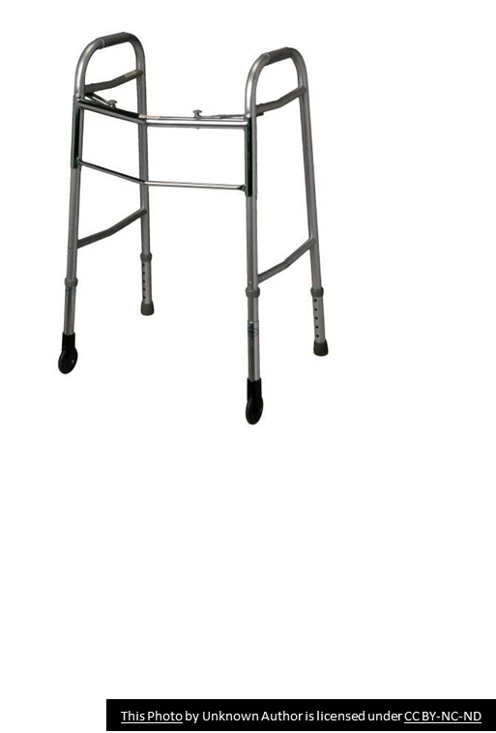
Handling Care Items and Equipment
If reusable equipment cannot be dedicated for a single resident use, clean and disinfect it between residents.
Do not share personal items (e.g., shampoo, soaps, lotions, razors, nail clippers) between residents.
Encourage use of recreational equipment (e.g., toys, shared electronic games) that are non-porous, easily cleanable and able to withstand rigorous cleaning.

Slide 12
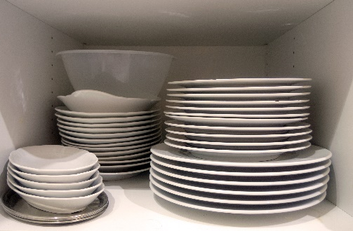
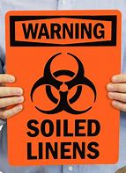
Linen & Dishes
Used meal trays and dishes do not require special handling.
All used linen is considered contaminated and handled the same way.
  Used linens should be put directly into a laundry bag in the area it’s removed.
  Do not overfill bags. Double bag only if leaking.
  Remember to remove items e.g., dentures, needles.

Slide 13
Environmental Cleaning
Clean resident care areas on a regularly scheduled basis and increase cleaning to high touched surfaces if there is suspected/confirmed infectious illness in home
Always follow proper cleaning and disinfection processes
Notes:
View the Environmental Cleaning presentation on this SASWH site for proper cleaning and disinfection in your care homes.
A good example is cleaning and disinfecting a hared tub. You would clean & disinfect and if the disinfectant has a 10 min kill time , you do not wipe or rinse for 10 minutes. If you do, the product will not work properly, and you may put the next resident at risk for infection. There is a method to proper environmental cleaning and we will have a knowledge break in Feb dedicated to environmental cleaning.

Slide 14
Waste and Sharp Handling
Handling waste
Wear gloves to remove waste from resident rooms, common care areas (e.g., resident tub rooms) and if the outside of bag is soiled.
  Remove gloves and perform hand hygiene.
Avoid contact with body when removing waste.
Handling sharps
Remember: New Needle, New Syringe, Every Time!
Dispose of sharps immediately after use in puncture-proof biohazard container.
Do not overfill waste or sharps container.

Slide 15
Staff/Employer Obligation
Staff
  Stay home if sick
  Follow home’s policy
  Follow infection control & safety protocols
  Employer
  Responsible to provide what is needed to keep staff and residents safe e.g., PPE, education/training, hand sanitizer, audits.

Slide 16

Break the Chain of Infection & Keep Yourself and Others Safe!
This Photo by Unknown Author is licensed under CC BY
Notes:
Use routine practice to break the chain of infection and keep yourself and those you care for safe. Every home needs to educate their staff in proper routine practices and other infection control principles and have regular audits to assure everyone is implementing good infection control practices.

Slide 17
References
www.Germsmart.ca
Public Health Ontario. (2021). IPAC Best Practices.
https://www.publichealthontario.ca/en/health-topics/infection-prevention-control/best-practices-ipac
Provincial Infection Control Network of British Columbia. (2011). Residential Care Infection Prevention and Control Manual For Non-affiliated Residential Care Facilities.
Saskatchewan Association for Safe Workplaces in Health. (2021). Infection Prevention and Control. https://saswh.ca/index.php/infection-prevention-and-control
Saskatchewan Health Authority. (2021). PPE/Infection Prevention and Control https://www.saskhealthauthority.ca/news/service-alerts-emergency-events/covid-19/PPE-infection-prevention-control/Pages/Home.aspx
https://www.saskhealthauthority.ca/

