Slide 1


Masks: Wearing the right one makes a difference!
November 2021
SASWH Infection Prevention & Control
Notes:
Welcome, opening remarks

Slide 2
You will Learn:
When and why, we wear masks.
What is a medical mask?
What standards need to be met to be considered medical grade?
How can I tell between a medical and a non-medical grade mask?
What are the differences in types of masks?

Slide 3
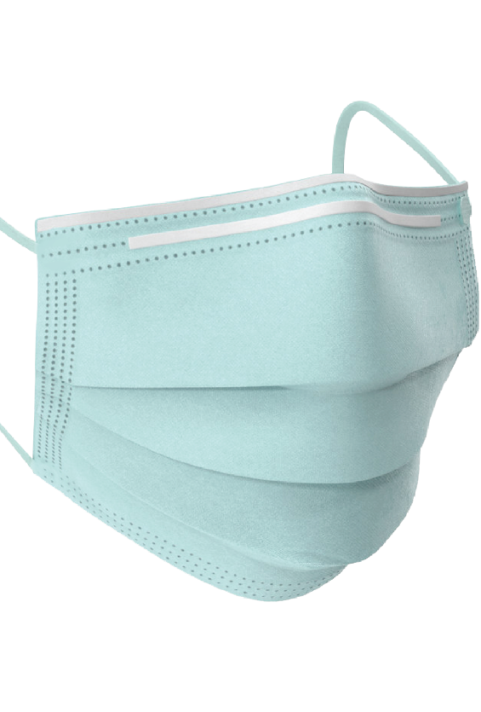
When & Why do we Mask?
COVID-19, Influenza & the common cold spreads through droplets and contact.
Physical distancing of greater than 2 m. decreases the risk of exposure.
Use masks when you cannot physical distance or when you are mandated to do so by a Public Health Order or employer.
This Photo by Unknown Author is licensed under CC BY-NC
Notes:
We would want to wear a mask when we are in close proximity to people with respiratory illness such as Covid-19, Influenza & common cold. These illnessess spreads through droplets and contact
Physical distancing of greater than 2 m. decreases the risk of exposure to these infectious illnesses
When we are around Infectious droplet respiratory illnesses, We should always wear masks when we cannot physical distance or when continuous masking recommendations or mandates are in place.

Slide 4
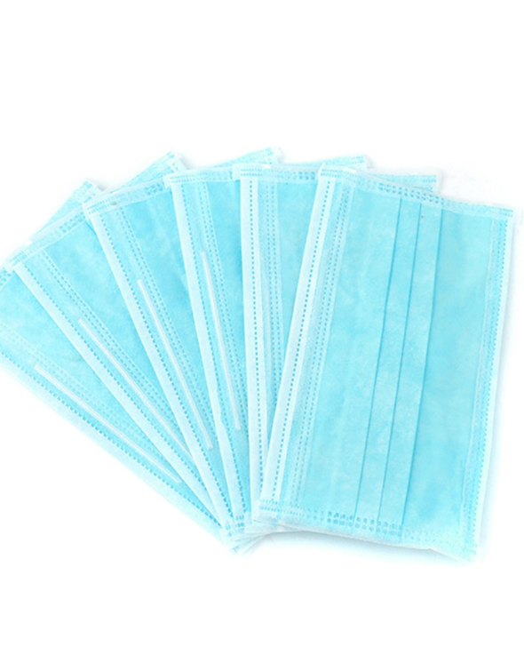
These may look like medical grade masks, but they are not!!
Notes:
Look at the small print on the box. Does it say Not for medical use, nonmedical mask or something similar?? Then it is not medical grade even if it is 3 ply

Slide 5
This is a medical grade mask! It is hard to tell the difference between it and the non-medical grade masks on the previous slide, isn’t it?
…
Notes:
Both medical grade mask and non-medical grade masks can look similar. They both come in several colours. They could be pink , blue , black, blue, green and other cplours.

Slide 6
What is “Medical Grade”?
Must meet a specific standard
ASTM (American) and EN (European) are accepted standards in Canada.
  Packaging will indicate ASTM F2100 or EN 14683 (in most cases, but not always).
  MDEL on package – Medical Device Establishment License-company authorized to import/manufacture. This indicates it has come from another country and has been approved in Canada (has met Canadian standards).
  https://www.primed.ca/resources/astm-mask-protection-standards/
Notes:
Medical grad masks must meet specific standards. The Packaging will usually indicate whether it is medical grade .ASTM F2100 indicates it is made in north America and has met Canadian standards or you may see EN 14683 . These is an indication it has met our Canadian ASTM standard but are imported from Europe. In addition, you may see MDEL on the box. These are approved medical masks as well .They are from another countries but are approved

Slide 7
ASTM Standards for Medical Face Masks
ASTM refers to the American Society of Testing and Materials (ASTM). ASTM standards are referenced by the Food and Drug Administration (FDA), as the endorsed standard in North America
BFE (Bacterial Filtration Efficiency): BFE measures how well the medical face mask filters out bacteria when challenged with a bacteria-containing aerosol.
PFE (Particulate Filtration Efficiency): PFE measures how well a hospital mask filters sub-micron particles with the expectation that viruses will be filtered in a similar manner.
Fluid Resistance: Fluid resistance reflects the surgical mask’s ability to minimize the amount of fluid that could transfer from the outer layers through to the inner layer as the result of a splash or spray.
Notes:
ASTM refers to the American Society of Testing and Materials (ASTM). ASTM standards are referenced by the Food and Drug Administration (FDA), as the endorsed standard in North America
1.The Bacterial Filtration Efficiencymeasures how well the medical face mask filters out bacteria 2. The Particulate Filtration Efficiency measures how well a mask filters sub-micron particles with the expectation that viruses will be filtered in a similar manner.
3. Fluid resistance reflects the mask’s ability to minimize the amount of fluid that could transfer from the outer layers through to the inner layer from splash or sprays

Slide 8
ASTM Standards
4. Delta P (Pressure Differential): Delta P measures the air flow resistance of the medical mask and is an objective measure of breathability.
5. Flame Spread: As hospitals contain sources of oxygen, heat, and fuel the ASTM standards include testing for flame resistance.
5.5 ISO Certification: In addition to the above tests, all medical face masks must be tested to an international standard (ISO 10993-5, 10) for skin sensitivity and cytotoxic tests to ensure that no materials are harmful to the wearer. Tests are conducted on materials used in construction of the mask which come in contact with the user's skin
Notes:
4. The Delta P measures the air flow resistance of the mask and is an objective measure of breathability.
5. As hospitals and other health care areas may contain sources of oxygen, heat, and fuel the ASTM standards include testing for flame resistance.
5.5 in addition There is an ISO Certification: which means all medical face masks must be tested to an international standard for skin sensitivity and cytotoxic tests to ensure that no materials are harmful to the wearer.

Slide 9
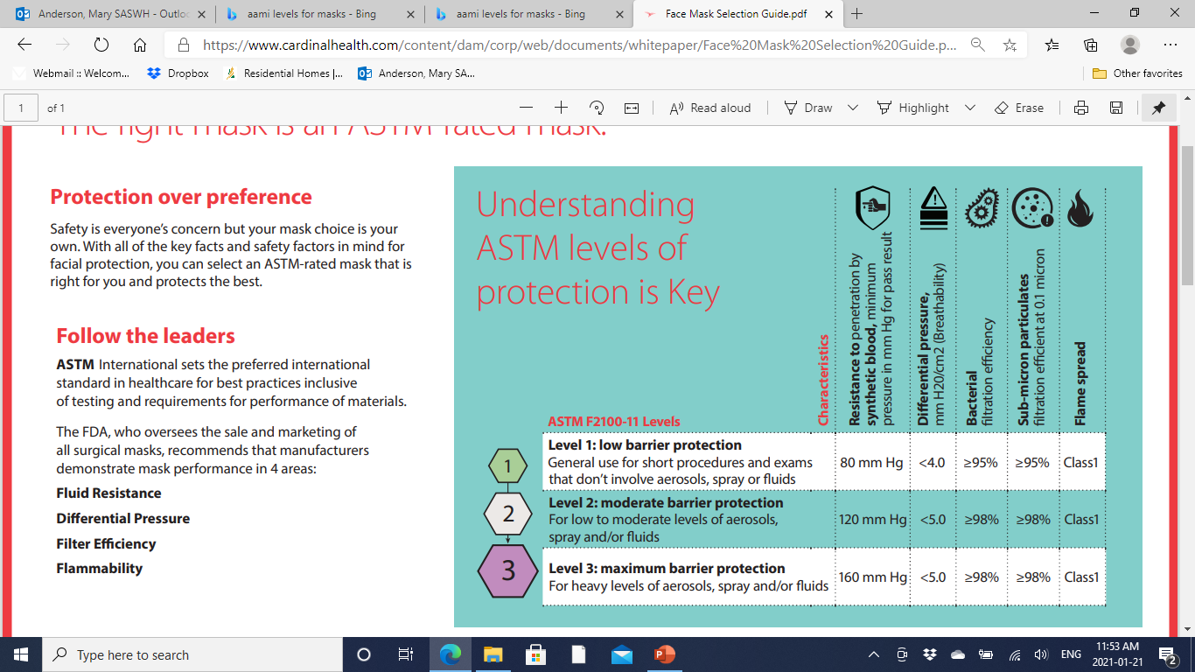
Levels of Protection
Face Mask Selection Guide.pdf (cardinalhealth.com)
Notes:
There are 3 levels of medical grade masks. All are acceptable level of protection for Personal care , group homes and most other health care settings. level 2 & 3 filter out viruses and bacteria at a level of 98% or gretarer and level 1 filters at a 95% or greater—which is still very good protection. It is a little easier to breath with a level 1 mask than a level 2 & 3 but it is just a slight difference. The main difference in the levels is the fluid resistance. Level 3 masks would be worn in health care areas where a high level of splashes and sprays may occur, such as the OR. Level 1 is good for those areas that have a low level sprays and fluids, as is the case in most personal care and group homes.

Slide 10
As you can see Medical Grade Masks = High Standards = Safety!
Provides staff with confidence in the level of protection, however;
  they need to be worn correctly – over mouth and nose
  proper hand hygiene is essential
    before putting on and after taking off
    if you touch the front, clean your hands
  change when wet, damaged or soiled or when it gets hard to breath.
Notes:
As you can see Medical Grade Masks = High Standards and high standards =Safety!
This provides individuals with confidence in the level of protection, however;
they need to be worn correctly –over mouth and nose like in this picture. With The metal nose piece molded around your nose. Hands need to be cleaned before putting on and after taking off. As well If you touch the front, clean your hands
Masks should be changed when wet , damaged or soiled or when it becomes hard to breath. Your breathe can cause your mask to get wet and it will not only become harder to breath , it will not protect as well . This is when it is time to change your mask.

Slide 11
Currently there is no shortage of Medical Grade Masks!!
Health Canada provides information on masks that are medical grade.
There are many medical suppliers!
Some examples of places where medical grade masks can be sourced:
Schaan Healthcare
Cardinal Health
Pro-Med

Slide 12
Notes:
In closing, I want to compare 3 types of masks and their intended use. The medical grade mask, as indicated in this presentation, meets ASTM standards and they filter large particle droplets that are transmitted with infectious illness such as Covid-19, Influenza & the common cold. They should be used by health acre workers including workers in personal care & group homes within 2 metres of residents that are Covid positive or have other respiratory illnesses. Or of course when Public Health recommends or mandates, they should be worn continuously in the home. Until Saskatchewan reaches herd immunity and we are out of our COVIID-19 pandemic masks will likely continue to be recommended by Public Health/
On the left hand side you see a N95 respirator. Respirators protect from exposure to airborne particles seen in illnesses such as TB and chicken Pox. Airborne paarticles are very small and light . They can float around the room and through the home and stay in the air for extended lengths of time. Certain aerosol generating medical procedures such as with a Cpap machine and medication administration through a nebulizer machine can cause large droplet illnesses like COVID to become tiny like seen in airborne illnesses. If one of these procedures is occurring on a suspect or Covid positive resident, then staff wear a N95 respirator while in the room and for 2 hours after the procedure if you enter the room. It is important to know, staff need to be fit tested to see what make model and size of respirator fits them best and also be trained to use it properly. The far right picture represents a non-medical masks. They can be cloth or disposable and have not be evaluated or tested to any recognized standard. They limit the spread of droplets and spit when you talk sneeze or cough, but how well they filter viruses are unknown. They are good to use in the general public when consistent physical distancing is not possible. But they are not recommended for staff working in group homes & personal care homes because the level of protection is unknown placing both the staff and residents at risk.
Wearing a medical grade mask in group & personal care homes can stop the spread of respiratory infections such as COVID-19, flu and colds and possible safe lives. Make your work place safe and wear a medical grade mask!

Slide 13
Contact Us:
Kim Bourassa
Kim.Bourassa@saswh.ca 306-584-3205
Mary Anderson
Mary.Anderson@saswh.ca 306-750-8310

