Slide 1
Where do I find……? An Orientation to Navigating the Infection Prevention & Control Web Page
july 2023

Slide 2
What is Infection Prevention and Control?
Infection control refers to evidence-based practices, that when consistently applied, will prevent or reduce the risk of transmission of infectious diseases to individuals
Infection control draws from many sciences including microbiology, epidemiology, and environmental health
Infection prevention and control is most commonly associated with healthcare settings; however, it is also a workplace safety concern (hand washing, cleanliness, and food preparation areas, etc., being common safety concerns)
In its simplest context, infection control provides the controls for most biological hazards that are contagious

Slide 3
Using the Hierarchy of Controls

Slide 4
Routine Practices
Routine Practices are the minimum
standard of practice for preventing
transmission of infectious diseases in
all health care settings for all patients,
including residents in group,
residential and personal care homes.
NOTE: In the United States, these are referred to as Standard Precautions.
The old term, Universal Precautions, and blood and body fluid precautions were combined and replaced with Routine Practices.
Included in Routine Practices are:
Hand Hygiene
Point of Care Risk Assessment
Personal Protective Equipment (PPE)
Resident Placement/Accommodation
Respiratory Hygiene/Cough Etiquette
Handling Resident Items & Equipment
Linen & Dishes
Environmental Cleaning
Waste and Sharp Handling

Slide 5
Additional Precautions
Although using Routine Practices with all residents, all the time, will satisfy most infection control issues, certain infections will require Additional Precautions.
Additional Precautions are used when providing care to residents known or suspected to be infected with germs that spread easily in the environment.
The type of Additional Precautions used are determined by the way germs could spread throughout the home or facility e.g., by contact, droplet or airborne.

Slide 6
https://www.saswh.ca/infection-prevention-control/

Slide 7
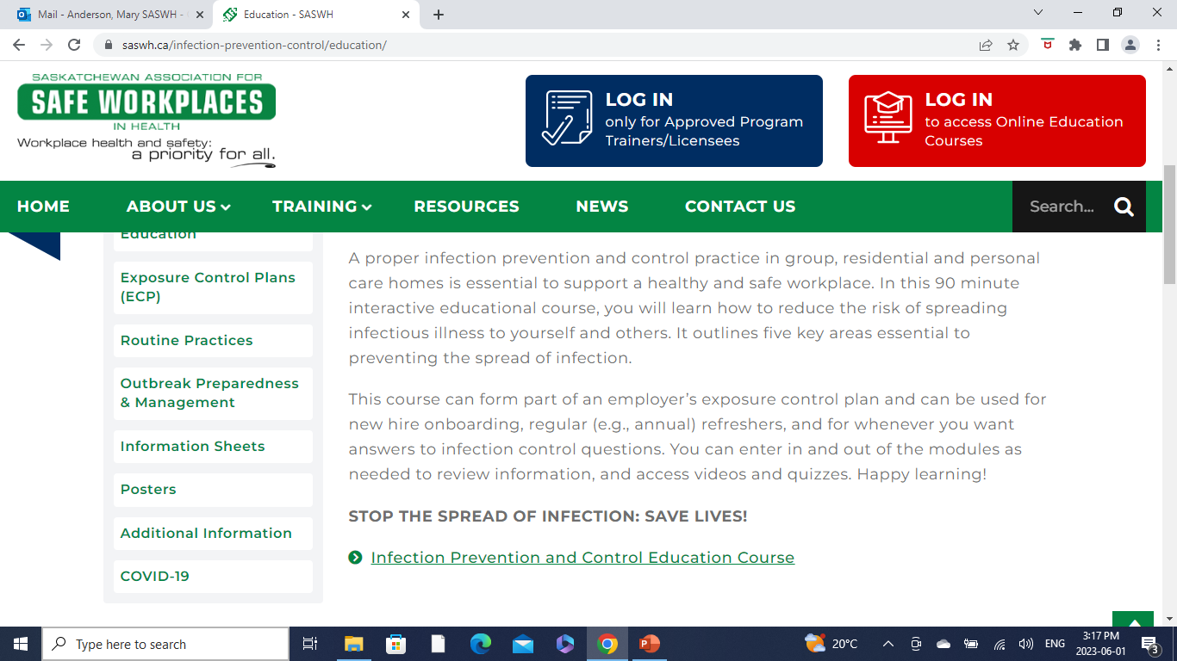
Education
An “quick” basic education course was needed for home operators and their staff.
The SASWH team had already developed a COVID -19 education package for families.
In addition, the IPAC staff had provided WebEx presentations on various infection control topics which were then recorded as a voice over Powerpoint presentation and uploaded to the site.

Slide 8
Exposure Control Plans
There are three templates on this page:
A generic template that can be used for common infections
A COVID-19 specific template
A template for blood and body fluids
Required under OHS regulation 6-22
Format can be a template or group of templates

Slide 9
Routine Practices
Documents on this page:
SASWH Glossary Infection Prevention & Control
SASWH Glove fact sheet
SASWH Enviro Services Best Practices Cleaning Biological Spills
SASWH Hand Hygiene - A guide to clean hands
SASWH IPAC Practice Scenario
SASWH Point of Care Risk Assessment (PCRA)
SASWH Risk of Transmission of Microorganisms Including Antibiotic Resistant Organisms
SASWH Routine Practices
SASWH Linen Laundry
SASWH Enviro Services Best Practices General Cleaning Principles
SASWH Worker Health Safety Clothing
SASWH Worker Health Safety Fit to Work
These are the infection control practices that should be in place and being used on a daily and regular basis wherever care is being delivered to residents/clients.

Slide 10
Outbreak Preparedness and Management
Outbreak Toolkit
Appendix A – Prepare for an Outbreak
Appendix B - PPE
Appendix C – Additional Precautions and Other Posters
Appendix D – Aerosol Generating Medical Procedures (AGMP)
Appendix E – Screening Tools and Visitor Log
Appendix F – Outbreak Checklist and Cleaning Protocols
The toolkit is a document originally developed by staff in the Ministry of Health. It has been reviewed and reposted here.
The appendices are in the main document but are further separated on the page so items can be found quickly. There are a few additional documents that are not in the main file as these were developed after the original toolkit.

Slide 11
Information Sheets
Gastro-Intestinal Illness
Influenza for General Public
Influenza for Health Care Professionals
Norovirus
The information sheets found in this section are intended to provide additional information about common infections.
The sheets can be used as an education tool with staff, clients, or families.

Slide 12
Posters
Posters include:
Germ Smart Hand Hygiene Sanitize Adult
Germ Smart Hand Hygiene Wash Adult
SASWH Doffing PPE Equipment Poster May 2021
SASWH Donning PPE Equipment Poster May 2021
COVID-19 Aerosolize Settle Time
CV -19 Symptoms Poster Feb. 2021
CV-19 Break Room Requirements
Physical Distancing in Effect
Protect Yourself and Others Stop the Spread of Viruses
Frontline Worker Guide
Family Presence Levels At a Glance
Although some of these posters can be found in other sections, it was decided to dedicate space where this information could be found quickly.

Slide 13
Additional Information
The following documents are on this page:
Additional Precautions for ARO residents
Best Practices for Environmental Cleaning in All Healthcare Settings 2018
Routine Practices & Additional Precautions 2017
Health Standards Organization (HSO)
Outbreak Guidance LTC - SHA
These documents are written and maintained by other agencies but are important resources that support the development and maintenance of the various documents on the IPAC page. For example, if someone questions why a certain practice is carried out, that answer should be within one of the documents.

Slide 14
IPAC Resources and Websites
Want more information? Here are some reputable sites we used:
Saskatchewan Health Authority Home | SaskHealthAuthority
Government of Saskatchewan COVID-19 | Emerging Public Health Issues | Government of Saskatchewan
SK Ministry of Health (Communicable Disease Manual) Manuals Communicable Disease Control Manual (ehealthsask.ca)
World Health Organization https://www.who.int/
Center for Disease Control https://www.cdc.gov/
Public Health Agency of Canada https://www.canada.ca/en/public-health.html
Public Health Ontario https://www.publichealthontario.ca/
IPAC Canada https://ipac-canada.org/
Alberta Health Services https://albertahealthservices.ca/ipc/ipc.aspx

