Slide 1

Professional Assault Response Training
6th Edition

Slide 2


Who Are We?
The Saskatchewan Association for Safe Workplaces in Health (SASWH)
is committed to work in partnership with health care industry workers and employers, to reduce the number of workplace injuries and illnesses in the health sector.
Notes:
Mission: To guide the health-related industry in the elimination of workplace illness and injury.
Vision: Workplace health and safety, a priority for all.

Slide 3






Housekeeping Details
Washrooms
Scent-Free
Policy
Stretch Your Legs
Cell Phones
Emergency Exits
Break Times
Notes:
Before we start let’s review some housekeeping details.
Washrooms
This is a scent-free session. If you have any scents with you, please don’t use them during this class.
Many of you are not used to sitting all day long. Don’t feel that you must sit continuously. Feel free to stand, stretch, lean against a wall. Please take advantage of the break times to stand and walk around
Please put your phones on silent and try not to refer to them during the class.
Point out the emergency exits and must point (You should have obtained this information from your facility contact prior to the class) You should also be able to explain the emergency process for the facility.
We will have 2 breaks today, one mid morning and one mid afternoon. They are each 15 minutes long.
There will be one 30-minute lunch break around noon.

Slide 4

Administrative Details
Sign in sheet - attendance list
Fit for Training declaration
Evaluation (pre-session questions)

Slide 5

Positive Participation Guidelines
Active Engagement
Constructive Feedback
Focus and Attention
Open-mindedness
Positive Attitude
Participation in Role Plays/Activities
Self-reflection
Notes:
Active Engagement: Encourage participants to ask questions, share ideas, contribute to discussions while being respectful to others.
Constructive Feedback: Provide feedback that is supportive and focused on improvement rather than criticism.
Focus and Attention: Stay attentive and avoid distractions, such as using phones or engaging in side conversations.
Open-mindedness: Be willing to learn new concepts and adapt to new ideas.
Positive Attitude: Maintain a positive attitude that encourages others and keeps the session productive and enjoyable.
Participation in Role Plays/Activities: Actively participate in hands-on activities, exercises, and role plays.
Self-reflection: After the session take time to reflect on how the training can be applied in real-life scenarios.

Slide 6


Learning Outcomes
PART Basic:
understand why individuals are acting out
understand how your attitude may aggravate the situation
know if you are physically and mentally prepared to work with potentially assaultive individuals
know the importance of effective communication to assist with de-escalating an assaultive situation
create a plan for self-control
know how you respond in a crisis situation
know how to identify why an individual may be assaultive
understand the importance of proper communication and documentation
demonstration, practice and return demonstration through exercises and role plays
Notes:
Learning outcomes for each portion of the PART program: basic, intermediate and advanced

Slide 7
Learning Outcomes
PART Intermediate:
the Basic learning outcomes
understand the principles of effective breakaway and evasion techniques (demonstration, practice and return demonstration of techniques – practice each technique three times)
responding to situations where assault causing bodily harm occurs, but there is no intent to do serious bodily harm

Slide 8
Learning Outcomes
PART Advanced:
the Basic learning outcomes
the Intermediate learning outcomes
understand the principles of effective manual restraint techniques (demonstration, practice and return demonstration of techniques – practice each technique three times)
Notes:
Hide slide if not teaching Advanced PART

Slide 9

Workers who have developed a
SYSTEMATIC APPROACH to the
treatment of aggressive or violent behavior are less likely to injure or be injured during an incident than those who haven’t!

Slide 10
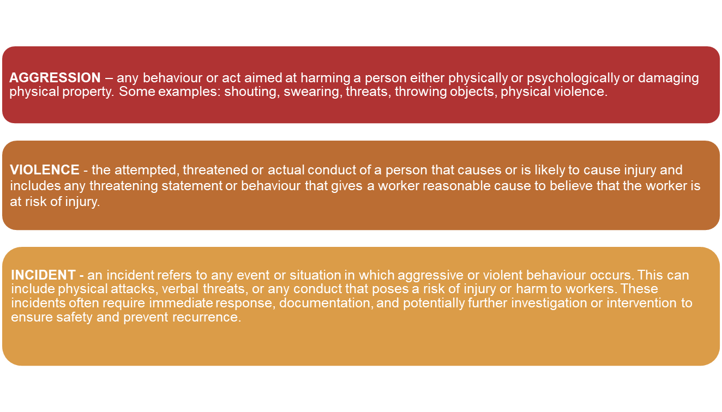
Description of Terms

Slide 11
Description of Terms
PROBLEM-SOLVING – asking the right questions.
EMERGENCY RESPONSE – primary plan, then secondary, then PART.
GENDER NEUTRAL – PART is designed to be free of gender bias.
APPROACH – principles, not specific interventions.
RIGHTS – individual and worker, both kept safe.
TEAMWORK – PART emphasizes the skills and qualities of effective teamwork.

Slide 12

Legislation
The three rights of a worker:
the right to know
the right to participate
the right to refuse

Slide 13
Course Background
As agencies assume responsibility for the treatment of people with assaultive behaviour, they face a clear pattern of risks.
What are the risks?
The individual will be successful in injuring themselves or others
The workers could be seriously injured during an incident
Workers could contribute to the injury using excessive force
Lack of teamwork could contribute to the injury
Managers could contribute to the injury by not providing adequate supervision
Public censure
Formal penalties from court or legislation

Slide 14
Learning Objectives
Purpose – what is my goal when responding to an individual with the potential for violence?
Professionalism – why do I do what I do?
Preparation – how have I prepared myself for this job/today?
Identification – can I identify why the behaviour is happening?
Response – can I respond appropriately?
Recording/reporting – how do I share this?
Follow-up/plan – can we work together to not have it reoccur?

Slide 15

Accountability
General definition of accountability:
Being bound to give an explanation of your conduct
Being responsible; answerable
What does “accountability” mean to you?

Slide 16
PART is designed to address the question:
What happens when the care/treatment plan breaks down?
The care or treatment focus is not on what the individual will stop doing, rather what the individual will be doing to meet their needs.
Plan Your Work
- - -
Work Your Plan!

Slide 17

PART Interventions
PART interventions are to be used all the time, but may also include the following:
when the primary care/treatment plan doesn't work;
when the back-up care/treatment plan doesn't work; and,
when you are facing an immediate threat of injury.
It is most important to stick to the primary plan for each individual while continually using PART principles.

Slide 18
PART is not a self-defense course.
The key question to be answered when considering the use of PART interventions is:
Is the behaviour dangerous?
Being obnoxious is a constitutional right.
Violating anyone’s human rights is a serious matter. It should never be done without sufficient cause.

Slide 19
PART Principle
Purpose:
When workers understand that beneath difficult or aggressive behaviours there is a message or a reason for the behaviours, workers will be less likely to react negatively to the behaviours and more likely to respond in ways that assist the individual to express their needs more effectively.
This will lead to better outcomes.
Notes:
Key Question: When responding to an individual displaying difficult or aggressive behaviour, what is your goal?

Slide 20
Purpose
Key question:
When responding to an individual displaying difficult or aggressive behaviour: what is your goal?

Slide 21
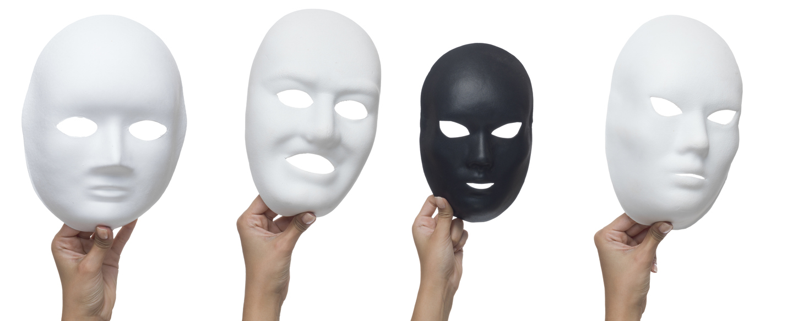
Remember…
"All behaviour is a form of communication.”
(Dr. Becky Bailey, 2023)

Slide 22
Professionalism:
Workers who understand why they have chosen to work in the healthcare/human services field are more motivated to respond in a positive manner when responding to difficult or challenging behaviours while not reacting with emotion.
Notes:
Key Questions:
What brought me to this job?
What keeps me here?
What are my attitudes towards my job and other individuals?
Am I suited for the demands of this job?

Slide 23
Response vs. reaction
A reaction is typically quick, instinctive, and often involves an emotional behavior in the moment. It's automatic and driven by immediate feelings or stimuli without much consideration of the consequences.
A response is more thoughtful and deliberate. It involves self-control, assessing the situation, and choosing the best course of action or response, often considering the potential outcomes or effects.

Slide 24



Professionalism
Self as a tool
Professionalism and safety
Do we pose a threat to ourselves and others?
Features of professionalism
Mood – what causes your moods?
Attitude – affects behaviour and performance
Motivation – what brought me to this job and what keeps me here.

Slide 25
Professionalism is…
Taking responsibility for the disciplined management of mood, attitude and motivation in the service of the individual.

Slide 26
Preparation:
Workers who are prepared to respond to challenging behaviours before they get to work are less likely to injure others or be injured than workers who are not prepared.
The fully prepared worker considers their attire, level of mobility, and well-practices observational strategies. A self-control plan will reduce the chance that you will contribute to the assaultive situation.
Notes:
Key Question: Am I physically and mentally prepared to work with potentially dangerous people? Am I taking care of myself by making healthy choices, getting enough “good” sleep, staying alert and aware of myself, the environment and others?

Slide 27
Preparation
Attire – right clothes for the job.
Mobility – ready to move.
Observation – my surroundings and individuals.
Self-Control – have a plan.
Notes:
Self-control plan = self assessment, know your limits, regain self-control, restoration and healing

Slide 28

Preparation
Attire:
Am I aware of how I am dressed and how that affects my ability to move/respond during an emergency?

Slide 29

Preparation
Mobility:
Am I prepared to move quickly if and when I need to?
What can I do to improve and maintain my ability to be mobile?

Slide 30

Preparation
Observation:
Do I have a well-developed observation strategy?
Do I observe the environment and the individual I interact with?
When and where am I more observant – when and where am I less observant?
Have I set up my environment to observe effectively?

Slide 31

Preparation
Self-control:
Maintaining self-control in difficult circumstances is one of the hallmarks of professionalism.
When you believe you are being threatened, your body will prepare to reduce or eliminate the threat.
  These processes are involuntary.
  FIGHT, FLIGHT, FREEZE or FAWN .
During an incident you may feel physically strong, but you are temporarily incapable of making good judgements.

Slide 32
Preparation
Self-control plan:
Self-assessments
Knowing your limits
Regaining self-control
Restoration and healing
What makes you lose control?
Plan your work and work your plan!

Slide 33
Identification:
The better we understand the many contributors to the occurrence and potential for challenging behaviours, the more likely we will be to prevent incidents from occurring or deal more effectively with incidents when they occur.
Notes:
Key Question: If an individual is displaying difficult or aggressive behaviours, can I identify why and adjust my response accordingly?

Slide 34
Identification
Identification
Legal Model
Developmental Model
Communication Model
Environmental Model
Interactive Model
Stress Model
Basic Needs Model
Socio-cultural Model
Common Knowledge Model

Slide 35
Legal Model
common assault
assault causing bodily harm
aggravated assault
This is not intended as legal advice.
Reasonable force: Using just enough force for effective self-protection, and no more than absolutely necessary.

Slide 36
Stress Model
(Assault Cycle)
Phase I: The Triggering Event
Phase II: Escalation
Phase III: Crisis
Phase IV: Recovery
Phase V: Post-Crisis Depression
Baseline

Slide 37

Developmental Model
Violence can be seen as a function of age.
It’s important to look at the difference between chronological and developmental age.

Slide 38
Developmental Model
The typical development stages of the ability to inhibit explosive outbursts:
Preschool age children:
  Little ability to control explosive outbursts.
  Can be easily provoked over relatively simple issues.
  Can have outbursts based on environmental features.
Early elementary age children:
  Have enough control to avoid hitting and biting however interactions can cause impulsive violent behaviour such as pushing.
  Sometimes violent expression is used to gain the attention of adults.
Late elementary age children:
  Can delay their impulses to fight until they can find a time and a place with less adult intervention.
  Fighting is much less frequent.
  There is a notable difference between gender’s ability to control their impulses at this age.

Slide 39
Developmental Model
Early adolescents:
  Provoke adults or authority figures intentionally.
  Typically pushing their limits and attempting to challenge authority.
  Inexperience and poor judgement sometimes lead youth to fight with someone who may injure them badly or injure another more than planned.
Late adolescents:
  Have the ability to channel most of their violent and destructive impulses into other activities.
  Relationships may provoke incidents (cheating, disagreements).

Slide 40
Developmental Model
Young adults:
  Rarely express their violent or aggressive impulses.
  Incidents are more isolated.
Middle aged adults:
  Rarely have physical fights.
  Violence is situationally caused (adultery, job loss, alcoholism).
Elderly:
  Typically avoid situations that may lead to violence altogether.
  Mental and physical impairments may produce the inability to inhibit impulsive violent expression.

Slide 41
Communication Model
Withdrawal
Passivity
Assertion
Aggression
Assault

Slide 42
Assertive Communication Tips
Create win-win situations, instead of I win – you lose
Be prepared to negotiate
Use assertive language
Use assertive body language
Use “I” statements
Be clear and specific
Stay calm and relaxed
Maintain eye contact
Listen actively
Stay focused on the issue
Set boundaries
Practice empathy
Take responsibility for your own actions
Practice assertiveness regularly

Slide 43
Basic Needs Model
Self-actualization: desire to be one’s best
Self-esteem: respect, recognition, strength, freedom
Love & Belonging: friendship, intimacy,
family, acceptance, trust
Safety: personal security, employment,
resources, health, property
Survival needs: air, water, food,
shelter, heat, sleep, clothing,
reproduction
Self-
Actualization
Self Esteem
Love & Belonging
Safety
Survival Needs

Slide 44

Environmental Model
physical conditions
lack of control
social environment
worker performance problems

Slide 45
Interactive Model
Individual
Environment
Worker
Mental State

Slide 46

Socio-cultural Model
Aggression is a result of:
Social training
individual’s upbringing, video games, tv shows
Social settings
gangs, professional fighting, hockey games, etc.

Slide 47
Common Knowledge Model
Four basic reasons why people threaten and injure themselves or others…
FEAR
FRUSTRATION
MANIPULATION
INTIMIDATION

Slide 48
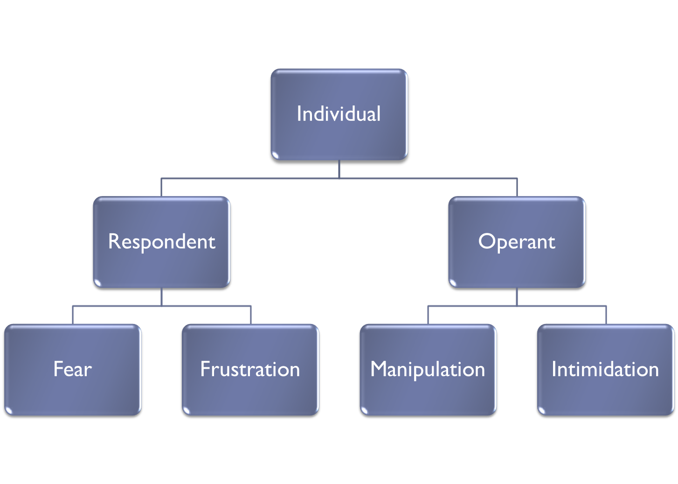
Common Knowledge Model
Behaviour
Behaviour

Slide 49
Fear
Signs of Impending Aggression
Visual | Auditory | History of Behaviour
Posture tense, prepared to defend, hide or run away Skin pale or ashen (depends on natural skin tone) Facial expression wide-eyed or fearful | Voice quality whining, pleading Breathing rapid, shallow, irregular | Personal history get to know the individual’s history, as fear could be considered a threat to their physical, emotional, or psychological well-being

Slide 50
Frustration
Signs of Impending Aggression
Visual | Auditory | History of Behaviour
Posture tense and escalated Skin tones of purple or red; splotches (may depend upon natural skin tone) Facial expression tense, focused, and angry | Voice quality menacing, aggressive, loud. Breathing loud, deep, long, heavy. | Personal history whether or not the individual’s behaviour typically escalates quickly. Determine the source of the frustration

Slide 51
Manipulation
Signs of Impending Aggression
Visual | Auditory | History of Behaviour
Difficult to interpret at any particular moment | Definite change: confusing demands, whining voice, “poor me”, words of pitiable victim may be overly friendly or pleasant outbursts of behaviour accusations, comparisons and trivia in more aggression tones will change tactics to get what they want threats and may attempt violence | Personal history losing control if there is a history of manipulation - there is a strong chance the manipulating behaviour will continue.

Slide 52

Tools to identify manipulation:
  The temper-tantrum: appearing to lose control (banging, stomping, yelling, etc.)
  Playing the numbers: playing people against each other hoping to find someone who will give in to the demand.
  Promoting confusion: bringing in related but irrelevant matters into the discussion.

Slide 53
Intimidation
Signs of Impending Aggression
Visual | Auditory | History of Behaviour
basically neutral or unremarkable with the exception of threatening posture. physical menacing/crowding (standing very close to or over the person being intimidated) as a way to threaten danger. | Voice quality menacing, threatening words definite pattern - clear and strong demand, believable threat finally, refusal to comply followed by an attempt to injure through violence | Personal history bullying and having demands met by using intimidating tactics extortion other criminal assault

Slide 54
Summary
assaultive incidents can be categorized into levels of dangerousness
incidents progress through a five-phase cycle
assaultive incidents are signaled by, and grow from patterns of unbalanced, and assertive communication
function of developmental age
environmental irritants often contribute
a perceived threat to deprive an individual of basic needs may lead to assault
often relate to social or cultural pressures
aggressive incidents develop from patterns of behaviour

Slide 55
Response:
Workers who are able to match their response to the level of dangerousness presented by the individual’s behaviour are less likely to use too much or too little force.
Notes:
Key Question: When we are responding to a person who is trying to injure, will we be able to match our response to the level of injury threatened?

Slide 56
Response
Least
aggressive
Crisis intervention:
Reacting appropriately to the phase of the violent incident.
Rule of five.
Evasion:
Getting out of the way.
Restraint:
Holding a person in place.
Most
aggressive

Slide 57

Principles of Crisis Intervention
Self-control
Identification
Communication
Timing
Patience
Spontaneity

Slide 58
Reasonable Force
Observed Behavior
common assault
assault causing bodily harm
aggravated assault
Reasonable Force
nil
crisis intervention
communication
evasive techniques
controlling techniques or manual restraint

Slide 59
Stress Model
(Assault Cycle)
Response: Escalation – verbal crisis communication (simple, direct, brief)
Response: Crisis Phase – verbal crisis communication, evasion, restraint
Crisis
Response: Recovery Phase – verbal crisis communication, no discussing of consequences (may re-ignite), voluntary self-isolation
Escalation
Recovery
Response: Triggering Phase self-control, de-escalation, diversion, distraction
Response: Post-crisis Depression – active listening, unconditional positive regard, allow expression of feelings, no discussing of consequences or determining blame, restraint is not necessary at this phase.
Triggering Event
Post-crisis Depression

Slide 60
Developmental Model Response
Stage | Identify | Response
Pre-school age children | Easily provoked, little ability to control their outbursts. Easily provoked by physical/environmental conditions (hunger, cold)
Early elementary age children | Usually, have developed control during outbursts to not hurt others.
Late elementary age children | Can usually delay their impulses to fight. Fighting is less frequent
Early adolescents | Tendency to provoke adults intentionally. May fight among peers and between rival groups. Poor judgement at this stage
Late adolescents | Mostly able to channel their energy into sports, etc. Relationships may provoke incidents.
Young adults | Rarely express themselves explosively. Isolated incidents. Drug and alcohol abuse make it difficult to inhibit explosive behaviour.
Middle-aged adults | Rarely have physical fights. Domestic matters may cause inhibitions to break down (adultery, job loss, threat to property, alcoholism, etc.)
Elderly adults | Healthy elderly avoid violent situations. Physical and mental impairments may cause impulsive violence

Slide 61
Communication Model Response
De-escalation tips:
Identify yourself and your goal - “Hello, my name is Linda, I am here to help you.”
Remember personal space - maintain a distance of four to six feet.
Be empathetic and non-judgemental.
Actively listen and use unconditional positive regard - allow for expression of feelings.
Look for the reason behind the behaviour.
Know and use their treatment/support plan.
Use your self-control plan.
Use a team approach – take a “time out” if needed to regain your self-control.
Respond appropriately to each motive including appropriate body language.
Find a worker that has a good rapport/relationship with the individual and have them talk to them.
Respect needs to communicate in different ways (recognize possible socio-cultural differences as well as fear, shame, and embarrassment they may be experiencing).

Slide 62
Interactive Model Response
When responding to an individual it is important to think about all aspects that may affect behaviour.
Components | Give examples that may affect behaviour | Response
Individual | Personal history Diagnosis Developmental stage Mental health conditions Unmet needs
Environment | Physical surroundings (temperature, noise, light) Staffing concerns Safety (real or perceived)
Mental State | Emotional state Cognition (confused disoriented) Hallucinations, delusions Coping strategies
Worker | Level of training Communication skills Attitudes and beliefs Personal triggers Personal well-being Workplace culture

Slide 63
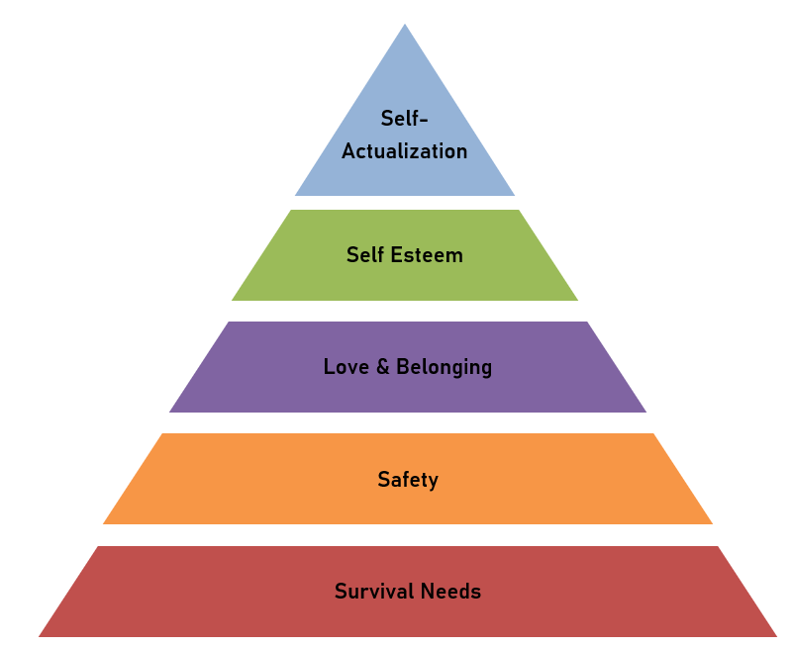
Basic Needs Model Response
By understanding and addressing the needs at each level of this hierarchy, you can tailor your responses and interventions to the individuals you support.

Slide 64
Socio-cultural Model Response
When responding to an individual it’s important to consider socio-cultural factors. The following are some key considerations:
Ensure there is understanding when communicating.
Be aware of body language, eye contact, and gestures.
Address individuals in a culturally and personally acceptable manner.
Approach each individual recognizing your own biases and values while being open to learning about their unique cultural background.
Be sensitive to cultural norms regarding gender roles.
Show respect for elders and authority figures within the individual’s culture.
Consider the individual’s access to healthcare, education, transportation, and financial resources.
Considering these socio-cultural key points in how we respond, will ensure it is respectful, and tailored to the individual.

Slide 65
Common Knowledge Model
FEAR: threat reduction
FRUSTRATION: control
MANIPULATION: detachment
INTIMIDATION: communicate consequences

Slide 66
Common Motive | Signs of Impending Aggression |  |  | Goal
 | Visual | Auditory | History
Fear |  |  |  | Threat Reduction
Individuals will react, possibly by displaying aggressive behaviours when they feel they are being assaulted or when they think that someone is going to take something away from them that is a basic need, necessary for their well-being. . | posture - tense, prepared to defend, hide or run away skin color - pale or ashen (depends on natural skin tone) facial - wide-eyed or fearful | voice quality - whining, pleading breathing - rapid, shallow, irregular | get to know the individual’s history, as fear could be considered a threat to their physical, emotional, or psychological well-being | Reducing the threat will also reduce the probability that the common assault will escalate.
Approach Techniques
Posture | Gesture | Position | Voice Quality | Speech Content | Eye Contact | Physical
relaxed and open, hands in full view | slow, palms-up and to the side | slightly off to the side, and far enough away (8-10 feet, if possible) to make it clear that you are not a threat. | firm, reassuring, confident | logical, encouraging calm reflection; if promising, ensure the promise is achievable. | if the individual seeks eye contact, should be given freely; if the individual tries to avoid eye contact it should not be forced on them. There are many cultures that discourage or limit communication through eye contact. | touch should not be given without permission and should be light with slow movements.

Slide 67
Common Motive | Signs of Impending Aggression |  |  | Goal
 | Visual | Auditory | History
Frustration |  |  |  | Control
Individuals may become aggressive and injure themselves or others, sometimes damaging property, as an expression of frustration. | posture – tense and escalated skin color - tones of purple or red; splotches (may depends upon natural skin tone) facial – tense, focused, and angry | voice quality - menacing, aggressive, loud breathing - loud, deep, long breaths | whether or not the individual’s behaviour typically escalates quickly. Determine the source of the frustration | Communication that demonstrates self-control contributes to the decrease of frustration and encourages restoration of the individual’s self-control.
Approach Techniques
Posture | Gesture | Position | Voice Quality | Speech Content | Eye Contact | Physical
self-confident, leading, in control | firm, directing, palms out and gesturing down | using our stance, be directly in front of the individual, and just outside of their striking range | quiet, firm, strong tones low enough to make the individual strain to hear | repetitive, confident directives without threat | direct and accompanied by facial expressions that indicate firm directives are being given | if physical contact is required, it should be made firmly but without excessive movement

Slide 68
Common Motive | Signs of Impending Aggression |  |  | Goal
 | Visual | Auditory | History
Manipulation |  |  |  | Detachment
Individuals can become impulsive and explosive in an effort to manipulate others into giving them something. (i.e. emotional control, physical objects) | difficult to interpret at any particular moment | definite change - confusing demands, whining voice, words of pitiable victim; may be overly friendly or pleasant; accusations, comparisons and trivia in more aggression tones; will change tactics to get what they want; threats and may attempt violence | -losing control -if there is a history of manipulation - there is a strong chance the manipulating behaviour will continue. | Communication that indicates refusal to become involved in manipulation will decrease the likelihood of manipulation.
Approach Techniques
Posture | Gesture | Position | Voice Quality | Speech Content | Eye Contact | Physical
closed relaxed | gestures of disapproval or mild irritation, non-engaging, detached from the situation (e.g., show no emotion), closed posture (e.g., cross your arms) | close enough to physically intervene, but far enough away to show non-involvement (4-5 feet) | detached, mechanical, slightly bored | quiet, repetitive, | avoid eye contact to show non-involvement. | if physical contact becomes necessary, it should be handled as quickly and unemotionally as possible. Try to make contact with clothing only, as contact with flesh may portray involvement.

Slide 69
Common Motive | Signs of Impending Aggression |  |  | Goal
 | Visual | Auditory | History
Intimidation |  |  |  | Consequences
The individual may threaten or instil fear to intimidate others to get what they want. (i.e. physical or emotional threat) | -basically neutral or unremarkable with the exception of threatening posture. -physical menacing/crowding (standing very close to or over the person being intimidated) as a way to threaten danger. | -menacing, threatening words -definite pattern - clear and strong demand, believable threat -finally, refusal to comply followed by an attempt to injure through violence | -bullying and having demands met by using intimidating tactics -extortion -other criminal | Clear communication of the consequences to reduce the probability that an intimidating individual will escalate to have their demands met.
Approach Techniques
Posture | Gesture | Position | Voice Quality | Speech Content | Eye Contact | Physical
poised and ready to move or react quickly (standing) | few and far between, to avoid the impression of momentary un-readiness or weakness | position yourself at a defensive advantage, such as standing with your back to an exit, having a chair, table or desk between you and the intimidating individual | matter of fact; monotone; emotionless; Maintain self-control | clear and direct statements of consequences, repeated as often as necessary. Avoid threats and unrealistic consequences | should be used sparingly, to emphasize a statement | if physical contact is necessary, it should be completed as quickly, smoothly, and as matter-of-factly as possible

Slide 70
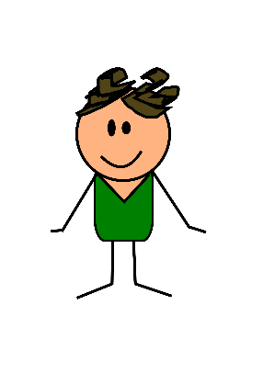
Key Information for Response
Personal Space
Slow down
Think about what is happening
Options
Plan to have some time to
yourself
Intimate zone
0 – 45 cm
Social zone
45 – 91 cm
Public zone
91 cm – 183 cm
Notes:
Intimate zone
0 -18 inches
Social zone
18 in - 3 feet
Public zone
3 - 6 feet

Slide 71
Key Information for Response
Distance
Stance
Placement of Arms
Eye Contact

Slide 72
Therapeutic Approaches
Validate the Individual as a Person
Respect the Individual's Privacy
Interview the Individual and Family to Determine History and Present Problems
Complete a Mental Status Evaluation to Determine
Determine Individual's Level of Functioning
Determine How the Individual Perceives and Relates to Casual Workers

Slide 73
STOP Strategy
Slow down
Think about what is happening
Options
Plan to have some time to
yourself
Notes:
By using assertive communication, workers automatically reduce the chances that an incident will occur. When an incident does occur use the STOP strategy.

Slide 74
Response Summary
Can we de-escalate the individual prior to escalation and/or crisis?
Match your response to the level of dangerousness presented – always keep in mind reasonable force guidelines.
Choose a response technique that matches the phase of the assault cycle.
Remember the general principles of verbal crisis intervention and de-escalation techniques.
Verbal crisis intervention should follow the approach techniques in the common knowledge model.

Slide 75
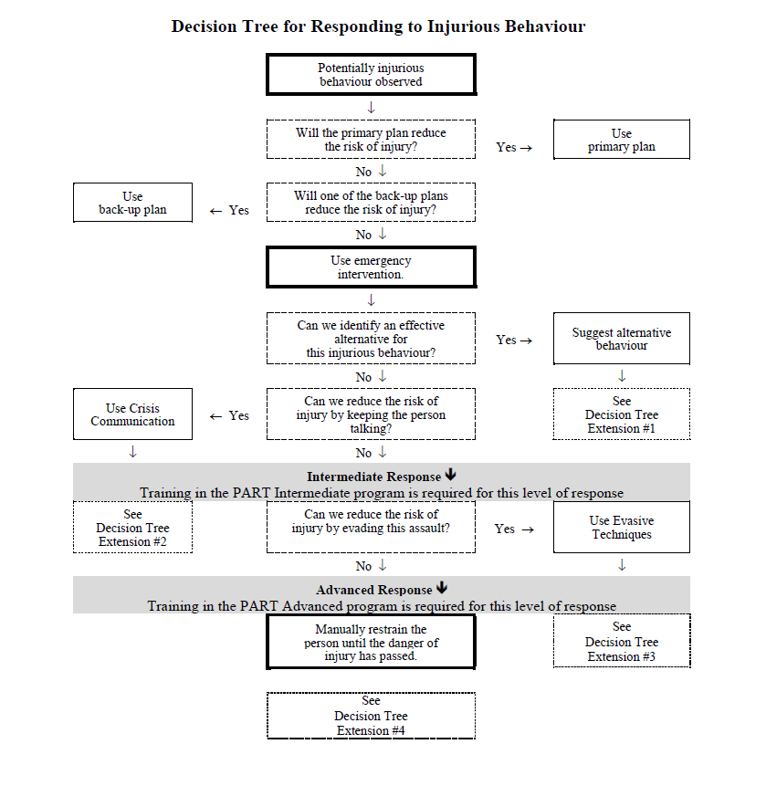

Slide 76
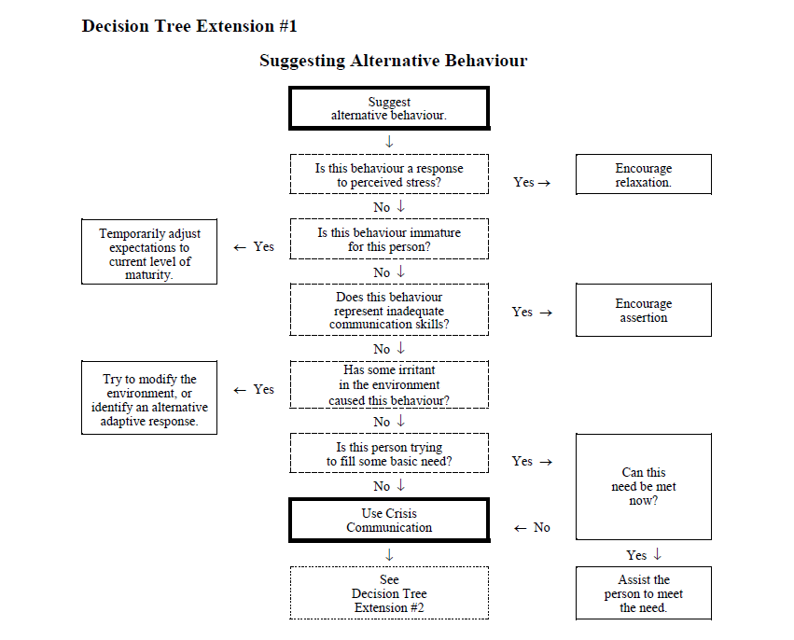

Slide 77
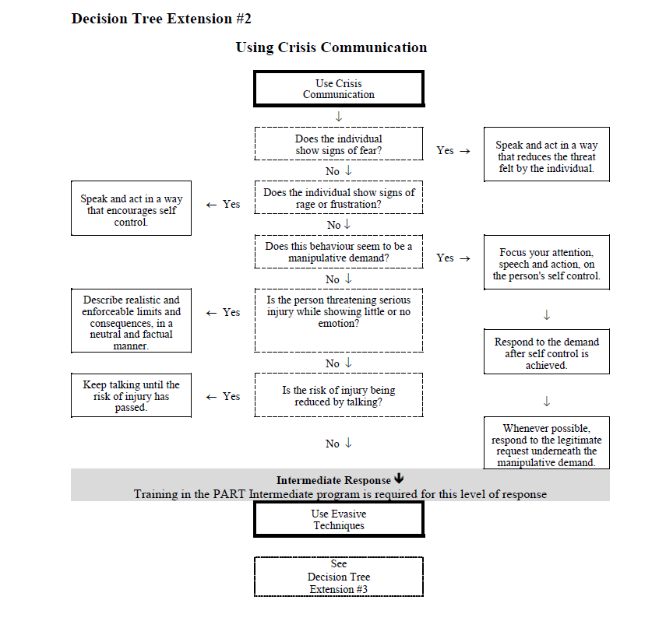

Slide 78
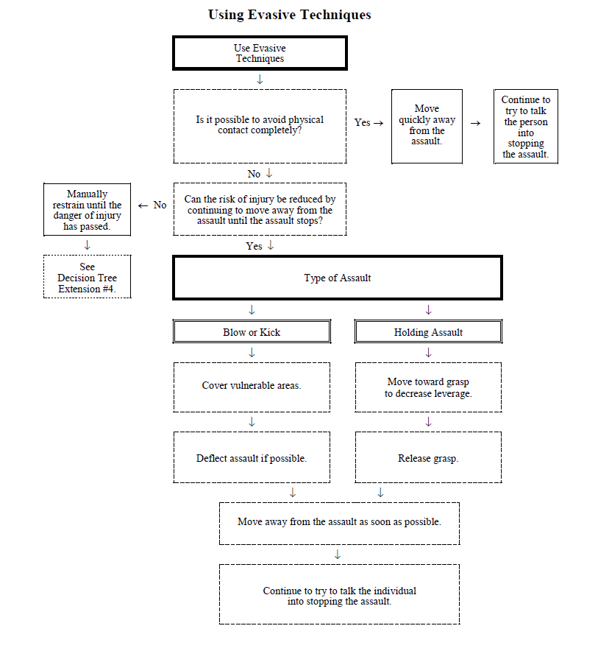

Slide 79

Recording
Who
Where
When
What
How
Why
Injuries
Notification
Simplicity
Follow-up

Slide 80
Remember:
If it isn’t in writing, it didn’t happen. If it is written incorrectly, it happened the way you wrote it. Keep your language simple, short, and jargon-free.
Ensure you know your employer’s policies and procedures for reporting.

Slide 81
Intermediate
Program
*Techniques must be practiced slowly*

Slide 82

Fit for Training
Please sign the Fit for Training declaration and give it to the trainer.
Inform your facilitator of any injuries or physical limitations.

Slide 83
Principles of Evasion
Keep talking
Stay out of the way
Get out of the way
Cover up
Deflect blows and kicks
Call for HELP!
Be patient
Control yourself
Roll with the punch
Escape holding assaults

Slide 84
Captures
Always move toward the point of capture
Point of Capture

Slide 85

Mobility and Warm-up
Stance
Breathing
Neck mobility/shoulder rolls
Toe/heel lifts
Balance
Crouch/cover
Side and back step
Pivot

Slide 86
Techniques
Blows
Punch to the face
Overhead blow
Lunging assault
Kicks
Kick to thigh
Kick to stomach
Knee kick to groin
Holding Assaults
Pinch release
Scratch response
Bite release
Hair pull release
Choking
Bear hug escape
Arm grab escape
Kick to head
Notes:
Do Dementia techniques as well if Dementia was taught.

Slide 87
Summary
Summary
You have learned:
Evasive techniques are designed to allow avoidance of the intended pain or injury without retaliation or overreaction
Evasive techniques meet the criteria for “reasonable force” when responding to a brief episode of assault causing bodily harm

Slide 88

Administrative Details
Fit for Training declaration
Evaluation (post-session questions)
Questions?
Certificate of completion
Re-evaluation
Be aware… be healthy… be safe.

Slide 89
Advanced
Program
*techniques must be practiced slowly

Slide 90
Disclaimer
The techniques taught in PART have BEEN proven safe and effective.
Their proper application is the responsibility of all WORKERS involved.
Instruction cannot be a substitute for professional judgement.

Slide 91
Manual Restraints
Definition of Restraint: forcible and involuntary deprivation of the liberty to move.
Types of Restraint:
  Manual (PART has some techniques)
  Seclusion
  Mechanical
  Chemical
PART does not teach about seclusion, mechanical or chemical restraint.

Slide 92
Principles of Manual Restraint
Master evasion techniques
Master capture techniques
Get a “grip”
Use weight not strength
Avoid pain
Use only reasonable force
Maintain a proper ratio
Be a team player
Select the least intrusive restraint position
Monitor breathing and circulation very closely

Slide 93
Rules for Manual Restraint
Don’t attempt to restrain unless you have twice the height and twice the weight.
Only the Captain talks to the individual and will use the “rule of five”.
When using restraints always watch for breathing and circulation.

Slide 94
Summary:
You have learned:
The purpose of training in manual restraints is to learn simple but effective methods of dealing with assault.
There is no such thing as a completely safe technique and that injury to the assaultive individual and staff is always possible.

Slide 95

Remember…
Before choosing to deprive a person of their liberty to move about, you should ask yourself:
What is the worst thing that is likely to happen if the individual isn’t restrained right now?

Slide 96
Administrative Details
Fit for Training declaration
Evaluation (post-session questions)
Questions?
Certificate of completion
Re-evaluation
Be aware… be healthy… be safe.

