Slide 1


Respiratory Fit Testing Train the Tester 2025
Notes:
Have this slide displayed as learners enter the room. You can insert your name in a text box on the slide if you want your name displayed.

Slide 2

Our Vision
Workplace health and safety: a priority for all.
Our Mission
To guide the health related industry in the elimination of workplace illness and injury.
Notes:
As per slide.

Slide 3

Land Acknowledgement
We are on Treaty 2, 4, 5, 6, 8, and 10 Territory and the Homeland of the Métis.
We respect and honour the Treaties that were made on all territories, we acknowledge the harms and mistakes of the past, and we are committed to move forward in partnership with Indigenous Nations in the spirit of reconciliation and collaboration.
Notes:
As per slide.

Slide 4
Housekeeping Details
Emergency Exits
Washrooms
Scent Free environment
Cell Phones
Break Times
Notes:
Before we start, let’s review some housekeeping details.
Washrooms
This is a scent-free session. If you have any scents with you, please don’t use them during this class
Many of you are not used to sitting all day long. Don’t feel that you must sit continuously. Feel free to stand, stretch, or lean against a wall. Please take advantage of the break times to stand and walk around
Please put your phones on silent and try not to use them during class
Point out the emergency exits and muster point (You should have obtained this information from your facility contact before the class). You should also be able to explain the facility’s emergency process
We will have 2 breaks today, one mid-morning and one mid-afternoon. They are each 15 minutes long
There will be one 30-minute lunch break around noon

Slide 5

Introductions
What is your name?
Where do you work?
What is your role?
What do you know about fit testing?
What do you hope to learn today?
Notes:
Do a round table introduction.
Go through the competencies required to become a Fit Tester:
Be a worker with job duties that allow for the time to prepare for and provide fit testing
Have the skill and ability to complete fit testing
Have effective observation, listening and clear communication skills
Complete the Train the Tester course. This course includes qualitative and/or quantitative fit testing methods
Delivers fit testing as outlined in the Protocols and Resources resource

Slide 6
Successful completion of this program includes:
Active involvement in discussion
Return demonstration on qualitative and/or quantitative respiratory fit testing equipment
Evaluation – pre-session/post-session
*Please follow along in the Fit Tester Protocols and Resources
Notes:
Instructors who are using this PowerPoint (PPT), remember this is a resource to highlight information. Use your Protocols and Resources along with this PPT.
The fit testing process is interactive and includes:
Open and respectful discussion for everyone
Fit tester’s clear explanation to the worker of the process and steps used in the fit testing process
Providing adequate time for each worker being fit tested to practice and provide a return demonstration of proper donning, doffing and performing seal checks for the respirator(s)
Providing adequate time for the worker to practice and provide return demonstration of disassembly, cleaning and reassembly of the elastomeric respirator

Slide 7
Competencies required to become a Fit Tester
Be a worker with job duties that allow for the time to prepare for and provide fit testing
Have the skill and ability to complete fit testing
Have effective observation, listening and clear communication skills
Complete the Train the Tester course
Deliver fit testing as outlined in the Protocols and Resources
Organization of all required documents
Notes:
Be a worker with job duties that allow for the time to prepare for and provide fit testing
Have the skill and ability to complete fit testing
Have effective observation, listening and clear communication skills
Complete the Train the Tester course. This course includes qualitative and/or quantitative fit testing methods
Deliver fit testing as outlined in the Protocols and Resources
Organization of all required documents

Slide 8
Legislation: Saskatchewan Employment Act
Definition of “train”:
“Means to give information and explanation to a worker with respect to a particular subject matter and require a practical demonstration that the worker has acquired the knowledge or skill related to the subject-matter.”
Notes:
When taught as intended, fit testing meets the definition of train as stated in the Saskatchewan Employment Act (SEA) Interpretation 3-1(1)(ff)“train”

Slide 9
SASWH Approved Fit Testers
Fit testers approved by SASWH have access to resources such as a PowerPoint for orientation and forms referenced in the Protocols and Resources.
Visit www.saswh.ca and login (blue tab) using the case-sensitive username and password:
Username: RFT1
Password: RFT2025Testers!
Notes:
All SASWH-approved fit testers have access to resources through our semi-secure site.
Fit Testers approved by SASWH have access to resources such as a PowerPoint for orientation and forms referenced in this material. Visit www.saswh.ca and Login/Register with the following username and password (case sensitive):
username: RFT1
password: RFT2025Testers!
Go to SASWH.ca and log in to the semi-secure area.
Blue login box at the top stating “only for approved fit testers.”
SASWH’s Approved Fit Tester Instructors
SASWH’s approved fit tester instructors are high-profile leads and are approved to teach SASWH’s Respirator Fit Testing Train the Tester (TTT), tester re-certification sessions, and perform worker fit testing. To become a SASWH fit tester instructor, candidates will:
Be approved by SASWH as an instructor
Complete SASWH’s online education course for fit testing
Have job duties that allow for the time to prepare for and provide the train the tester and general fit testing sessions, and to support and follow up with testers and workers
Have effective skills in facilitation, listening and clear communication
Have a solid understanding of the SASWH Fit Testing material layout and intent to assist others with locating information and applying the content to situations
Support the standards of SASWH’s Fit Testing program as it applies to the fit testing process, and Saskatchewan’s Occupational Health & Safety legislation as it pertains to fit testing
Have the ability to track testers approved (e.g., in an Excel spreadsheet or database), notify testers appropriately of required re-approval, and communicate program enhancements to aid in ensuring all testers utilize the current program materials/resources
The following are the RFT instructor qualification procedures:
Must be a current fit tester with knowledge and experience of fit testing SASWH's RFT program
Instructor co-teach x 2 (minimum) with an approved SASWH instructor.
Once the RFT instructor deems the instructor candidate competent, SASWH is contacted to observe a TTT for final approval
Instructor candidates are observed doing a Train the Tester course by an SASWH RFT instructor to obtain instructor status.
Competency is required in all areas to be approved.
Congratulations! A qualified instructor will be added to the instructor database and the provincial instructor group
To maintain an instructor status, the instructor must:
Attend at least one provincial SASWH Fit Testing instructor meeting each year
Teach/co-teach a TTT or fit tester recertification session at least once a year, and
Teach/co-teach a fit testing session for a minimum of 5 workers each year.
RFT Instructors approved by SASWH have access to resources such as a PowerPoint for orientation and forms referenced in this material. Visit www.saswh.ca and Login/Register with the following username and password (case sensitive):
username: RFT3
password: Instructors2025RFT!

Slide 10
Re-approval
Fit testers require re-approval every 2 years. This can be achieved by attending an SASWH’s fit tester re-certification session.
A fit tester will be eligible for re-approval so long as they have fit tested a minimum of 5 workers in the previous 2 years.
The process of fit testing must always be delivered with consistency.
Notes:
A fit tester will require re-approval in 2 years by attending SASWH’s fit tester re-evaluation session. A fit tester will be eligible for re-approval so long as they have fit tested/taught a minimum of 5 workers in the previous two years. This session will include discussion and practice, including a review of the Saskatchewan OH&S legislation, the process for qualitative and/or quantitative fit testing, along with a review of the required documentation.
Fit testers and instructors may want to use a “parking lot/park-aide” approach to record any questions or concerns that may not be answerable or problem-solved during fit testing.
Consistency When Fit Testing
Orientation, Respirator Screening Form, and the process of fit testing (qualitative and/or quantitative) must always be delivered with consistency.

Slide 11
Supplies for Fit Testing
Orientation
Respirator Screening Form
Attendance List - Worker
NIOSH/CSA approved respirators
Mirror
Equipment/supplies for the method of fit testing you are conducting
Safety Data Sheet for the sensitivity and fit test solution (qualitative)
Safety Data Sheet for the alcohol solution (quantitative)
Water for participants of qualitative fit testing
Stickers/wallet cards
Additional PPE that may be required
Notes:
Supplies for fit testing training sessions
Orientation - a presentation can be provided to a group (a laptop, projector, extension cord and screen/blank wall for a PowerPoint presentation may be needed); alternatively, each worker being fit tested can read and sign the orientation (self-directed learning)
Respirator Screening Form - a form must be completed prior to any fit testing being performed
Attendance List - Worker- a form to be completed and provided to the employer for tracking the fit testing workers have received. This document is not required, but it is good practice.
NIOSH/CSA approved respirators only - elastomeric and/or disposable. Various sizes of respirators are needed in order to do the fit testing
Respirators must be approved by NIOSH.
Mirror - to assist the worker in evaluating the fit and positioning of the respirator and any PPE
Equipment/supplies for qualitative fit testing - hood, collar, nebulizer, solution
Equipment/supplies for quantitative fit testing - PortaCount/AccuFit, humidifier
Pens, folders/envelopes for completed forms to help organize this documentation
Safety Data Sheet for the sensitivity, Bitrex and/or Saccharine solution used with qualitative fit testing
Safety Data Sheet for the alcohol solution used with equipment for quantitative fit testing
Water for participants of qualitative fit testing
Wallet cards/Stickers listing successful make/ model/size
Always consider additional PPE/requirements based on the current situation

Slide 12

Risk Assessments
Self-risk assessment:
Consider if the fit tester is not able to perform the fit testing process on the day of training, or if a second fit tester is needed
Assess communication skills to ensure participants understand the information fit testers are providing
Consider your own sensitivity to Bitrex or Saccharin. (when using the qualitative method)
Is the fit tester equipped to handle an adverse reaction?
Who would the fit tester connect with if an adverse reaction occurs?
What is the emergency protocol?
Notes:
Safety First - Assess for risks before training sessions take place
Ensure a self-risk assessment is completed to identify where risks can be eliminated or managed.
Consider:
Ensure the fit tester can clearly communicate fit testing requirements to the worker
A fit tester’s own sensitivity to Bitrex; consider wearing a respirator, gown and appropriate gloves when fit testing
Is the fit tester equipped to handle an adverse reaction? Who would the fit tester connect with in that event? Is the fit tester aware of the emergency protocol for the area where fit testing is being completed?

Slide 13
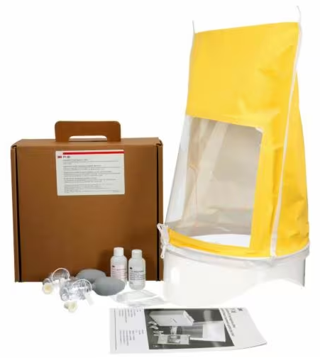
Risk Assessments
Equipment risk assessment:
Ensure equipment has been maintained according to the manufacturer’s guidelines
Check for loose chair legs, table legs, and frayed extension cords to ensure these items do not pose a risk of injury
Notes:
Equipment risk assessment:
Ensure an equipment risk assessment to identify where risks can be eliminated or managed.
Consider:
equipment has been maintained according to manufacturer’s guidelines (e.g., calibration, cleaning of nebulizers, humidifier or particulate generator for quantitative testing)
check all furniture and equipment to ensure these items do not pose a risk of injury

Slide 14
Risk Assessments
Environment risk assessment:
Consider loose tile/carpet and ensure burnt out lightbulbs are repaired
Consider proximity to hazards, violence, excessive noise, odours, and building access/exits
For qualitative testing: rooms are to be well ventilated
For quantitative testing: a smaller room may be better for the count of air particulates
Notes:
Environment risk assessment:
Ensure an environment risk assessment for the room/s to identify where risks can be eliminated or managed.
Consider:
Loose tile/carpet, burnt-out lightbulbs are repaired
Proximity to hazards/violence/excessive noise/odours/access/exits
For qualitative, rooms are to be well ventilated
For quantitative, a smaller room may be better for the count of air particulates

Slide 15
Risk Assessments
Object (and task) risk assessment:
Weight of the objects
Sharp edges
Safely accessible
Appropriate handles
Notes:
Object (and task) risk assessment
Ensure an object (and task) risk assessment for the items used in training to identify where risk can be eliminated or managed.
Consider:
Weight of the objects
Sharp edges
Safely accessible
Appropriate handles

Slide 16
Reporting, documenting, and communicating identified risks
Any defective/non-functioning equipment and/or items are not to be used during training.
Report risks, including how they were eliminated or managed according to the process for the site/area where fit testing is being conducted.
Notes:
Reporting, documenting, and communicating identified risks
Any defective/non-functioning equipment and/or items are not to be used during training.
Report these risks, including how they were eliminated or managed, according to the process for the site/area fit testing is being done.

Slide 17
Legislation
OH&S legislation that applies to RFT includes:
The Occupational Health and Safety (OH&S) Regulations, 2020
General duties of employers, 3‑1
Occupational health and safety program, 3‑11
Part 7, Personal Protective Equipment, Use of equipment required, 7‑1
General responsibilities, 7‑2
Respiratory protective devices, 7‑3
Purging and ventilating of unsafe atmosphere, 18‑8
Respiratory protective devices, 21‑8
Notes:
Have trainers reference the legislation in their Protocols and Resources.
Do not read each regulation, but ensure trainers are aware of the regulations that are relevant to fit testing.

Slide 18
Introduction to Fit Testing The potential of air quality hazards exists.
Employers must:
Complete hazard assessments and eliminate the hazards whenever possible
When other controls are not possible, provide appropriate Personal Protective Equipment (PPE)
Ensure workers are properly trained to correctly use PPE
Notes:
The potential of air quality hazards exists in every workplace in the province. Some can be Immediately Dangerous to Life and Health (IDLH), such as hydrogen sulfide (H₂S) in the oil and gas industry. Some hazards, such as mould problems, can cause long-term health effects. Whatever the hazards, employers are required by legislation to assess their worksites, evaluate the hazards, eliminate them where possible, and when other control are not possible, provide appropriate PPE and ensure employees are properly trained to use it.

Slide 19
Learning Outcomes
Legislated requirements pertaining to fit testing
Hazard assessment
Selection of appropriate respirator(s)
Respirator fit testing (qualitative and/or quantitative)
Orientation (self-directed and facilitated)
Health surveillance
Program evaluation
Recordkeeping
Maintenance
Principles of qualitative and/or quantitative fit testing
Notes:
Learning outcomes for SASWH’s Fit Tester Train the Tester include:
By the end of the session, participants will be able to:
Explain the requirements of Saskatchewan’s occupational health and safety legislation related to respiratory fit testing.
Conduct a hazard assessment to determine the need for respiratory protection
Identify and select the appropriate type of respirator based on the hazard and work environment
Demonstrate an understanding of qualitative and/or quantitative fit testing procedures
Participate in or facilitate orientation and training related to respirator use
Understand the process for health surveillance, including completion of the respirator screening form
Evaluate the effectiveness of a respiratory protection program
Maintain accurate records of fit testing, training and program elements
Perform cleaning, inspection, maintenance, and storage of respirators
Apply the principles of qualitative fit testing (option: practice with water rather than Bitrex) and/or Saccharin
Apply the principles of quantitative fit testing (practice with a PortaCount, AccuFit)

Slide 20
Three Rights of Workers
The Right to Know
Every worker has a right to be informed about the hazards at work, trained to recognize those hazards, and trained to protected themselves from those hazards
The Right to Participate
The occupational health committee (OHC) or the OH&S representative is the principal vehicle for worker participation in the workplace
The Right to Refuse
A worker has the right to refuse work that the worker has reasonable grounds to believe is unusually dangerous
Notes:
Three Rights of Workers
Saskatchewan’s OH&S legislation has also given every worker, including managers and supervisors, three basic rights:
The right to know
The right to participate
The right to refuse work believed to be unusually dangerous
The Right to Know
Every worker has a right to be informed about the hazards at work, trained to recognize those hazards, and trained to protect him or herself from those hazards. This right is built into all regulations where information and training could help to protect workers. Workers must use the information and instructions provided.
The Right to Participate
The occupational health committee (OHC) or the OH&S representative is the principal vehicle for worker participation in the workplace. It is the forum for cooperative involvement of every worker, at every level.
Workers' participation assists in developing a strong safety culture. Workers participate by:
being knowledgeable regarding their rights and responsibilities under the legislation;
asking for information from the supervisor;
reporting health and safety concerns;
attending training;
discussing health and safety concerns at meetings;
working safely;
consulting and cooperating with the Saskatchewan Ministry of Labour Relations and Workplace Safety's occupational health officer (OHO);
assisting in inspections and investigations; and,
participating in safety.
The Right to Refuse
A worker has the right to refuse work that the worker has reasonable grounds to believe is unusually dangerous. The unusual danger may be to the worker or to others. This right is set out in Part III, Division 5 of the Act, section 3-31.
An unusual danger could include:
a danger that is not normal for the job
a danger that would normally stop work
an imminent danger and in contravention of the Act and Regulations
a situation for which the worker is not properly trained, equipped or experienced.
The right to refuse is the right of an individual, not the right of a group. During a refusal, the refusing worker is protected from discriminatory action (Act, PART III, Division 5, 3-35).

Slide 21
Purpose of Fit Testing
Orientation completed. Verify a worker’s comfort and ability to obtain an effective seal for a tight-fitting respirator.
Confirm a worker’s ability to inspect the respirator.
Verify a worker’s competency in donning & doffing the respirator. Have the worker perform a seal check.
No worker shall use or be assigned to use a tight-fitting respirator until a satisfactory fit has been verified by a qualitative or quantitative fit test.
Notes:
The purpose of a qualitative or quantitative fit test is to confirm that the worker can achieve an effective seal and a comfortable fit with the selected tight-fitting respirator. The fit test also ensures the worker can competently don and doff the respirator, inspect it, and perform an appropriate seal check.
Fit testing also helps ensure that each worker is matched with the correct make, model, and size of respirator to achieve a reliable seal under expected work conditions. For this reason, a range of respirator sizes and models should be available to accommodate individual workers’ needs.
The Saskatchewan Employment Act (SEA) defines “competent” as possessing the knowledge, experience, and training to perform a specific task. (SEA, 3-1(1e)). OHS Regulations require the employer to ensure that if a respirator is provided to a worker, the worker must be “trained by a competent person in the proper testing, maintenance, use and cleaning of the respiratory protective device and in its limitations.” (Reg. 7-3(2a))

Slide 22
Legislation and the CSA Standards
Occupational Health and Safety (OH&S) Regulations, 2020
CSA-Z94.4-18 (R.2023) Selection, use and care of respirators
Notes:
In respiratory protection programs, both legislative requirements and CSA Standards outline essential responsibilities to help ensure worker safety
Legislation and the CSA Standards provide guidelines for employers to develop respiratory protection programs.
The CSA Standards are updated every 5 years. So, it is important to stay on top of any changes to procedures that may occur.
Excerpts of legislation are in italics. CAN/CSA-Z94.4-18 (R.2023) Selection, use and care of respirators is the national standard in Canada.

Slide 23
Roles and Responsibilities
Respirator fit tester:
Conduct hands-on respirator fit testing and worker training
Follow all protocols outlined in the respiratory fit-testing program
Worker responsibilities:
Use the PPE provided by the employer
Take reasonable care to prevent damage to the PPE
Notes:
The CSA Standard - CAN/CSA-Z94.4-18 (R2023), describes the role of the respirator fit tester as the designated individual responsible for conducting hands-on fit testing and providing training to workers. Fit testers are required to adhere strictly to all procedures and protocols outlined in the respiratory fit testing program.
Worker responsibilities as described in the Occupational Health and Safety (OH&S) Regulations, 2020
General Responsibilities
7-2 (4) A worker who is provided with personal protective equipment by an employer or contractor shall:
(a) use the personal protective equipment; and
(b) take reasonable steps to prevent damage to the personal protective equipment

Slide 24
CSA Standard - CAN/CSA-Z94.4-18 (R2023) A respiratory protection program shall consist of the following components:
CAN/CSA-Z94.4-18 | Aligned with OH&S Regulations, 2020
Roles and responsibilities: Clause 5 | General duties of employers: 3-1 General duties of workers: 3-2 Supervision of work: 3-6
Hazard assessment: Clause 6 | Exposure control plan: 6-22 Occupational Health and Safety program: 3-11
Respirator selection: Clause 7 | Respiratory protective devices: 7-3, 21-8
Training: Clause 8 | General responsibilities: 7-2 General duties of employers: 21-1 Training of workers: 3-8
Respirator fit testing: Clause 9 | General responsibilities: 7-2 Respiratory protective devices: 7-3
Use of respirators: Clause 10 | General responsibilities: 7-2
Cleaning, inspection, maintenance and storage of respirators: Clause 11 | Exposure control plan: 6-22 General responsibilities: 7-2 Respiratory protective devices: 7-3 Inspection of respiratory protective devices: 7-4
Health surveillance: Clause 12 | Respiratory protective devices: 7-3
Program evaluation: Clause 13 | Exposure control plan: 6-22 General duties of employers: 21-1
Recordkeeping: Clause 14 | Occupational health and safety program: 3-11 Respiratory protective devices: 7-3
Notes:
The current CSA Standard - CAN/CSA-Z94.4-18 (R2023) Selection, use, and care of respirators is the Canadian national standard. It provides guidelines for workplace respiratory and fit testing programs.
A respiratory protection program shall consist of the components listed in your protocols and resources.

Slide 25
Training
The fit tester shall be competent in:
Verification of worker’s ability in the fit test process
Fit testing
Fit test methods
Instruction
A competent person shall provide instruction on the required elements of the employer's respiratory protection program
Care and practical use
The tester must be competent to provide a practical evaluation of the care, use and maintenance of respirators
Limitations Clause
Training must include all information from manufacturers and the Saskatchewan Occupational Health and Safety Regulations and applicable standards on the limitations of the protection provided by respirators.
Repair and maintenance
Training must include the manufacturers recommendations for the repair and maintenance of respirators
Notes:
Fit testing
The fit tester must be able to perform fit tests correctly, ensure the worker gets a proper seal and comfort, manage the testing process, interpret results, and document all required information.
Instruction
Instructors must understand the respiratory protection program and teach participants about: a) program policies, procedures, and responsibilities; b) workplace respiratory hazards and their health effects; c) why specific respirators are chosen and where to get more information; and d) what to do in an emergency.
Care and practical use
The tester must be competent to provide a practical evaluation of the care, use and maintenance of respirators
Limitations
Training must include all information from manufacturers and the Saskatchewan Occupational Health and Safety Regulations and applicable standards on the limitations of the protection provided by respirators.
The packaging on the respirator box or an informational insert from the manufacturer would indicate cautions/limitations of that specific respirator.

Slide 26
Hazard Assessment
Before fit testing begins, it is important to understand what respiratory hazards may be present in the workplace.
There are two main types of respiratory hazards in the workplace:
1. Unsafe atmospheres
2. Airborne Contaminants
Notes:
Before fit testing begins, it is important to understand what respiratory hazards may be present in the workplace. Knowing the types and levels of airborne contaminants helps ensure the right respirator is chosen and that the fit test reflects actual working conditions.
1. Unsafe Atmosphere: Where the potential for an oxygen-deficient or oxygen-enriched atmosphere exists, the oxygen concentration is to be measured. Where oxygen concentration is confirmed to be below 19.5%or above 23% (CSA Standard Z94.4-18), (SK Occupational Health & Safety Regulations, 2020), the cause of the deficiency or enrichment shall be determined and
a) Ongoing monitoring shall be performed; and/or
b) The atmosphere shall be assumed to be IDLH [immediately dangerous to life or health].
This situation most likely would be encountered by maintenance staff and, as such, should be discussed in detail with the supervisor at the workplace
Refer to the CSA Standard or Regulations for additional information
2. Airborne Contaminants: If the work area has levels of contamination which exceed workplace guidelines. To determine the exact concentration of the above contaminants, special equipment must be used. Air contaminants include:
Biological: viruses, bacteria, moulds, etc., found in a variety of areas in the health care setting.
Dust: particles released during operations such as grinding, sawing, and housekeeping.
Mists: Particulate or liquid droplets released during painting, insecticide spraying, patient care, and housekeeping.
Vapours: gaseous forms of liquid released during painting, patient care.
Fumes: vapourized condensed metals released during welding operations.
Gases: gases are usually released due to leaks in a system, but can be found naturally forming (e.g., underground vaults, sewer systems, etc.). Gases can displace oxygen in an atmosphere, causing oxygen deficiencies.
Fibres: particulate matter longer than it is wide (e.g., asbestos, fiberglass)

Slide 27
Hazard Assessment
None of the respirators covered in SASWH’s fit testing session provide protection in unsafe atmospheres
All confined spaces are considered hazardous until proven not to be
Always check with your supervisor regarding entering an unsafe atmosphere
Notes:
The hierarchy of controls is a systematic approach to managing hazards by prioritizing the most effective methods first. Controls are implemented in order of effectiveness, with elimination and substitution preferred over engineering, administrative controls, and personal protective equipment.
Respirators are the least effective control in the hierarchy of controls and are used only when hazards cannot be eliminated or adequately controlled through engineering or administrative measures. Proper selection, fit testing, training, and maintenance are essential to ensure respiratory protection is effective.

Slide 28
Controlling respiratory hazards
Employers are to implement engineering, administrative and lastly PPE to control hazards and protect employees from workplace hazards.
Notes:
OH&S Regulations 7-1(1): Use of equipment required
If it is not reasonably practicable to protect the health and safety of the workers by design of the plant and work processes, suitable work practices or administrative controls, an employer or contractor shall ensure that every worker wears or uses suitable and adequate personal protective equipment.

Slide 29
Four basic groupings of respirators
Atmosphere-supplying respirators
Air purifying respirators (APR), non-powered and powered (PAPR)
Combination respirators – both atmosphere-supplying and air-purifying
Escape-only respirators (atmosphere-supplying or air-purifying)
Notes:
The air purifying respirators, non-powered (APR) is the focus of this training.
Respirator that delivers air from an external source (supplied-air respirator (SAR))
Respirator that removes contaminants from ambient air (air-purifying)
Combination respirator (a configuration incorporating both atmosphere-supplying and air-purifying); and
Respirator designed solely for escape situations (escape-only respirator)

Slide 30
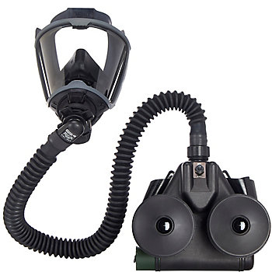
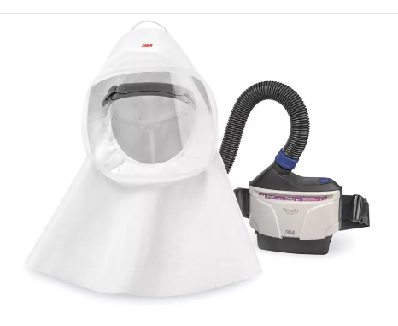
Powered Air-purifying Respirators (PAPR)
There are two types of powered air-purifying respirators (PAPR):
Tight seal, which requires fit testing
Loose hood does not require fit testing
Notes:
This training does not cover powered respirators. This is only additional information.
Note: A loose-fitting hood does not require fit testing because it operates under positive pressure. The continuous airflow within the hood helps prevent contaminated air from entering, removing the need for a tight facial seal.

Slide 31
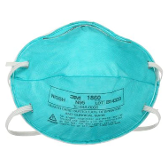
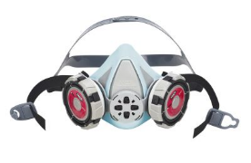
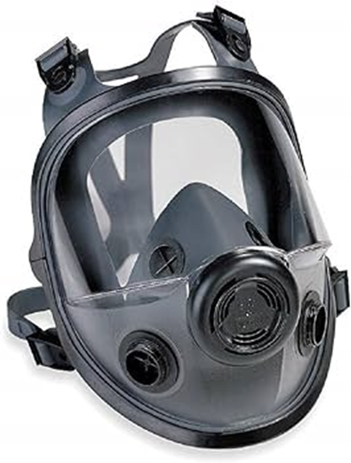
Air-purifying Respirators (APR)
There are several styles of air-purifying respirators:
Non-powered air-purifying:
Disposable respirators
Half-face respirator just covers the nose and mouth area
Full-face respirator covers the nose, mouth and eyes

Slide 32
Air-purifying Respirators
The PPE used to protect the worker from air-borne contaminants is an air-purifying respirator. There are two types of air purifying respirators:
Disposable
Elastomeric
Notes:
The next slides will provide more info

Slide 33

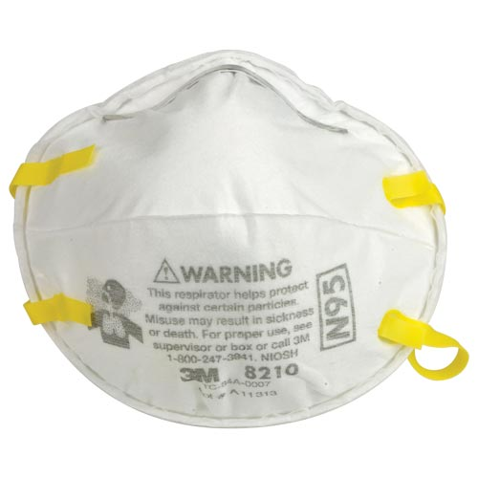
Respirator Selection
Disposable:
Single use
Cloth like fibres
Must be NIOSH/CSA approved
Example: N95 Particulate
Notes:
Disposable: these respirators tend to be fairly inexpensive; they likely have packaging marked as “single use”. They are often made of cloth-like fibers and cannot be washed and reused. N95 and N100 fall in this category along with generic dust respirator that might be found in housekeeping and maintenance.
*The particulate respirator rating will be explained in the upcoming slides. Refer to the Protocols and resources for rating information.

Slide 34
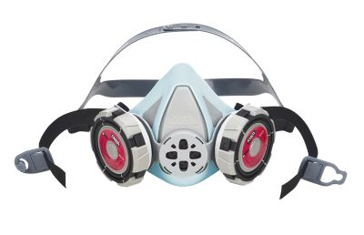
Respirator Selection
Elastomeric
Re-useable
Requires cleaning and maintenance
Rubberized components
Different cartridges/filters to match the type of hazard
Cartridges/filters must be NIOSH approved
Notes:
Elastomeric: these can include non-powered and powered respirators.
This style is reusable and has to be cleaned and maintained by the worker in order to work properly. They are usually made of rubberized compounds, and individual parts can be washed.
There are different types of filters and cartridges, so the type of hazard group must be considered when making decisions as to what type of filter or cartridge should be used. Both filters and cartridges must be NIOSH-approved.
The cartridges are replaceable, and logs should be kept for them.
This type may be found in the maintenance department, lab, housekeeping, emergency medical services, and public health inspection.
We will be discussing and working with elastomeric’s in more detail later in the day.

Slide 35
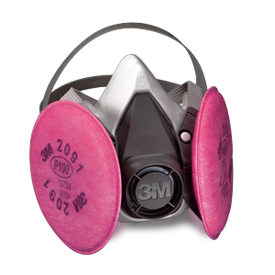
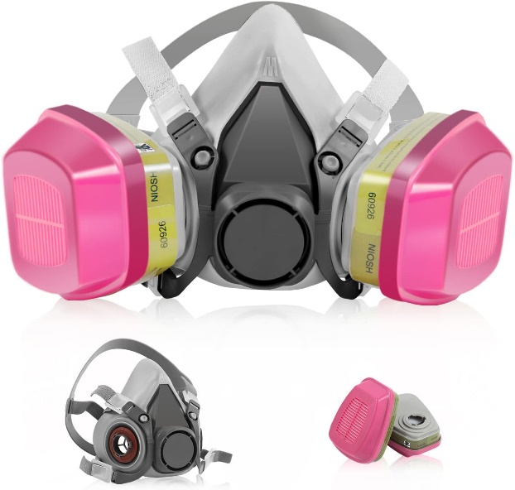
Elastomeric respirators use two main types of protection:
Particulate filters
Cartridges
Notes:
Elastomeric respirators use two main types of protection: particulate filters and cartridges.
Particulate filters block things like dust, smoke, and tiny airborne particles.
Cartridges protect the worker from harmful gases and chemical vapours. Knowing the difference helps you choose the right protection for the job.

Slide 36
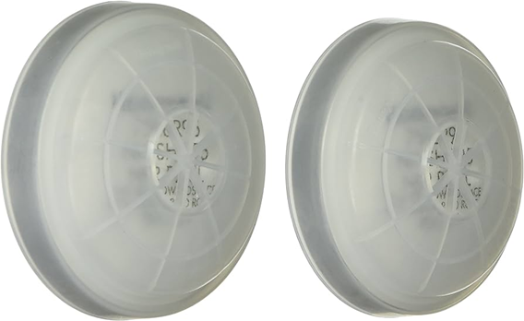
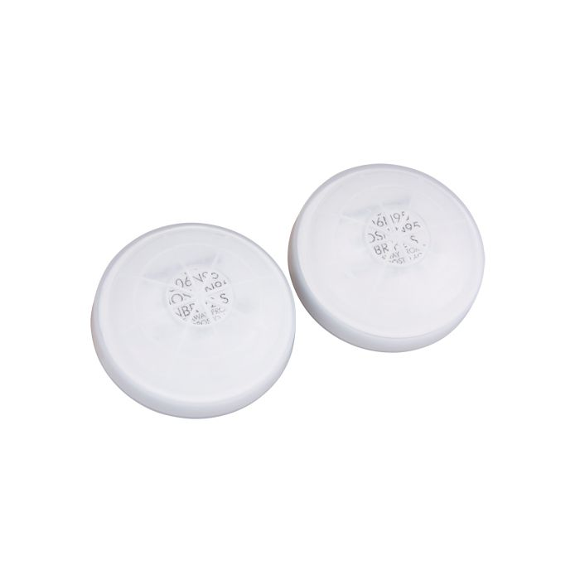
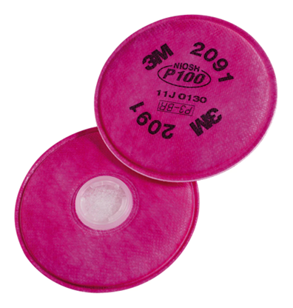
Particulate Filters
Remove particles from the air that is breathed through them
Different filters are specific to the type of hazard
Notes:
Particulate Filters
Remove particles from the air that is breathed through them
Different filters are specific to the type of hazard
What they protect against:
Solid particles (dust, metal fumes)
Liquid aerosols (mists, biological aerosols like viruses)
Examples:
N95, P100 filters for elastomeric respirators (often labeled as P100 or N95 filter disks)
How they work:
Capture particles by mechanical filtration and electrostatic attraction
Do not protect against gases or vapours
Physical appearance:
Usually flat or pancake-style filters
Can be used alone or snapped onto a gas/vapour cartridge as a combo filter

Slide 37

Gas/Vapour Cartridges
Protects from harmful gases and chemical vapours
Different cartridges are specific to the type of hazard
Notes:
Gas/Vapour Cartridges
Protects from harmful gases and chemical vapours
Different cartridges are specific to the type of hazard
What they protect against:
Chemical gases and vapours:
Organic vapours (solvents, paints, fuels)
Acid gases (chlorine, sulfur dioxide)
Ammonia, formaldehyde, etc.
How they work:
Use activated carbon (or special sorbents) to adsorb gases and vapours
Do not protect against particles unless paired with a particulate filter
Physical appearance:
Often larger, oval-shaped or cylindrical
Colour-coded based on the chemical hazards they protect against (per NIOSH standards)

Slide 38
Filter Ratings and Efficiency
95 - Filters out 95% of particulate matter 0.3 microns in size
99 - Filters out 99% of particulate matter 0.3 microns in size
100 - Filters out 99.7% of particulate matter 0.3 microns in size
N - Not resistant to oil; therefore, not suitable for atmospheres that may contain oil
R - Resistant to oil; therefore, can be used in oily atmospheres
P – Proofed for oil; suitable for any particulate and oily atmospheres (P100 filters out 99.7 % of 0.3 microns in size)
For example, N95: the respirator is not resistant to oil, and it filters out 95 percent of particulate matter 0.3 microns in size
Notes:
Respirators are rated according to the particulates they filter out of the atmosphere.
The rating indicates the percentage of a particulate filtered out of the atmosphere.
Before choosing which type and style of respirator and filter, the personnel responsible would have sound knowledge of the type of hazard, the concentration and toxicity of hazard: dust, gases, and if oil is present too. They must know the application the respirator will be used under and the limitations of the respirator.
Definition: P – Proofed for oil = oil will not absorb or leak through the respirator.

Slide 39
Disposable Respirators
Change-out Protocol
Wet
Resistance in breathing
When leaving the contaminated area
Breakthrough (smell or taste is recognized)
Breakthrough is a poor and dangerous method of establishing change out timings
Notes:
Change-out needs to happen:
When it is wet
When there is a perceived increase in resistance to breathing
When leaving the contaminated area
If the respirator allows breakthrough (smell or taste is recognized)
Breakthrough is a poor and dangerous method of establishing change-out timings

Slide 40
Elastomeric Respirators
Change-out Protocol
Expiry
End of service life indicator (ESLI) has been reached
Breakthrough (smell or taste is recognized)
Resistance in breathing
Breakthrough is a poor and dangerous method of establishing change out timings
Notes:
Change-out needs to happen:
When cartridge systems have reached the workplace appointed expiry time set by competent assessors.
Resistance in breathing
When the cartridge system’s estimated service life indicator (ESLI) has been reached.
When the properties of the contaminant can be detected through taste or smell it indicates(breakthrough).
Breakthrough is a poor and dangerous method of establishing change-out timings
Ensure to reference the manufacturer's guidelines for protocols indicating change-out times.

Slide 41
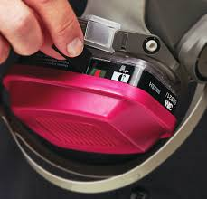
End-of-Service-Life Indicator
End-of-service-life indicator (ESLI)
Depending on the manufacturer’s specifications, the indicator window will change colour when the filter has become saturated and needs to be replaced
Notes:
End-of-service-life indicator (ESLI)
Depending on the manufacturer’s specifications, the window will indicate by change of colour when the filter has become saturated and needs to be changed
Ensure to reference the manufacturer's guidelines for protocols indicating change-out times.

Slide 42
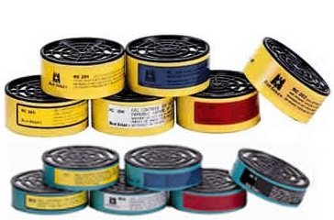
NIOSH Colour Scheme
White - acid gas (H₂S escape only)
Black - organic vapors
Green - ammonia gas
Yellow - mix of organic and acid
Olive - multi gas
Blue - carbon monoxide
Purple - radioactive
Red - mercury vapor
Notes:
As previously indicated, elastomeric respirators use cartridges depending on the type of environment in which they are used. The following is the NIOSH Colour Scheme for cartridges that is used in conjunction with elastomeric respirators.

Slide 43
Elastomeric Respirators
Storage:
Respirators should be stored clean and dry, with adequate room to prevent distortion
Cartridges should be stored in a separate sealed plastic bag, not in a respirator bag

Slide 44
Respirator Fit Testing
Hazard assessments have been completed, a hazard has been recognized, PPE has been chosen, and the fit tester now performs testing.
Fit testers are responsible for completing all necessary records of fit testing.
Notes:
To be competent, fit testers must be qualified through training, knowledge, and experience to conduct the appropriate tests that will help ensure workers are protected from hazards during respirator use.
Trainers will only be trained in the method they will be using, QLFT or QNFT or both.
Fit testers may also be responsible for maintaining, repairing, calibrating and cleaning logs, depending on the responsibilities outlined in the employer’s program.

Slide 45
Respirator Fit Testing
The fit test shall be used to verify the selection of the specific make, model and size of a tight-fitting respirator for individual workers.
All workers requiring a tight-fitting respirator must be fit tested by a competent person in an approved manner.
The fit tester must not alter or adjust the respirator in any way that differs from the manufacturer’s specifications to make it fit.
Employers must have a selection of respiratory protection devices to ensure comfortable fit and effective seal to all workers. One size does not fit all.
Notes:
The information on this slide is paraphrased from Clause 9 of CSA Standards CAN/CSA–Z94.4-18(R2023)

Slide 46
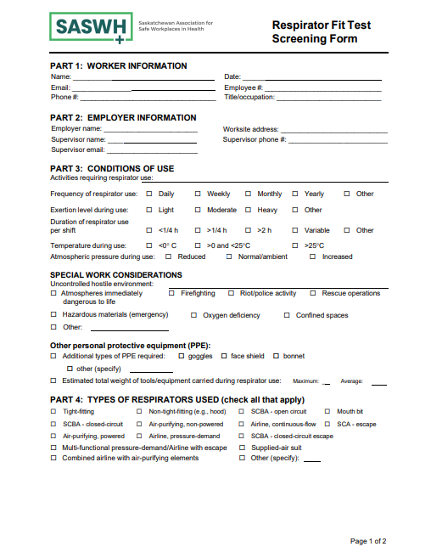
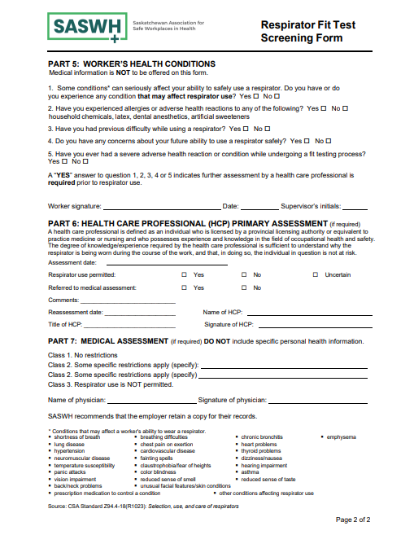
Respirator Fit Test Screening Form
Notes:
The respirator fit test screening form needs to be completed by the worker before fit testing starts.
Completing the form requires a clear understanding of the health assessment process, including awareness of physiological and psychological conditions that may necessitate reassessment, as well as individual responsibilities. An initial evaluation of a worker's suitability to wear a respirator may be conducted by someone who is not a health care professional, provided they are working under the supervision of one. The respirator screening form serves as a tool to help determine worker suitability and to identify any health concerns that may require further medical evaluation by a qualified health care professional.
The fit tester must review this document once complete and refer the worker to a healthcare professional for further medical assessment when necessary.
A medical assessment must include a review and written determination by a qualified health care professional regarding the worker’s ability to safely use a respirator. Accurate records of this assessment must be maintained; however, personal medical details must be excluded to protect confidentiality.
Review this document with the fit testers, which can be found in the Forms tab. Ensure they understand how to fill it out.
Each tester candidate must complete their own screening form to be fit tested.

Slide 47
Health Surveillance
Ensure documentation is completed
All health information shall be treated as medically confidential
If there is a concern, ensure the worker obtains the opinion of a health care professional – fit testing will not be completed until written approval is received
Notes:
The respirator screening form serves as a tool to help determine worker suitability and to identify any health concerns that may require further medical evaluation by a qualified health care professional.
Medical information on medical screens is considered confidential under the Health Information Protection Act (HIPA).
All completed screening forms must be protected and should not be stored with other training documentation.
ACTION: Go to the Forms section and review page two of this document with the fit testers.

Slide 48
Worker Health Conditions
Screening and Medical Assessment
Conditions that may be exacerbated by respiratory use:
Diabetes (can drop blood sugars during testing)
Cardiovascular and respiratory disease
Reduce pulmonary function
Epilepsy
Allergies and Asthma
Anxiety
Other Factors
Notes:
There are many health conditions that may be exacerbated by fit testing or respirator use. Ensure the worker completes the health surveillance assessment to the best of their ability. If there is concern about their health condition, forward them to a medical professional for further assessment.
NOTE: Before any fit test can be carried out, a medical screening or health surveillance assessment must be completed by the worker. This is the second page of the Respirator Screening Form that was just reviewed. This list is not exhaustive. If the medical screening indicates any level of concern, refer the employee to their Health Care Professional for a primary assessment.
Until the time the employee is cleared by the Health Care Professional, they should not complete fit testing or enter a situation that requires the use of a respirator.
SASWH has developed and offers a Respirator Screening Form that aligns with the current CSA Standard (see Forms tab).
SHA has their own version that is available for use.

Slide 49
Orientation and Training
Workers receive instruction on:
Hazards
Respirator use and limitations
Donning, doffing, seal checks
Care and storage
The orientation may be facilitated or self-directed.
Notes:
ACTION: Go through the Respirator Fit Test Orientation found in the Forms tab.
Ensure workers are reviewing the Respirator Fit Test Orientation before continuing.

Slide 50
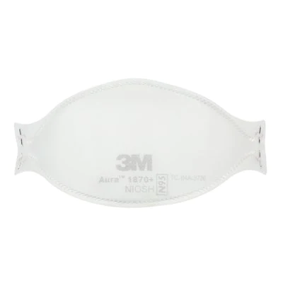

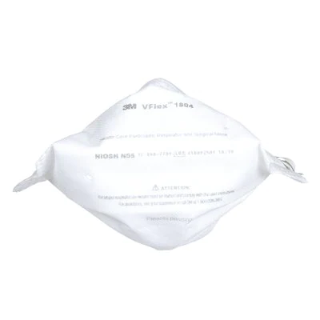
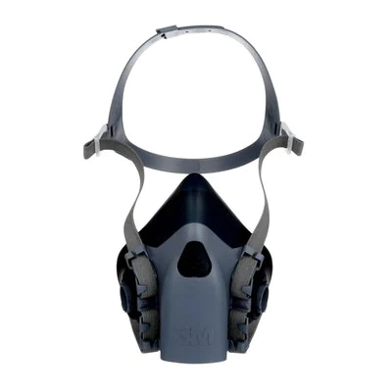

Donning and Doffing
Follow the manufacturer’s guidelines and instructions
Notes:
ACTION: Demonstrate proper donning and doffing of various N95 disposable respirators, as well as elastomeric.

Slide 51
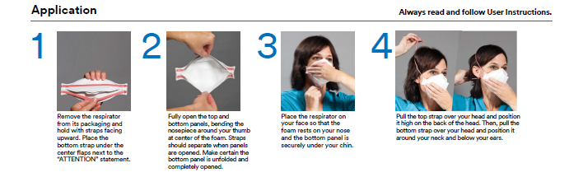
Donning and Doffing
Notes:
The following is a poster from 3M on donning and doffing a 3M Aura 1870+ respirator.
ACTION: Go through each step and have the fit testers follow along. If they don’t have this style to trial, follow the specific manufacturer's instructions for donning and doffing the respirator available.

Slide 52
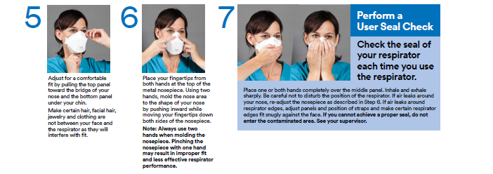
Donning and Doffing

Slide 53
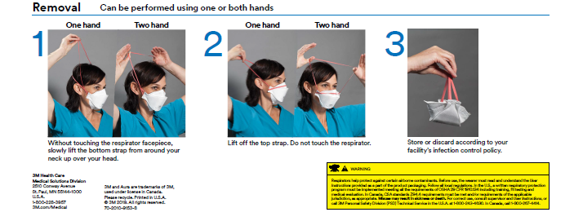
Donning and Doffing
Notes:
Once the respirator has been properly donned, the worker must complete a negative and positive seal check.

Slide 54
Negative And Positive Seal Checks
Seal checks must be completed every time a respirator is donned!
Ensure a tight and effective seal is achieved before entering a hazardous space!
Notes:
Once the respirator has been properly donned, the worker must complete a negative and positive seal check.
Negative and Positive Seal Checks
Several styles of respirators should be available for the test procedure. Candidates will be given time to select a respirator that gives them a good positive and negative seal check prior to the test.
Negative and Positive Pressure Seal Checks for Disposable Respirators
The following procedures are provided as examples once the respirator is properly donned.
During a negative pressure seal check, the worker inhales sharply while blocking the paths for air to enter the respirator. A successful check is when the respirator collapses slightly under the negative pressure that is created with this procedure.
To conduct a negative pressure seal check, the worker covers the filter surface with their hands as much as possible and then inhales. The facepiece should collapse slightly on the worker’s face, and they should not feel air passing between their face and the respirator.
During a positive pressure seal check, the worker exhales gently while blocking the paths for air to exit the respirator. A successful check is when the respirator is slightly pressurized before increased pressure causes outward leakage.
To conduct a positive pressure seal check, the respirator exhales gently into the respirator. The fit is considered satisfactory if a slight positive pressure is being built up inside the respirator without any evidence of outward leakage of air at the seal. Examples of such evidence would be the feeling of air movement on their face along the seal of the respirator, fogging of their glasses, or a lack of pressure being built up inside the respirator.
In either seal check, if air leaks around the nose, the worker uses both hands to readjust the nosepiece by placing fingertips at the top of the metal nose clip. Slide fingertips down both sides of the metal strip to more efficiently mould the nose area to the shape of the worker’s nose. Readjust the straps along the sides of the head until a proper seal is achieved. Repeat the seal checks.
Not every respirator can be checked using both positive and negative pressure. Refer to the manufacturer’s instructions for conducting seal checks on any specific respirator. This information can be found on the box or individual respirator packaging.
Note: Explain the negative and positive seal checks. Demonstrate and have participants practice and receive a return demonstration of understanding. If there are no elastomeric respirators available for the testers to practice with, only demonstrate the procedure.
If workers cannot achieve a proper seal due to air leakage, they may need to be fit tested for a different respirator model or size.

Slide 55
Fit Test Preparation
Verify clean-shaven requirement (NIOSH standard)
Confirm no interfering accessories or products
No food/drink for at least 15 minutes before testing
Select a respirator and perform positive/negative seal checks
Cautions/limitations reviewed
Notes:
Fit test preparation ensures both the worker and the equipment are ready for an accurate and reliable fit test. This step confirms all required conditions are met, including proper grooming, the absence of interfering accessories, and correct respirator selection. The fit test can then be performed safely and effectively. Proper preparation helps ensure consistent results and supports the overall success of the respiratory protection program.

Slide 56
Fit Test Preparation
Orientation completed | ¨ Yes | ¨ No - reschedule fit testing accordingly
Respirator screening form completed | ¨ Yes | ¨ No - reschedule fit testing accordingly
Has had no food/drink (except plain water), has not smoked/chewed gum for at least 15 minutes prior | ¨ Yes | ¨ No - reschedule fit testing accordingly
Clean shaven/no respirator interference | ¨ Yes | ¨ No | ¨ Not Applicable
Eye glasses | ¨ Yes | ¨ No | ¨ Not Applicable
Contact lenses | ¨ Yes | ¨ No | ¨ Not Applicable
Dentures | ¨ Yes | ¨ No | ¨ Not Applicable
Hair style (e.g., hair buns) | ¨ Yes | ¨ No | ¨ Not Applicable
PPE worn by worker (indicate): | o goggles o face shield o bonnet o other:
Cautions/limitations reviewed for awareness | ¨ Yes | ¨ No
Notes:
This is from the Respirator Fit Test Documentation form. Review the Pre-fit testing requirements on the form.

Slide 57
Respirator interference concerns
Facial hair
Personal conditions
Personal effects or accessories
Factors that can compromise the face-to-respirator seal:
Notes:
Facial hair: Individuals must be clean-shaven wherever the respirator seals to the face or neck. Because hair growth varies, most people should shave within the past 24 hours—preferably within 12—to ensure no hair interferes with the respirator seal, valves, or function.
Personal conditions: Individuals must appear for fit testing in the same condition they will be in when using the respirator, including hairstyle and use of dentures, eyeglasses, or contact lenses.
Personal effects or accessories: Individuals must appear for fit testing without any accessories—such as head coverings, garments, or facial jewelry—that could come between the skin and the respirator’s sealing surface.
Note: These items, as well as makeup, creams, or lotions, can interfere with proper sealing, valve function, and respirator positioning. Above information is paraphrased from the CSA Standards 9.2.2, 9.2.3, and 9.2.4.
ACTION: Refer to the Facial Hairstyles and Filtering Facepiece Respirators document in the Forms tab.

Slide 58
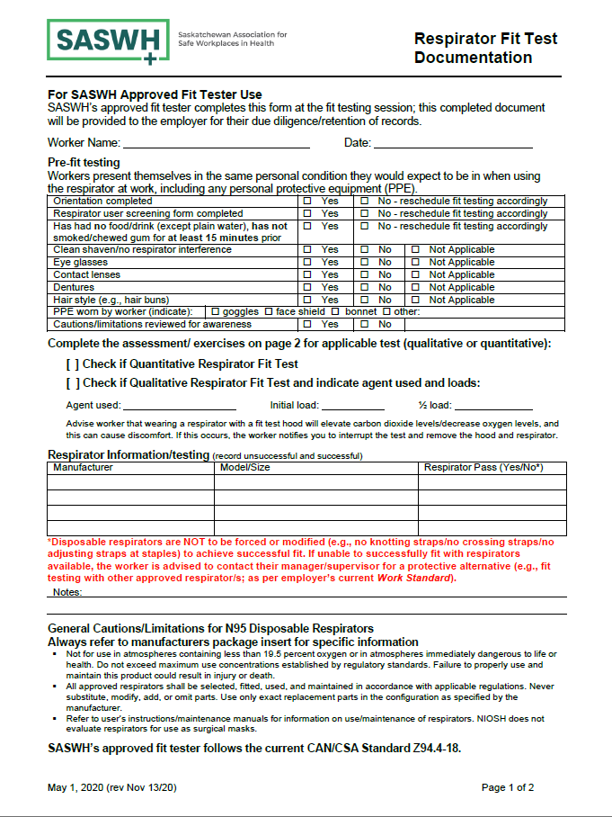
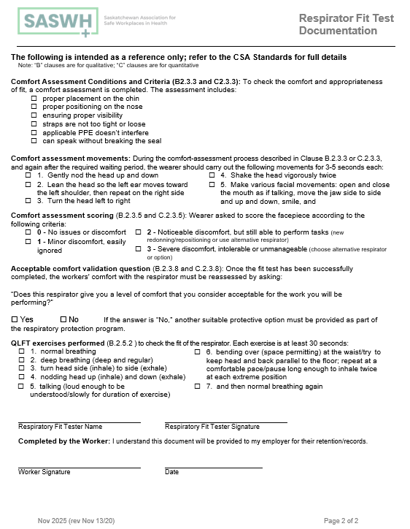
Respirator Fit Test Documentation Form
Notes:
This is the full documentation form.
After the pre-fit testing has been reviewed and the worker is cleared for fit testing, the fit tester selects a respirator appropriate for the hazard, as well as the correct size and shape for the worker. Once the worker has a respirator, they must inspect it, don the respirator and perform a positive and negative seal check.
ACTION: Review this form with the fit testers, which can be found in the Forms tab. Ensure they understand how to fill this out.

Slide 59
Comfort assessment
Assessment of comfort shall include reviewing the following points with the worker.
a) Proper placement on the chin
c) Ensure proper visibility if using full-face respirator
e) Applicable PPE or other accessories don’t impact the seal, such as glasses, hearing aids, dentures, etc.
d) Strap tension is not too tight or loose
b) Positioning on the nose
f) Speak without a break in the seal
Notes:
CSA Standard CAN/CSA Z94.4-18(2023)
B.2.3.3 Comfort assessment conditions and criteria

Slide 60
Comfort assessment movements
To ensure comfort and proper fit of the respirator, perform these instructions:
Gently nod the head up and down
Lean the head so the left ear moves toward the left shoulder, then repeat on the right side
Turn the head left to right
Shake the head vigorously twice
Make various facial movements
Notes:
Comfort assessment movements:
During the comfort-assessment process described in Clause B.2.3.3 or C.2.3.3, and again after the required waiting period, the worker should carry out the following movements for 3-5 seconds each:
Gently nod the head up and down
Lean the head so the left ear moves toward the left shoulder, then repeat on the right side
3. Turn the head left to right
4. Shake the head vigorously twice
5. Make various facial movements: open and close the mouth as if talking, move the jaw side to side and up and down, smile, and frown

Slide 61
Comfort Assessment Score
The worker shall be asked to score the respirator according to the following criteria:
0- No issues or discomfort
1- Minor discomfort, easily ignored
2- Noticeable discomfort, but still able to perform tasks
3- Severe discomfort, intolerable or unmanageable
Notes:
0 – No issues or discomfort
1 – Minor discomfort, easily ignored
2 – Noticeable discomfort, but still able to perform tasks
3 – Severe discomfort, intolerable or unmanageable
A score of 2 should prompt the fit tester to initiate re-donning, adjust the respirator’s positioning, or consider an alternative respirator model.
A score of 3 indicates unacceptable discomfort and requires immediate rejection of the respirator in use. If a suitable respirator cannot be identified for the specific application, an alternative form of respiratory protection must be provided in accordance with the respiratory protection program. It is important to note that a small percentage of individuals may be unable to use any tight-fitting respirator.
Redonning or repositioning a respirator doesn’t mean it’s a fit test failure. If it's required to use an alternative respirator, this means the first one is excluded. There is to be no force-fitting of a respirator.

Slide 62
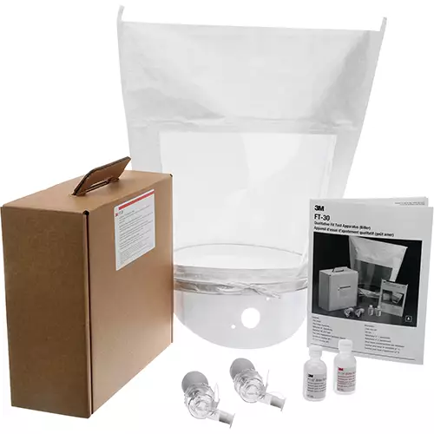
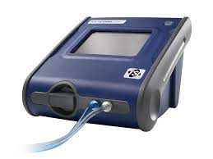
Types of Fit Testing
Qualitative Fit Testing
(QLFT)
Uses a detectable test product to determine fit such as Bitrex or Saccharin
Quantitative Fit Testing
(QNFT)
Measures accurate particulate counts inside and outside of the respirator to determine the fit factor
Used by organizations with fewer number of employees that require testing
Higher risk of error
Notes:
Having completed the comfort-assessment scoring, the next step is to evaluate the respirator’s fit using recognized fit-testing methods. Fit testing can be performed using either a qualitative fit test (QLFT) or a quantitative fit test (QNFT). QLFT methods rely on the worker’s sensory detection of a test agent to determine whether a suitable seal is achieved, while QNFT methods use instrumentation to measure and calculate the actual fit factor. The following sections outline the requirements and procedures for each type of test.

Slide 63
QLFT
Qualitative fit testing
Is suitable for N95 respirators or half-mask respirators
Relies on the worker’s sensory reaction to a test agent, which may be Saccharin or Bittrex, to determine a proper fit
Is not recommended for full-face respirators
Notes:
N95 respirators or half-mask respirators. This type of test relies on the worker’s sensory reaction to a test agent, which may be Saccharin or Bittrex, to determine a proper fit.
Qualitative testing is not suitable for full-face respirators or where high-hazard situations may require more precise protection.

Slide 64
Prior to QLFT
Prepare all equipment (refer to manufacturer’s instructions) hood, collar, solutions, gloves, hand sanitizer, pens, forms, drinking water, etc.
Screening form or employer’s equivalent has been completed and reviewed.
The complete fit testing procedure is to be explained prior to fit testing.
The worker must be clean-shaven as per NIOSH standard.
Incorporate proper hand hygiene.
Select the respirator to be used and follow the manufacturer’s donning and doffing procedure. Ensure the worker can demonstrate competency in the process.
Notes:
Explain to the fit testers that these are the steps to take prior to QLFT:
Prepare all equipment (refer to manufacturer's instructions): hood, collar, solutions, gloves, hand sanitizer, pens, forms, drinking water, etc.
Screening form or employer's equivalent has been completed and reviewed by the fit tester.
All workers being fit tested will have the complete testing procedure explained to them before being tested.
Worker is clean-shaven as per NIOSH and CSA Standard.
Incorporate proper hand hygiene.
Select the respirator to be used and follow the manufacturer's donning and doffing procedure. Ensure that the worker can demonstrate competency in the process.

Slide 65
Prior to QLFT continued
Proceed with the threshold screening.
Fit testing for qualitative should be done in a well-ventilated room.
Documentation is started and completed as testing proceeds.
Proceed to fit test.
Before removing the hood following a satisfactory fit test, the fit tester shall ask the worker to break the face-to-respirator seal.
Acceptable comfort validation question.
Notes:
ACTION: Go through the QLFT Protocols in the Protocols and Resources pages 20-22. Ensure the fit testers understand how to complete the threshold sensitivity test and the fit test before proceeding.
Proceed with the threshold screening, using either bitter or sweet sensitivity solutions; this is ideally completed in a separate room from the actual fit test, if space and equipment are available to do so.
Fit testing for qualitative should be done in a well-ventilated room.
Respirator fit test documentation or an employer's equivalent is started and completed as testing proceeds.
Proceed to the fit test. Follow the manufacturer’s instructions in the qualitative kit that is provided by the employer. As an example, a copy of the 3M’s Quick Reference Guide is found in the Forms tab.
Before removing the hood following a satisfactory fit test, the fit tester shall ask the test subject to break the face-to-respirator seal. Having the worker detect the test agent confirms the validity of the fit test and the effectiveness of the respirator.
The acceptable comfort validation question is asked.
More instruction is available in the CAN/CSA-Z94.4-18(2023), Annex B (normative), qualitative fit testing.

Slide 66
Qualitative Fit Test
If the test agent is detected at any point in the test procedure, the test is considered a failure. Another respirator should be chosen, and the test procedure repeated from the beginning.
Notes:
Bitrex is suggested to be the first test agent, and Saccharin is the second. When using Saccharin, ensure that the workers do not have any artificial sweetener allergies.

Slide 67
QNFT
Quantitative fit testing
Is suitable for:
Half-mask fit testing
Full-face fit testing
Disposable respirator fit testing
Notes:
Self-Contained Breathing Apparatus (SCBA), gas mask, and PAPR fit testing – SASWH does not perform

Slide 68
Prior to QNFT
Prepare AccuFit or PortaCount according to the manufacturer's instructions and guidelines.
Screening form or employer’s equivalent has been completed and reviewed.
The complete fit testing procedure is to be explained prior to fit testing.
Worker must be clean shaven as per NIOSH standard.
Incorporate proper hand hygiene.
Notes:
Prepare AccuFit or PortaCount according to the manufacturer's instructions and guidelines. Ensure all necessary materials are available, including forms, pens, respirators, and hand sanitizer.
Screening form or employer's equivalent has been completed and reviewed.
All persons being fit tested will have the complete testing procedure explained to them prior to being tested.
The worker is clean-shaven as per NIOSH Standard
Incorporate proper hand hygiene.

Slide 69
Prior to QNFT continued
Select the respirator to be used and follow the manufacturer’s donning and doffing procedure. Ensure the worker can demonstrate competency in the process.
Proceed to fit test.
Demonstrate and have participants practice and receive a return demonstration of understanding.
Acceptable comfort validation question.
Documentation is started and completed as testing proceeds.
Notes:
ACTION: Go through the QNFT Protocols in the Protocols and Resources page 23. Ensure the fit testers understand the protocols before proceeding.
Select the respirator to be used and follow the manufacturer's donning and doffing procedure. Ensure that the worker can demonstrate competency in the process.
Respirator fit test documentation or the employer's equivalent is started and completed as testing proceeds.
Demonstrate and have participants practice and receive a return demonstration of understanding.
The acceptable comfort validation question is asked.

Slide 70
Once the fit test has been completed, the worker’s comfort with the respirator must be reassessed by asking: “Does this respirator give you a level of comfort that you consider acceptable for the work you will be performing?” Yes or No. If the answer is “No”, another suitable protective option must be provided as part of the respiratory protection program.
Comfort Validation
Notes:
As per slide

Slide 71
Respirator Fit Testing
When utilizing qualitative fit testing hoods, they shall be cleaned and sanitized between each person being fit tested.
A fit test shall be carried out according to the Protocols and Resources.
Tight-fitting respirators are always tested against negative pressure leakage.
Notes:
Ensure the fit tester are using the Protocols and Resources 2nd Edition, 2025.

Slide 72
Fit Test Documentation
Screening form
Documentation Form (manufacturer, model, size, pass/fail, method)
Tester’s notes (comfort score, issues encountered)
Required signatures on forms completed
Notes:
Maintain records of hazard assessments and respirator selection, documenting the initial and ongoing need for respirators. Update and record respirator selection whenever hazards change and retain all records as required by policy.
If there is a change in the respiratory hazard, the fit testing process needs to be repeated and documented.

Slide 73
Respirator Issuance and Practical Use
Provide the documentation to the worker on the respirator that fits.
Ensure the worker understands the cautions and limitations of the respirator fitted to them. This can be found on the packaging or on the instruction sheet from the manufacturer.
The worker performs a seal check before each use.

Slide 74
Cleaning, inspection, maintenance, and storage of respirators.
Each manufacturer has developed their own protocols for the inspection, storage, cleaning and maintenance of their respiratory protective devices.
Please refer to the manufacturer's recommendations for the chosen respirator.
Refer to the Respirator Fit Test Orientation.

Slide 75
Recording
Maintain records of hazard assessments and respirator selection, documenting the initial and ongoing need for respirators
Update and record respirator selection whenever hazards change. Retain all records as required by policy
Notes:
Maintain all documentation as required by OH&S Regulation, 2020, 7 - 3(5).
ACTION: Review Regulation 7- 3 (5) on page 5 of the Protocols and Resources.

Slide 76
Overview of Forms Required
Orientation
Screening form
Documentation form
Attendance list (if used)
Notes:
ACTION: In detail, go through each of the following forms:
Orientation
Screening form
Documentation form

Slide 77
Let’s set-up and practice QLFT QNFT
Notes:
Not all trainers will be using both testing methods. Fit test instructors should be trained to both types of equipment. Use your protocols and resources for fit testing procedures.

Slide 78
Summary
Responsibilities: Ensure fit testers are trained and competent.
Hazard Assessment: Identify airborne hazards and determine required controls.
Respirator Selection: Choose appropriate respirator types, models, and sizes.
Medical/Screening: Complete screening and refer to healthcare professionals as needed.
Worker Training: Provide instruction on hazards, respirator use, seal checks, care, and storage.
Pre-Test Steps: Verify clean-shaven status, remove interfering items, perform seal checks, and complete comfort assessment.

Slide 79
Summary
Fit Testing: Conduct QLFT and/or QNFT following required procedures; document results.
Documentation: Maintain screening forms, fit-test records, and tester notes.
Issuance & Use: Provide a fitted respirator; workers perform seal checks before each use.
Maintenance & Storage: Follow proper cleaning, storage, and filter/cartridge replacement schedules.
Program Review: Re-test annually and evaluate program performance; maintain tester competency.
Recordkeeping: Keep all required documents per OH&S regulations.

Slide 80
Contact Us:
Trainer Name
952 Albert Street
Regina SK S4R 2P7
306-XXX-XXXX
Email contact
info@saswh.ca
www.saswh.ca

