Slide 1

Professional Assault Response Training (PART®)
6th Edition, Blended Session
Notes:
There are hidden slides in this PPT presentation. You may unhide any slides you feel would benefit your PART® blended training session. If you would like to add any slides that aren’t in this presentation, please reach out to info@saswh.ca.

Slide 2

Who Are We?
Saskatchewan Association for Safe Workplaces in Health (SASWH)
is committed to work in partnership with healthcare industry workers and employers to reduce the number of workplace injuries and illnesses in the health sector.
Notes:
Mission: To guide the health-related industry in the elimination of workplace illness and injury.
Vision: Workplace health and safety, a priority for all.

Slide 3

Land Acknowledgement
We are on Treaty 2, 4, 5, 6, 8, and 10 Territory and the Homeland of the Métis.
We respect and honour the Treaties that were made on all territories, we acknowledge the harms and mistakes of the past, and we are committed to move forward in partnership with Indigenous Nations in the spirit of reconciliation and collaboration.
Notes:
As per slide.

Slide 4
Housekeeping Details
Emergency Exits
Washrooms
Scent Free environment
Cell Phones
Break Times
Notes:
Before we start, let’s review some housekeeping details.
Washrooms
This is a scent-free session. If you have any scents with you, please don’t use them during this class
Many of you are not used to sitting all day long. Don’t feel that you must sit continuously. Feel free to stand, stretch, or lean against a wall. Please take advantage of the break times to stand and walk around
Please put your phones on silent and try not to use them during class
Point out the emergency exits and muster point (You should have obtained this information from your facility contact before the class). You should also be able to explain the facility’s emergency process
We will have 2 breaks today, one mid-morning and one mid-afternoon. They are each 15 minutes long
There will be one 30-minute lunch break around noon

Slide 5
Participant Notice of Physical Techniques Training
May be emotionally or psychologically challenging or may cause a strong emotional response.
If you require accommodations or modifications – let the trainer know
If unable to continue – let the trainer know
Notes:
Read this statement to the participants.
This PART® training includes hands-on practice of physical techniques to provide you with tools to respond to a potentially violent situation. This training requires you to be in close proximity with other participants, which may involve vulnerable positions, including simulated chokes, holds, and other physical interventions. Some participants may find these activities emotionally or psychologically challenging or may experience a strong emotional response.
If you anticipate that any of the techniques may cause a strong emotional response or if you require modifications to participate safely, please let me know before or at any time during the training. We will work with you to make reasonable accommodations or modifications whenever possible.
If at any point you feel unable to continue participating in a technique or the training, please inform me immediately so we can discuss appropriate options.

Slide 6
Administrative Details
Sign-in sheet - attendance list
Fit for Training declaration
Evaluation (pre-session questions)

Slide 7

Positive Participation Guidelines
Active Engagement
Constructive Feedback
Focus and Attention
Open-mindedness
Positive Attitude
Participation in Role Plays/Activities
Self-reflection
Notes:
Active Engagement: Encourage participants to ask questions, share ideas, contribute to discussions while being respectful to others.
Constructive Feedback: Provide feedback that is supportive and focused on improvement rather than criticism.
Focus and Attention: Stay attentive and avoid distractions, such as using phones or engaging in side conversations.
Open-mindedness: Be willing to learn new concepts and adapt to new ideas.
Positive Attitude: Maintain a positive attitude that encourages others and keeps the session productive and enjoyable.
Participation in Role Plays/Activities: Actively participate in hands-on activities, exercises, and role plays.
Self-reflection: After the session take time to reflect on how the training can be applied in real-life scenarios.

Slide 8
What Was Covered Online
Saskatchewan's Legislation
  Definition of Violence
  Three Rights of Workers
Understand the features of Professionalism
Prepare physically and mentally to work with potentially challenging behaviours
Know the importance of effective communication to assist with de-escalating a situation
Create a plan for self-control
Identify why an individual may escalate
Understand the importance of proper communication and documentation
Notes:
This slide is an overview of what was covered in the online training. Do not go through this slide in detail or reteach what they have learned.

Slide 9
High-Level Online Content Discussion
What content from the online training is still unclear to you?
Notes:
Have the participants open their handbooks to view the PART® principles pages. Ask the participants if they have any questions or require any clarification from the online training. Use your PART® Trainer Manual to answer any questions they may have.
Clarification has been needed on the difference between a response and a reaction, and chronological vs developmental stages (ages vs stages).

Slide 10
Purpose
Principle
When workers understand that beneath difficult or aggressive behaviours there is a message or a reason for the behaviours, workers will be less likely to react negatively to the behaviours and more likely to respond in ways that assist the individual to express their needs more effectively. This will lead to better outcomes.
Notes:
FACILITATOR NOTE: DO NOT use this slide to review or reteach the online content. Use this time to facilitate a brief reflection and discussion of workplace application. KEEP discussion focused to remain within allotted time.
Guide participants with questions such as (this list is not all-inclusive)
How could you apply the PART® Principle in your day-to-day work?
What would this look like in interactions with clients, patients, and residents?
What actions or behaviours would demonstrate this principle in practice?

Slide 11
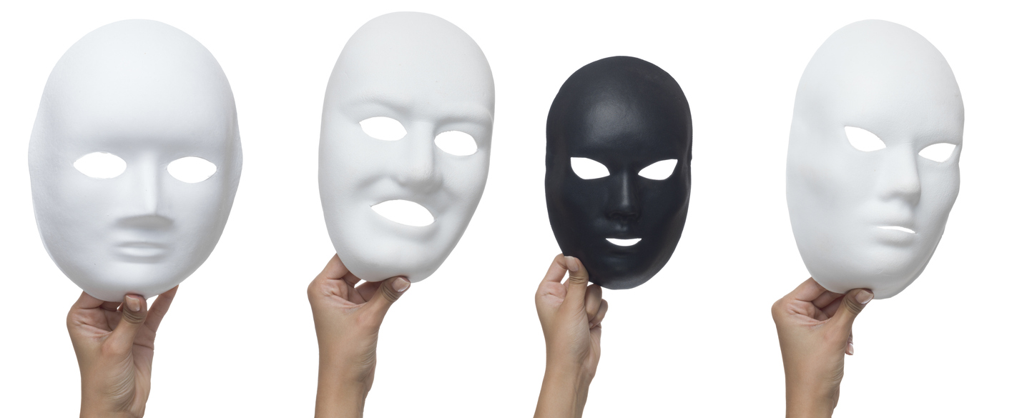
Remember…
"All behaviour is a form of communication.”
(Dr. Becky Bailey, 2023)

Slide 12
Professionalism
Principle
Workers who understand why they have chosen to work in the healthcare/human services field are more motivated to respond in a positive manner when responding to difficult or challenging behaviours while not reacting with emotion.
Notes:
FACILITATOR NOTE: DO NOT use this slide to review or reteach the online content. Use this time to facilitate brief reflection and discussion of workplace application. KEEP discussion focused to remain within allotted time.
Guide participants with questions such as (this list is not all-inclusive)
How could you apply the PART Principle in your day-to-day work?
What would this look like in interactions with clients, patients, and residents?
What actions or behaviours would demonstrate this principle in practice?

Slide 13
Response vs. Reaction
A reaction is typically quick, instinctive, and often involves an emotional behavior in the moment. It's automatic and driven by immediate feelings or stimuli without much consideration of the consequences.
A response is more thoughtful and deliberate. It involves self-control, assessing the situation, and choosing the best course of action or response, often considering the potential outcomes or effects.

Slide 14
Professionalism is…
Professionalism is…
Taking responsibility for the disciplined management of mood, attitude and motivation in the service of the individual.

Slide 15
Preparation
Principle
Workers who are prepared to respond to challenging behaviours before they get to work are less likely to injure or be injured than workers who are not prepared. The fully prepared workers consider their attire, level of mobility and well-practiced observational strategies. A self-control plan will reduce the chance that you will contribute to the assaultive situation.
Notes:
FACILITATOR NOTE: DO NOT use this slide to review or reteach the online content. Use this time to facilitate brief reflection and discussion of workplace application. KEEP discussion focused to remain within allotted time.
Guide participants with questions such as (this list is not all-inclusive)
How could you apply the PART Principle in your day-to-day work?
What would this look like in interactions with clients, patients, and residents?
What actions or behaviours would demonstrate this principle in practice?

Slide 16
Preparation
Attire – right clothes for the job.
Mobility – ready to move.
Observation – my surroundings and individuals.
Self-Control – have a plan.
Notes:
Self-control plan = self assessment, know your limits, regain self-control, restoration and healing

Slide 17

Preparation
Self-control plan:
Self-assessments
Knowing your limits
Regaining self-control
Restoration and healing
Plan your Work and Work Your Plan!
What makes you lose control?

Slide 18
Identification
Principle
The better we understand the many contributors to the occurrence and potential for challenging behaviours the more likely we will be to prevent incidents from occurring or deal more effectively with incidents when they occur.
Notes:
FACILITATOR NOTE: DO NOT use this slide to review or reteach the online content. Use this time to facilitate brief reflection and discussion of workplace application. KEEP discussion focused to remain within allotted time.
Guide participants with questions such as (this list is not all-inclusive)
How could you apply the PART Principle in your day-to-day work?
What would this look like in interactions with clients, patients, and residents?
What actions or behaviours would demonstrate this principle in practice?

Slide 19
Identification
Legal Model
Developmental Model
Communication Model
Environmental Model
Interactive Model
Stress Model
Basic Needs Model
Socio-cultural Model
Common Knowledge Model

Slide 20
Communication Model
Withdrawal
Passivity
Assertion
Aggression
Assault

Slide 21
Assertive Communication Tips
Create win-win situations, instead of I win – you lose
Be prepared to negotiate
Use assertive language
Use assertive body language
Use “I” statements
Be clear and specific
Stay calm and relaxed
Listen Actively
Stay focused on the issue
Set boundaries
Practice empathy
Take responsibility for your own actions
Practice assertiveness regularly

Slide 22
De-escalation Tips:
Identify yourself and your goal - “Hello, my name is Linda, I am here to help you.”
Remember personal space - maintain a distance of four to six feet.
Be empathetic and non-judgemental.
Actively listen and use unconditional positive regard - allow for expression of feelings.
Look for the reason behind the behaviour.
Know and use their treatment/support plan.

Slide 23
De-escalation Tips:
Use your self-control plan.
Use a team approach – take a “time out” if needed to regain your self-control.
Respond appropriately to each motive including appropriate body language.
Find a worker that has a good rapport/relationship with the individual and have them talk to them.
Respect needs to communicate in different ways (recognize possible socio-cultural differences as well as fear, shame, and embarrassment they may be experiencing).

Slide 24
Common Knowledge Model
Four basic reasons why people threaten and injure themselves or others…
FEAR
FRUSTRATION
MANIPULATION
INTIMIDATION

Slide 25
Common Motive | Signs of Impending Aggression |  |  | Goal
 | Visual | Auditory | History
Fear |  |  |  | Threat Reduction
Individuals will react, possibly by displaying aggressive behaviours when they feel they are being assaulted or when they think that someone is going to take something away from them that is a basic need, necessary for their well-being. . | posture - tense, prepared to defend, hide or run away skin color - pale or ashen (depends on natural skin tone) facial - wide-eyed or fearful | voice quality - whining, pleading breathing - rapid, shallow, irregular | get to know the individual’s history, as fear could be considered a threat to their physical, emotional, or psychological well-being | Reducing the threat will also reduce the probability that the common assault will escalate.
Approach Techniques
Posture | Gesture | Position | Voice Quality | Speech Content | Eye Contact | Physical
relaxed and open, hands in full view | slow, palms-up and to the side | slightly off to the side, and far enough away (8-10 feet, if possible) to make it clear that you are not a threat. | firm, reassuring, confident | logical, encouraging calm reflection; if promising, ensure the promise is achievable. | if the individual seeks eye contact, should be given freely; if the individual tries to avoid eye contact it should not be forced on them. There are many cultures that discourage or limit communication through eye contact. | touch should not be given without permission and should be light with slow movements.

Slide 26
Common Motive | Signs of Impending Aggression |  |  | Goal
 | Visual | Auditory | History
Frustration |  |  |  | Control
Individuals may become aggressive and injure themselves or others, sometimes damaging property, as an expression of frustration. | posture – tense and escalated skin color - tones of purple or red; splotches (may depends upon natural skin tone) facial – tense, focused, and angry | voice quality - menacing, aggressive, loud breathing - loud, deep, long breaths | whether or not the individual’s behaviour typically escalates quickly. Determine the source of the frustration | Communication that demonstrates self-control contributes to the decrease of frustration and encourages restoration of the individual’s self-control.
Approach Techniques
Posture | Gesture | Position | Voice Quality | Speech Content | Eye Contact | Physical
self-confident, leading, in control | firm, directing, palms out and gesturing down | using our stance, be directly in front of the individual, and just outside of their striking range | quiet, firm, strong tones low enough to make the individual strain to hear | repetitive, confident directives without threat | direct and accompanied by facial expressions that indicate firm directives are being given | if physical contact is required, it should be made firmly but without excessive movement

Slide 27
Common Motive | Signs of Impending Aggression |  |  | Goal
 | Visual | Auditory | History
Manipulation |  |  |  | Detachment
Individuals can become impulsive and explosive in an effort to manipulate others into giving them something. (i.e. emotional control, physical objects) | difficult to interpret at any particular moment | definite change - confusing demands, whining voice, words of pitiable victim; may be overly friendly or pleasant; accusations, comparisons and trivia in more aggression tones; will change tactics to get what they want; threats and may attempt violence | -losing control -if there is a history of manipulation - there is a strong chance the manipulating behaviour will continue. | Communication that indicates refusal to become involved in manipulation will decrease the likelihood of manipulation.
Approach Techniques
Posture | Gesture | Position | Voice Quality | Speech Content | Eye Contact | Physical
closed relaxed | gestures of disapproval or mild irritation, non-engaging, detached from the situation (e.g., show no emotion), closed posture (e.g., cross your arms) | close enough to physically intervene, but far enough away to show non-involvement (4-5 feet) | detached, mechanical, slightly bored | quiet, repetitive, | avoid eye contact to show non-involvement. | if physical contact becomes necessary, it should be handled as quickly and unemotionally as possible. Try to make contact with clothing only, as contact with flesh may portray involvement.

Slide 28
Common Motive | Signs of Impending Aggression |  |  | Goal
 | Visual | Auditory | History
Intimidation |  |  |  | Consequences
The individual may threaten or instil fear to intimidate others to get what they want. (i.e. physical or emotional threat) | -basically neutral or unremarkable with the exception of threatening posture. -physical menacing/crowding (standing very close to or over the person being intimidated) as a way to threaten danger. | -menacing, threatening words -definite pattern - clear and strong demand, believable threat -finally, refusal to comply followed by an attempt to injure through violence | -bullying and having demands met by using intimidating tactics -extortion -other criminal | Clear communication of the consequences to reduce the probability that an intimidating individual will escalate to have their demands met.
Approach Techniques
Posture | Gesture | Position | Voice Quality | Speech Content | Eye Contact | Physical
poised and ready to move or react quickly (standing) | few and far between, to avoid the impression of momentary un-readiness or weakness | position yourself at a defensive advantage, such as standing with your back to an exit, having a chair, table or desk between you and the intimidating individual | matter of fact; monotone; emotionless; Maintain self-control | clear and direct statements of consequences, repeated as often as necessary. Avoid threats and unrealistic consequences | should be used sparingly, to emphasize a statement | if physical contact is necessary, it should be completed as quickly, smoothly, and as matter-of-factly as possible

Slide 29
Verbal Crisis Intervention and De-escalation Role-Play
The goal is to practice communication skills, using assertive communication and de-escalation techniques.
Notes:
Divide the participants into teams to role-play each of the motives. While role-playing, have the participants practice their communication skills (verbal crisis intervention and de-escalation). Use the examples provided or have the teams come up with their own. Have participants refer to the common knowledge flow sheets in their participant handbook, the signs of impending aggression, as well as the approach techniques. Following the role-play, discuss what was demonstrated by those intervening as well as the motive. The purpose of the role-play is not to do everything correctly, but to practice the new skills and to learn both from the successful and not-so-successful attempts at intervention and de-escalation.
The next few slides are hidden; you can unhide them to remind participants what communication techniques they will be practicing.

Slide 30
Role-play Examples:
Fear: terrified about surgery, unfamiliar environment
Frustration: long wait times in an emergency room, slow progress of rehabilitation
Manipulation: a person who uses drugs, trying to get more pills from a nurse, diet restrictions in place, and the individual is trying to get more food
Intimidation: wanting preferential treatment, a family member trying to get preferential treatment for their loved one

Slide 31
Case Studies
Resident “Jane” Jane is a 68-year-old resident who is pleasant most of the time. Jane often hides in her room and makes mumbling sounds. She is at times loud, shouting, “No!” and making other repetitive loud noises and squawks.
Jane has dementia and is progressing in her disease. Jane doesn’t like staff “doing things” to her and needs time to process information. Jane has lost control of herself in the past and physically and verbally assaulted others.
What could the individual be responding to?
What is an effective response?
How would you de-escalate the situation?
What would be your first step in de-escalation?
Notes:
This is one example of a case study.
While teaching PART® Level Three© to Five©, include scenarios or case studies that allow participants to apply their knowledge from the online course. You may use the case studies that are on the SASWH website (www.saswh.ca) semi-secure login area of PART®, or you can come up with your own. These scenarios and questions are intended to be brief, but we must ensure the learning outcomes are met.

Slide 32
Response
Principle
Workers who are able to match their responses to the level of dangerousness presented by the individual’s behaviour are less likely to use too much or too little force.
Notes:
FACILITATOR NOTE: DO NOT use this slide to review or reteach the online content. Use this time to facilitate brief reflection and discussion of workplace application. KEEP discussion focused to remain within allotted time.
Guide participants with questions such as (this list is not all-inclusive)
How could you apply the PART Principle in your day-to-day work?
What would this look like in interactions with clients, patients, and residents?
What actions or behaviours would demonstrate this principle in practice?

Slide 33
Response
Principles of Verbal Crisis Intervention
Matching our responses to the level of dangerousness presented by the individual’s behaviour is a necessary part of our job. Verbal crisis intervention (or talking an individual into stopping the behaviour) will almost always fit within the definition of reasonable force.
Verbal crisis intervention is the appropriate response to a situation in which a threat of minor physical injury is present, but without actual physical contact occurring.
Notes:
FACILITATOR NOTE: DO NOT use this slide to review or reteach the online content. Use this time to facilitate brief reflection and discussion of workplace application. KEEP discussion focused to remain within allotted time.
Guide participants with questions such as (this list is not all-inclusive)
How could you apply the PART Principle in your day-to-day work?
What would this look like in interactions with clients, patients, and residents?
What actions or behaviours would demonstrate this principle in practice?

Slide 34
STOP Strategy
Slow down
Think about what is happening
Options
Plan to have some time to
yourself

Slide 35
Summary
Can we de-escalate the individual prior to escalation and/or crisis?
Match your response to the level of dangerousness presented – always keep in mind reasonable force guidelines.
Choose a response technique that matches the phase of the assault cycle.
Remember the general principles of verbal crisis intervention and de-escalation techniques.
Verbal crisis intervention should follow the approach techniques in the common knowledge model.

Slide 36
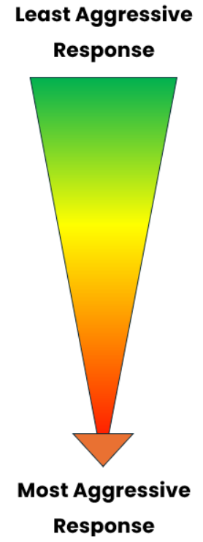
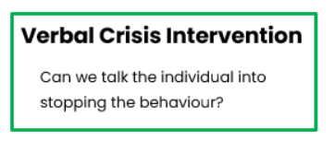
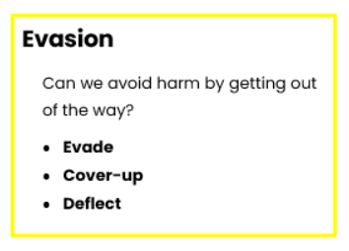
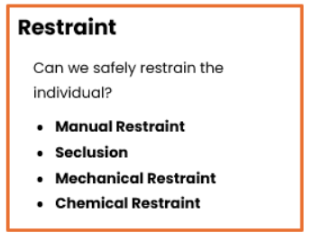
Reasonable Force Response

Slide 37
Level Three© Techniques
*Techniques must be practiced slowly and carefully*

Slide 38

Fit for Training
Please sign the Fit for Training declaration and give it to the trainer.
Inform your facilitator of any injuries or physical limitations.

Slide 39
Principles of Evasion
Keep talking
Stay out of the way
Get out of the way
Cover up
Deflect blows and kicks
Call for HELP!
Be patient
Control yourself
Roll with the punch
Escape holding assaults

Slide 40
Captures
Always move toward the point of capture
Point of Capture

Slide 41

Mobility and Warm-Up
Stance
Breathing
Neck mobility/Shoulder Rolls
Toe/Heel Lifts
Balance
Crouch/Cover
Side and Back Step
Pivot

Slide 42
Level Three© Techniques
Blows
Punch to the face
Overhead blow
Lunging assault
Kicks
Kick to thigh
Kick to stomach
Knee kick to groin
Holding Assaults
Pinch release
Scratch response
Bite release
Hair pull release
Choking
Bear hug escape
Arm grab escape
Kick to head
Point of Capture

Slide 43
Balance Control Techniques
Hip Pivot
Clothing Pivot
Belt Pivot
Belt and Shirt Control

Slide 44
Level Three© Summary
You have learned:
Evasive techniques are designed to allow avoidance of the intended pain or injury without retaliation or overreaction
Evasive techniques meet the criteria for “reasonable force” when responding to a brief episode of assault causing bodily harm

Slide 45
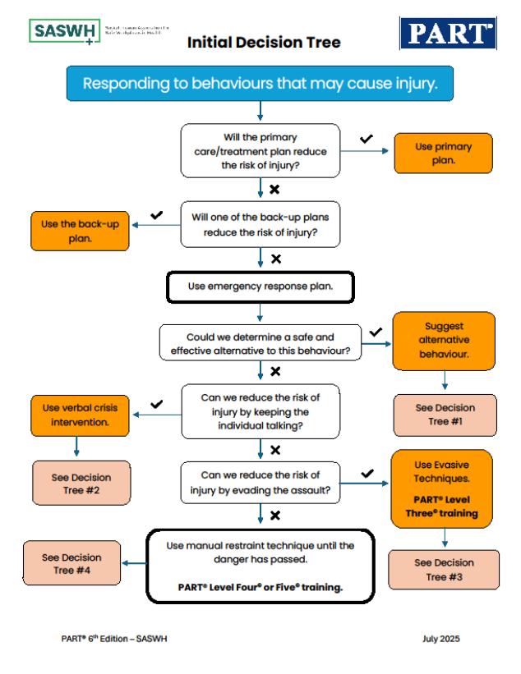
Decision Trees
Decision trees assist workers in decision-making and direction when responding to individuals exhibiting challenging behaviours
Notes:
Review the decision trees on the next few slides. The picture on this slide can be reviewed following this slide.

Slide 46
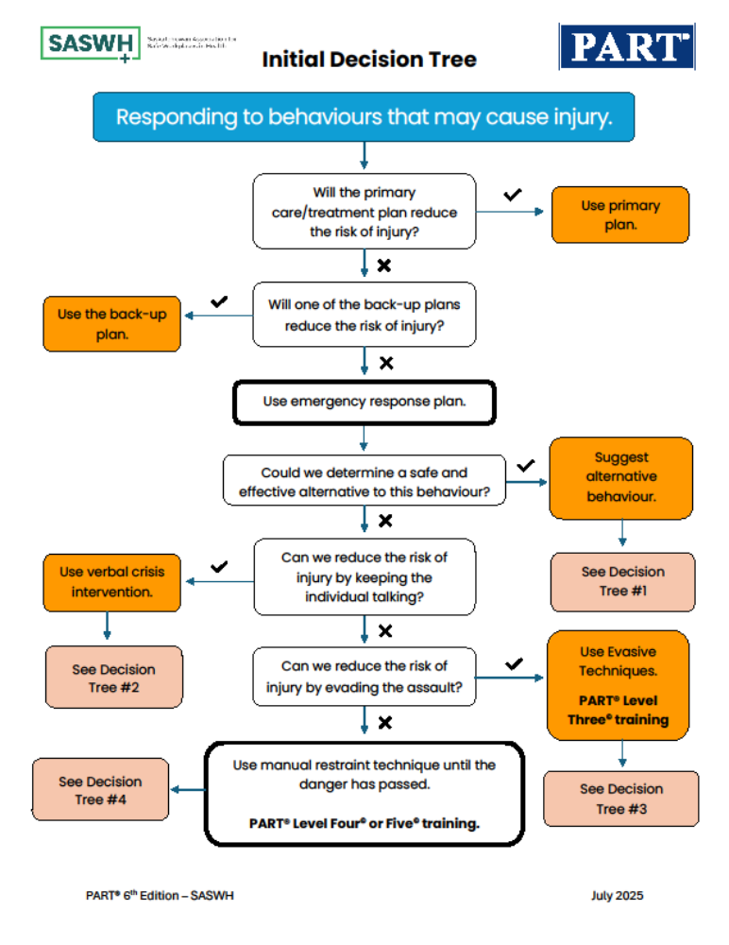

Slide 47
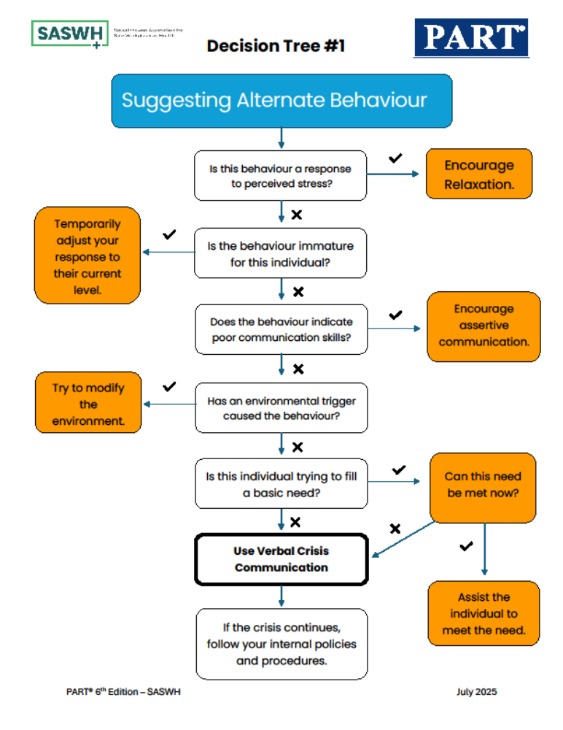

Slide 48
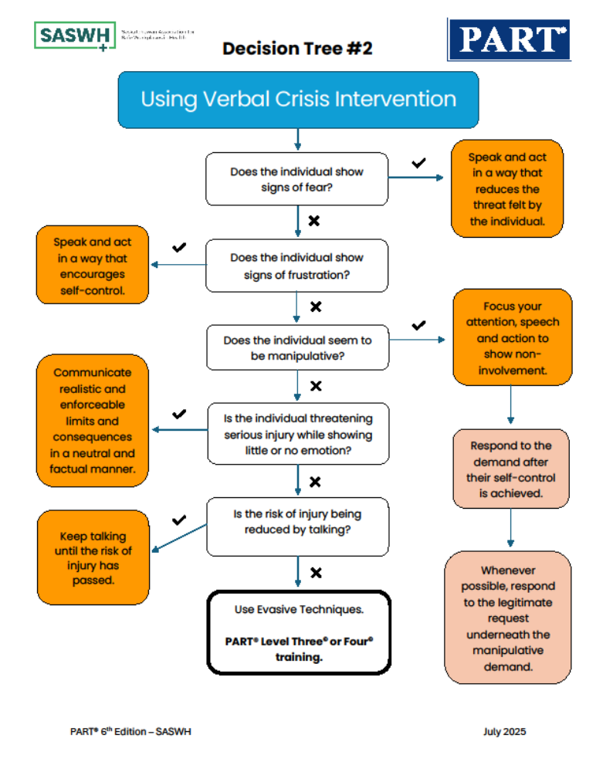

Slide 49
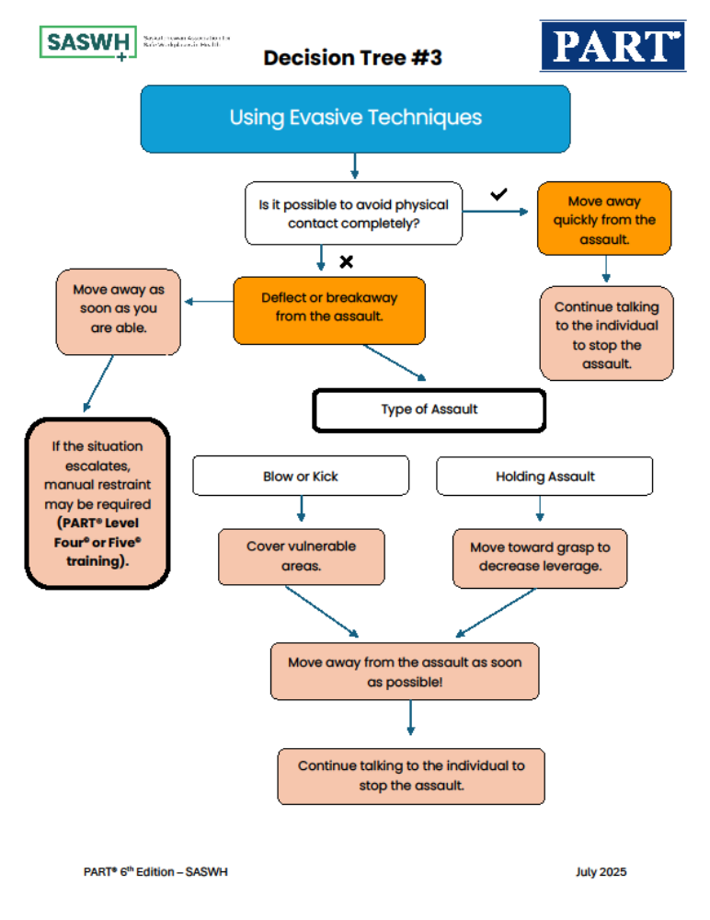

Slide 50

Administrative Details
Fit for Training Declaration
Evaluation (post-session questions)
Questions?
Certificate of Completion
Re-evaluation

Slide 51
Level Four© & Level Five© Techniques
*Techniques must be practiced slowly and carefully*

Slide 52
The techniques taught in PART® have BEEN proven safe and effective.
Their Proper application is the responsibility of all workers involved.
Instruction cannot be a substitute for professional judgment.

Slide 53
Level Four© & Level Five©
Definition of Restraint: forcible and involuntary deprivation of the liberty to move.
Types of Restraint:
  Manual (PART® has some techniques)
  Seclusion
  Mechanical
  Chemical
PART® does not teach about seclusion, mechanical or chemical restraint.

Slide 54
Principles of Manual Restraint
Master evasion techniques
Master capture techniques
Get a “grip”
Use weight not strength
Avoid pain
Use only reasonable force
Maintain a proper ratio
Be a team player
Select the least intrusive restraint position
Monitor breathing and circulation very closely

Slide 55
Rules for Manual Restraint
Don’t attempt to restrain unless you have twice the height and twice the weight.
Only the Captain talks to the individual and will use the “rule of five”.
When using restraints always watch for breathing and circulation.

Slide 56
Level Four© & Level Five© Summary
You have learned:
The purpose of training in manual restraints is to learn simple but effective methods of dealing with assault.
There is no such thing as a completely safe technique and that injury to the assaultive individual and staff is always possible.

Slide 57
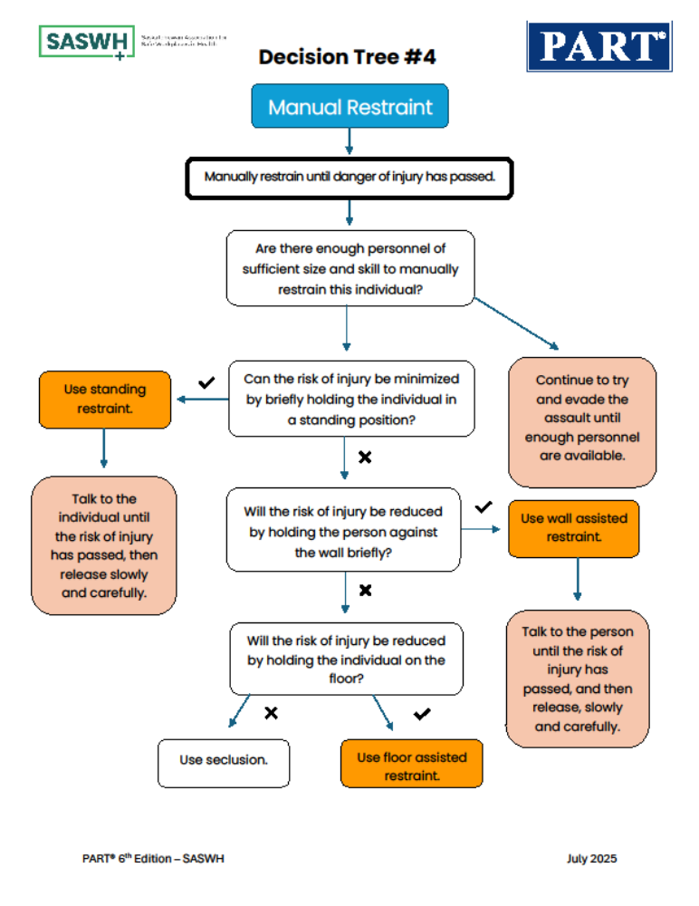

Slide 58

Remember…
Before choosing to deprive a person of their liberty to move, you should ask yourself:
What is the worst thing that is likely to happen if the individual isn’t restrained right now?

Slide 59
Administrative Details
Fit for Training Declaration
Evaluation (post-session questions)
Questions?
Certificate of Completion
Re-evaluation

